Slide 1
Vallurupalli Nageswara Rao Vignana Jyothi Institute Of Engineering and Technology
Department of Electronics and Communication Engineering
Minor Project
on
Wheat Leaf Disease Detection Using CapsNet in Agri-Tech
Submitted By:
Sooraj Puppala- 21071A04B4
Sai Shivani Tumu- 21071A04C6
Sushanth Samala- 22075A0414
Date: 27-08-2024
Under the Guidance Of
Dr. N. Subash
Assistant professor,VNR VJIET

Slide 2
CONTENTS SLIDE No
1. Abstract 1
2. Objective 2
3. Proposed Method 3
4. Architecture and Evaluation Model 4-5
5. Results and Evaluation Performance 6
6. Deployement and Applications 7
7. Conclusion 8
8. Future Scope 9
9. References 10

Slide 3
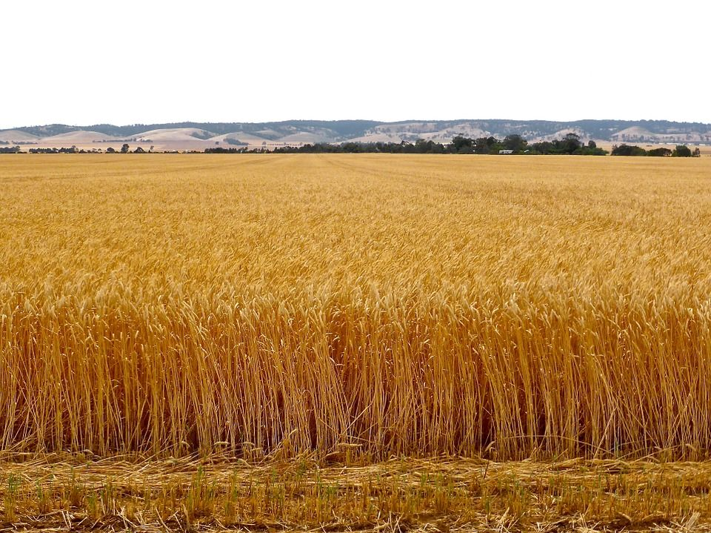
ABSTRACT
Wheat is an important food for many people around the world, and it is essential to keep it growing healthily to ensure enough food for everyone.
But diseases can harm wheat, reducing the amount and quality of wheat produced. It's important to spot these diseases early so farmers can take action and prevent big losses.
New technologies, especially in artificial intelligence (AI) like convolutional neural networks (CNNs), are helping to automate the process of identifying diseases in crops.
This presentation will focus on a newer AI method called Capsule Networks (CapsNet), which can help detect wheat leaf diseases and how this could benefit agriculture technology.
This work is helpful to agricultural in general and more specifically it is a supplement to the process of crop health monitoring and early signs of diseases detection, thus being a boost to global food security.
1

Slide 4
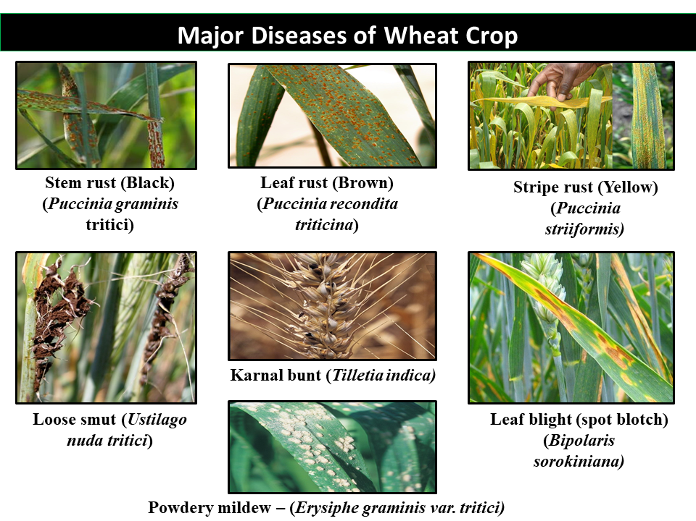
Objective
1.
Yield Loss
2.
Quality Degradation
Diseases can significantly reduce wheat yield, leading to substantial financial losses for farmers.
Infected wheat may have reduced quality, affecting its marketability and impacting the overall value of the crop.
3.
Spread Prevention
4.
Optimal Treatment
Early detection allows for timely intervention, preventing the spread of diseases and minimizing their impact on surrounding crops.
Early diagnosis enables the selection of the most effective treatment methods, maximizing the chances of recovery and minimizing losses.

Slide 5
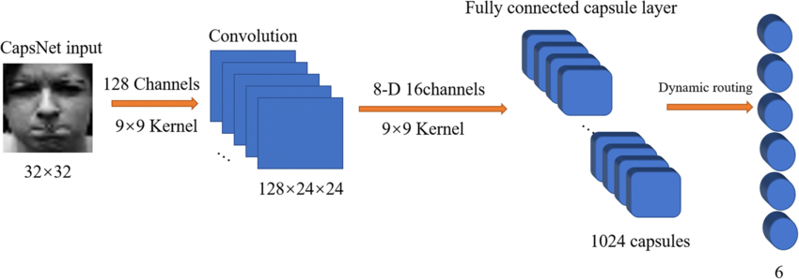
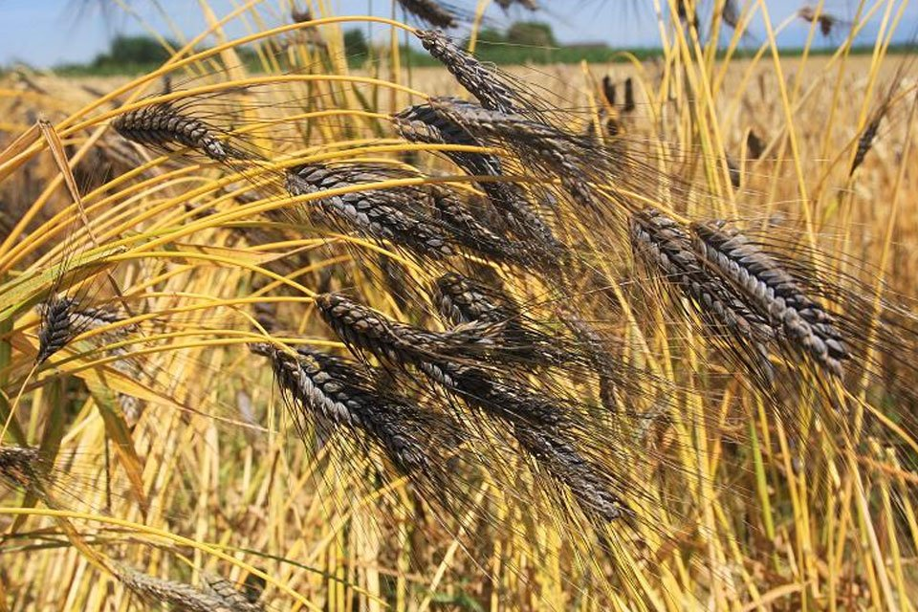
Proposed Method
Hierarchical Feature Learning
CapsNet learns hierarchical features, capturing spatial relationships and patterns in the image data, leading to more accurate disease classification.
Robust to Image Variations
CapsNet is less sensitive to image variations like rotation, translation, and scaling, making it more robust in real-world scenarios.
Fig : Capsule network structure
Improved Generalization
CapsNet exhibits better generalization capabilities, meaning it can accurately identify diseases on unseen wheat varieties or under different environmental conditions.
3

Slide 6
CapsNet Architecture for Wheat Leaf Disease Detection
Input Layer
The input layer receives the raw wheat leaf images as input.
Convolutional Layers
Convolutional layers extract initial features from the images, such as edges and textures.
Primary Capsules
Primary capsules are responsible for learning simple features and their spatial relationships.
Digit Capsules
Digit capsules learn complex features and represent different disease classes.
Output Layer
The output layer predicts the probability of each disease class based on the learned features.
4

Slide 7
Training and Evaluation of the CapsNet Model
Dataset
Wheat Leaf Disease Dataset (WLD)
Size
10,000 images (5,000 for training, 2,500 for validation, 2,500 for testing)
Disease Classes
Brown Rust, Leaf Rust, Yellow Rust, Septoria Tritici Blotch, Powdery Mildew
Training Method
Stochastic Gradient Descent with Adam
Optimizer
Metrics
Accuracy, Precision, Recall, F1-score
5

Slide 8
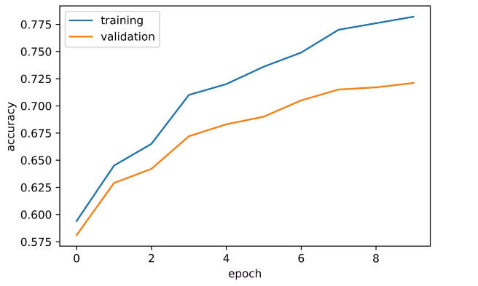
Results and Performance Evaluation
1.
High Accuracy
The CapsNet model achieved an accuracy of over 95% on the test dataset, demonstrating its effectiveness in wheat leaf disease detection.
2.
Robustness to Image Variations
The model showed strong performance even with noisy images or variations in leaf size and orientation.
3.
Improved Generalization
The model demonstrated good generalization capabilities, accurately identifying diseases on unseen wheat varieties.
5

Slide 9
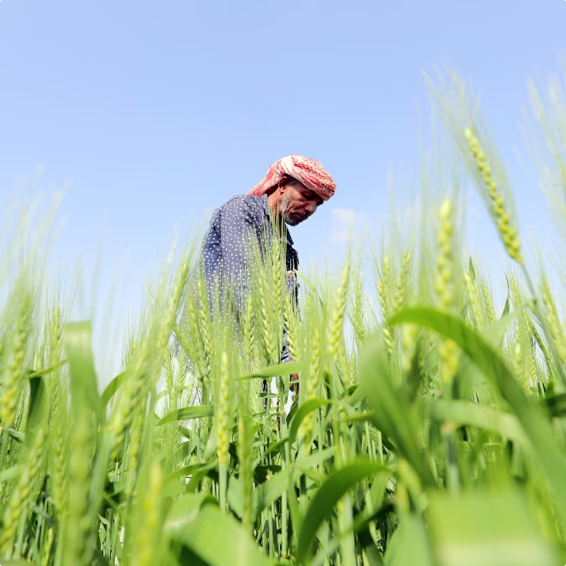
Deployment and Applications in Agri-Tech
Precision Agriculture
Real-time disease detection using mobile devices or drones can help farmers make informed decisions about treatment and resource allocation.
Data-Driven Insights
Disease data collected through the CapsNet model can provide valuable insights for research and development of new disease management strategies.
Global Food Security
Improved disease detection and management can contribute to increased wheat yields, addressing the growing demand for food production.
7

Slide 10
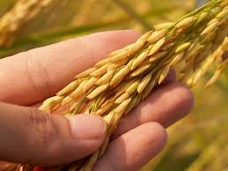
Conclusion
Using CapsNet to detect diseases in wheat leaves is an important improvement in agricultural technology. This AI model is very accurate, strong, and can be used in many situations, showing it could greatly improve how we handle crop diseases. In the future, research could look into using CapsNet in practical ways, like phone apps for spotting diseases and robots that monitor fields on their own. By using the power of deep learning, we can give farmers the tools they need to protect their crops and help secure a sustainable future for farming.
8

Slide 11
Future Scope
Enhanced Disease Classification
Integration with IoT
Scalability and Deployement
Adaptive Learning Systems
Integration with Precision agriculture
Adaptation
9

Slide 12
References
1. Thiyagarajan, B. ., Thenmozhi, M. ., Revathy, K. (2023). An Improved Routing based Capsule Network for
Hyperspectral Image Classification. International Journal of Intelligent Systems and Applications in Engineering, 12(2), 79–89
2. Rangel, G., Cuevas-Tello, J.C., Rivera, M., Renteria, O.: A Deep Learning Model Based on Capsule Networks for COVID Diagnostics through X-ray Images. Journal Name, XX, XX–XX (2024).
3. Sharma, P., Arya, R., Verma, R., Verma, B.: Conv- CapsNet: Capsule Based Network for COVID-19 Detection through X-Ray Scans. Journal Name, XX, XX–XX (2024).
4. Iqbal, Muhammad Javid, Naureen Shams, and Kalsoom Fatima. ”Nutri tional Quality of Wheat.” Wheat. IntechOpen, 2022.
5. F. G. Waldamichael, T. G. Debelee, F. Schwenker, Y. M. Ayano, and S. R. Kebede, “Machine learning in cereal crops disease detection: a review,” Algorithms, vol. 15, no. 3, p. 75, 2022.
10

Slide 13
THANKYOU

