Slide 1


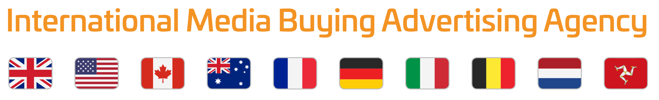
Whatever your advertising needs, Mediatech speaks your language.

Slide 2






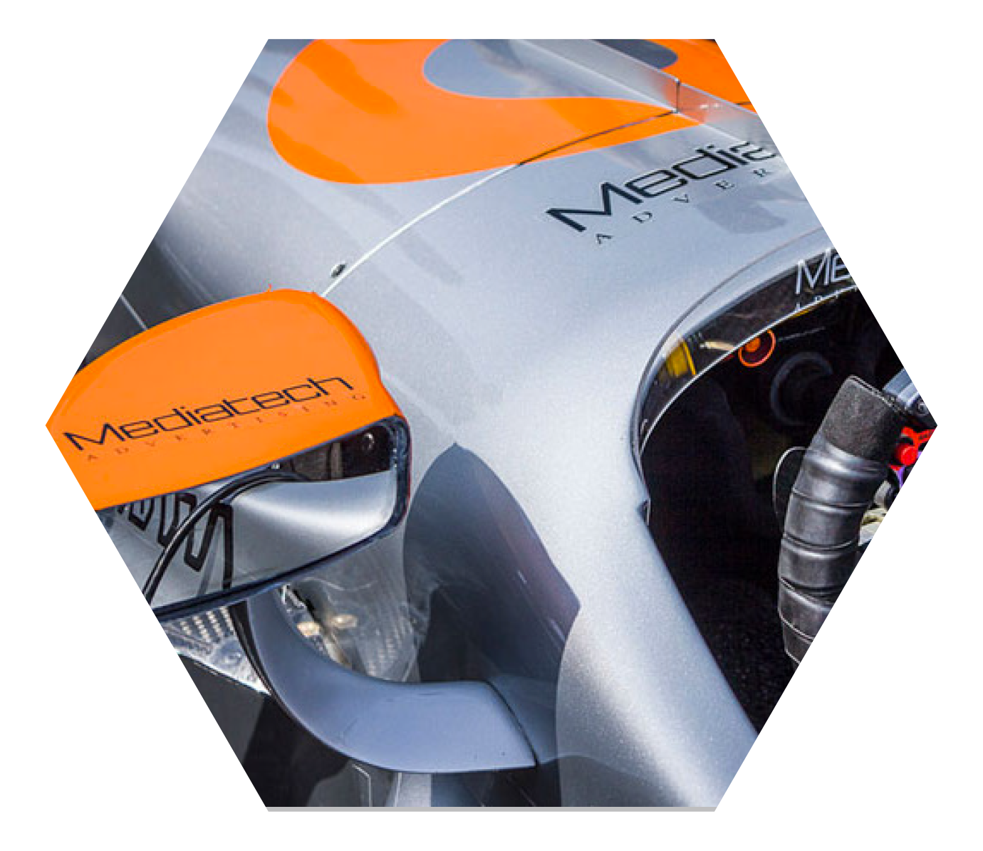

Introduction
As an International Media Buying
agency, Mediatech has established
long-standing relationships with media suppliers worldwide, always aiming to provide a cost-effective global reach.
Our media team use their many years
of experience to plan effective campaigns placing your ads in areas where media will deliver you the best results.
Due to our excellent buying power,
our friendly and efficient relationship
with our suppliers has helped us to negotiate exceptionally good deals on behalf of our clients.

Slide 3



TV Advertising
Mediatech successfully plans and
manages DRTV campaigns in Canada,
USA, UK, Germany, France, Belgium, Italy,
Australia & New Zealand on behalf of clients. Our experienced staff negotiate media buys directly with broadcasters enabling us to achieve the best rates possible.
A DRTV campaign is an efficient method to measure successful ROI and to generate high margin sales of a new product in a short time frame.
Both long and short form Direct Response campaigns provide brands with immediate information about the effectiveness of their ads and the relevance of their products in the market place. Content and media spend can be adjusted in order to achieve an improved response at any time.
Successful DRTV campaigns build a
loyal customer base who will continue to purchase products and add-ons long after the initial purchase.

Slide 4

Print Media
Mediatech clients worldwide benefit from our expert industry knowledge and timely negotiations allowing them to pay the best rates for the most effective print media return on investment.
Our proactive approach brings additional benefits such as premium positions and free editorial. This is helped by Mediatech’s substantial media spend across many countries for our existing clients.

Slide 5
Digital
Mediatech can handle all aspects
of your company’s digital marketing,
from website design and build through
to paid search engine adverts and social media campaigns.
Our talented and highly experienced team have many strengths, most notably in the field of design, programming and marketing.
Working together to solve problems
and achieve your goals we utilise these skills to their full potential.

Slide 6
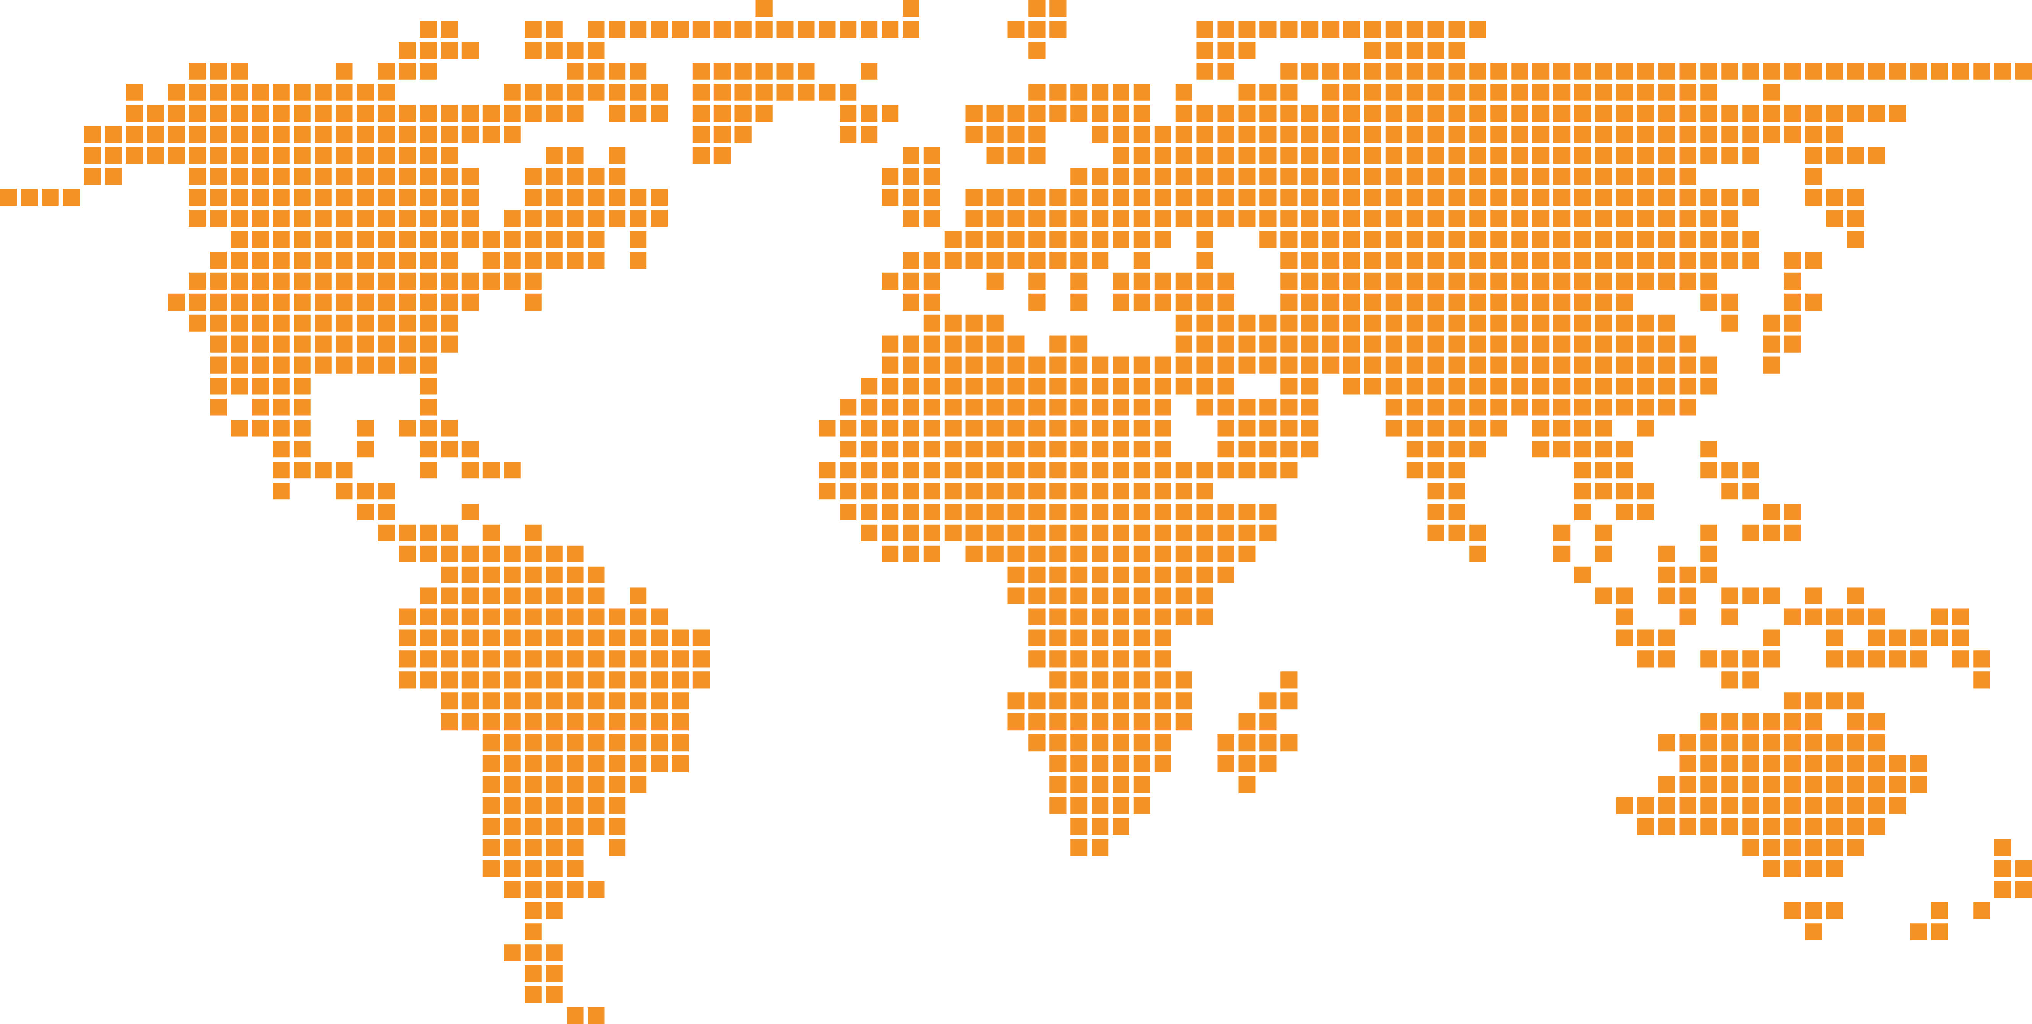
Global presence is an essential element of Mediatech’s business strategy, so that we can respond
as effectively as possible to client needs.
Doing business at a global level
has become second nature to Mediatech, and we always make it a priority to develop good relations with local business partners.
Wherever our clients are based, Mediatech aims to provide the best possible support for their growth.

Slide 7
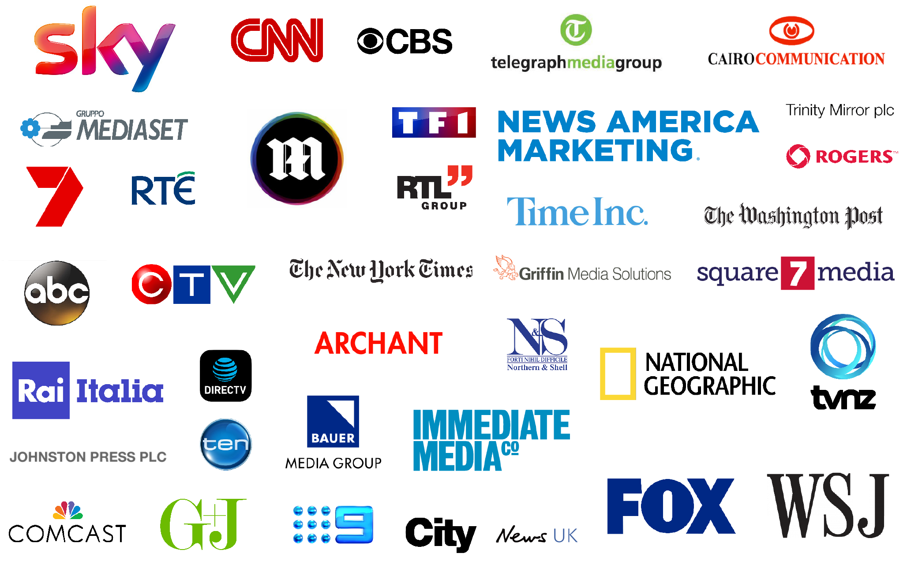


• TV Advertising
• Print Media
• Digital
• Marketing
• Copywriting
• Lead Generation
• Public Relations
• Client Media Library

Slide 8
Whatever your advertising needs, Mediatech speaks your language.

