Slide 1


Slide 2

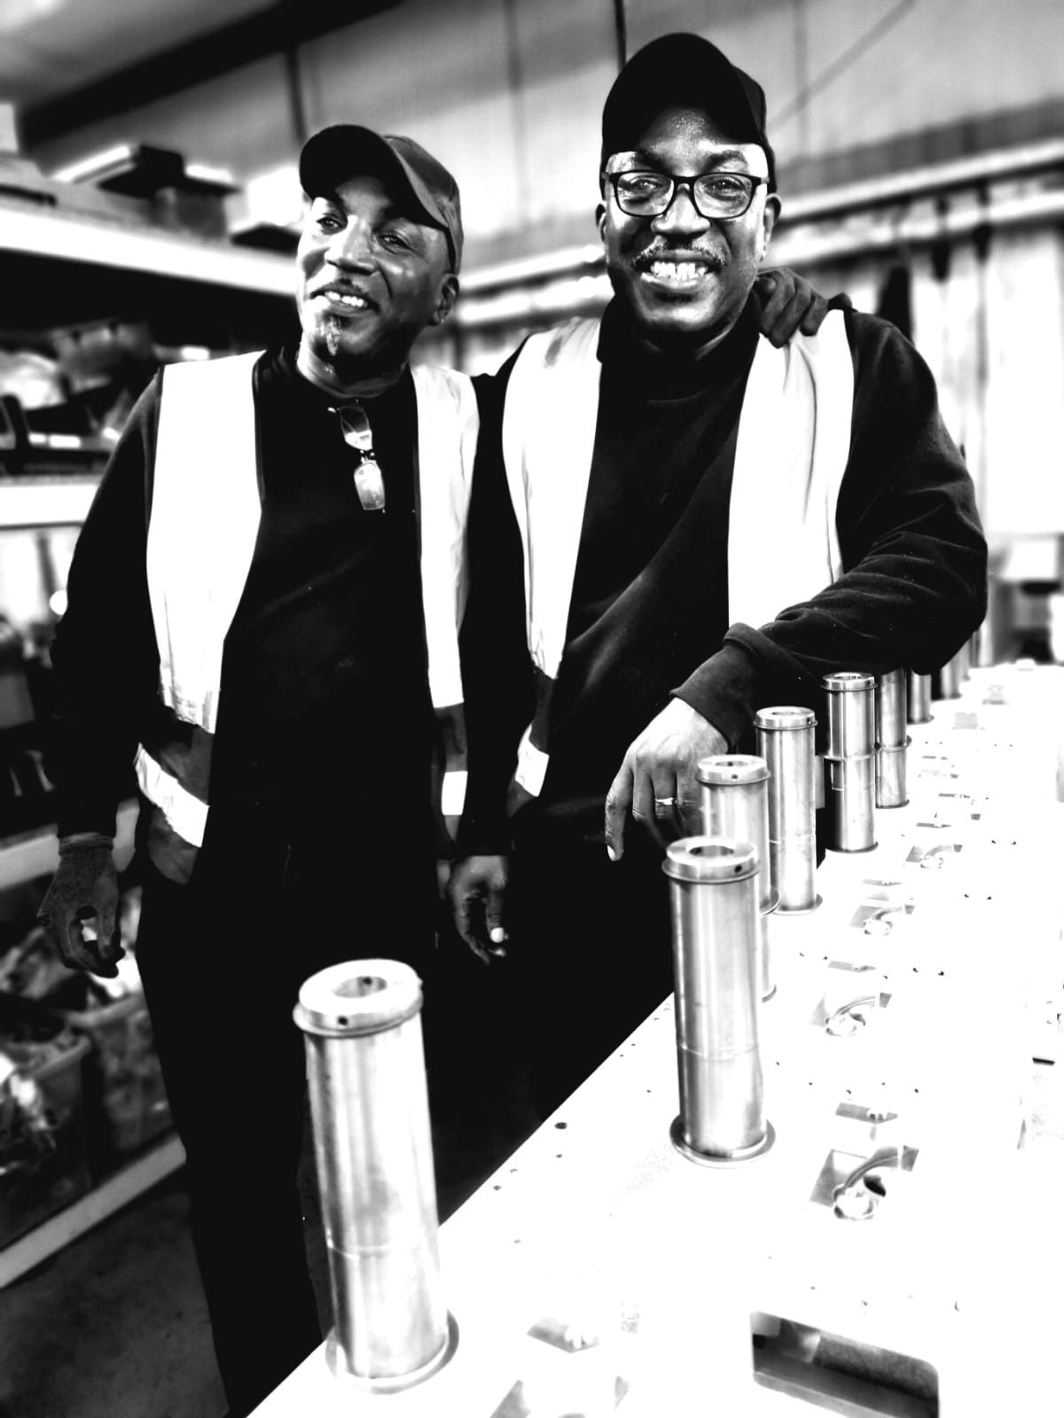
THE BESPOKE JOURNEY
“The Bespoke Stairlifts team, through their ever-improving processes and innovation, has
made it truly fun and easier to ‘be the best for our customers’.
And for that we say
THANK YOU!”

Slide 3
THE BESPOKE JOURNEY
When Bespoke Stairlifts opened its doors back in 2003; our mission was to create cost effective and reliable solutions to transform the lives of those living with reduced mobility.
Today, our mission hasn’t changed, as we heavily invest in all aspects of our business to ensure we continue to manufacture and distribute a range of straight and curved stairlifts to a wider reach of partners without compromising our core beliefs.
Listening to the challenges of our customers we ensure to provide a fast and reliable service with safety and quality always at the forefront of everything we do.

Slide 4
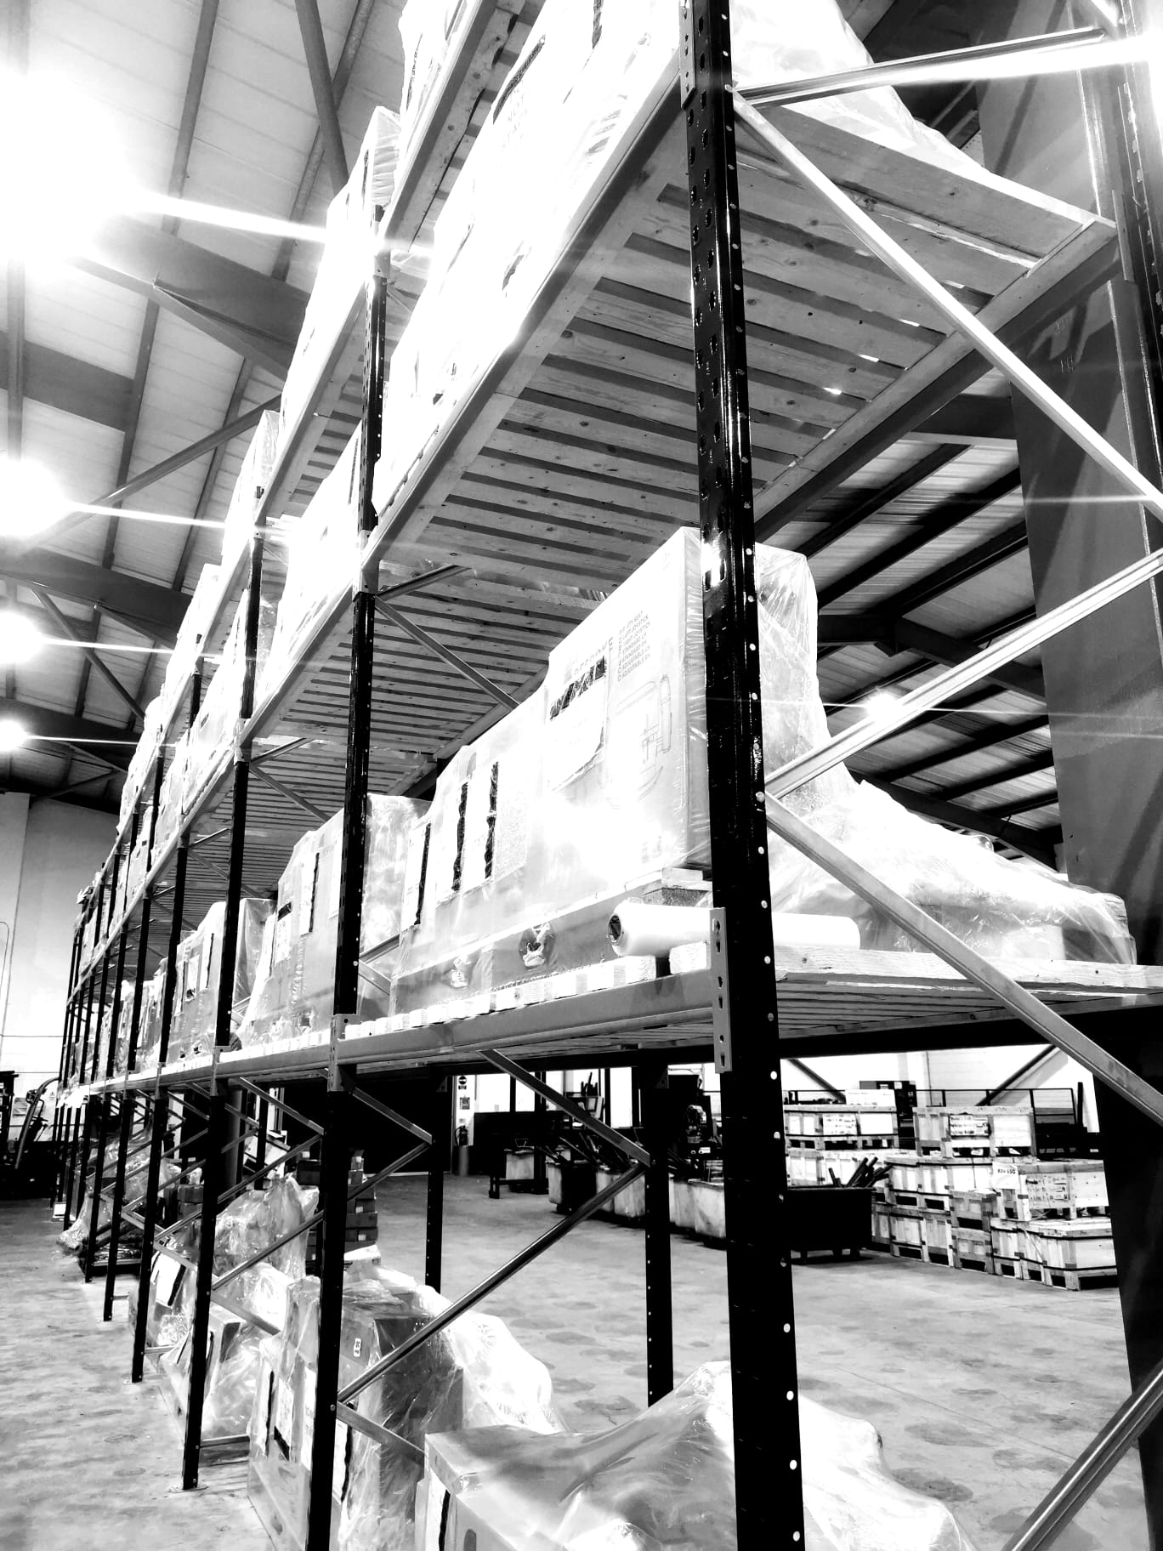
THE BESPOKE JOURNEY
2003
Bespoke opened the Huddersfield site
2006
Workforce expansion
2008
Expanded into overseas market
2012
Increase in production facility

Slide 5
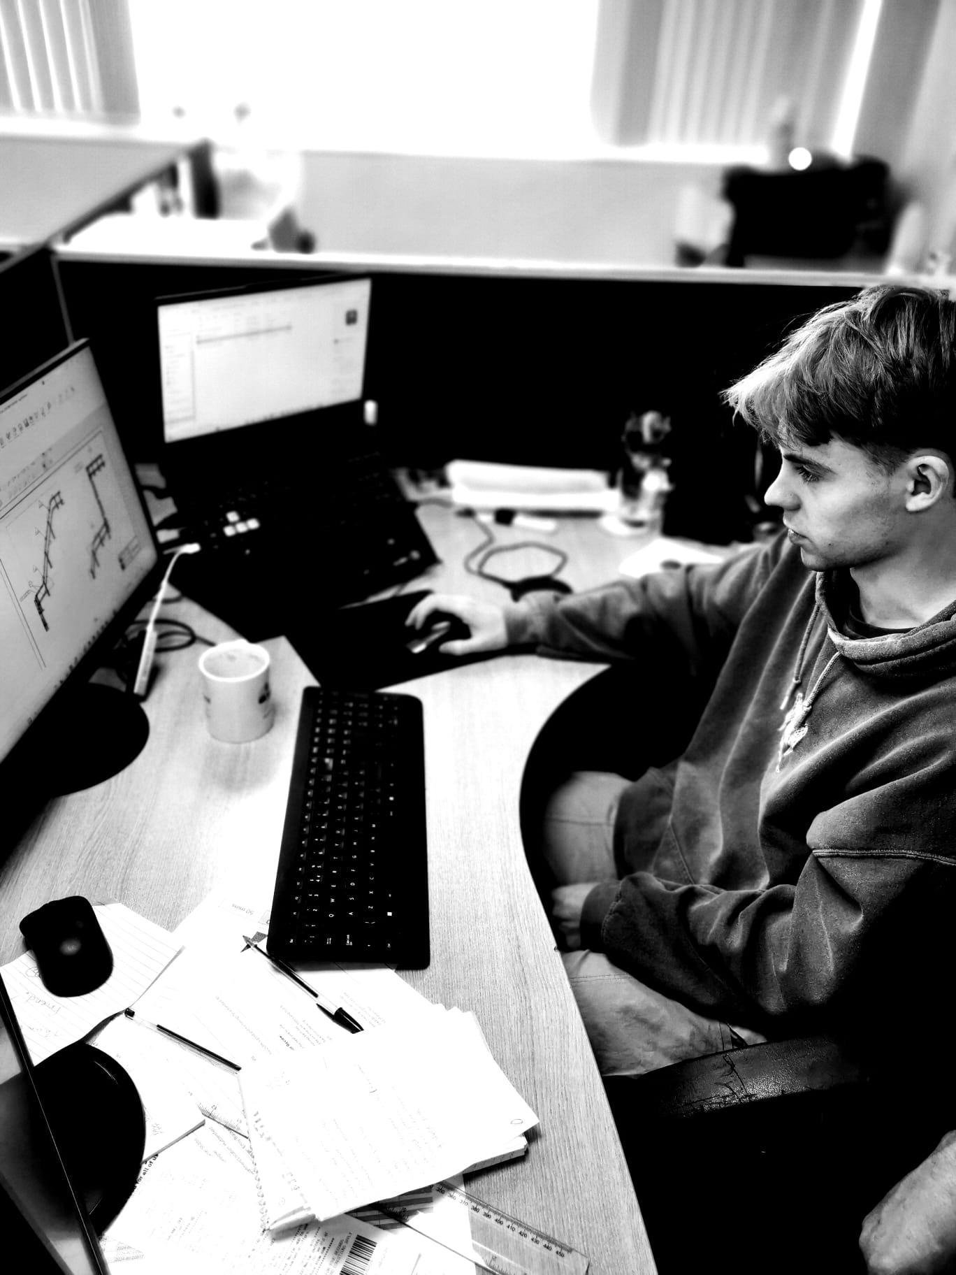
THE BESPOKE JOURNEY
2014
Invested in CNC Tube bending and CAD design
2015
Launched the Infinity MKI
2016
First sales in North America
2018
Expanded our multilingual sales team

Slide 6
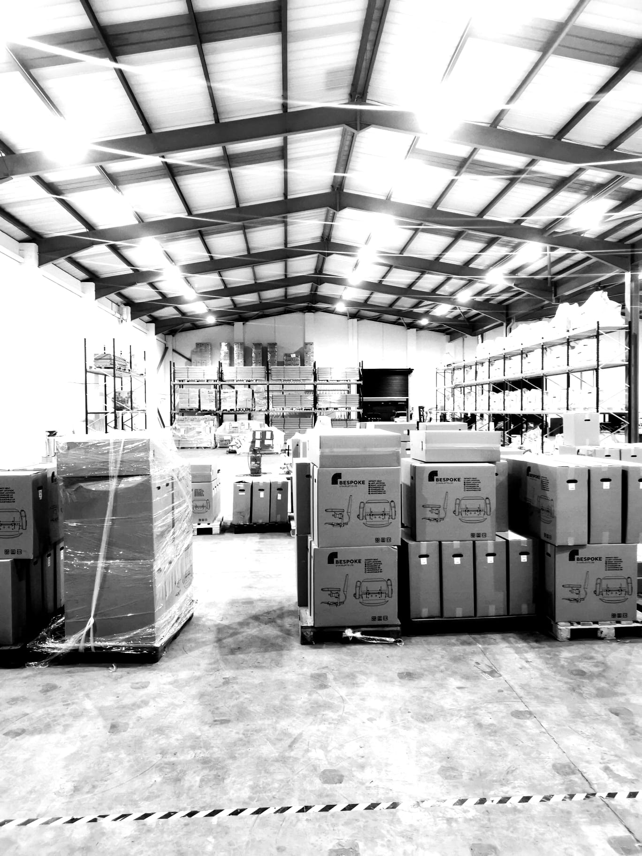
THE BESPOKE JOURNEY
2019
Introduced the Synergy Straight Stairlift
2020
Opened our dedicated sales office in Cottingley, West Yorkshire
2021
Launch of online demonstrations and virtual training
2022
Launched Infinity MKII

Slide 7
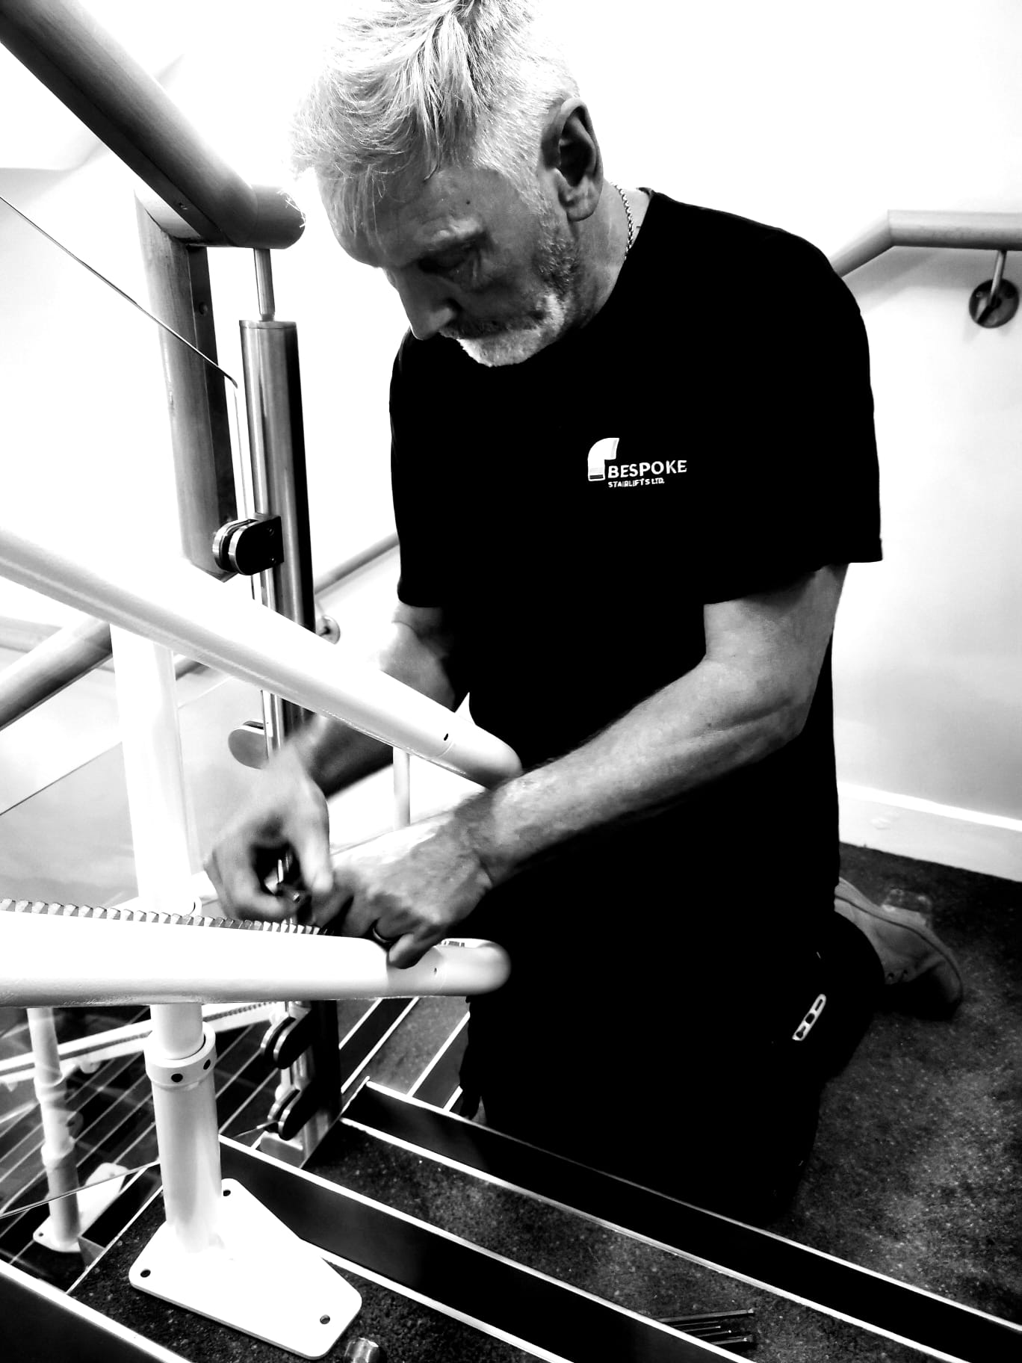
THE BESPOKE JOURNEY
2023
Continued investment in resource,
headcount and accreditation
2024
Purchase of additional premises to cope
with continued expansion

Slide 8

WHO ARE BESPOKE?
Leading manufacturer of stairlift solutions.
Established presence in the stairlift
industry for over 20 years.
Recognised for reliability,
quality, and customer service.
Supplying to over 60 countries.
Embrace innovative technology
Knowledgeable and loyal employees

Slide 9
WHO ARE BESPOKE?
MANAGEMENT EXPERIENCE
Gavin Finn Chairman

Slide 10
WHO ARE BESPOKE?
MANAGEMENT EXPERIENCE
Gavin Finn Chairman
Joanne Kennedy Managing Director

Slide 11
WHO ARE BESPOKE?
MANAGEMENT EXPERIENCE
Gavin Finn Chairman
Joanne Kennedy Managing Director
Simon Waddington Technical Director

Slide 12
WHO ARE BESPOKE?
MANAGEMENT EXPERIENCE
Gavin Finn Chairman
Joanne Kennedy Managing Director
Simon Waddington Technical Director
Jen Hewitt-Brown Finance Director

Slide 13
WHO ARE BESPOKE?
TECHNICAL/CAD DEPARTMENTS
The Technical and CAD Departments play a crucial role in ensuring Bespoke’s stairlifts meet the highest standards of quality, safety, and efficiency; using advanced software to create stairlift solutions that fit the unique dimensions and characteristics of a customer's staircase, including curved, straight, or narrow staircases.
The CAD and Technical Department work closely with
many other teams; for example, sales and survey teams,
to gather precise measurements; and installation teams
to provide technical guidance for seamless integration.
In addition, this skilled department forms the backbone
of Bespoke’s unique product training team.

Slide 14
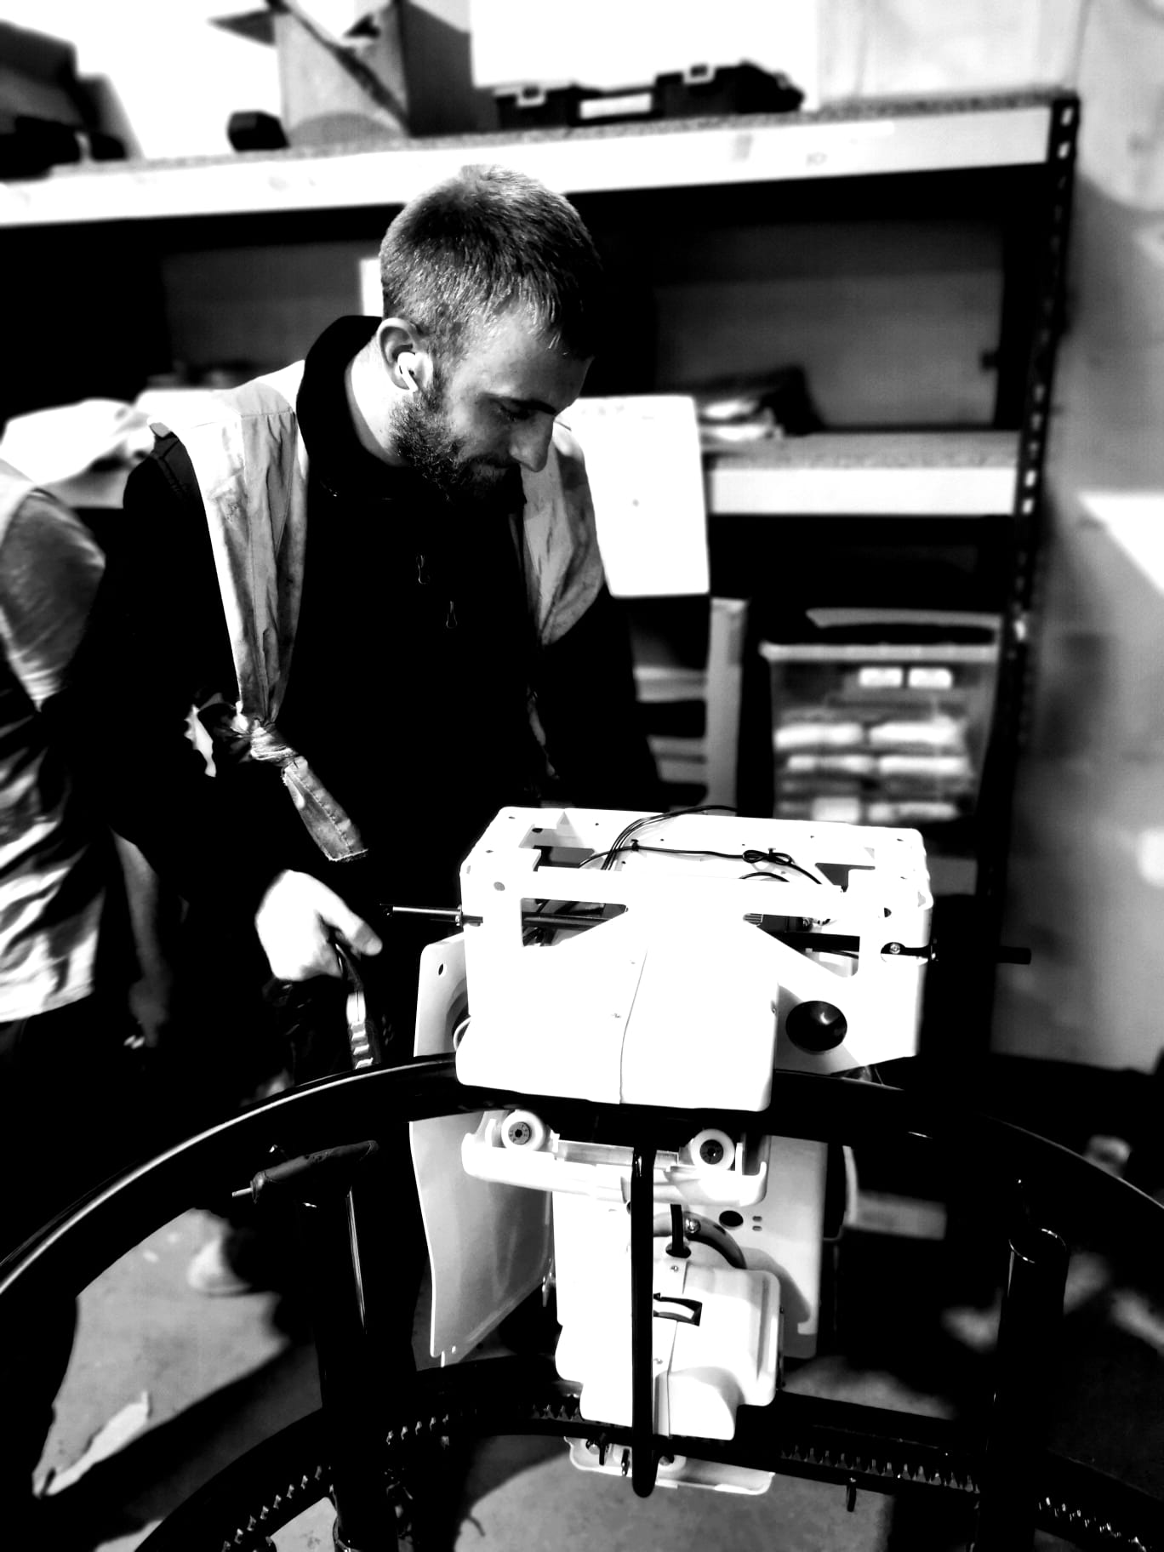
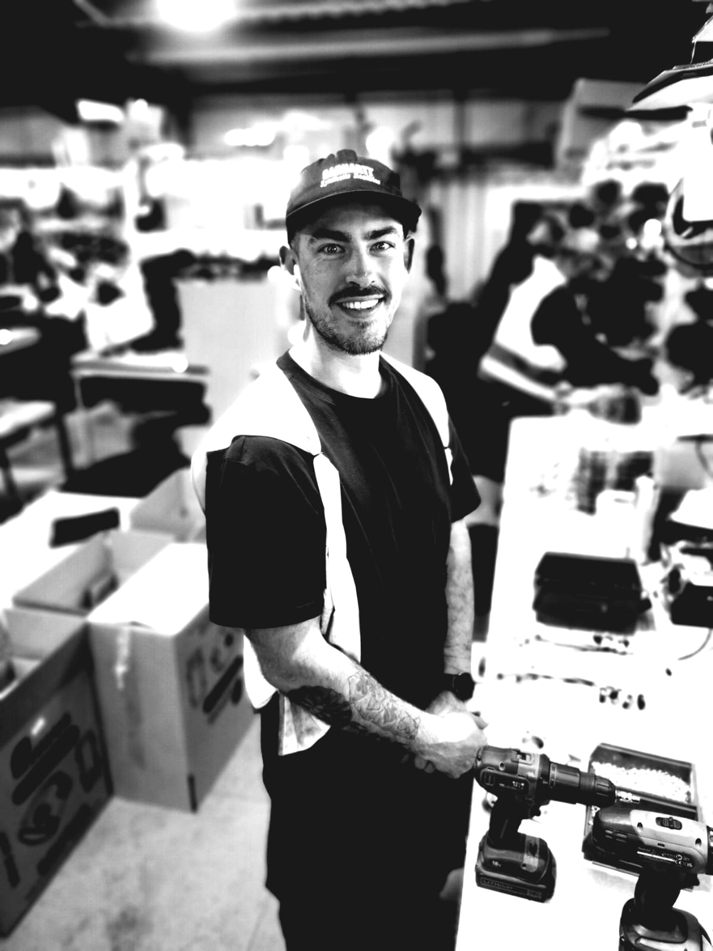
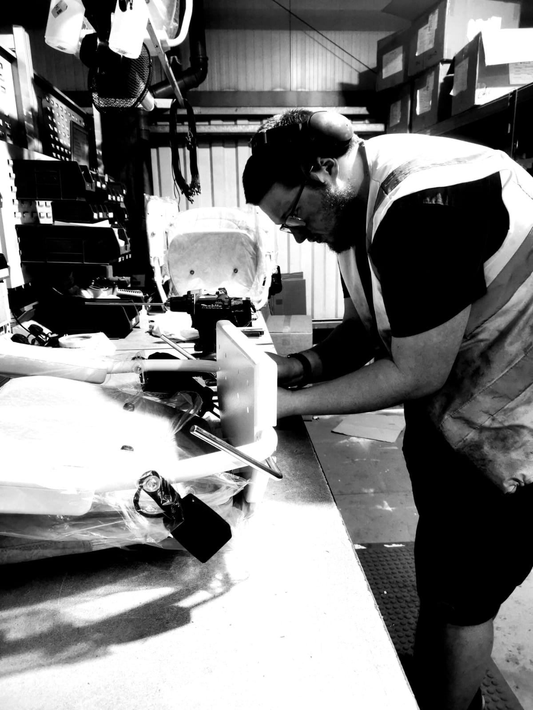
WHO ARE BESPOKE?

Slide 15
WHO ARE BESPOKE?

Slide 16
WHO ARE BESPOKE?
PRODUCTION
The Production Team at Bespoke Stairlifts turns innovative designs into high-quality stairlifts, carefully crafted to meet each customer’s needs.
They streamline workflows to ensure
every part is assembled, tested, and
inspected to the highest standards.
By working closely with supply chains
and logistics teams, they keep
production on schedule, minimise delays,
ensuring every order is correct
and sent out on time.

Slide 17
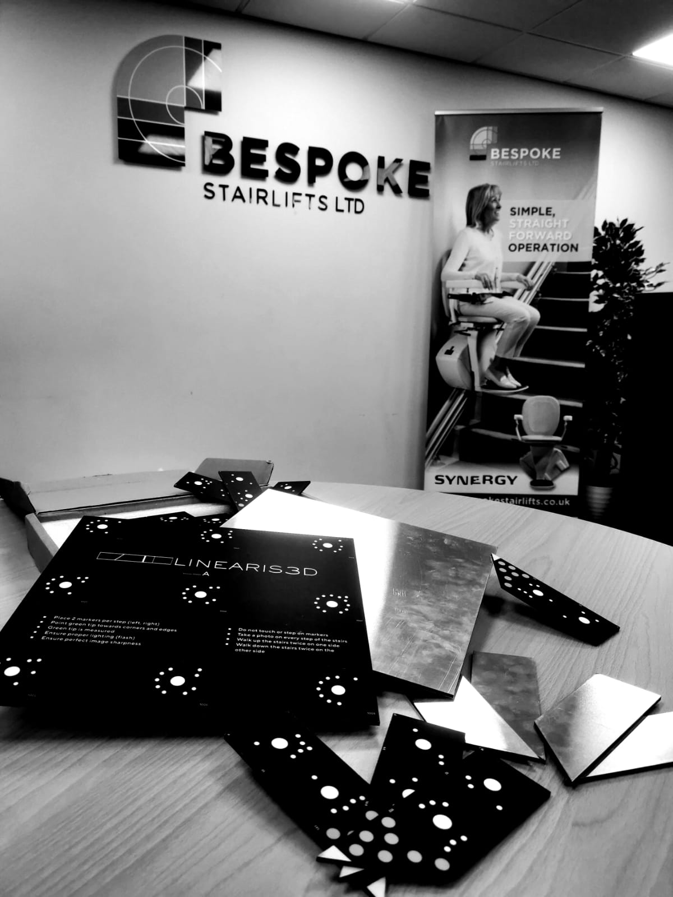
WHO ARE BESPOKE?
OPERATIONS AND AFTERSALES
From co-ordinating logistics and managing order fulfilment; to overseeing the delivery and installation of stairlifts, the Operations Team ensures efficiency at every stage.
Meanwhile, the Aftersales Team provides ongoing support to customers, addressing queries, offering maintenance advice, and resolving any technical issues swiftly. With in-depth product knowledge and technical expertise, they ensure customers receive tailored guidance and solutions.

Slide 18
WHO ARE BESPOKE?
TRADE AND INTERNATIONAL SALES
The UK Sales and International Sales Teams at Bespoke Stairlifts are the driving force behind building strong relationships with both new and existing customers.
They provide advice to ensure customers find the perfect stairlift solution, whether in the UK or around the globe.
Keeping in constant communication with customers and key stakeholders, they address queries, provide updates, and ensure every need is met with professionalism.
By collaborating closely with other departments, they ensure customer requirements are clearly communicated throughout
the business.

Slide 19
WHO ARE BESPOKE?
FINANCE
The Finance Team at Bespoke Stairlifts is essential to maintaining the company’s strong foundation of stability, efficiency, and growth. By managing budgets, forecasting, and financial planning, they ensure the smooth operation of every aspect of the business.
The Finance Team collaborates closely with various departments, including sales and procurement, to align financial strategies with customer needs and operational goals. They also partner with production and installation teams to ensure cost-effective processes and seamless project execution.

Slide 20
WHO ARE BESPOKE?
MARKETING
The Marketing Team at Bespoke Stairlifts plays a vital role in showcasing the company’s commitment to quality, innovation, and customer satisfaction. Through creative campaigns and strategic outreach, the team highlights Bespoke's ability to provide tailored stairlift solutions for every customer, including curved, straight, or narrow staircases.
The Marketing Team works closely with many other departments, such as sales and customer service, to understand customer needs and develop targeted messaging. They also collaborate with the installation team to capture real-life success stories and with the training team to ensure the Bespoke brand is represented consistently.

Slide 21
THE ORDER LIFECYCLE
INITIAL ENGAGEMENT
  Dealer expresses interest through outreach,
  referrals, or Bespoke’s website. Bespoke
  assesses compatibility by gathering information
  on dealer expertise, customer base,
  and product preferences.

Slide 22
THE ORDER LIFECYCLE
ONBOARDING PROCESS
  Dealer receives a product-specific onboarding pack and completes completes account sign-up.
  Account manager provides a product overview without the need for technical training.

Slide 23
THE ORDER LIFECYCLE
ORDER PLACEMENT & SURVEY
  Dealer submits an order form or requests a survey for a more complex staircase. Survey is arranged within 3-5 days for Curved Stairlifts, with data shared for review.

Slide 24
THE ORDER LIFECYCLE
DESIGN & APPROVAL
  CAD generates drawings within 24-48 hours post-survey. Dealer approves staircase drawings before proceeding to production.

Slide 25
THE ORDER LIFECYCLE
PRODUCTION
  Straight Stairlifts: Production begins immediately.
  Curved Stairlifts: Production starts after survey approval and CAD confirmation.
  Lead times: Straight (7-10 working days), Curved (15 working days).

Slide 26
THE ORDER LIFECYCLE
INSTALLATION
  Installation date confirmed with the dealer.
  Post-installation, all documents are shared
  with the dealer.

Slide 27
THE ORDER LIFECYCLE
AFTERCARE AND SUPPORT
  12-month warranty provided.
  After-Sales team handles any issues during the warranty period.

Slide 28
THE ORDER LIFECYCLE
LIFECYCLE MAINTENANCE
  Bespoke ensures ongoing support to maintain long-term success and strengthen the dealer relationship.

Slide 29
THE ORDER LIFECYCLE
BUY BETTER,
BUY BESPOKE

