Slide 1
CSA: Measuring and Improving Commercial Motor Vehicle Safety
Spring 2017
Notes:
There are 5 million truck and bus drivers sharing the road with more than 250 million motorists. With stakes so high, it’s essential that everyone Get Road Smart about safety compliance. It starts with understanding, following the rules and regulations of safety, and learning about the Compliance, Safety, Accountability program, or CSA.
Today’s briefing will help you take an important step to help keep the Nation’s highways safer for everyone, by getting road smart about CSA.

Slide 2
Agenda
Who Is FMCSA?
What Is Compliance, Safety, Accountability (CSA)?
CSA’s Three Core Components
Improving Your Safety Data

Slide 3
Who Is FMCSA?
The Federal Motor Carrier Safety Administration (FMCSA) is a transportation agency with over 1,000 Federal employees and 13,000 State Partners across the Nation committed to our safety mission—preventing crashes, injuries, and fatalities related to large trucks and buses on our highways.
Notes:
At FMCSA, safety is Job 1. Our more than 1,000 Federal employees and 12,000 State Partners from across the Nation are dedicated to making America’s roads as safe as they can be for everyone.
We help ensure safety in motor carrier operations, including those of owner-operators, by enforcing safety regulations, targeting high-risk carriers for interventions, improving safety information systems and technologies, strengthening the standards of commercial motor vehicle (CMV) equipment and operations, and increasing safety awareness.
We partner with Federal, State, and local enforcement agencies, motor carriers, drivers, and other safety stakeholders to get this job done.
Our CSA program is essential to achieving our safety mission.

Slide 4
What Is Compliance, Safety, Accountability (CSA)?
FMCSA’s data-driven safety compliance and enforcement program
Designed to improve safety and prevent commercial motor vehicle (CMV) crashes, fatalities, and injuries
Helps carriers and drivers improve safety compliance, so everyone gets home safely
Notes:
CSA is the safety compliance and enforcement program that FMCSA uses to monitor the safety record of all registered motor carriers in the United States.
CSA is important to every motor carrier, including owner-operators, because FMCSA uses it to identify, prioritize, and intervene with large truck and bus carriers who pose the highest safety risk on our roadways. You help keep your fleet on the road by adhering to FMCSA’s rules and regulations, and taking corrective action swiftly when necessary.
Safety means business, and here’s why: we analyze data from 3.5 million roadside inspections, and 100,000 crash reports—including all violations, investigations, and crash reports from the last two years. Your drivers’ performance is included in your record, so it is essential to you that everyone understand and follow the CSA program.
FMCSA launched CSA in 2010, after five years of collaborative, transparent, and research-based development, with listening sessions, a 30-month pilot phase in nine States, and an 8-month preview for enforcement and motor carriers.
FMCSA made many enhancements to CSA during this time, and the Agency continues to improve the program to make it easier for carriers, drivers, and law enforcement to understand and correct safety compliance issues.

Slide 5
Why Does CSA Matter?
More than 5.5 million truck and bus drivers share the road with more than 250 million motorists
Preventable crashes cost lives and livelihoods
Strong safety practices are good for business and make our Nation’s roadways safer for everyone
Notes:
There are over 5 million truck and bus drivers who share the road with more than 250 million motorists. That’s a lot of people to keep safe.
We know how seriously you take the responsibility of ensuring that your drivers, vehicles, and other motorists are safe on the road. You do much more than deliver goods and passengers to their destinations, so it’s essential that you and your drivers Get Road Smart about CSA.
This presentation is designed to help you do just that. It gives you an overview of CSA’s three elements―the Safety Measurement System (SMS), the safety interventions process, and the Safety Fitness Determination (SFD). It also shows you how to check and request a review of your safety data, and provides you with the tools and resources you need to improve your safety compliance.

Slide 6
CSA’s Three Core Components
The Safety Measurement System (SMS)
  FMCSA’s workload prioritization tool that identifies carriers for interventions (e.g., warning letters, investigations)
Safety Interventions Process
  Creates new and more efficient ways for FMCSA to interact with carriers and help bring them into compliance (e.g., warning letters and Onsite Focused Investigations)
Safety Fitness Determination (SFD)
  Uses the safety rating process in 49 CFR Part 385
Notes:
The CSA program consists of three key components that work together to improve safety on America’s highways:
The Safety Measurement System, or SMS
The safety interventions process
The SFD
We will provide an overview of all three elements, and then take a closer look at each, starting with the SMS.
Through the SMS, CSA analyzes data from roadside inspections, including all violations, investigations, and crash reports from the last two years to prioritize carriers for interventions. It’s important to remember that all roadside inspection results and crash reports count in the SMS, not just out-of-service violations.
The second element of the CSA program is the safety interventions process. An intervention is an enforcement action that may be taken when a carrier’s safety performance data indicate a potential safety risk. An FMCSA intervention evaluates why safety problems occur, recommends remedies, encourages corrective action, and when necessary, invokes strong penalties for carriers failing to comply.
The SFD is the rule component of the program. It uses the safety rating process in 49 CFR Part 385.
Now, let’s take a closer look at the heart of CSA—the SMS.

Slide 7
CSA’s Three Core Components
The Safety Measurement System

Slide 8
The SMS
Prioritizes and identifies carriers for interventions (e.g., warning letters, investigations) using:
  State-reported crash records
  All roadside inspection safety-based violations
  Certain violations found during inspections
  Serious Violations found during investigations
Updates results once per month based on the prior 24 months of data (weighted based on severity and when events occurred)
Organizes data into seven categories called Behavior Analysis and Safety Improvement Categories (BASICs)
Note: The SMS is not a safety rating and does not alter a carrier’s safety rating
Notes:
The SMS assesses motor carrier safety compliance and identifies carriers for interventions using all roadside violation, inspection, and crash data. This means that each year data from at least 3.5 million roadside inspections and crash reports feed into SMS to identify noncompliant and at-risk carriers.
The SMS assesses carrier safety based on 24 months of inspection and crash data and considers:
The number of safety violations, such as speeding, fatigued driving, and crashes
The severity of violations or crashes
When the safety violations occurred, with recent events weighted more heavily
FMCSA updates the SMS once a month with roadside inspection and crash data from the past 24 months.
FMCSA organizes the SMS data into seven Behavior Analysis and Safety Improvement Categories, or BASICs. The BASICs relate to unsafe behaviors that may cause crashes.
We will discuss the seven BASICs in more detail on the next two slides.

Slide 9
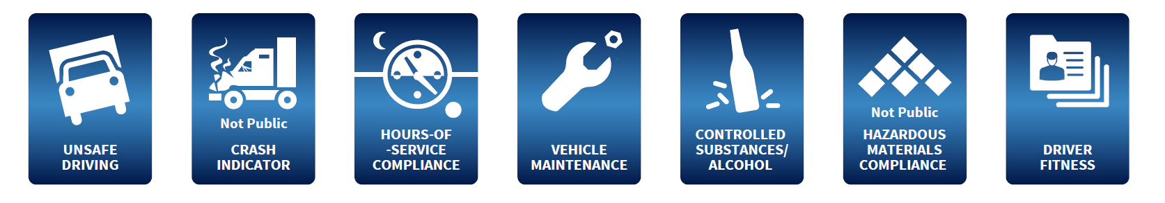
The SMS and the BASICs
The BASICs help you understand where you’re having safety problems so you can correct them
Each BASIC addresses specific requirements in FMCSA’s regulations
Notes:
The SMS assesses your safety compliance with FMCSA’s regulations by organizing your roadside inspection, crash, and investigation data into seven safety behavior categories or BASICs:
Unsafe Driving
Crash Indicator
Hours-of-Service Compliance
Vehicle Maintenance
Controlled Substances/Alcohol
Hazardous Materials (HM) Compliance
Driver Fitness
The BASICs help you understand where you stand in terms of safety compliance with FMCSA regulations, or Federal Motor Carrier Safety Regulations (FMCSRs). Each BASIC addresses specific requirements in the FMCSRs, and focuses on behaviors linked to crash risk.
For instance, the Unsafe Driving BASIC relates to Parts 392 and 397 of the FMCSRs, and refers to the operation of CMVs by drivers in a dangerous or careless manner. Some examples of roadside safety violations that may cause a carrier to rank poorly in this BASIC include speeding, reckless driving, improper lane change, and inattention.
We’ve listed example roadside violations for each BASIC on this slide.
There are two ways that your safety performance is measured in each BASIC―the BASIC measure and the BASIC percentile. It is important to know the difference between the two and how each of these measurements is calculated. We will cover these on the next couple of slides.

Slide 10
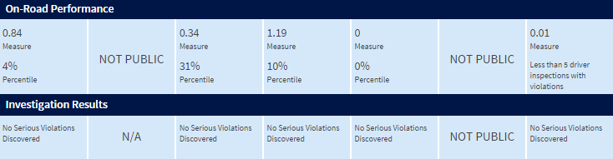
SMS and Prioritization for Interventions
Prioritization is based on two factors:
  On-road performance (i.e., BASIC percentile data)
  Investigation results (i.e., Serious Violations)

Slide 11
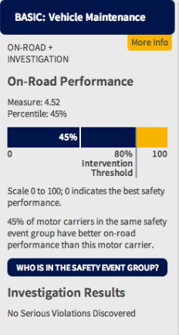
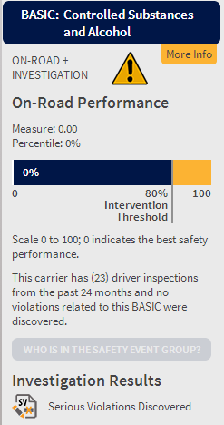
SMS and Prioritization for Interventions
Prioritization based upon on-road performance (percentile)
Prioritization based upon Serious Violations found during an investigation

Slide 12
Prioritization: On-Road Performance
Carriers are assigned a measure and percentile in each BASIC:
  Measure reflects your own company’s safety performance (SMS converts BASIC data (e.g., inspections) into a quantifiable measure)
  Percentile rank reflects your on-road safety performance compared to other carriers with similar fleet size and safety events
BASICs prioritized may trigger an intervention
Monitor your BASICs and take immediate action
Notes:
Your safety performance in each BASIC is measured in two ways:
Measure
Percentile
Your BASIC measure only reflects your company’s safety performance. The SMS calculates your measure for each BASIC by combining time and severity weighted violations and crashes. Remember, more recent safety violations are weighted more heavily. The lower the BASIC measure, the better the performance. The measure is the best way to track your company’s individual safety performance.
Your BASIC percentile is calculated based on your measure and reflects your safety performance compared to other carriers with similar safety events. The SMS calculates your percentile for each BASIC by:
Grouping and ranking you by BASIC with other similar carriers into a safety event group
Assigning you a percentile
The higher the BASIC percentile, the worse the performance.
Carriers with percentiles exceeding acceptable thresholds are prioritized for interventions. Those thresholds are set based on a given BASIC’s relationship to crash risk.
You may also be prioritized for an intervention based on Serious Violations found during investigations, the type of commodity you haul (e.g., hazardous materials, passenger carriers), your intervention history, or the time since your last intervention.
We will take a closer look at one of these factors—Serious Violations—in more detail later.

Slide 13
Prioritization: On-Road Performance
BASIC Measure
BASIC Percentile
Calculation | Only considers individual carrier performance Based on carrier violations or crashes weighted by time and severity | Based on carrier’s BASIC measure Groups and ranks carrier by BASIC with carriers that have similar safety events (i.e., inspections, inspections with violations, crashes) into a safety event group
Scale | The lower the measure, the better the performance | 0-100, with 100 indicating worst performance
Notes:
This table provides a simple breakdown of the differences between the BASIC measure and BASIC percentile, what each is based on, how each is calculated, and their scales.
Note that a safety event group is defined as a group of carriers with similar safety events (inspections, inspections with violations, crashes) in a BASIC. Safety event groups allow the SMS to account for differences in the motor carrier population and ensure similar carriers are held to the same standards.
Now we will move on to Serious Violations.

Slide 14
Prioritization: Serious Violations
Serious Violations found during investigations are considered in the carrier’s overall BASIC status, and they:
  Identify noncompliance so severe that they warrant immediate corrective action
  Are linked to a carrier’s management and/or operational controls
  May prioritize the carrier for an intervention in one or more BASICs
  Are displayed on a carrier’s record for 12 months
In March 2015, the Agency updated SMS and our Serious Violations spreadsheet to better align the Acute and Critical Violations in our regulations and IT systems, including five Serious Violations that are currently used in investigations.
  These violations took effect in the SMS as of February 1, 2015
Notes:
Serious Violations are found during investigations, are considered in the carrier’s overall BASIC status, and may be considered when prioritizing carriers for intervention.
They generally identify severe noncompliance in need of corrective action, and relate to a carrier’s management/operational controls.
They are displayed on a carrier’s record for 12 months.
Serious Violations can affect how you are prioritized for investigations. If you receive Serious Violations and do not submit a corrective action plan for them, they will impact the number of BASICs that may be selected for investigation.
FMCSA updated the SMS and the Serious Violations spreadsheet to better align with all of the Serious Violations in our regulations and IT systems, including five Serious Violations that are currently used in investigations. These violations took effect in the SMS as of February 1, 2015 and are as follows:
172.704(a)(4) Failing to provide security awareness training [Hazardous Materials (HM) Compliance]
172.704(a)(5) Failing to provide in-depth security awareness training [HM Compliance]
383.37(c)Knowingly allowing, requiring, permitting, or authorizing an employee with more than one commercial driver's license to operate a commercial motor vehicle [Driver Fitness]
395.3(a)(3)(i) Requiring or permitting a property-carrying commercial motor vehicle driver to drive more than 11 hours [Hours-of-Service (HOS) Compliance]
395.3(a)(3)(ii) Requiring or permitting a property-carrying commercial motor vehicle driver to drive if more than 8 hours have passed since the end of the driver's last off-duty or sleeper-berth period of at least 30 minutes [HOS Compliance]

Slide 15
Prioritization: Serious Violations
Examples of Serious Violations*
  §395.8(e) False reports of records of duty status
  §382.305(b)(2) Failing to conduct random controlled substances testing on drivers
  §383.51(a) Knowingly allowing, requiring, permitting, or authorizing a driver to drive who is disqualified to drive a CMV
*For a complete list of all Serious Violations and updated descriptions, view the Serious Violations spreadsheet: http://csa.fmcsa.dot.gov/Documents/Serious_Violations.XLSX
Notes:
Here are some examples of Serious Violations, which may cause a carrier to be prioritized for an intervention in one or more BASICs.

Slide 16
What You and Your Drivers Should Know
Motor carriers are accountable for their drivers’ violations
  All inspections and violations your drivers receive while they work for you remain part of your carrier record for 24 months (regardless of whether they continue operating for you)
  Carriers do not inherit past violations of a newly hired driver
Roadside inspection data remain part of a driver’s record for three years, crash data for five years
Notes:
It’s also essential to understand what CSA means for your drivers and how their safety performance impacts your business.
You are accountable for your drivers’ violations.
While you do not inherit past violations of a driver you have just hired, the data from inspections while a driver works for you remain part of your record for two years.
It’s vital to safety—and to the health of your business, to make sure your drivers get road smart.

Slide 17
What You and Your Drivers Should Know
Safety Investigators use drivers’ roadside inspection and crash data when investigating a carrier
The SMS does not assign safety ratings, “scores,” or points to drivers
  Note: The Federal and State governments do not calculate or issue a driver “score.” There is no universal evaluation method for drivers.*
  Carriers and independent third parties combine Pre-Employment Screening Program (PSP) and other driver information, and call it a “CSA score” or “CSA driver scorecard.” The Federal government does not endorse third-party driver “scores.”
*FMCSA’s Driver SMS (DSMS) does not generate or issue driver safety ratings or “scores.” It does not affect a driver’s commercial driver’s license, or a carrier’s safety rating. DSMS results are not available to motor carriers, drivers, third-party providers, or the public. DSMS results are an investigative tool only available to enforcement officials for examining commercial motor vehicle driver performance as part of CSA investigations. DSMS results are not a measure of a driver’s overall safety condition.
Notes:
Safety Investigators (SIs) use driver information in the SMS to help conduct more effective and efficient investigations by focusing on specific drivers for those carriers already identified for investigations.
Here is a very important point, and a source of much confusion in the motor carrier industry:
Some third-party companies use data from FMCSA records and issue what THEY call a “CSA score” or “CSA driver scorecard.” These “scores” are not issued by the Federal or State government.
Regardless of what you may have heard, FMCSA does not currently assign safety ratings, “scores,” or points to drivers.

Slide 18
What You and Your Drivers Should Know
The PSP
  The PSP was mandated by Congress
  It’s a screening tool that provides a driver’s Federal crash and inspection history record including:
    Five years of reportable crashes
    Three years of inspections
  Carriers can only use PSP for hiring purposes and can only order a driver’s record with his or her authorization
  Drivers can obtain their record any time
  You can obtain a driver’s record for a $10 fee at http://www.psp.fmcsa.dot.gov or for free via a Freedom of Information Act (FOIA) request
Notes:
Let’s talk about how you can use the Pre-Employment Screening Program, or PSP to make informed hiring decisions.
PSP provides you with secure, electronic access to a driver’s crash and inspection history from FMCSA’s Motor Carrier Management Information System (MCMIS) database.
A PSP record includes a driver’s most recent five years of crash information and most recent three years of inspection information. The record displays a snapshot in time, based on the most recent MCMIS data uploaded to the PSP system. A new snapshot is uploaded approximately once per month.
You will need the driver’s consent to obtain the record, and may only request the record for pre-employment screening purposes.
Drivers can obtain their own record any time through the PSP online service for a $10 fee or for free via a Freedom of Information Act request.
On the next slide, we will show you how to review your safety data in the SMS.

Slide 19
Reviewing Your Safety Data in the SMS
What safety data can you view?
Public | BASIC information for all carriers, except for the Hazardous Materials (HM) Compliance and Crash Indicator BASICs Driver names are not included
Carriers (logged in) | All BASIC information, including HM Compliance and Crash Indicator BASICs, driver names per inspection, and downloadable inspection and crash data Public view of all other carriers
Drivers | Public view of all carriers
Notes:
First, it’s important to understand what safety data you can view as a logged-in motor carrier and what safety data everyone else can see.
The table above provides a breakdown of available safety data by user.
The public view is available to everyone—it includes BASIC information for all carriers, with the exception of the HM Compliance and Crash Indicator BASICs.
Once you are logged in, you can view all of your company’s own BASIC information, including the HM Compliance and Crash Indicator BASICs, driver names per inspection, and downloadable inspection and crash data.
Enforcement can see all of the safety data in your SMS profile, as well as some additional safety information, which help them prioritize their resources and conduct investigations.

Slide 20
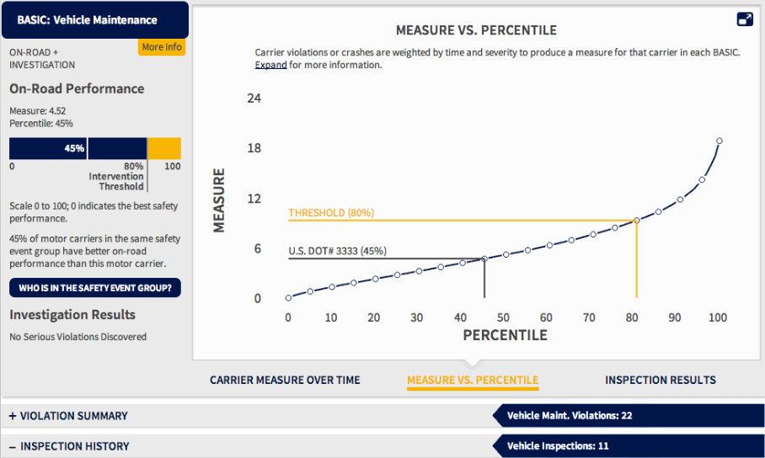
SMS Screenshots
Notes:
This is a screenshot of the public view of the SMS Website.

Slide 21
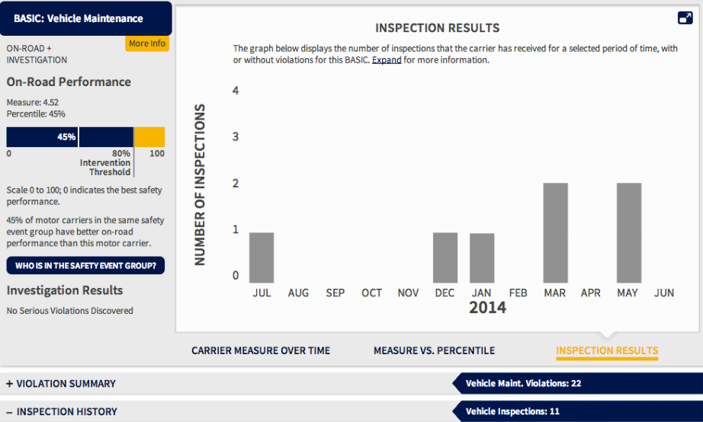
SMS Screenshots
Notes:
This is a screenshot of the public view of the SMS Website.

Slide 22
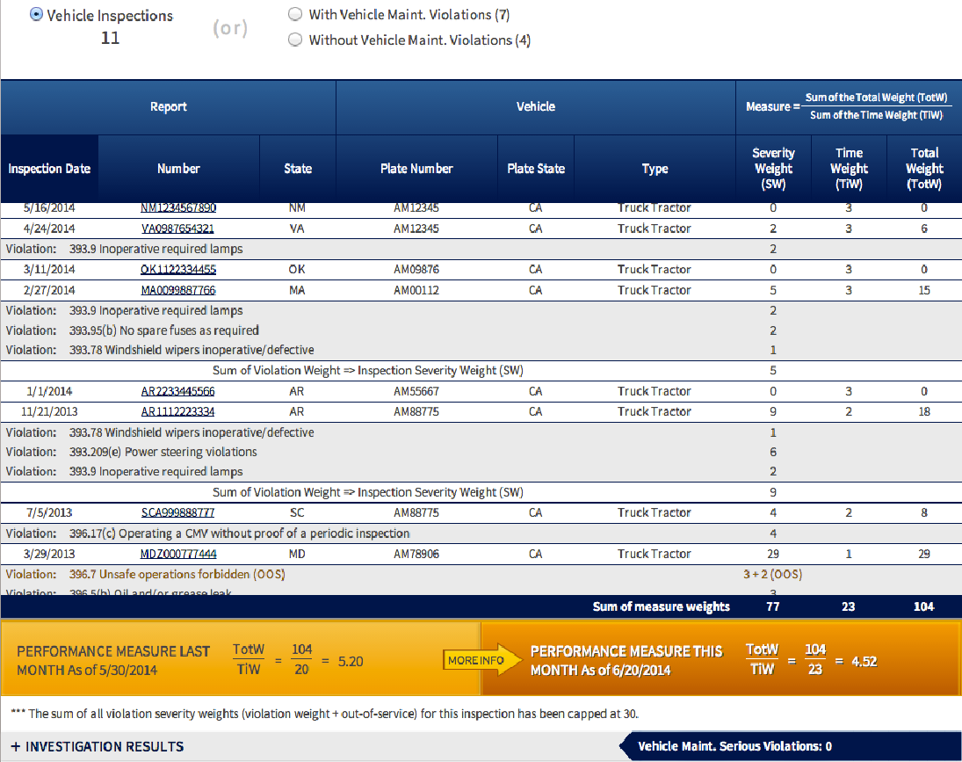
SMS Screenshots
Notes:
This is a screenshot of the public view of the SMS Website.

Slide 23
Why Your Safety Data Matters
Your safety data affects your safety record
  The SMS uses your roadside inspection and crash data to calculate BASIC percentiles
  FMCSA uses the SMS to prioritize carriers for interventions, focusing on those that pose the highest safety risk
FMCSA, the public, and other stakeholders can see SMS results, so it’s important to make sure they are based on accurate data
Notes:
Your safety data is important to your business. It affects your safety record, and FMCSA, the public, and other safety stakeholders can see it.
FMCSA urges you to check your data periodically to make sure that it’s accurate.
Let’s take a step-by-step walk through how to check your data, and what you can do if you believe some data needs to be corrected.

Slide 24
DataQs: Improving Your Safety Data
Allows carriers/drivers to file a Request for Data Review (RDR) to identify concerns about data in FMCSA’s data systems that may be incomplete or incorrect
Forwards your RDR to the appropriate office for resolution
Gives you updates on the status of your RDR, from submission through resolution
Notes:
First, check your safety record on the SMS Website.
Then use FMCSA’s online system, DataQs, to request a review of your data if needed.
Anyone can use DataQs to file a Request for Data Review, or RDR, to identify concerns about data in FMCSA’s data systems. As a motor carrier or owner-operator, you can file concerns about your inspection and crash data, or other information displayed in your safety record.
Once you have completed an RDR form, DataQs will automatically forward your RDR to the appropriate office for resolution and collect updates and responses for your current requests.
On the next couple slides, we will cover what you need to know about filing RDRs—from best practices to inappropriate requests.

Slide 25
DataQs: Improving Your Safety Data
When filing an RDR, remember to:
  Write a specific and detailed explanation
  Attach relevant supporting document(s):
    Example: include a lease agreement if you are an owner-operator with a valid lease agreement with another company
  Ensure your contact information is accurate
  Check the status of your RDR frequently (additional information may be requested)
  Consult the DataQs guide for additional tips: https://dataqs.fmcsa.dot.gov/Data/Guide/DataQs_Users_Guide_and_Best_Practices_Manual.pdf
Notes:
An RDR is your chance to correct errors in your safety data, so it’s important that you provide sufficient information to support your request. States need as much supporting documentation as possible to accurately resolve a data review request.
A complete and accurate RDR will make the process faster and reduce the likelihood that you will need to resubmit your request.
Here are the essential steps to ensure your RDR is complete.

Slide 26
Requests for Data Review (RDRs)
RDRs can only be submitted for violations that were erroneously reported or incorrectly documented during the inspection
Examples of improper requests:
  “Driver fired”
  “Crash not our fault”
  “Driver caused the violation”
  “An owner-operator or another carrier committed the violation while they were leased to our operation”
Notes:
Understand when you can submit an RDR:
You can only submit an RDR for violations that were incorrectly reported or documented during an inspection.
Requests that do not meet this criteria are inappropriate. These may include statements such as: the crash wasn’t our fault, or the driver was fired.

Slide 27
Adjudicated Citations Policy
  The updated Adjudicated Citations policy went into effect in August 2014
  Improves the quality and uniformity of violation information in FMCSA systems (e.g., MCMIS)
  Allows FMCSA to upload the results of State citations associated with violations that the court has adjudicated
  Process highlights:
    Carriers and drivers can submit RDRs along with court documentation via DataQs
    The State will review and document the citation results for the associated violations, and those results will impact PSP and SMS as listed on the next slide
Notes:
FMCSA’s updated adjudicated citations policy improves the quality and uniformity of violation information in FMCSA systems.
This policy allows the results of State citations associated with violations contested in court to be incorporated into the Agency’s MCMIS database.
This policy also impacts how violations are displayed and used in the SMS and the PSP.
In addition, the policy establishes specific procedures for processing RDRs on violations associated with an adjudicated citation.
Carriers and drivers are able to submit RDRs along with court documentation using DataQs. States will review and document the citation results for the associated violations, and those results will impact PSP and SMS as listed.
If a citation has been dismissed without a fine or the party was found not guilty, the violation is removed from both the PSP and SMS. If the party was convicted of a different charge, the violation will be indicated as a conviction of a different charge in both the PSP and the SMS. The SMS severity weight is reduced to 1. If the party is convicted or dismissed with a fine, the violation is retained on both the PSP and SMS.

Slide 28
Adjudicated Citations Policy
Results of adjudicated citation associated with a violation uploaded to MCMIS | Violation in SMS | Violation in PSP
Dismissed with fine or punitive court costs | Violation not removed | Violation not removed
Dismissed without fine or punitive court costs | Remove violation | Remove violation
Not Guilty | Remove violation | Remove violation
Convicted or a lesser charge | Append inspection to indicate violation “Resulted in conviction of a different charge.” Change severity weight to 1. | Append inspection to indicate violation “Resulted in conviction of a different charge.”

Slide 29
CSA’s Three Core Components
Safety Interventions Process

Slide 30
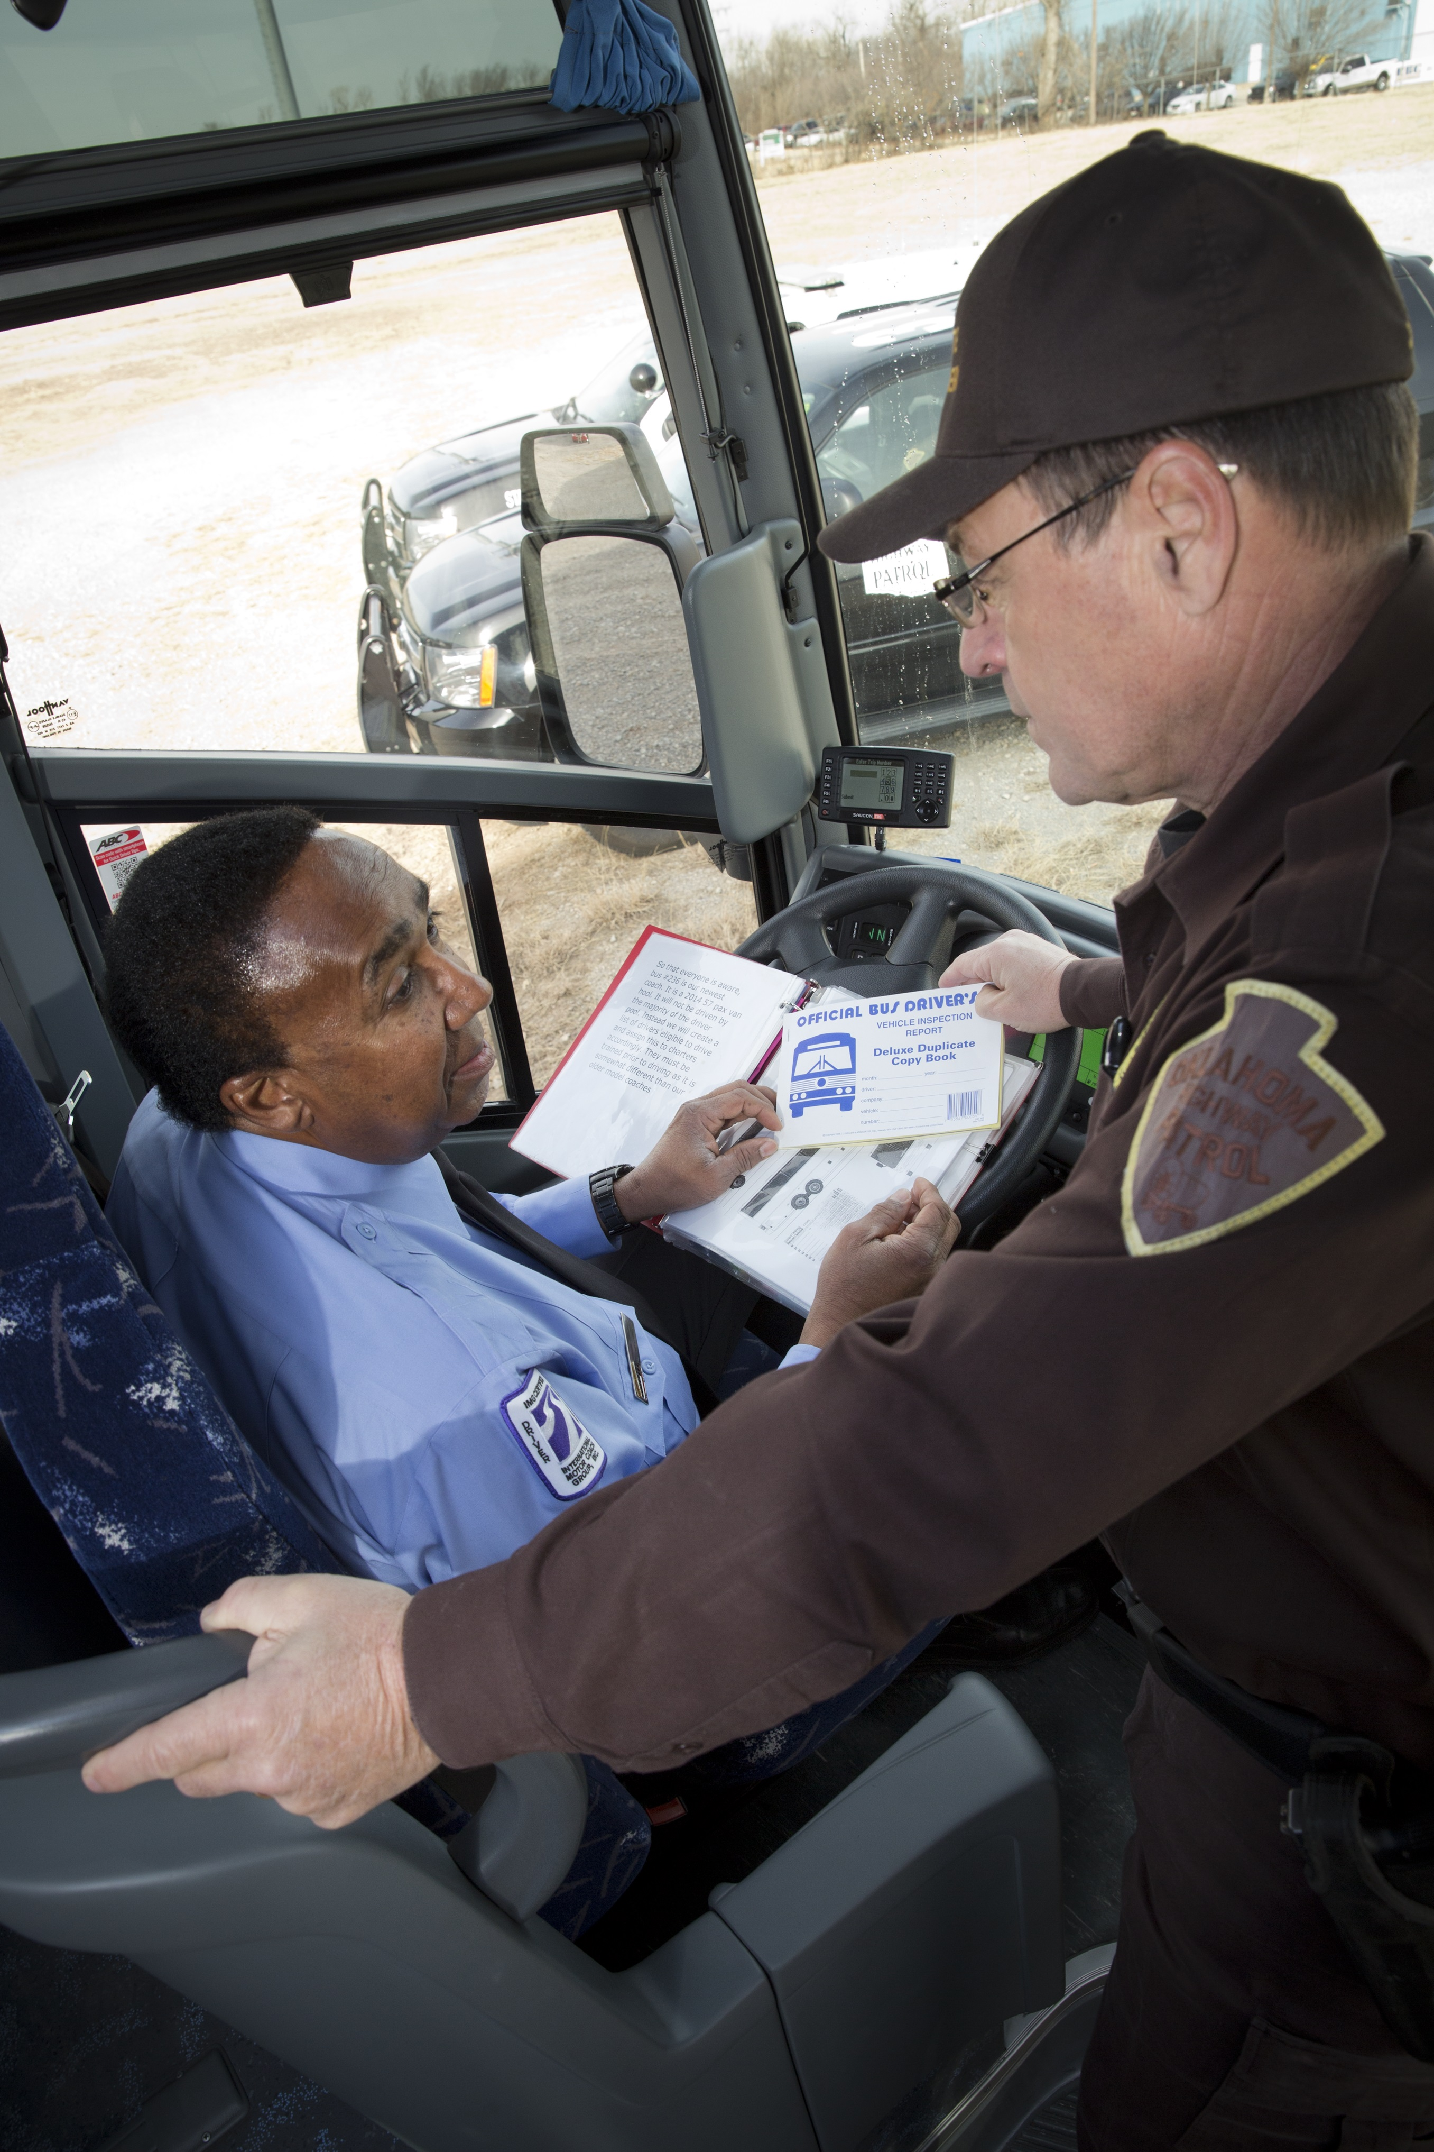
Safety Interventions Process
  CSA Interventions
  Wide array of interventions FMCSA uses to address safety problems―before crashes occur
  Safety Management Cycle (SMC)
  A process to help pinpoint safety problems and take corrective action
Notes:
Let’s take a look at the second element of CSA, the Safety Intervention Process.
An intervention may be taken by FMCSA when a carrier’s safety performance data indicate a potential safety risk.
The FMCSA interventions process evaluates why safety problems occur, recommends remedies, encourages corrective action, and when necessary, invokes strong penalties for carriers failing to comply.
You can use it to gain a deeper understanding of why the violations occurred and how they can be corrected. And once you understand the why, you can use FMCSA’s Safety Management Cycle (SMC)—a methodical process to help you understand and correct safety problems.
But first, let’s take a closer look at the range of interventions we use.

Slide 31
CSA Interventions
Warning Letter
  Alerts carriers to safety issues and consequences of failing to correct them
  Chance to improve without further FMCSA intervention
Investigation
  Offsite (done remotely): conducted via documentation requests; addresses emerging safety problems
  Onsite Focused (at your business site): focuses on specific compliance areas
  Onsite Comprehensive (at your business site): addresses compliance across a carrier’s entire operation
Notes:
CSA Interventions are divided into three categories to match the nature and severity of the carrier’s safety problems:
Early contact
Investigation
Follow-on corrective action
Early Contact
Warning Letter
A warning letter is your chance to improve your safety performance without further intervention from FMCSA. If you receive a warning letter, it means that you are not complying with all of the FMCSRs. The letter identifies one or more areas where your company has shown a pattern of violations or crashes, explains how to access your safety record, and outlines possible consequences for failing to improve your safety performance. You don’t need to respond to the letter in writing, however, FMCSA will continue to monitor your safety compliance through the SMS, and if you do not improve, you may be identified for an investigation.
Investigations
Offsite Investigation
This investigation does not occur at your place of business. SIs work with you to identify the root causes of your safety problems using documentation that you provide related to each BASIC. For example, SIs may request the following types of documents from you: toll receipts, border crossing records, or drug testing records. Following this intervention, if you do not improve, you may be identified for an Onsite Focused Investigation or Onsite Comprehensive Investigation.
Onsite Focused Investigation
This investigation occurs at your place of business and focuses on specific problem areas (e.g., maintenance records). You may be selected for an Onsite Focused Investigation if you have exceeded the Intervention Threshold in one, two or three BASICs.
Onsite Comprehensive Investigation
This investigation occurs at your place of business and covers your entire safety operation. This type of investigation includes a compliance review (CR), as defined in 49 CFR Part 385, as well as the use of the SMC and other CSA investigative tools. You may receive this kind of investigation if you exhibit severe safety compliance problems (e.g., a pattern of BASICs over the Intervention Threshold, four or more worsening BASICs, or a fatal crash or complaint).

Slide 32
CSA Interventions
Follow-on Corrective Action
  Cooperative Safety Plan: voluntary improvement plan
  Notice of Violation (NOV): violations severe enough to warrant formal action, but not a civil penalty
  Notice of Claim (NOC): violations severe enough to warrant assessment and issuance of civil penalties
  Out-of-Service Order (OOSO): deemed “unfit” to operate; requires you to cease motor vehicle operations immediately
Notes:
Follow-on Corrective Action
Cooperative Safety Plan
This is a voluntary plan that you can implement with the help of SIs to address your safety problems. The plan may be used alone or with a Notice of Violation (NOV), but it cannot replace a Notice of Claim (NOC). Here is what each of those is:
NOV
You may receive a Notice of Violation, or NOV, if you have violations that are severe enough to warrant formal action, but not civil penalties. To avoid further intervention from FMCSA, you must take corrective action and provide evidence of it, or contest the violations.
NOC
You may receive a Notice of Claim, or NOC if you have violations that are severe enough to warrant an assessment and civil penalties.
Out-of-Service Order (OOSO)
Most severe is the Out-of-Service Order. If FMCSA issues you an OOSO, it means that you have been deemed “unfit” to operate and must immediately stop all motor vehicle operations.

Slide 33
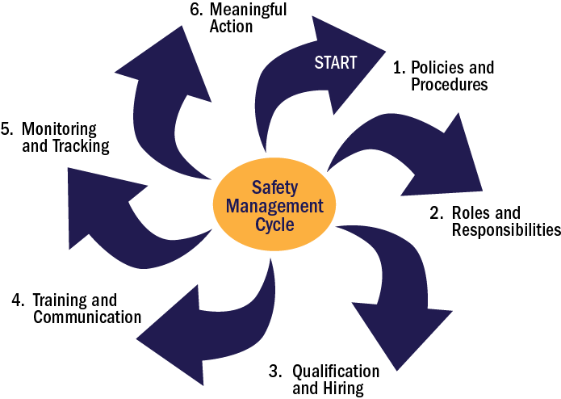
What is the Safety Management Cycle (SMC)?
Step-by-step process consists of six SMPs
Notes:
The Safety Management Cycle (SMC) is the second component of the Safety Interventions Process and motor carriers use it to identify, understand, and address safety challenges in their operations.
The SMC considers six areas of a carrier’s operations. We call them Safety Management Processes or SMPs.
Taken together, the SMPs help provide a framework that carriers and investigators can use to identify and choose solutions, and implement plans to improve a carrier’s safety operations.
Let’s review the six areas in more detail. They include:
Policies and Procedures
Roles and Responsibilities
Qualification and Hiring
Training and Communication
Monitoring and Tracking
Meaningful Action
The first area, Policies and Procedures, establishes guidelines for how motor carriers and their employees should behave in a given situation, and how to enact these guidelines.
The second, Roles and Responsibilities, clearly defines what each employee should do to successfully implement the policies and procedures.
The third area, Qualification and Hiring, discusses recruiting and screening applicants to fulfill the roles and responsibilities for positions.
The fourth area, Training and Communication, identifies key components of a motor carrier’s communication of its policies, procedures, roles, and responsibilities to its staff, and how they are used to make sure everyone understands expectations, training, and testing related to their policies and procedures.
The fifth area, Monitoring and Tracking, is focused on the importance of establishing a system to monitor and track employee performance related to their roles and responsibilities.
The sixth and final area, Meaningful Action, identifies and explains approaches to correcting employee behavior in order to improve safety performance, including refresher training and positive reinforcement such as rewards or bonuses.

Slide 34
How Can Carriers Use the SMC?
Identify trends by reviewing your violations and crash history in the SMS
Detect potential process breakdowns that may contribute to violations by analyzing each Safety Management Process (SMP) (start with no.1 Policies and Procedures)
Assess why these breakdowns occur
Identify safety improvement practices
  Safety Investigators may walk carriers through the SMC during investigations and carriers can use the tool on their own
  Find tools for using the SMC: http://csa.fmcsa.dot.gov/about/smc_overview.aspx
Notes:
You can learn more about the SMC, and find tools you can use to implement these safety practices at the website on the screen.
FMCSA recognizes that many small carriers or owner-operators only have one person assigned to perform all of the listed safety management functions and is in the process of developing a set of recommendations on how small carriers can apple the SMC.

Slide 35
CSA’s Three Core Components
Safety Fitness Determination (SFD)

Slide 36
Current Safety Rating Process
Ratings are issued based on investigation findings and do not take into account roadside inspection data
A rating may result from an Onsite Investigation
Current process is outlined in 49 CFR Part 385
Note: Drivers are not rated, and they do not have an SFD
Notes:
The third focus area, is the Safety Fitness Determination or SFD.
Let’s talk about the current SFD process. Under the current SFD process, ratings—Satisfactory, Conditional, or Unsatisfactory—are issued based on investigation findings.
There are two kinds of Onsite Investigations, both of which are conducted at the carrier’s place of business. One is a comprehensive investigation, which looks at a carrier’s entire operations. The other is a focused investigation, which is limited in scope to specific areas of concern.
The Onsite Comprehensive Investigation can result in a rating of Satisfactory, Conditional, or Unsatisfactory. However, because the Onsite Focused Investigation is limited to a few areas of focus, it can result only in a Conditional or Unsatisfactory Rating.
In most cases, a carrier’s safety rating remains intact until the carrier receives another Onsite Investigation. However, FMCSA will upgrade the safety rating if a carrier prevails in an administrative review proceeding as outlined in §385.15. A carrier may also request that FMCSA upgrade its rating by demonstrating required corrective action as outlined in §385.17.
Drivers are not rated, and they do not have a Safety Fitness Determination (SFD)*
*FMCSA’s Driver SMS (DSMS) does not generate or issue driver safety ratings or “scores.” It does not affect a driver’s commercial driver’s license, or a carrier’s safety rating. DSMS results are not available to motor carriers, drivers, third-party providers, or the public. DSMS results are an investigative tool only available to enforcement officials for examining commercial motor vehicle driver performance as part of CSA investigations. DSMS results are not a measure of a driver’s overall safety condition.

Slide 37
Get Road Smart About CSA

Slide 38
CSA Is Helping Us Do More
Reaching more carriers, earlier
  100,000+ warning letters sent since CSA rollout
Assessing nearly 200,000 carriers that account for 92% of reportable crashes – and 80% of CMVs
Decreasing violation rates, representing the highest decrease in a decade
Better identifying high-risk carriers for interventions*
Better identifying carriers of all sizes for interventions*
*Findings from the SMS Effectiveness Test (numbers as of January 2014): http://csa.fmcsa.dot.gov/Documents/CSMS_Effectiveness_Test_Final_Report.pdf
Notes:
CSA is helping FMCSA do more.
We are reaching more carriers, sooner.
We are assessing more carriers for safety compliance.
We can better identify high-risk carriers of all sizes for interventions.
We are building industry awareness of CSA, SMS, and how to get road smart to improve safety performance.
Three years after its launch, FMCSA conducted a study of the effectiveness of the SMS. These are just a few of the results. You can find the full study online. http://csa.fmcsa.dot.gov/Documents/CSMS_Effectiveness_Test_Final_Report.pdf.
Reaching more carriers, earlier
86,000 warning letters sent since CSA rollout
Assessing more carriers
SMS has sufficient data to assess nearly 200,000 carriers who account for:
80% of CMVs
92% of reportable crashes
Better identifying high-crash risk carriers for interventions
Carriers with one or more BASICs identified for interventions had a 79% higher crash rate than those with no BASICs identified for interventions.
Carriers that exceeded the Intervention Thresholds in any of 6 of the 7 BASICs showed a higher future crash risk than the national average.
Better identifying carriers of all sizes for interventions
Large carriers (more than 500 CMVs) identified for interventions had a 60% higher crash rate than those active carriers not identified.
Small carriers (five CMVs or less) identified for interventions had a 137% higher crash rate than those active carriers not identified.
Building motor carrier awareness
68 million visits to the SMS Website this year, that’s:
20 million more visits than the year before; and
Twice as many visits compared to two years ago.

Slide 39
Get Road Smart
You drive safety home.
CSA holds drivers accountable for safe on-road performance. Learn how to strengthen your safety record while making America’s roads as safe as they can be for everyone. Visit our website to learn how to:
Order driver records (PSP)
Request a review of your data (DataQs)
See motor carrier data (SMS)
Five and a half million truck and bus drivers share America’s roads and highways with more than 250 million motorists. With stakes so high, it’s essential that everyone Get Road Smart.
To Get Road Smart, visit us today: http://csa.fmcsa.dot.gov/?industry
Notes:
We know you take a lot of pride in the important job you do.
Join FMCSA and State enforcement agencies in our national commitment to prevent large truck and bus crashes and Get Road Smart about CSA.
Following safety rules protects everyone on our motorways, including you—allowing you to continue cheering in the stands at your kids’ games, seeing them on graduation day, and celebrating every birthday, including yours, for years to come.
Visit our website, review your safety record, learn and follow safety rules, and help strengthen your safety record as well as your employer’s while making America’s roads as safe as they can be for everyone.

Slide 40
Get Road Smart
Stay connected.
  Visit the Motor Carrier Resource Center at:
  http://csa.fmcsa.dot.gov/?carriersafety
  Sign up for important updates via the CSA Website at: http://csa.fmcsa.dot.gov/subscription.aspx
  Contact FMCSA if you have questions or feedback at: http://csa.fmcsa.dot.gov/CSA_Feedback.aspx or by calling 877-254-5365
  Download Get Road Smart brochures, pocket cards, posters, and factsheets at: http://csa.fmcsa.dot.gov/?toolkit2, or order by calling the InfoLine at 877-254-5365
Notes:
As part of our new Get Road Smart campaign to help learn about and follow important safety rules and requirements, FMCSA launched a new online Motor Carrier Resource Center, where you can find practical information and useful links about CSA, SMS, and more.
We urge you to visit us online to Get Road Smart about CSA at http://csa.fmcsa.dot.gov/getroadsmart.

