Slide 1
Volleyball Skill Development & Assessment
Presented by: Jack Neumuth
PE Volleyball Unit Overview

Slide 2
Learning Objectives
Demonstrate correct technique: serve, bump, set, spike
Apply strategy and teamwork during gameplay
Understand and use key volleyball terms

Slide 3
Assessment Overview
Psychomotor: Skill checklists for 4 main skills
Cognitive: Exit slips on vocabulary and strategy
Focus on both doing and understanding

Slide 4
Key Results & Takeaways
Most students showed strong bumping and serving
Spiking and setting were more challenging
Teamwork and strategy understanding were solid overall

Slide 5
Next Steps for Learning
More targeted practice for spiking and serving control
Peer feedback and language supports
Small group stations to reinforce technique and communication

Slide 6
Final Thoughts
Students are developing both physically and mentally
Assessment guided instructional decisions
Excited to continue building skills and teamwork in PE

Slide 7
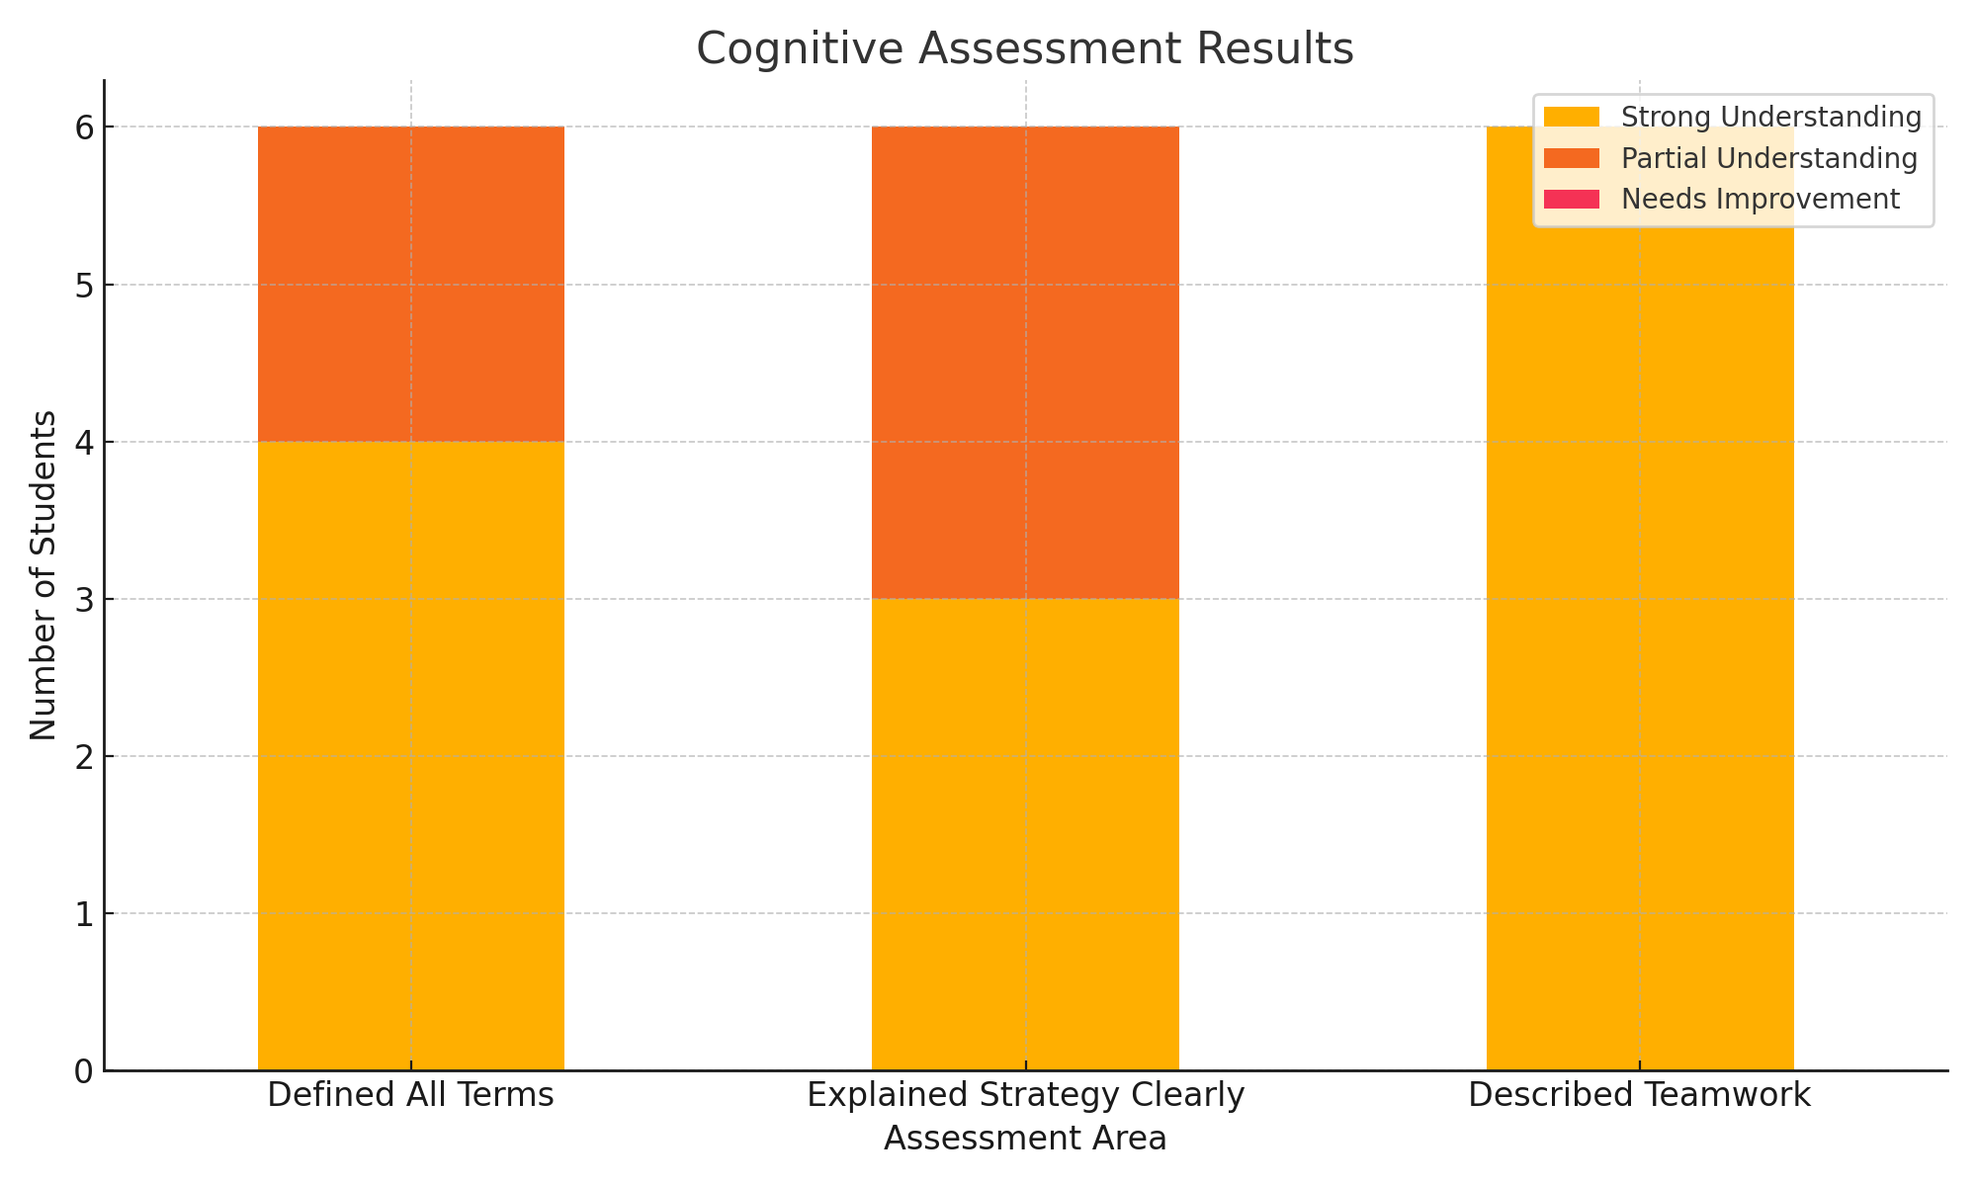
Cognitive Chart

Slide 8
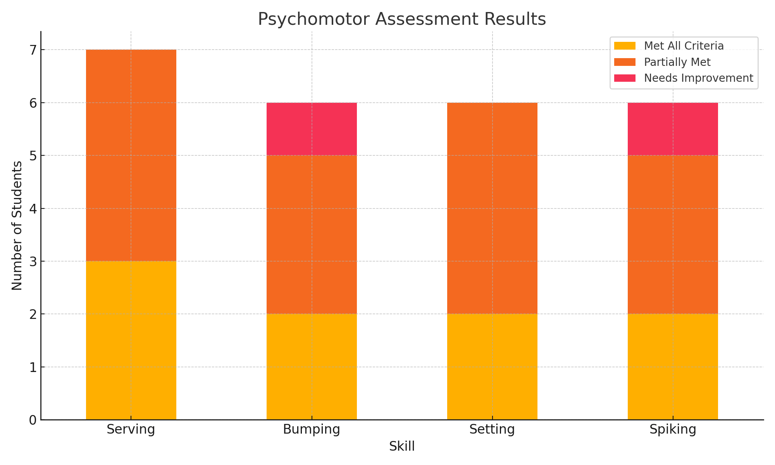
Psychomotor Chart

