Slide 1
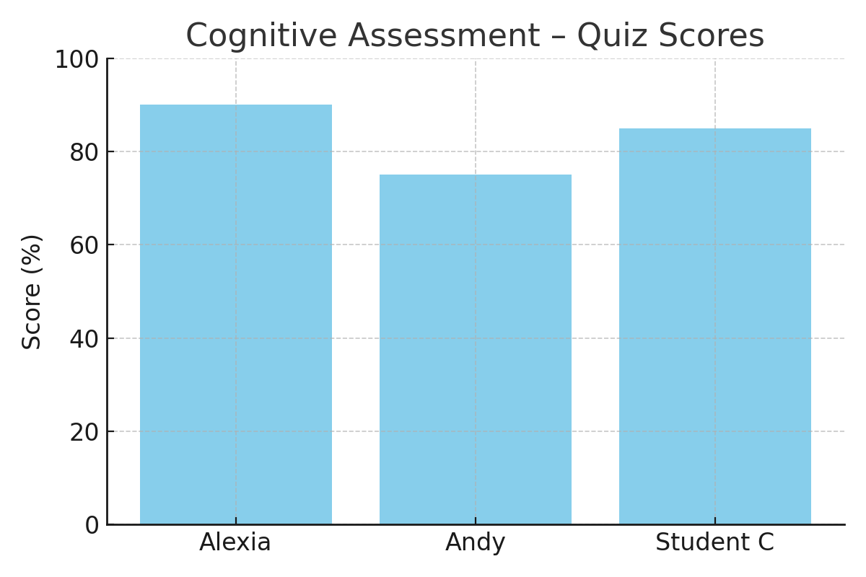
Pickleball Unit: Student Assessment & Reflection
Prepared by Jack Neumuth – Physical Education

Slide 2
Overview of Unit Goals
• Promote consistency in rallying using forehand and backhand strokes
• Develop cooperative gameplay skills
• Improve strategic thinking and rules comprehension
• Foster a positive attitude and respectful communication during games

Slide 3
Assessment Tools Used
• Psychomotor – Rally Counter Student Sheet
• Cognitive – Rules and Strategy Quiz
• Affective – Exit Slips and Self-Reflections
• Observation Checklists – Engagement, Communication, Effort

Slide 4
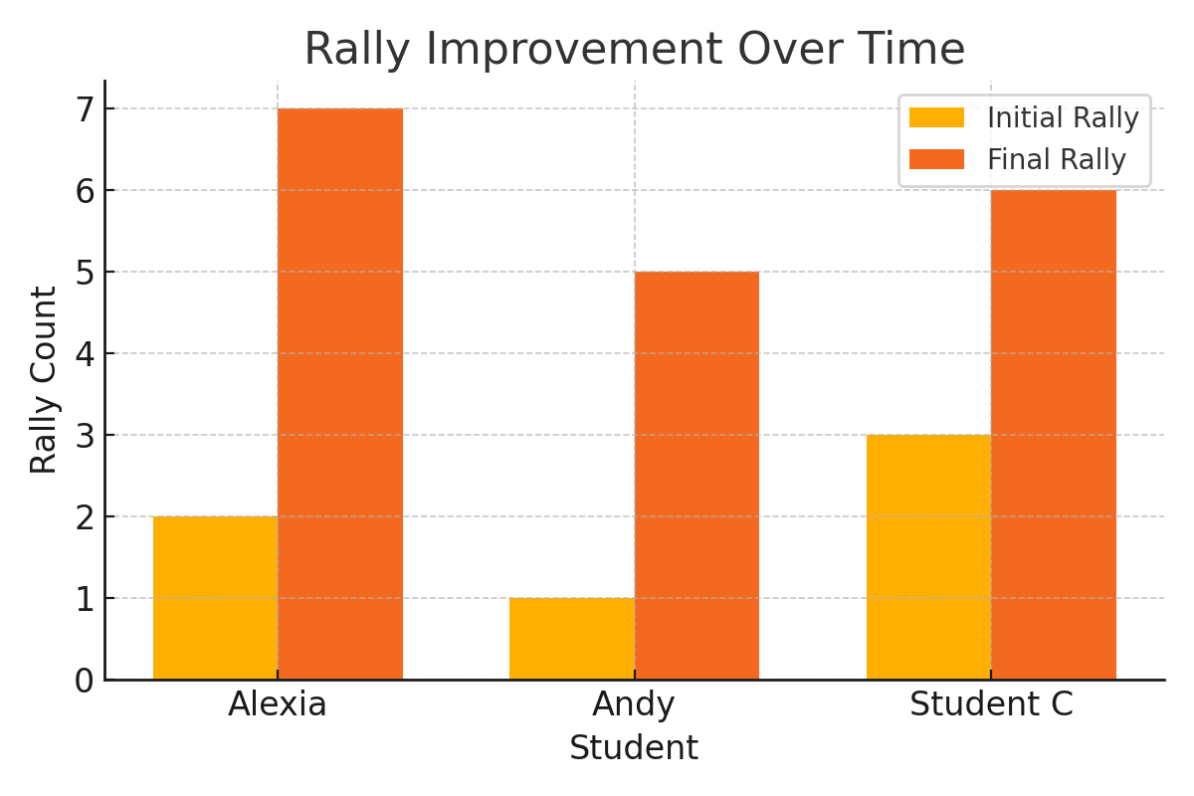
Student Rally Progress

Slide 5
Cognitive Assessment – Quiz Scores

Slide 6
Student Reflections – Affective Domain
Alexia: 'I liked how my partner and I kept trying and didn’t give up. I felt proud when we got 7 hits.'
Andy: 'I learned to say good shot even if I missed. It helped my partner play better too.'
Student C: 'I used to get mad when I missed but now I just try again and talk to my partner more.'

Slide 7
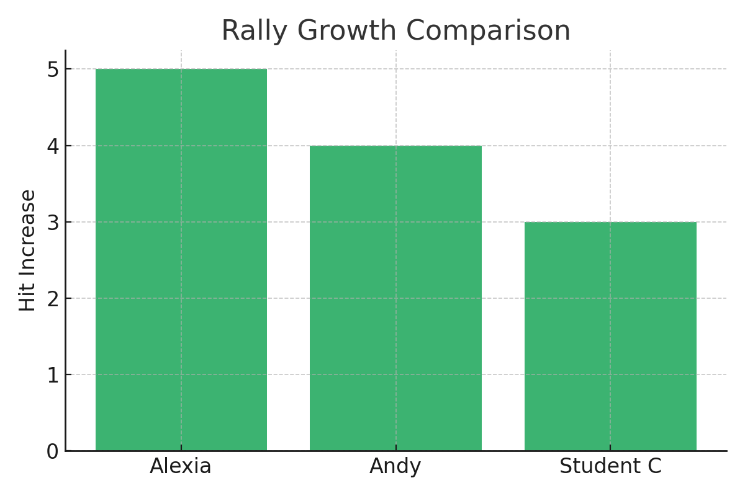
Psychomotor Growth – Rally Count Increase

Slide 8
National PE Standards Alignment
• Standard 1: Demonstrates competency in a variety of motor skills and movement patterns
• Standard 2: Applies knowledge of concepts, principles, strategies, and tactics related to movement and performance
• Standard 4: Exhibits responsible personal and social behavior that respects self and others
• Standard 5: Recognizes the value of physical activity for health, enjoyment, challenge, and social interaction

