Slide 1
Launch Your Career in Mental Health After 12th
India’s 1st and only RCI-approved UG program in Clinical Psychology.

Slide 2
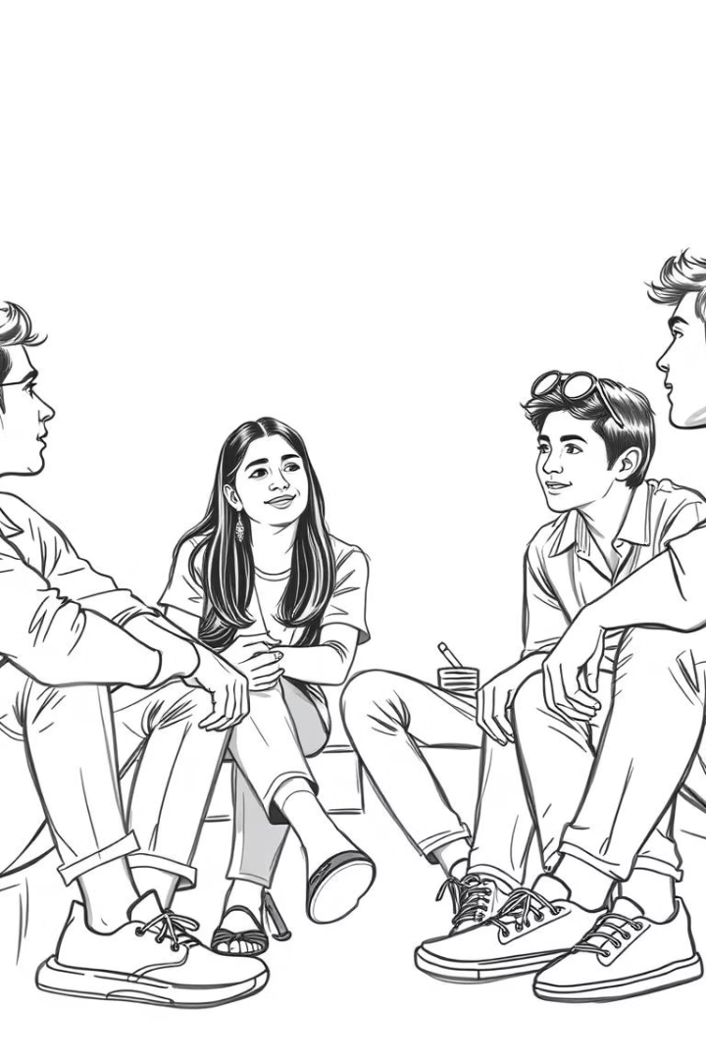
Is This Program Right for You?
12th Science Passed
Interest in Psychology
Preferably PCB stream, seeking alternatives to MBBS or engineering.
Want to help people with a career-ready course, not just theory.
Career Focused
Looking for real clinical impact and job readiness.

Slide 3
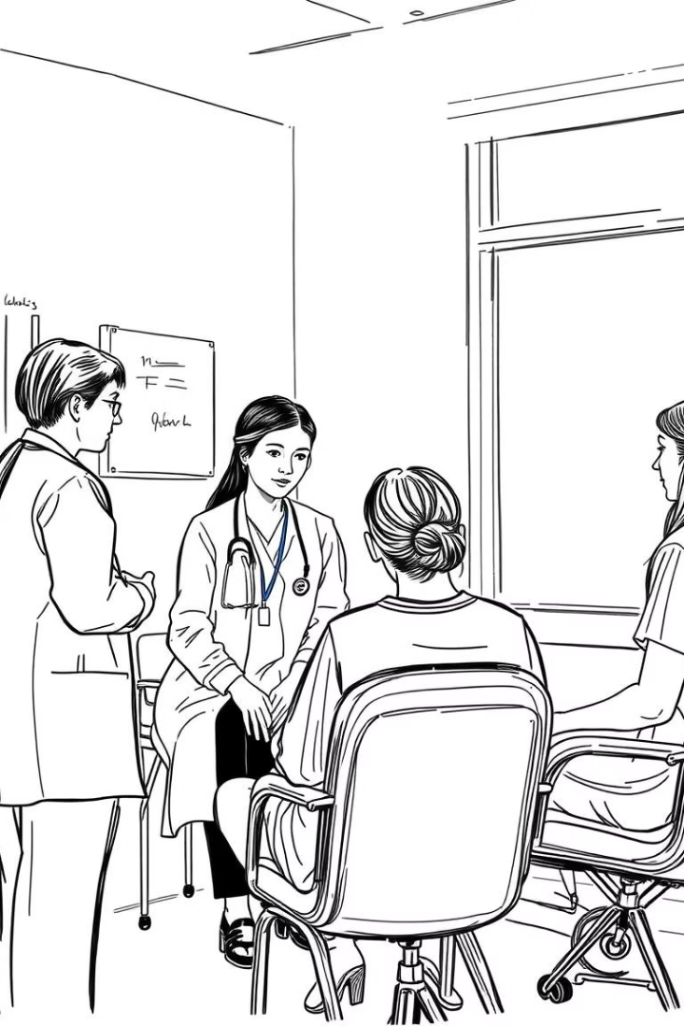
Program Highlights
RCI-Approved
India’s only UG psychology program with clinical licensure.
Start Clinical Work Year 1
Training in hospitals, schools, rehab centres, and NGOs.
Licensed Clinical Assistant
Graduate as a nationally certified clinical assistant (RCI).
Affordable Fees
₹90,000 per year with loan facility available.

Slide 4
Who Should Apply?
12th Science Students
NEET Aspirants
Parents
Especially those from PCB stream seeking clinical careers.
Looking for a people-first alternative to medicine or engineering.
Seeking a stable, ethical, and job-ready career path for children.

Slide 5
What You’ll Learn
Clinical Foundations
Psychopathology, diagnostics, and psychological testing.
Counselling & Ethics
Skills for ethical mental health practice and patient care.
Field Practicum
Hands-on training in hospitals, schools, and NGOs.
Pharmacology Basics
Integrated mental health care knowledge.

Slide 6
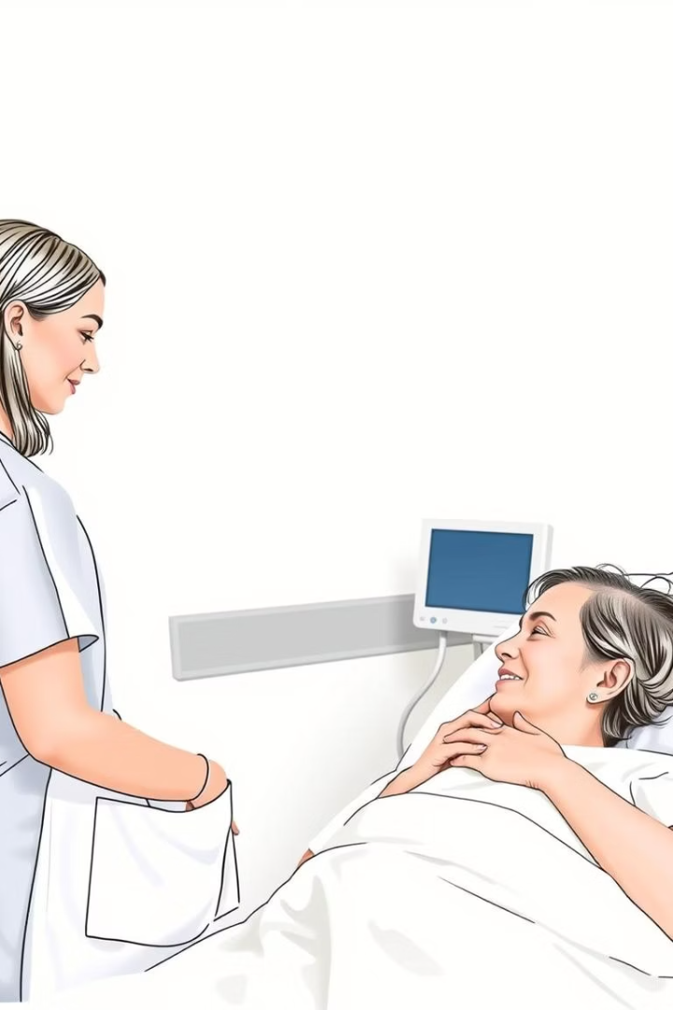
Career Outcomes
Clinical Assistant
Schools & NGOs
Advanced Studies
Work in psychiatric and mental health care teams.
Support mental health in educational and social settings.
Pursue M.Phil. Clinical Psychology or PsyD degrees.

Slide 7
Fees & Financial Aid
Loan Facility
2
Easy EMI and quick approval through partner banks.
Annual Fee
1
₹90,000 per year
3
Scholarships
Available based on merit and financial need.

Slide 8
Admissions & Contact
📲 +91 99992 12823 📲 +91 70110 08679 🌐 www.connaissancespecialist.com

