Slide 1





ENGLISH FLUENCY AND SELF-VALUE
ENGLISH LANGUAGE & CONFIDENCE COACH
Presented By:
CARINE ANGELE TANG
www.ndalcommunications.site

Slide 2



Program Guide
Speak with Confidence: English Fluency and Self-Value for Health Professionals
Duration: 12 Weeks
Level: Intermediate → Expert
Instructor Role: English Language & Confidence Coach

Slide 3


Program Approach
This program blends language mastery and personal development to create confident, articulate, and self-assured communicators in the health field.
  3 sessions per week (90 minutes each
  2 English Fluency sessions
  1 Confidence & Self-Value sessions
  Emphasis on speaking, listening, and reflective practice
  Continuous feedback and self-assessment

Slide 4

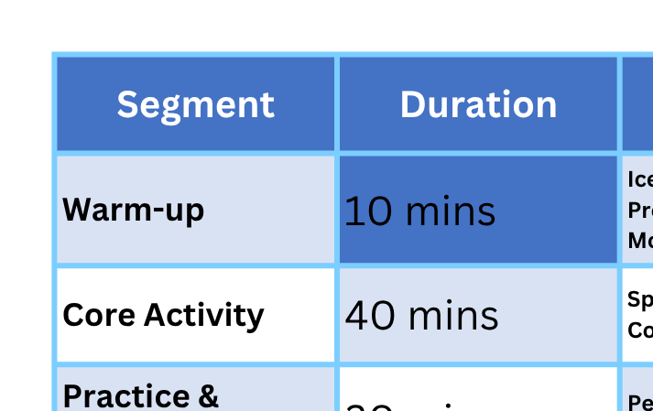

SESSION STRUCTURE TEMPLATE
Each session (90 mins) follows this rhythm:

Slide 5

WEEK 1
FOUNDATION: COMMUNICATION AND CONFIDENCE AWARENESS
WEEK-BY-WEEK TRAINER GUIDE

Slide 6


WEEK I. FOUNDATION: COMMUNICATION AND CONFIDENCE AWARENESS
  English Objective: Establish fluent speech routines and basic healthcare dialogues.
  Confidence Objective: Build awareness of personal strengths and communication patterns
SESSIONS
  Session 1 (English): Pronunciation warm-up (minimal pairs), “Introduce yourself as a health worker.”
  Session 2 (English): Role-play – patient introduction and comfort.
  Session 3 (Confidence): Activity – “Who am I?” (short sharing of personal journeys). Group reflection – “What confidence means to me.”
Tools: Zoom, M. Teams, Google Meet (for recording introductions)
Assignment: 1-minute self-introduction video.
Outcome: Learners identify their communication style and confidence baseline.
WWW.NDALCOMMUNICATIONS.COM

Slide 7

WEEK 2
EXPRESSING CLEARLY AND LISTENING ACTIVELY
WEEK-BY-WEEK TRAINER GUIDE

Slide 8
WEEK II. EXPRESSING CLEARLY AND LISTENING ACTIVELY
  English Objective: Practice clarity, tone, and empathy in patient conversations.
  Confidence Objective: Develop strong body language and posture.
SESSIONS
  ·English 1: Listening & repeating real doctor-patient dialogues (BBC / YouTube).
  ·English 2: Paraphrasing practice: “How to explain treatment clearly.”
  ·Confidence 1: Body language workshop – posture, gestures, eye contact. “Presence Walk” exercise (students walk and speak with authority).
Assignment: Record a 3-minute dialogue practicing empathy and clarity.
Tools: Speechling, YouGlish
Outcome: Clearer speech and confident physical presence.
WWW.NDALCOMMUNICATIONS.COM

Slide 9

WEEK 3
OVERCOMING FEAR OF SPEAKING
WEEK-BY-WEEK TRAINER GUIDE

Slide 10
WEEK III. OVERCOMING FEAR OF SPEAKING
  English Objective: Improve spontaneous speaking and pronunciation of medical terms.
  Confidence Objective: Manage nervousness and fear of public speaking.
SESSIONS
  ·English 1: “Describe this medical process” mini-speeches (blood test, vaccination, etc.)
  ·English 2: Pronunciation of medical vocabulary (audio comparison and repetition).
  ·Confidence 1: Mindset coaching: identifying personal fears. Breathing & visualization exercise before speaking.
Assignment: Record short “patient education” video.
Tools: Flip, Elsa Speak
Outcome: Reduced anxiety; improved control under pressure.
WWW.NDALCOMMUNICATIONS.COM

Slide 11

WEEK 4
STORYTELLING IN HEALTHCARE
WEEK-BY-WEEK TRAINER GUIDE

Slide 12

WEEK IV. STORYTELLING IN HEALTHCARE
  English Objective: Use storytelling for empathy and impact.
  Confidence Objective: Share personal experiences confidently.
SESSIONS
  English 1: Storytelling structure (hook, conflict, resolution).
  English 2: Practice: Tell a story about helping a patient.
  Confidence 1: “My proudest moment” presentation. Peer feedback and positive reinforcement.
Assignment: 2-minute storytelling video.
Tools: Canva (for visual story aids), Flip
Outcome: Emotional connection through speech.
WWW.NDALCOMMUNICATIONS.COM

Slide 13

WEEK 5
PROFESSIONAL VOCABULARY & POSITIVE SELF-TALK
WEEK-BY-WEEK TRAINER GUIDE

Slide 14
WEEK V. PROFESSIONAL VOCABULARY & POSITIVE SELF-TALK
  English Objective: Learn advanced healthcare collocations and idioms.
  Confidence Objective: Build self-belief and reprogram negative thoughts
SESSIONS
  English 1: Vocabulary drills (Quizlet).
  English 2: Debate: “Is technology replacing human touch in healthcare?”
  Confidence 1: Exercise: Write 5 affirmations starting with “I am…” Group discussion: “How language shapes
Assignment: Debate reflection journal.
Tools: Quizlet, Padlet
Outcome: Confident, purposeful communication.
WWW.NDALCOMMUNICATIONS.COM

Slide 15
WEEK 5
PROFESSIONAL VOCABULARY & POSITIVE SELF-TALK
WEEK-BY-WEEK TRAINER GUIDE

Slide 16
WEEK V. PROFESSIONAL VOCABULARY & POSITIVE SELF-TALK
  English Objective: Learn advanced healthcare collocations and idioms.
  Confidence Objective: Build self-belief and reprogram negative thoughts
SESSIONS
  English 1: Vocabulary drills (Quizlet).
  English 2: Debate: “Is technology replacing human touch in healthcare?”
  Confidence 1: Exercise: Write 5 affirmations starting with “I am…” Group discussion: “How language shapes
Assignment: Debate reflection journal.
Tools: Quizlet, Padlet
Outcome: Confident, purposeful communication.
WWW.NDALCOMMUNICATIONS.COM

Slide 17
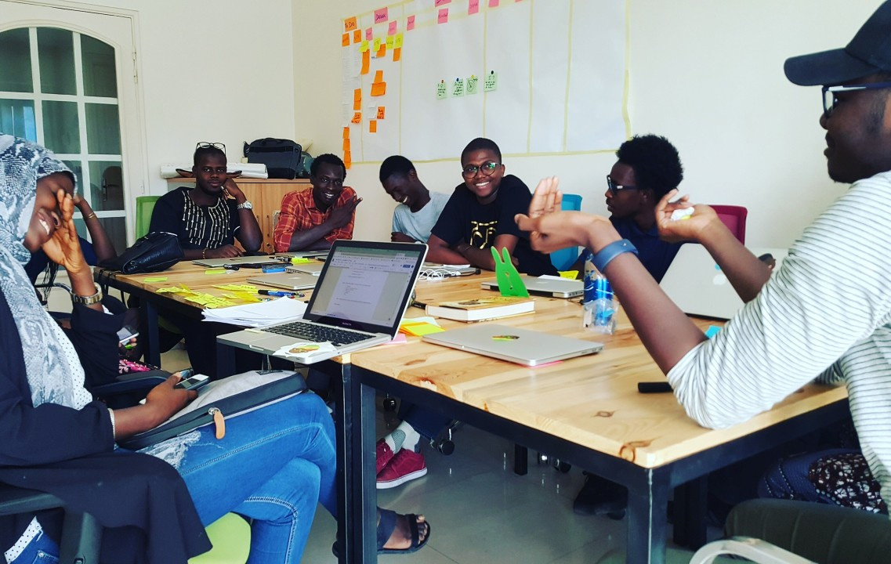
WEEK 7
PRESENTING WITH IMPACT
WEEK-BY-WEEK TRAINER GUIDE

Slide 18
WEEK VII. PRESENTING WITH IMPACT
  English Objective: Learn structure and delivery of professional presentations.
  Confidence Objective: Develop stage presence and projection.
SESSIONS
  English 1: Presentation structure (intro-body-conclusion).
  English 2: Practice: Present a health campaign.
  Confidence 1: Voice training (projection, pitch control). Visualization exercise before performance.
Assignment: 3-minute recorded presentation.
Tools: PowerPoint, Zoom recording
Outcome: Professional, composed presentation delivery.
WWW.NDALCOMMUNICATIONS.COM

Slide 19
WEEK 8
PERSUASIVE & LEADERSHIP COMMUNICATION
WEEK-BY-WEEK TRAINER GUIDE

Slide 20
WEEK VIII. PERSUASIVE & LEADERSHIP COMMUNICATION
  English Objective: Develop argumentation and persuasion skills.
  Confidence Objective: Communicate like a leader.
SESSIONS
  English 1: Persuasive speech practice (health advocacy topics).
  English 2: Mock “health meeting” scenario.
  Confidence 1: Exercise: “Leading the discussion.” Reflection: “Leadership through communication.”
Assignment: Group health policy debate.
Outcome: Learners project authority, empathy, and leadership.
WWW.NDALCOMMUNICATIONS.COM

Slide 21
WEEK 9
HANDLING PRESSURE
WEEK-BY-WEEK TRAINER GUIDE

Slide 22
WEEK IX. HANDLING PRESSURE
  English Objective: Speak fluently in emergencies and high-pressure situations.
  Confidence Objective: Stay calm under stress.
SESSIONS
  ·English 1: Emergency communication drills (“Code Blue” simulation).
  ·English 2: Quick response challenge: summarizing patient needs.
  ·Confidence 1: Breathing techniques under pressure. “From Panic to Power” reflection.
Tools: Role-play kits, audio scripts
Outcome: Controlled speech under stress.
WWW.NDALCOMMUNICATIONS.COM

Slide 23
WEEK 10
ACCENT POLISHING & SELF-REFLECTION
WEEK-BY-WEEK TRAINER GUIDE

Slide 24
WEEK X. ACCENT POLISHING & SELF-REFLECTION
  English Objective: Refine accent and natural rhythm.
  Confidence Objective: Reconnect with inner voice and identity.
SESSIONS
  English 1: Shadowing native speakers (YouGlish or Speechling).
  English 2: Mimic health talk show or TED Talk.
  Confidence 1: Mirror talk exercise. Self-reflection journal: “Who I’ve become.”
Outcome: Enhanced fluency and self-awareness.
WWW.NDALCOMMUNICATIONS.COM

Slide 25

WEEK 11
TEAM COMMUNICATION & COLLABORATION
WEEK-BY-WEEK TRAINER GUIDE

Slide 26
WEEK XI. PERSUASIVE & LEADERSHIP COMMUNICATION
  English Objective: Communicate effectively in medical teams.
  Confidence Objective: Build trust and collaboration skills.
SESSIONS
  English 1: Group role-play: nurse–doctor–patient handover.
  English 2: Case discussion simulation.
  Confidence 1: Giving and receiving constructive feedback. Trust circle activity: affirming teammates’ strengths.
Outcome: Team synergy and interpersonal confidence
WWW.NDALCOMMUNICATIONS.COM

Slide 27
WEEK 12
EMPOWERMENT AND PERFORMANCE
WEEK-BY-WEEK TRAINER GUIDE

Slide 28
WEEK XII. EMPOWERMENT AND PERFORMANCE
  English Objective: Deliver a final professional presentation or speech.
  Confidence Objective: Reflect and celebrate transformation.
SESSIONS
  English 1: Final presentation preparation.
  English 2: Public speaking showcase.
  Confidence 1: Vision statement: “My confident professional future.” Celebration & group affirmation session.
  Presentation (30%)
  Growth journal (20%)
  Participation (30%)
  Self-assessment + peer feedback (20%)
Final Evaluation
WWW.NDALCOMMUNICATIONS.COM

Slide 29
Trainer’s Materials
  Facilitation Tools:
  Zoom / Teams for live sessions
  Flip for video assignments
  Google Classroom for organization
  Padlet or Miro for reflections
2. Facilitation Tools:
  BBC Learning English, TED Talks, YouTube health talks
  Quizlet (custom health vocabulary sets)
  Speechling / Elsa Speak for pronunciation

Slide 30
Add-Ons
  Guest speaker (health professional who speaks internationally)
  Weekly podcast summaries or film discussions
  End-of-program certificate and portfolio presentation
Duration: 12 Weeks
Level: Intermediate → Expert
Instructor Role: English Language & Confidence Coach

Slide 31



THANK YOU
Expert
CARINE ANGELE TANG
CONTACT INFORMATION:
+237 695 852 644
info@ndalcommunications.site
www.ndalcommunications.site
Bertoua, Cameroon

