Slide 1


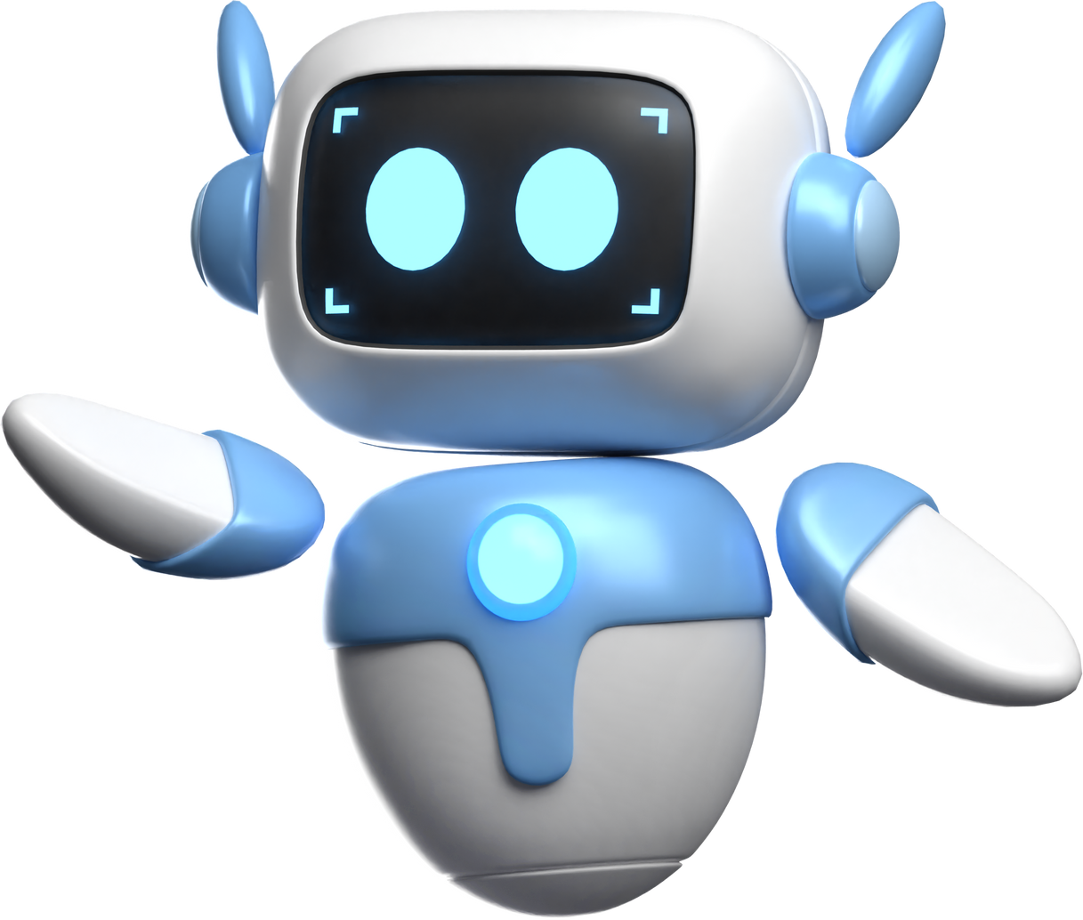

AI TOOLS
Chatbots and Prompting

Slide 2


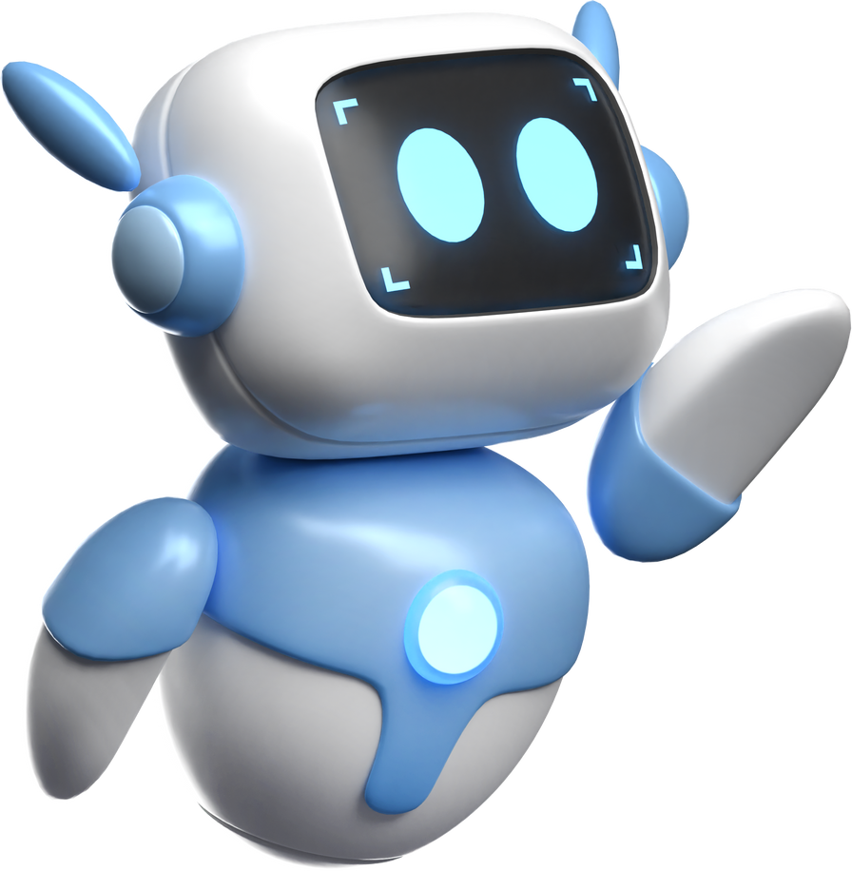
How to Create Precise Instructions

Slide 3


1
Step-by-Step Clarity
Bad Example:
Make a peanut butter sandwich. (Too vague—does not specify the steps.)
Good Example:
Place one slice of bread on a flat surface.
Open the peanut butter jar by twisting the lid counterclockwise.
2
Avoid sentences with two or more meanings
✗ Bad Example:
"Put peanut butter on the bread." (How much? Where exactly?)
✔ Good Example:
"Scoop 20 grams of peanut butter with the knife and spread evenly on one side of the first slice of bread."
Notes:
uzupelnic o przykłady

Slide 4
3
Use Actionable Commands
✗ Bad Example:
"Be careful when spreading." (What does “careful” mean for a machine?)
✔ Good Example:
"Hold the knife at a 20-degree angle and move it at 2 cm per second while spreading the peanut butter evenly."
4
Sequence Matters
✗ Bad Example:
"Spread peanut butter before opening the jar." (Impossible order)
✔ Good Example:
"First, open the peanut butter jar by twisting the lid counterclockwise. Then, scoop 20 grams of peanut butter with a knife and spread it on the bread."
Notes:
uzupelnic o przykłady

Slide 5



challenge
One perso will give detailed, step-by-step instructions on how to draw a simple image from
a provided paper. Their partner, partner can not see the image as well as the describing person can’t see what the other person is drawing . YOU HAVE TO GIVE CLEAR INSTRUCTIONS.

Slide 6

What is AI?
AI stands for Artificial Intelligence, and it refers to computer systems designed to perform tasks that normally require human intelligence. These tasks include recognizing speech, translating languages, making decisions, and even understanding context in conversations.
Notes:
What is AI?
Who here has used AI before? Can you name some examples?” (Wait for answers: Siri, Google Assistant, ChatGPT, etc.)
Think of AI as a really skilled chef. If you give it ingredients (data), it can make a variety of dishes (outputs). The better the ingredients, the tastier the dish!

Slide 7

KEY CHARACTERISTICS OF AI
Learning Ability: AI can learn from data and improve over time. (Youtube)
Pattern Recognition: AI can recognize patterns and make predictions. (Online shopping)
Automation of Tasks: AI can take over repetitive tasks, such as sorting emails or filtering spam messages
Problem-Solving Skills: AI can analyze large amounts of information and provide solutions.

Slide 8

Real-Life Applications of AI
Notes:
• Voice Assistants (e.g., Siri, Alexa, Google Assistant)
• Recommendation Systems (e.g., Netflix suggesting movies, Spotify creating playlists for you)
• Self-Driving Cars (e.g., Tesla using AI to navigate roads)
• Chatbots and Virtual Support (e.g., customer service bots helping answer FAQs)

Slide 9
challenge
In small groups, select a specific area where AI is currently being used. Research its applications, impact, and potential future developments. Prepare a brief but insightful presentation to share your findings with the group.

Slide 10
ChatBOts
and
turing test
Notes:
A human judge (the tester)
A human
A computer (AI)
The judge talks to both the human and the computer through text (like chatting online). The judge doesn’t know which one is which.
After a conversation, the judge must decide: Which one is the human, and which one is the computer?
If the computer fools the judge into thinking it's the human a significant number of times, then it passes the Turing Test—meaning it is (at least in that conversation) as intelligent as a human.
CHATGPT in 2022 has passed the turing test as a first chatbot in history

Slide 11

LLM ChatBOTS
ChatGPT
OPENAI - Complex task
claude
Anthropic - focus on privacy
Gemini
Google - Good integration with Google apps
Grok
X, Elon Musk - offering unfiltered answers
DEEPSEEK
Alibaba - free to use and cheaper API better for developers
copilot
Microsoft - good integration with microsoft office

Slide 12

What is prompting?
Notes:
A prompt is a command or question given to an AI system or chatbot. The way a prompt is structured determines the accuracy, depth, and relevance of the AI's response.
Why Are Prompts Important?
AI follows instructions literally; vague prompts can lead to incorrect or unhelpful responses.
Well-crafted prompts ensure you get accurate, relevant, and useful responses.
Good prompting saves time by reducing back-and-forth clarifications.
“Have you ever received a response from an AI that didn’t make sense? What do you think went wrong?” (Encourage discussion.)

Slide 13

HOW TO PROMPT WELL
1
Clarity and Specificity

Slide 14
1
Clarity and Sepcificity
AI performs best when given clear and precise instructions.
      Poor Prompt: “Tell me about history.”
      Better Prompt: “Provide a summary of World War II focusing on its causes and effects.”

Slide 15
HOW TO PROMPT BASICS
1
Clarity and Specificity
2
Contextualization

Slide 16
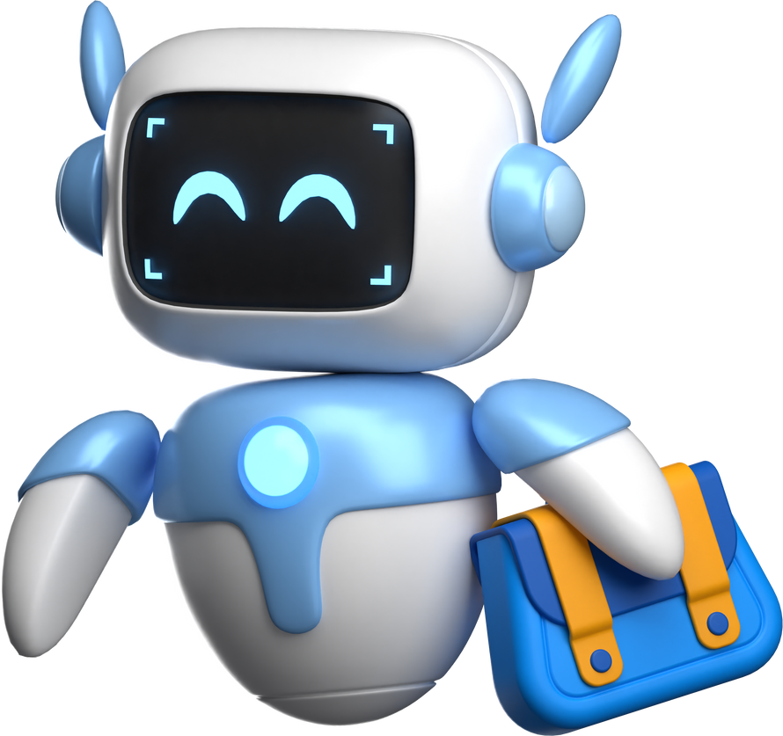
2
Contextualization
Providing background information helps AI tailor responses.
      Poor Prompt: “Translate this.”
      Better Prompt: “Translate this paragraph from English to French using informal language.”

Slide 17
HOW TO PROMPT BASICS
1
Clarity and specificity
2
Contextualization
3
Output format specification

Slide 18
3
output Format Specification
Specify what the ouput structure you want to get. (Bullet points, pdf document, csv etc)
      Poor Prompt: “Tell me about AI.”
      Better Prompt: “Explain AI in three bullet points for a beginner.”

Slide 19
HOW TO PROMPT BASICS
1
Clarity and specificity
2
Contextualization
3
Output format specification
4
Step-by-Step instructions

Slide 20
4
Step-by-Step Instructions
Breaking down requests ensures clarity.
      Poor Prompt: “How do I bake a cake?”
      Better Prompt: “List step-by-step instructions for baking a chocolate cake using simple ingredients.”

Slide 21
HOW TO PROMPT BASICS
1
Clarity and specificity
2
Contextualization
3
Output format specification
4
Step-by-Step instructions
5
Adding constraints or conditions

Slide 22
5
Adding constraints or conditions
Adding conditions helps control the scope of responses.
      Poor Prompt: “Give me a summary.”
      Better Prompt: “Summarize this article in 50 words or less.”

Slide 23


Prompting TRIcks
ROLE-BASED PROMPTING
CHAIN-OF-THOUGHT PROMPTING
FEW-SHOT LEARNING

Slide 24
Role-Based Prompting
You can assign a role to the AI to generate more specialized responses.
    Prompt: “You are a history professor. Explain the causes of the Cold War in a way that a high school student can understand.”
    Prompt Canvas on prompts.chat

Slide 25
Chain-of-Thought Prompting
Encouraging AI to explain its reasoning leads to more thoughtful responses. It’s simillar to step by step rule but know we are focusing of thought processing part.
    Prompt: “Explain the process of photosynthesis step by step, as if you were teaching a 10-year-old.”

Slide 26
Few-Shot Learning
Providing examples helps AI generate responses that match
a desired pattern.
    Prompt: “Here is a summary of an article: 'The economy is slowing down due to inflation.' Now summarize the following article in a similar way: [insert article]”

Slide 27
challenge
You will be given vague prompts. Your goal is to refine the prompts using the principles learned and later test your refined prompts on an AI chatbot (e.g., ChatGPT, Claude, or Gemini). At the end compare before-and-after responses and discuss the improvements.

Slide 28
ChatGPT
functionality
to do better prompts website
- promptperfect
Notes:
GPTs
DALLE
Ask him to correct your PROMPT
https://github.com/f/awesome-chatgpt-prompts
tell about perplexity

Slide 29


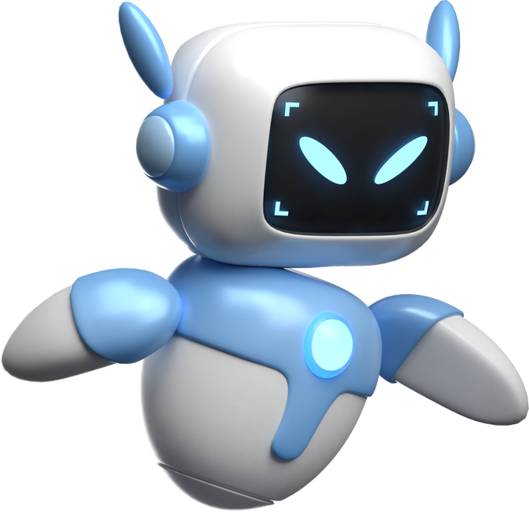
Throwbacks of LLM Chatbots
HALLUCINATION
PROMPT INJECTION ATTACK

Slide 30
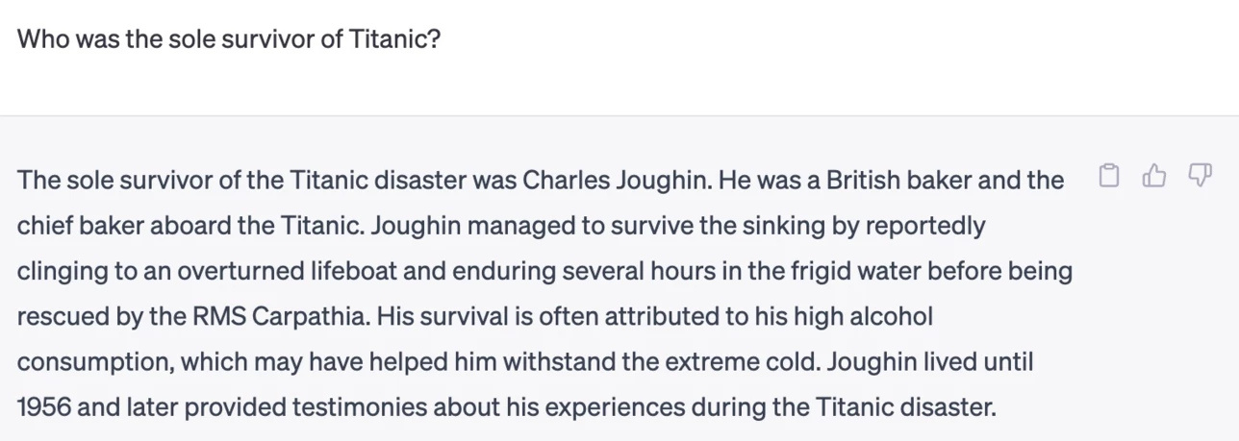
hallucination
In the world of AI, when an AI is lying, the experts call it hallucinating. For ChatGPT, it means giving false or misleading information, which makes it challenging to determine the accuracy and truthfulness of its responses. For example, I asked it to tell me who was the sole survivor of Titanic, despite knowing that over 700 people actually survived the catastrophe.
Once I asked it to provide sources, it immediately corrected itself.
source:flyingbisons.com

Slide 31
challenge
Use AI to design a structured life plan by defining clear goals, breaking them into milestones, and creating daily actions. Start with career, education, finances, personal growth, and life experiences. AI can suggest timelines, learning paths, networking strategies, and financial steps. Example: "I want to be a software engineer in 5 years." AI helps map skills, courses, and job applications. Use AI prompts for refining goals, tracking progress, and adjusting strategies. A structured roadmap turns dreams into achievable steps, making success predictable and manageable. To be more sufficient ask chat “aske me that many qeustion that you need to make this structed plan the most tailored to me”.🚀

Slide 32
UPLOAD YOUR CV AND TRY THIS PROMPTS
  Analyze my experience and find all the hidden patterns of success that I am not taking full advantage of.
  Find the gaps between my current competencies and what the market pays the most for in my profession.
  Analyze my experience and show all missed opportunities for monetisation.
  Find all the points on my resume that can be scaled up without extra time
*bonus one: Based on my CV and what you know about me, tell me how old you think I am?

Slide 33
Script to text app - Visla or Invideo

Slide 34
challenge
Brainstorm a topic that is currently the most captivating for you. Then, using prompting techniques via chatbot, generate a script for a short AI-generated video. Finally, use Visla to create the video based on the script.
VIDEO SEND TO hubertn0w4k@gmail.com

Slide 35
THANK YOU FOR ATTENTION
HUBERT NOWAK

