Slide 1

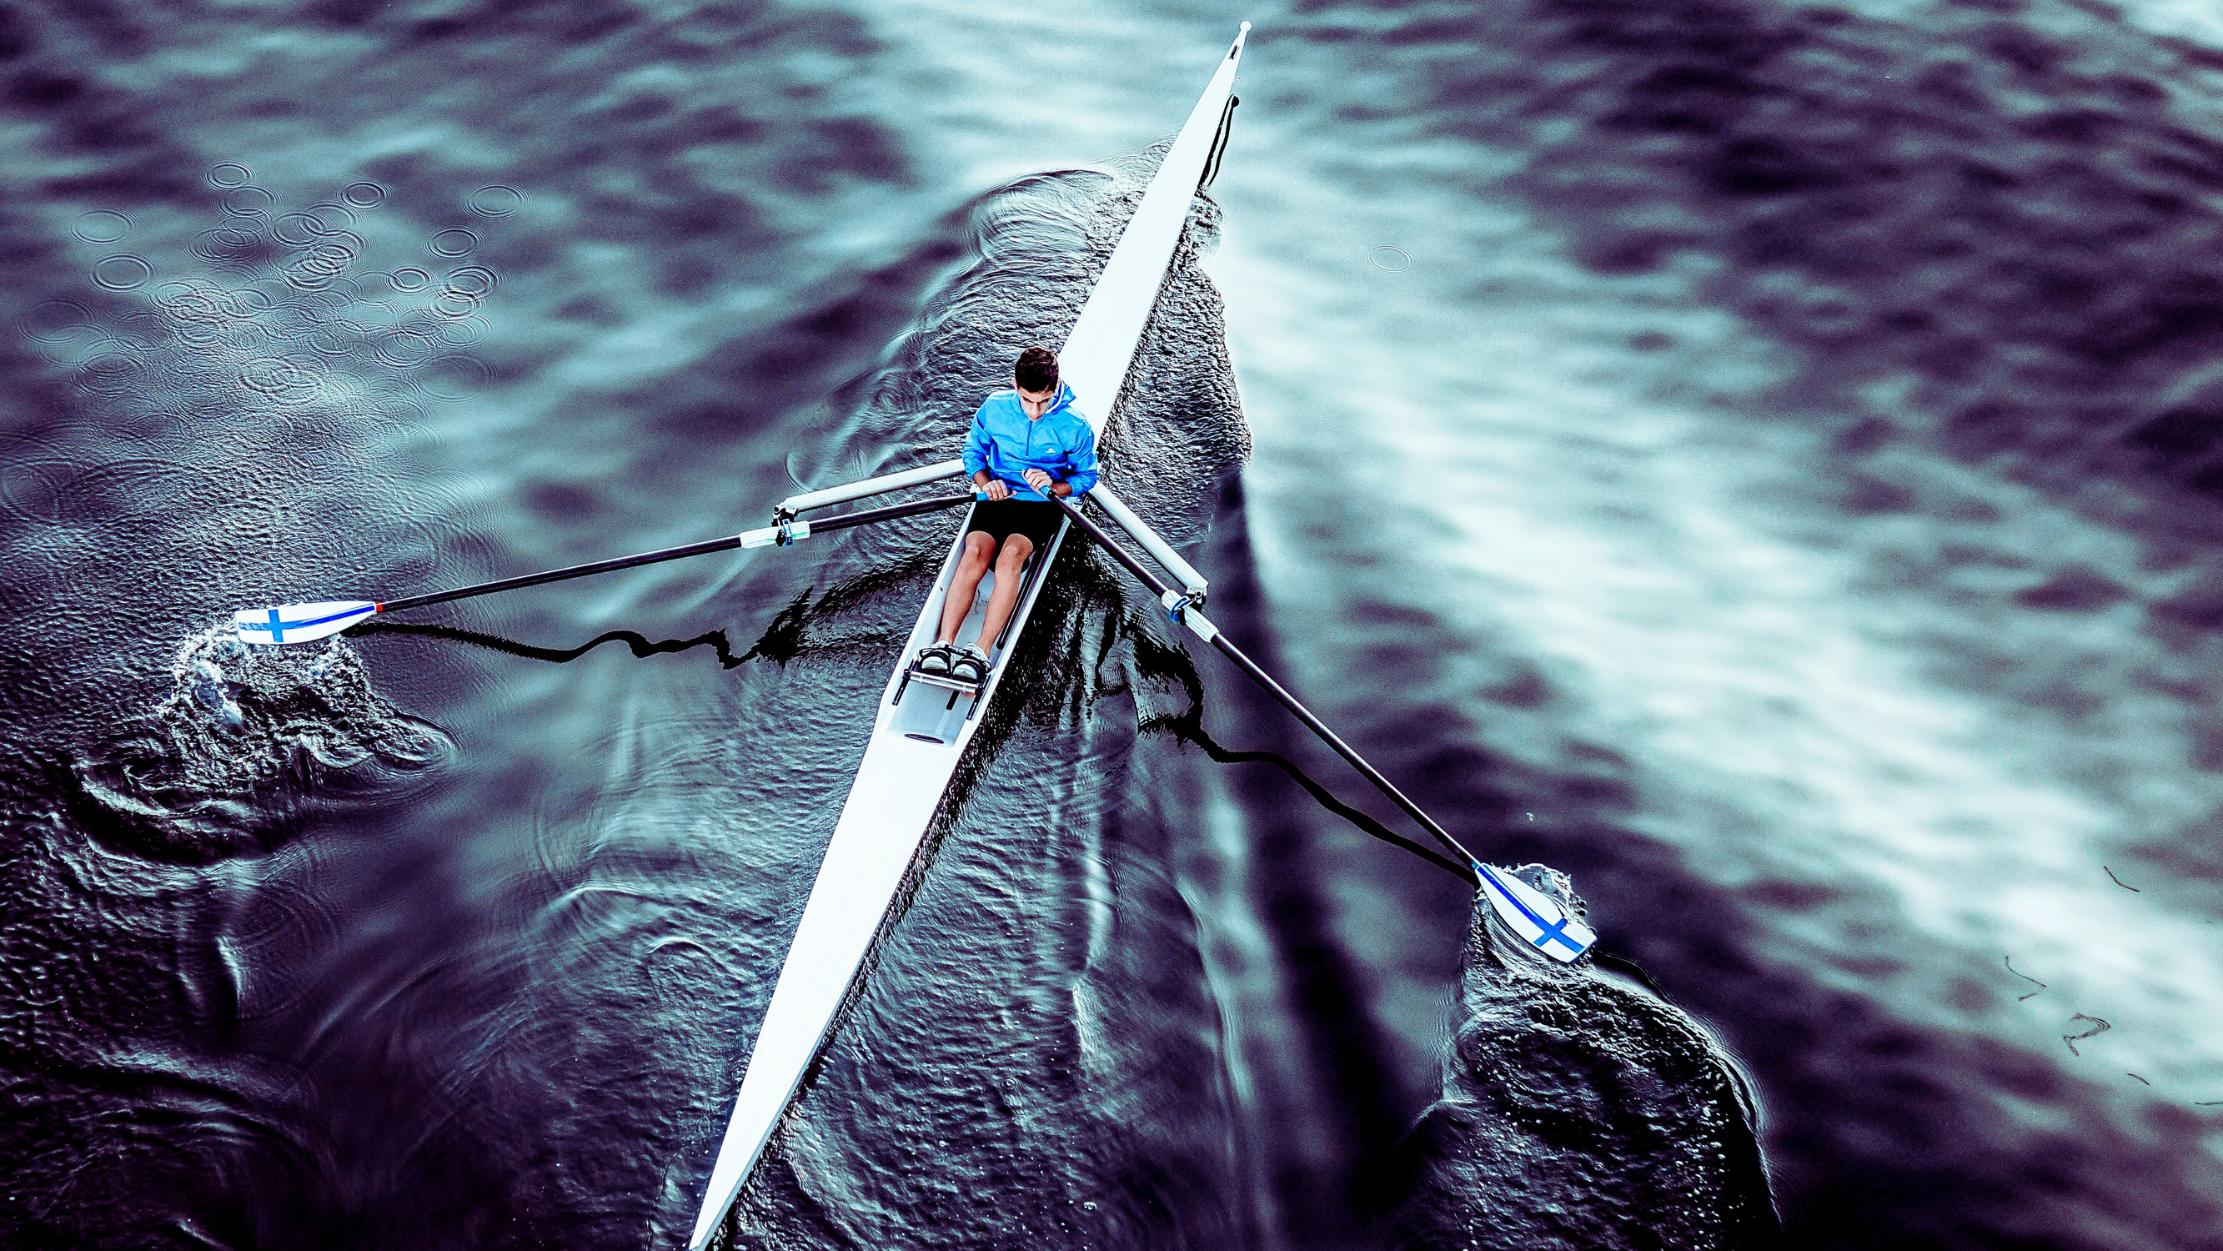

POTOMAC FALLS HIGH SCHOOL
INTEREST MEETING
January 2025

Slide 2
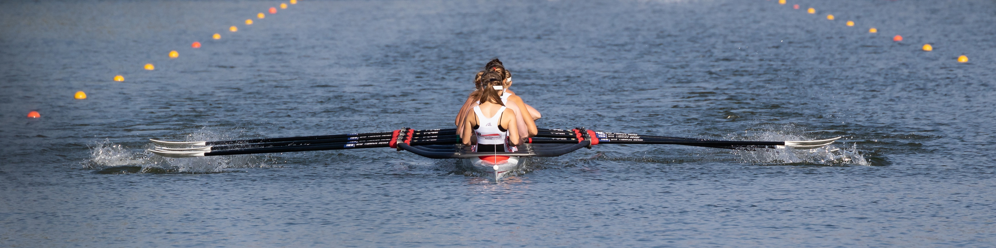
Welcome
AGENDA
Introductions
Club Overview & Goal
Board & Volunteers
Organizational Plans
About Rowing
Eligibility
Spring 2025 Season
Costs
Important Dates and Schedules
Q&A
Established Potomac Falls Crew Club (April 2024)

Slide 3
PFCC CLUB
Club Overview
Potomac Falls Crew Club is an approved 501(c) 3 nonprofit organization with the goal of expanding the sport of rowing and providing residents of the community with the opportunity to participate in club and compete at a High School level.
Established Potomac Falls Crew Club (April 2024)

Slide 4

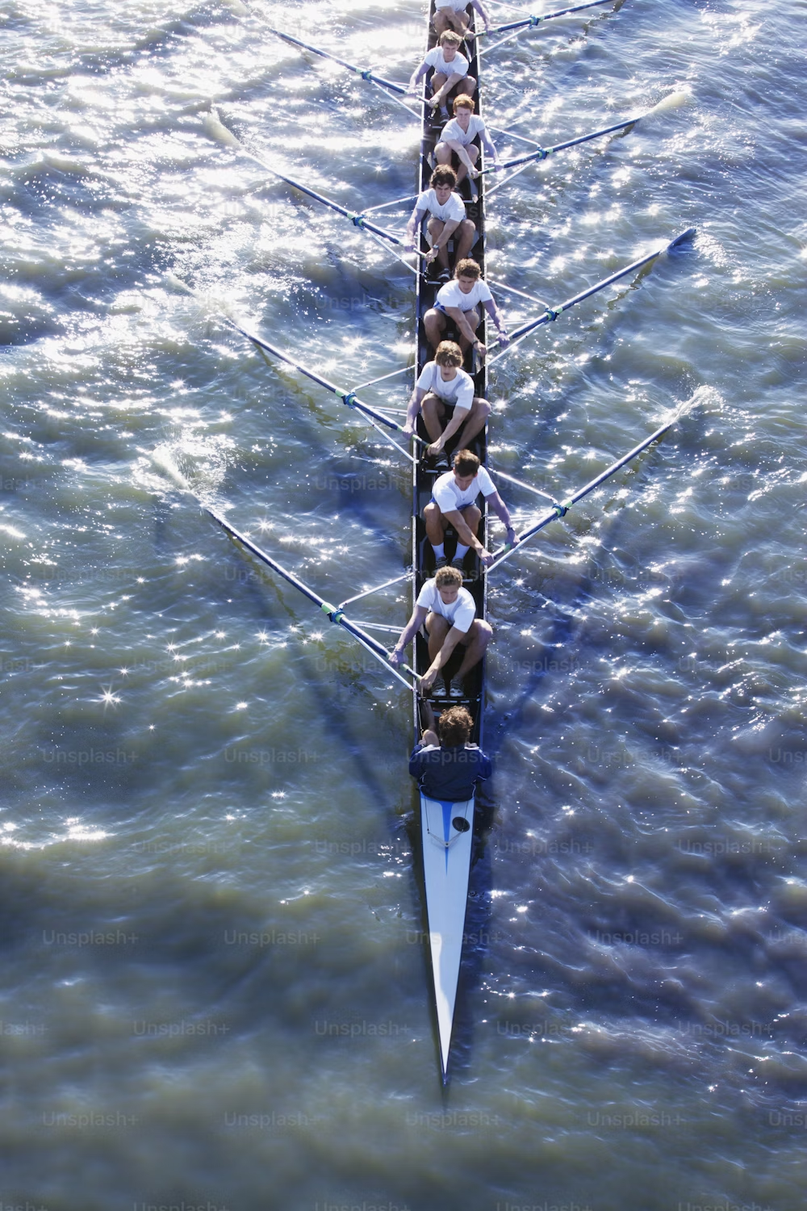


Our Goal
Establish the inaugural Potomac Falls High School Crew Team for Spring 2025 Season

Slide 5
Crew Board
Club Board
Coaches
Support
Ali Ibrahimi: Co-Founder & President
Khatera Panjshiri : Head Coach
PFHS Sponsor: Jennifer Blair
Khatera Panjshiri : Co-Founder & VP
Assistant Coach: Dean Ballew (TBD)
Registration/Volunteer Coordinator:
  Dean/Bonnie Ballew
Club Sponsor: TBD
Social Media Manager: Brenna Gordon
Hibe Kalfan: Secretary
Assistant Coach: Brenna Gordon (TBD)
Julie Flake: Treasurer
We need additional Support & Volunteers

Slide 6
Volunteers & Support
Role | POC
Communications | Open
Fundraising | Brenna Gordon/Dean Ballew
VASRA Volunteers | Open
Marketing | Open
Team Photographer | Open
Regatta Coordinator | Open
Events Support & Spirit wear | Open
We need additional Support & Volunteers

Slide 7
Plans – Organizationally
Establish Fundraising – PF Boosters, Corporate Sponsorships
Need to formalize a Parent organization (Board & Volunteers)– Please Sign-up!
Need to formalize a Student organization - (Recruiting, Communications, Logistics) – Please Sign-up!
  Grassroots support from students to recruit to establish enough athletes
Establish student athletes' participants (goal is 30+)
  Minimum 10 Boys & 10 Girls
  Recruitment – Middle School & grassroots HS

Slide 8
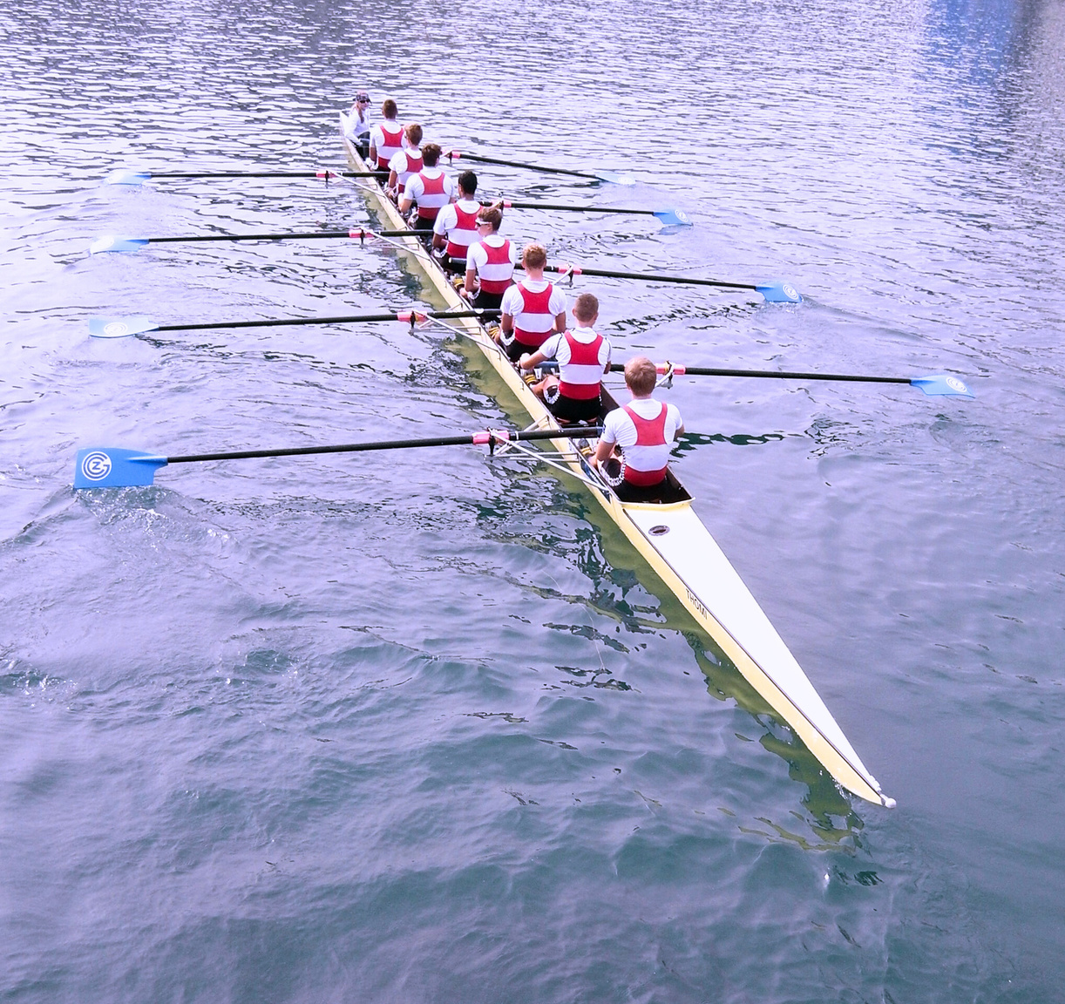
What is Rowing?
Rowing / Crew
  Crew is essentially “rowing” and a sport in which athletes race against each other on rivers & lakes. There are boats (called shells) of 4 or 8 rowers, spring season sport in High School, fall club rowing, & summer conditioning.
Benefits
Great Full Body Workout
Discipline & Focus
Teamwork & Community
High School Competitions
Looks great on College Resume
SUMMER& WINTER SEASONS
Students have opportunities to train and learn thru indoor conditioning.
FALL SEASON
Students compete as a Club with PFCC
SPRING SEASON
Students compete as Tier 3 Sport for PFHS
ROWING SEASONS

Slide 9
Rowing in Loudoun
03
Tier 3 Varsity Sport in Virginia
Require establishment of a Memorandum of Agreement (MOA) between HS and Club Team
20+
Larger Teams have over 60+ athletes
Initial Team of 20+ to begin rowing in the Spring 2025 Season (Goal of 30+)
08
High Schools with Rowing Teams:
  Broad Run HS
  Briar Woods HS
  Rock Ridge HS
  Stone Bridge HS
  Loudoun County HS
  Independence HS
  Riverside HS
  Freedom HS
Rowing at AlgonkianPark

Slide 10
Eligibility
All students welcome – no previous experience necessary .
Must pass swim test
We will hold learn to row sessions, training, & conditioning
Boys boats and Girls boats on the same team
Initial teams will only have one level
As program builds follow-on will include level Freshman, JV, Varsity

Slide 11
Spring 2025
Start Competing in Spring 2025
Ideally, we would like two 8 boats & two 4 boats (that’s 30+ on the team)
  At least one 4 boat and one 8 board
3-4 Regattas per season initially
Practice 3 times a week (times TBD)

Slide 12
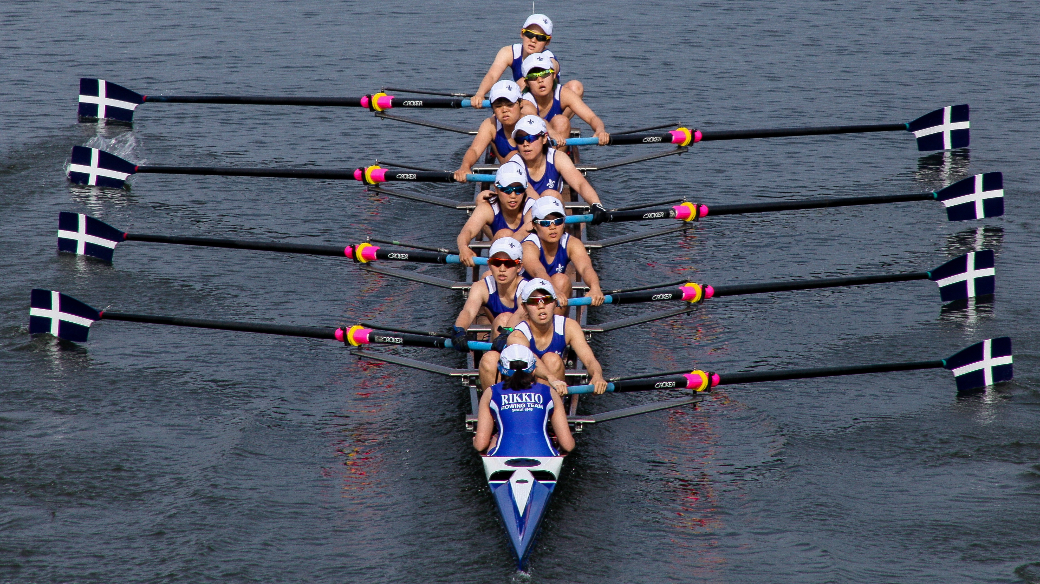
Rowing Cost & Commitment
Spring 2025 Season:
  High School Sport
  3-4 practices a week
  6-8 Regattas (Races)
  Annual dues for ($1250)
Fall 2025 Season:
  Club Sport
  Annual dues for Fall 2025 (TBD)

Slide 13
Important Dates & Steps
Date | Event
January 8 | Interest Meeting 1 – Sign-Up
February 1 | Team Registration Opens
February 28 | Final Payment Due
March 03 | First day of Practice
Next Steps
1. Athletic Registration Online Potomac Falls High School (PFHS)
2. Athletic Physical submitted to PFHS
3. Order Team Uniform
4. Swim Test before water practice starts
5. Join US Rowing online before practice starts

Slide 14
Spring 2025 Regatta Schedule
Date | Event
Sat 3/29/2025 | Walter Mess Regatta
Sat 4/5/2025 | Darrell Winslow Regatta
Sat 4/12/2025 | Ted Phoenix Regatta
Mon 4/14/2025 | LCPS Spring Break
Sat 4/26/2025 | Al Urquia Regatta
Sat 5/3/2025 | VSRCs Day 1 (State Championships)
Sat 5/10/2025 | VSRCs Day 2 (State Championships)
Sat 5/16-17/2025 * | Stotesbury Cup Philadelphia PA (not all boats)
Sat 5/23- 5/24/2025 * | SRAA National Championship
*Pending performance and rankings.

Slide 15
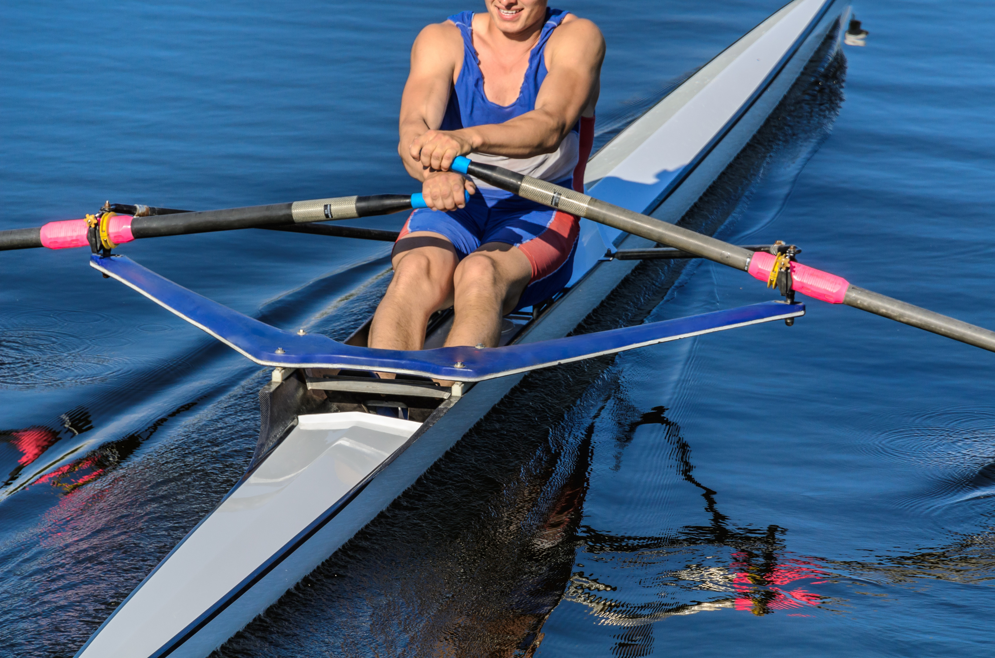
Questions?

Slide 16



Thank you
Contact Us
Khatera Panjsheri & Ali Ibrahimi
Potomac Falls Crew Club
703-593-4204 / 703-402-3924
pfcrew24@gmail.com
www.pfrowing.com (coming soon)

