Slide 1
GOOD MINDS
Interior & Exterior
PROPRITER : | CHIRANJIB PAL.
CVIL ENGINER | 34 YRS EXPERIENCE
CALL | 8777369247

Slide 2
OFFICE INTERIOR DESIGN
LAFARGE OFFICE
@
Chinar Park, New Town

Slide 3
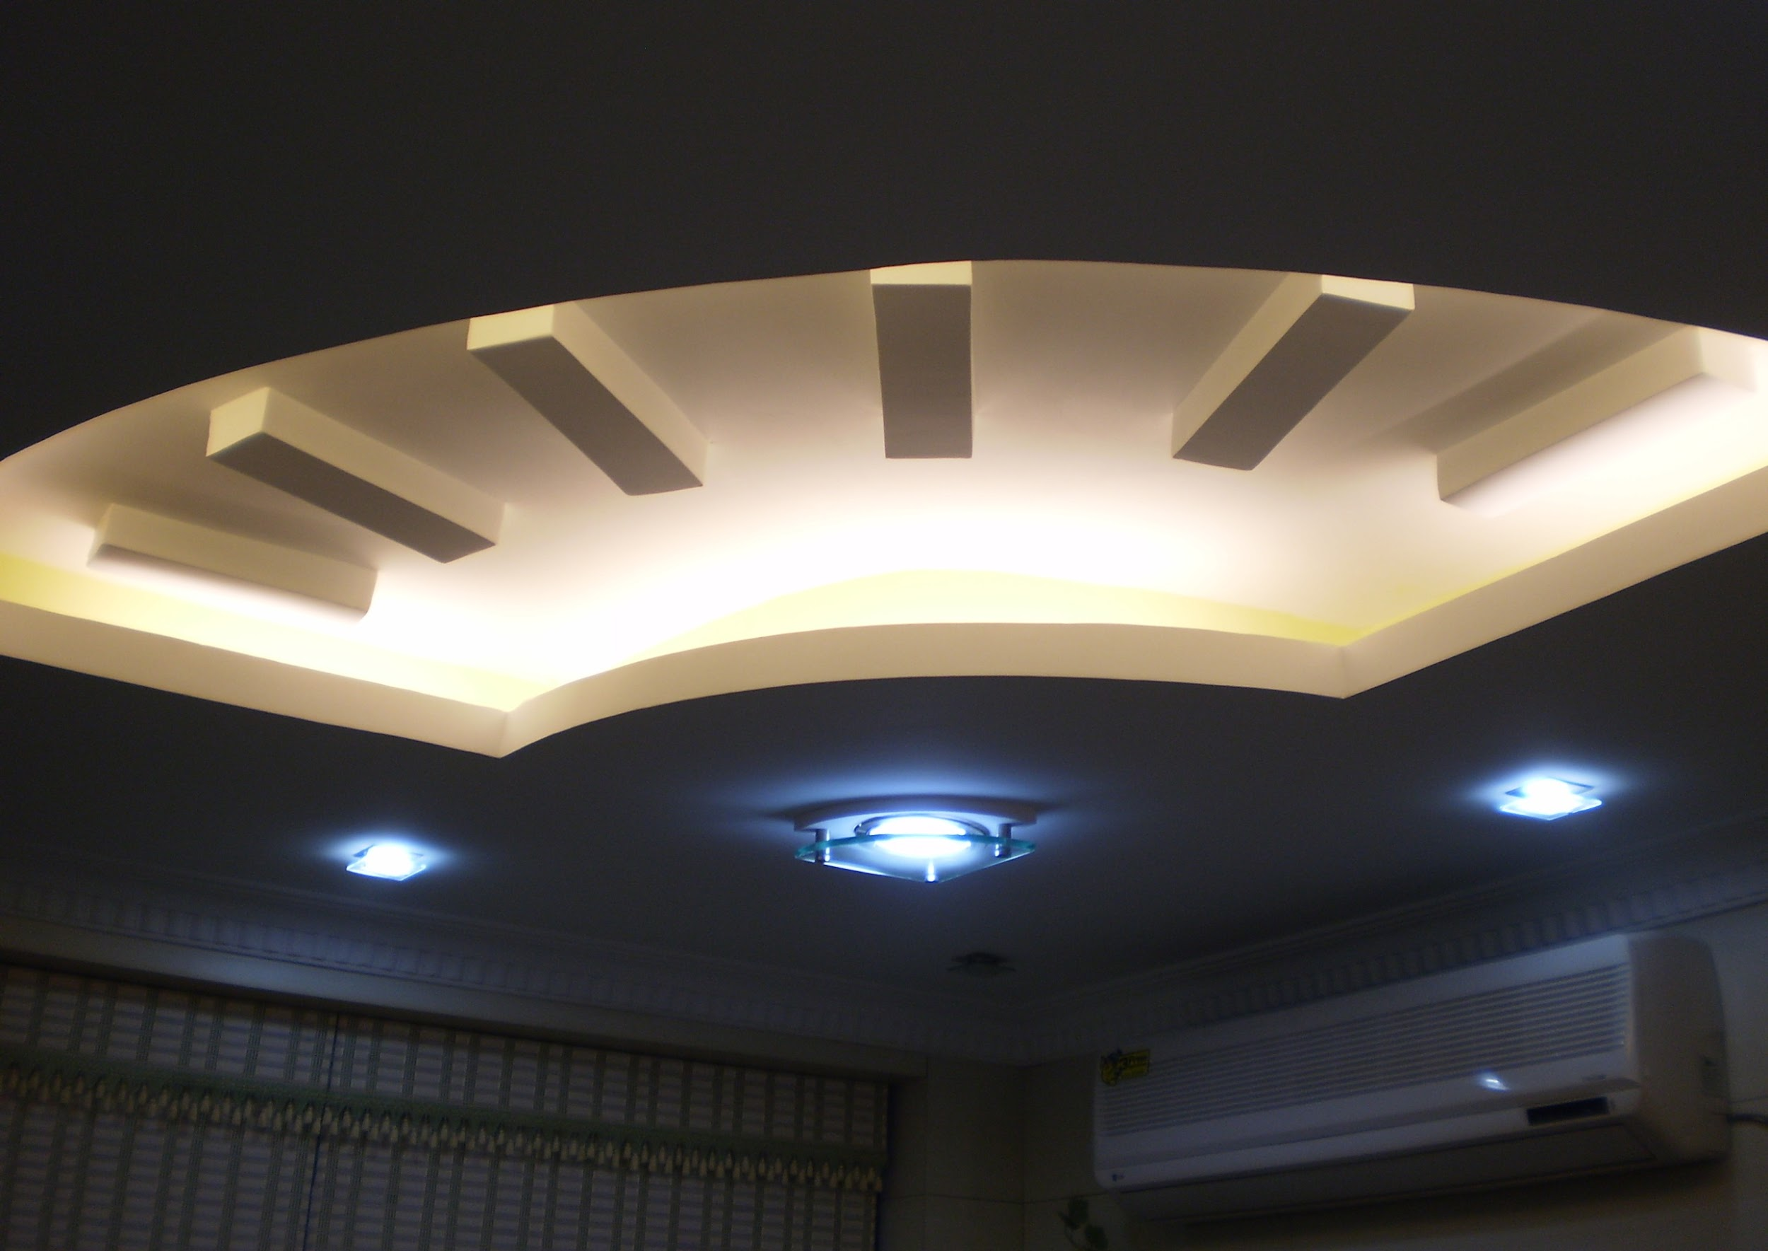
Lafarge Office at Chinar Park

Slide 4
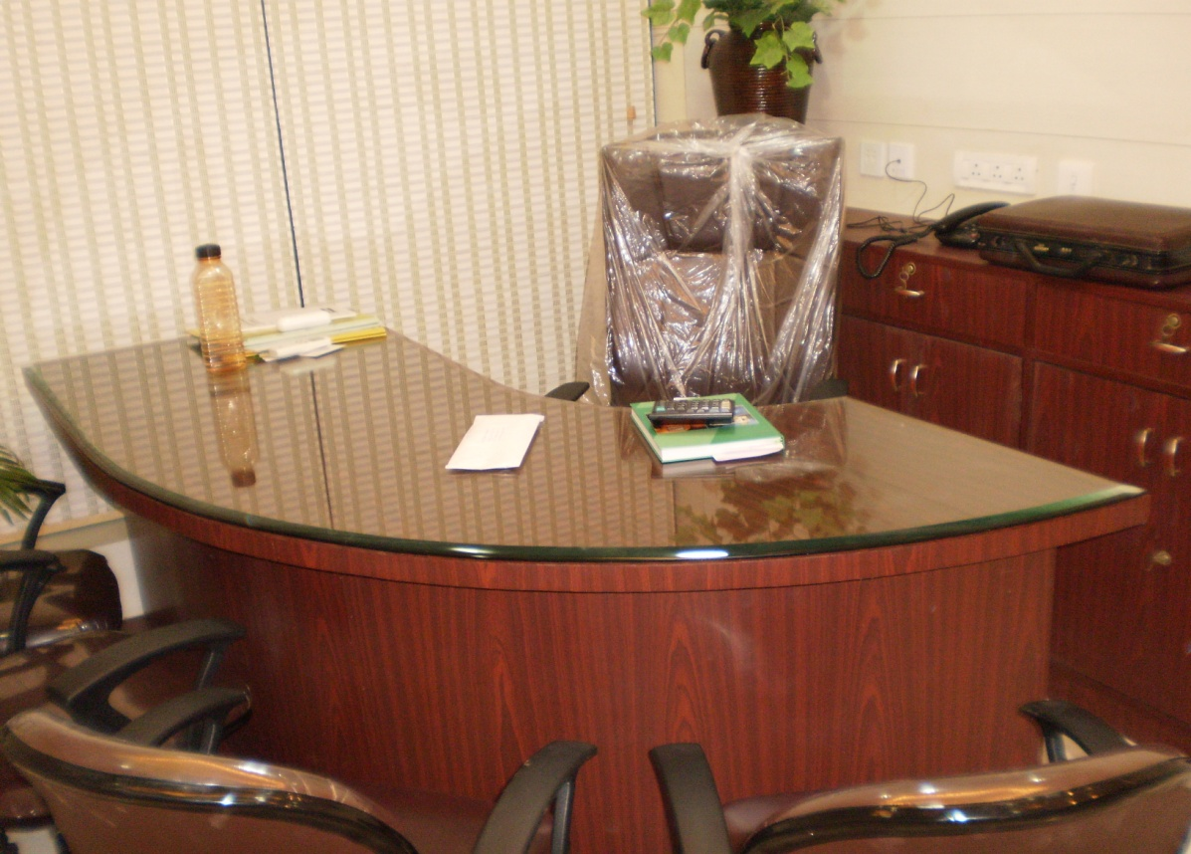
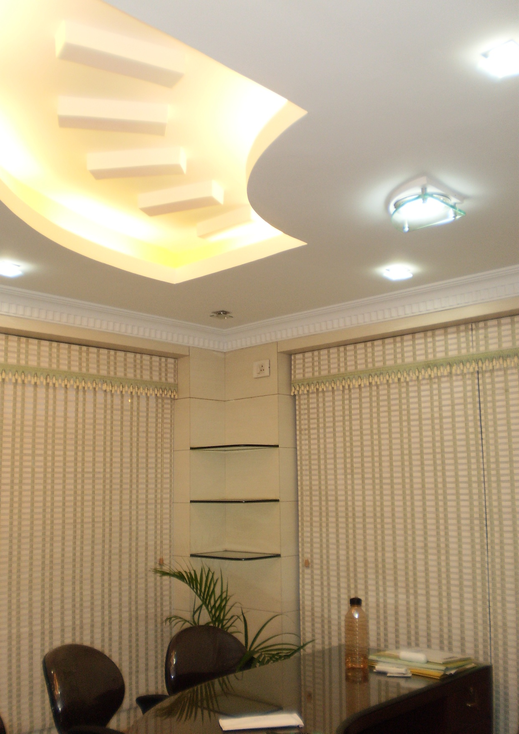
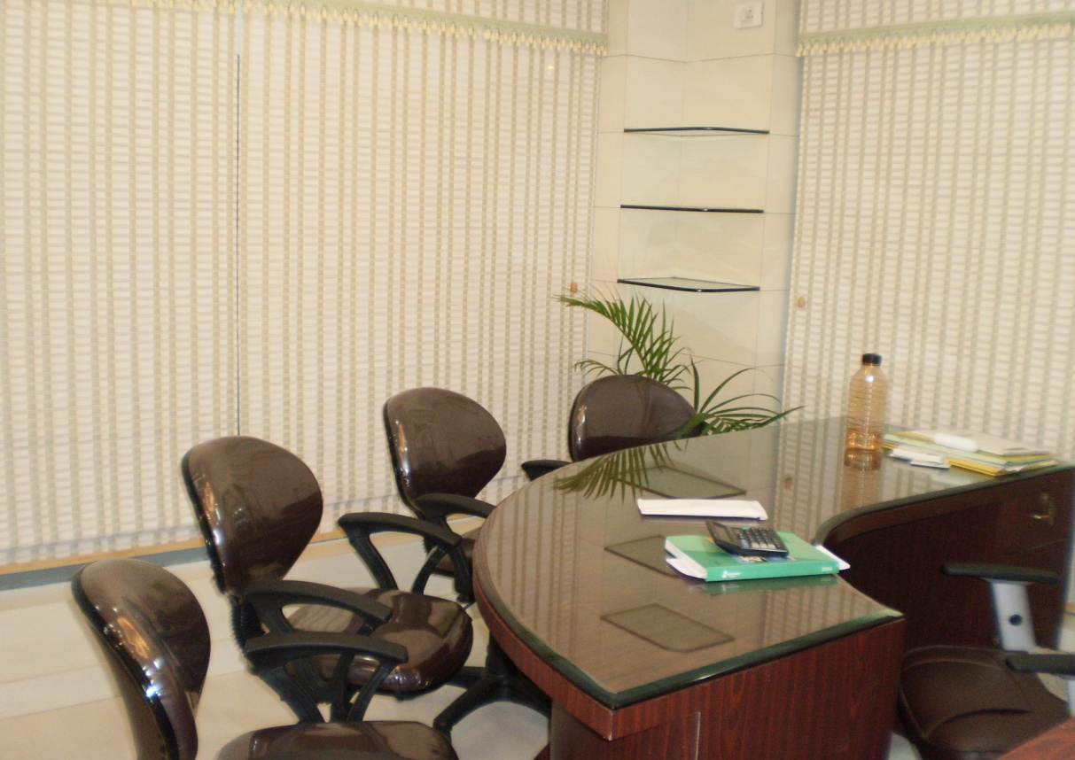
Lafarge Office at Chinar Park

Slide 5
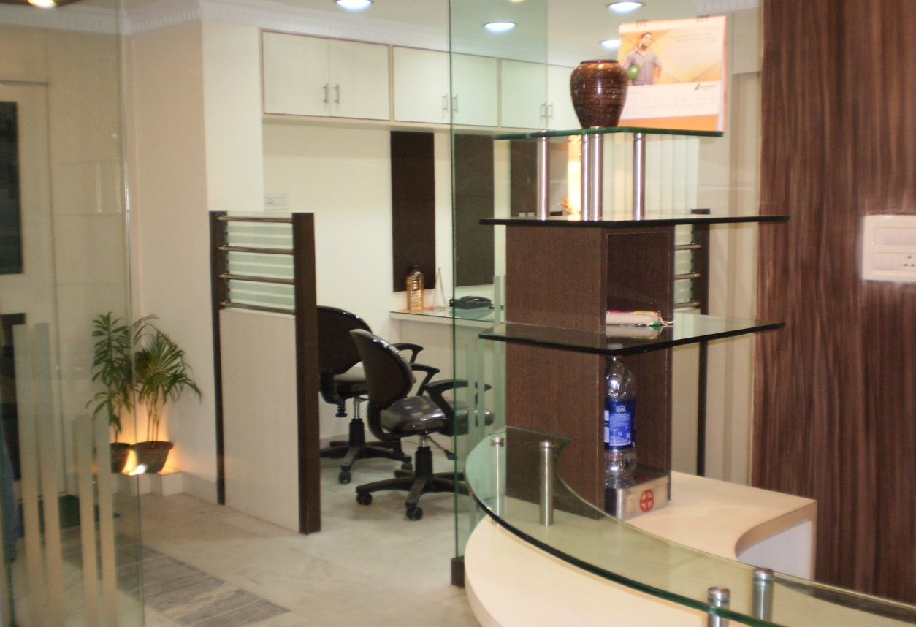
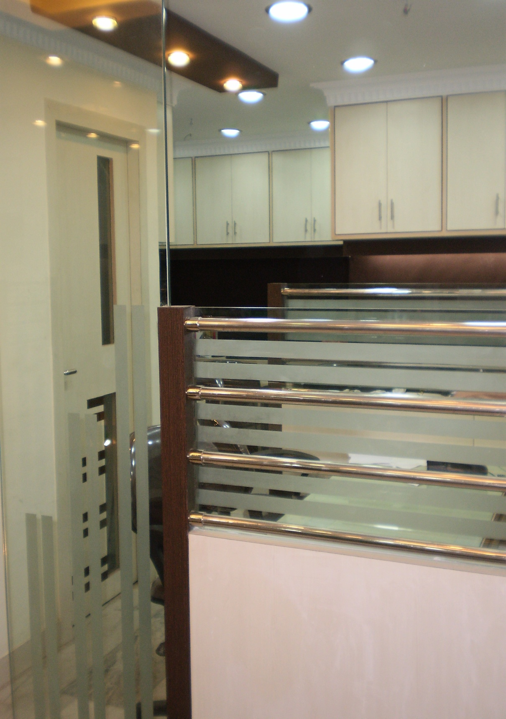
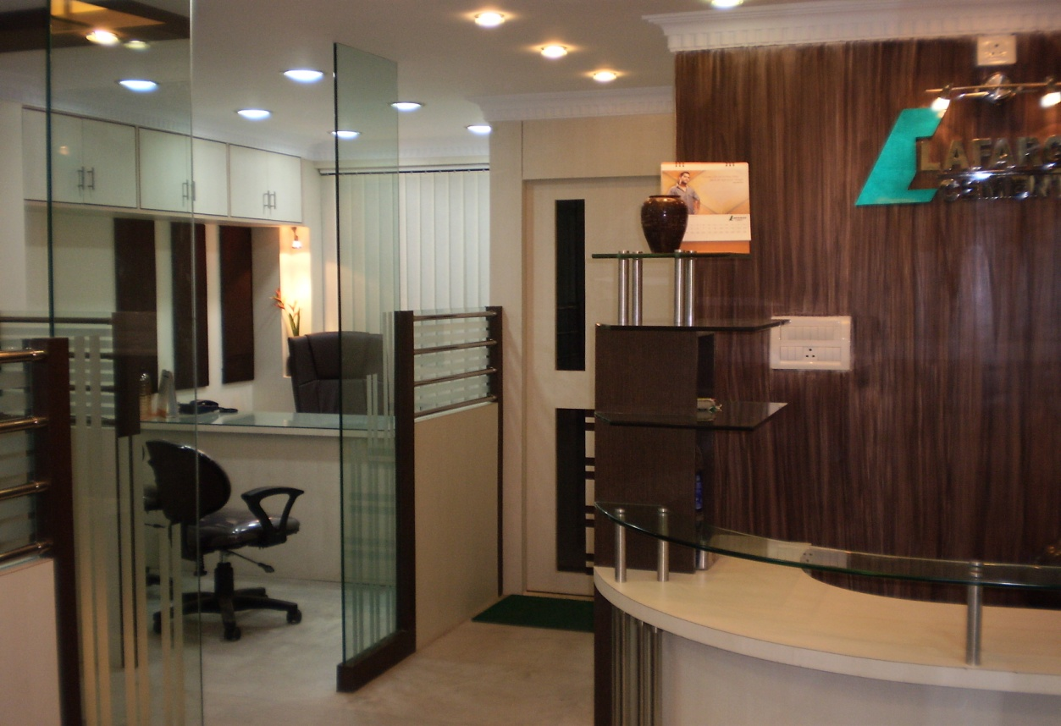
Lafarge Office at Chinar Park

Slide 6
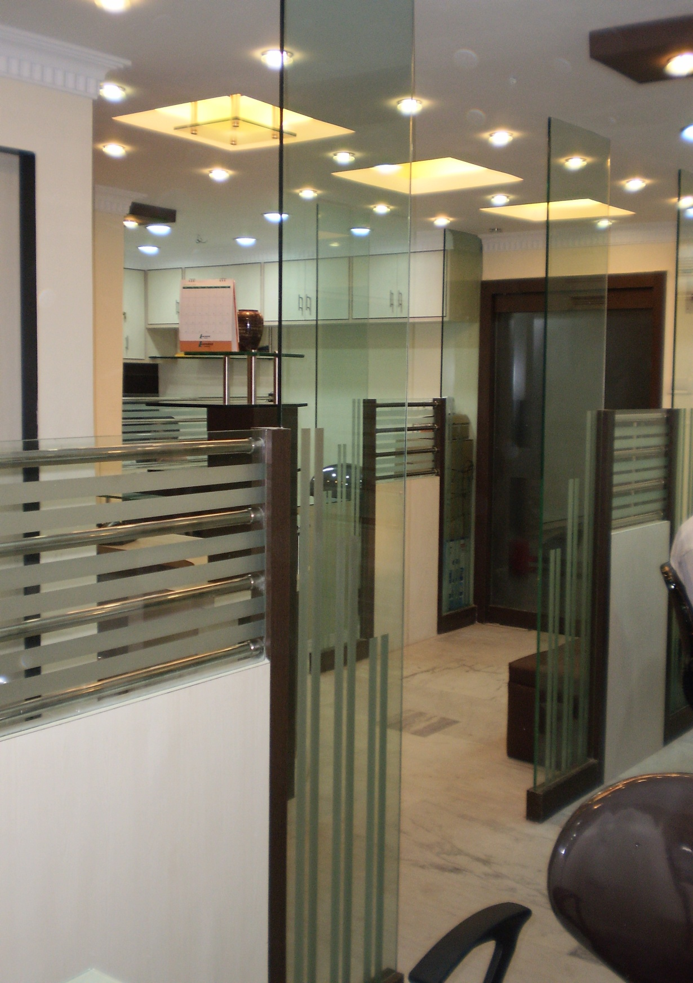
Lafarge Office at Chinar Park

Slide 7
OFFICE INTERIOR DESIGN
Pallishree Limited - Head office
@
Room-1205, Merlin Infinity Building, Sec-V, Salt Lake City

Slide 8
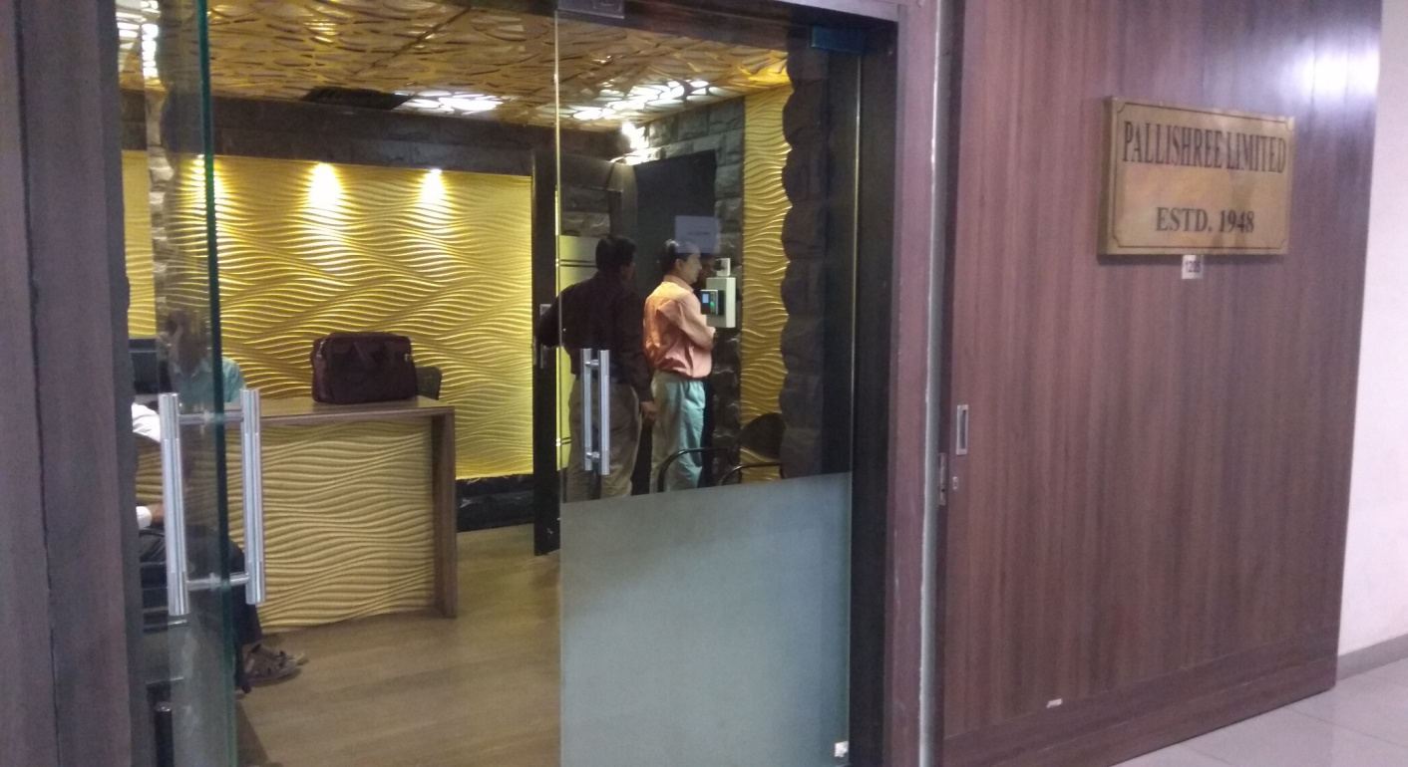
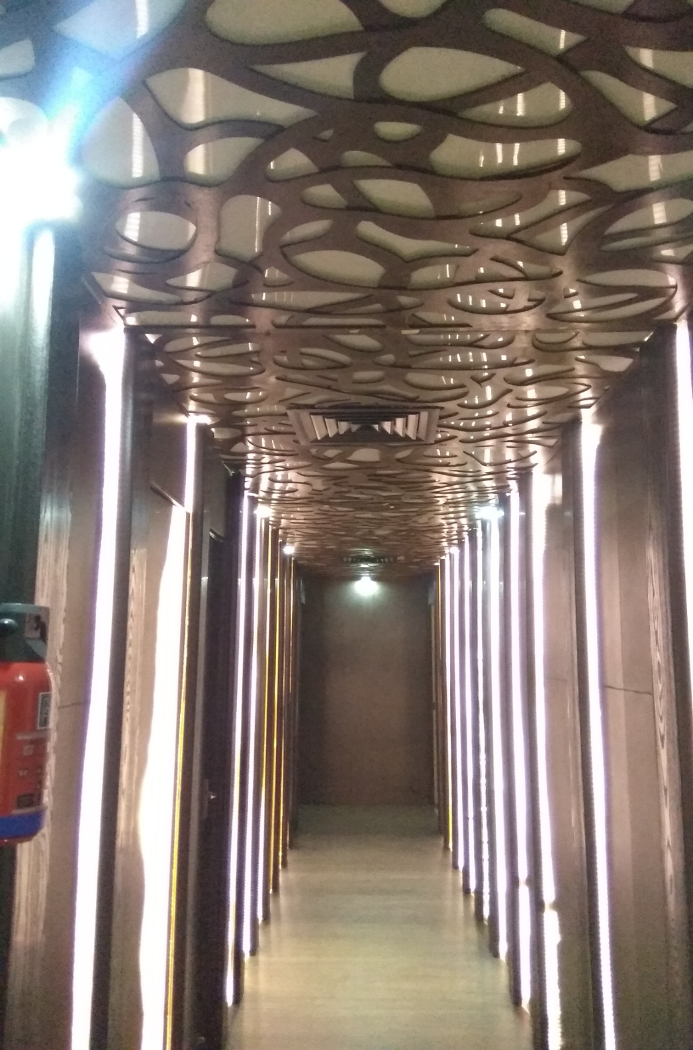
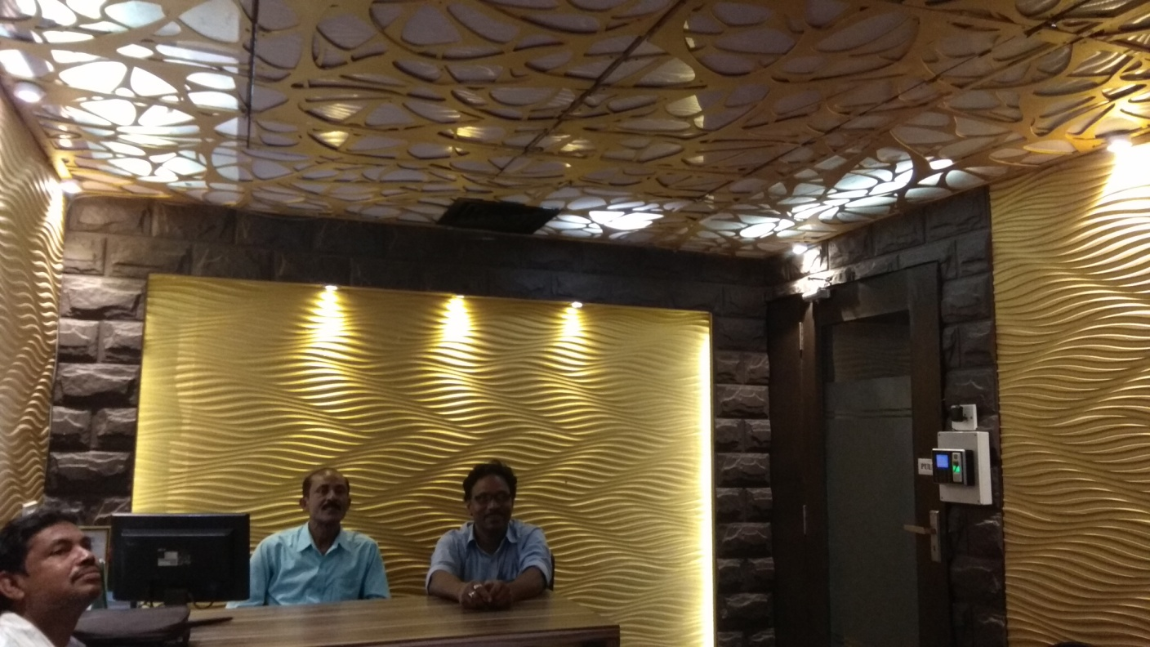
Pallishree Ltd., Head office, Merlin Infinity, Room-1205, Sec-V, Salt Lake

Slide 9
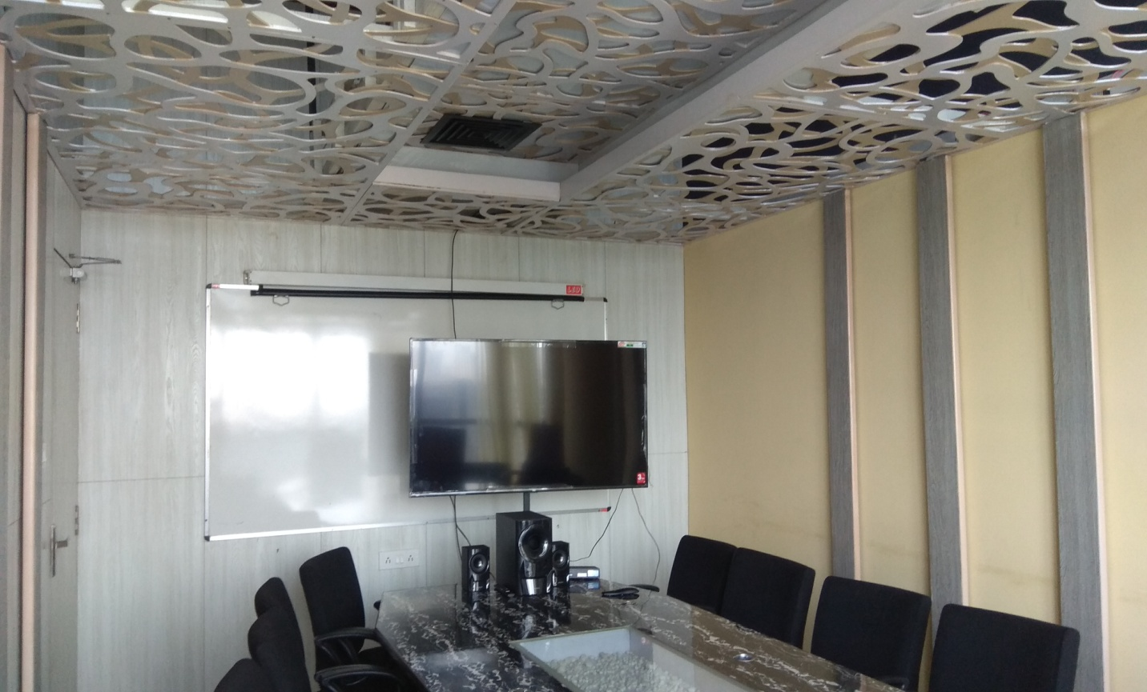
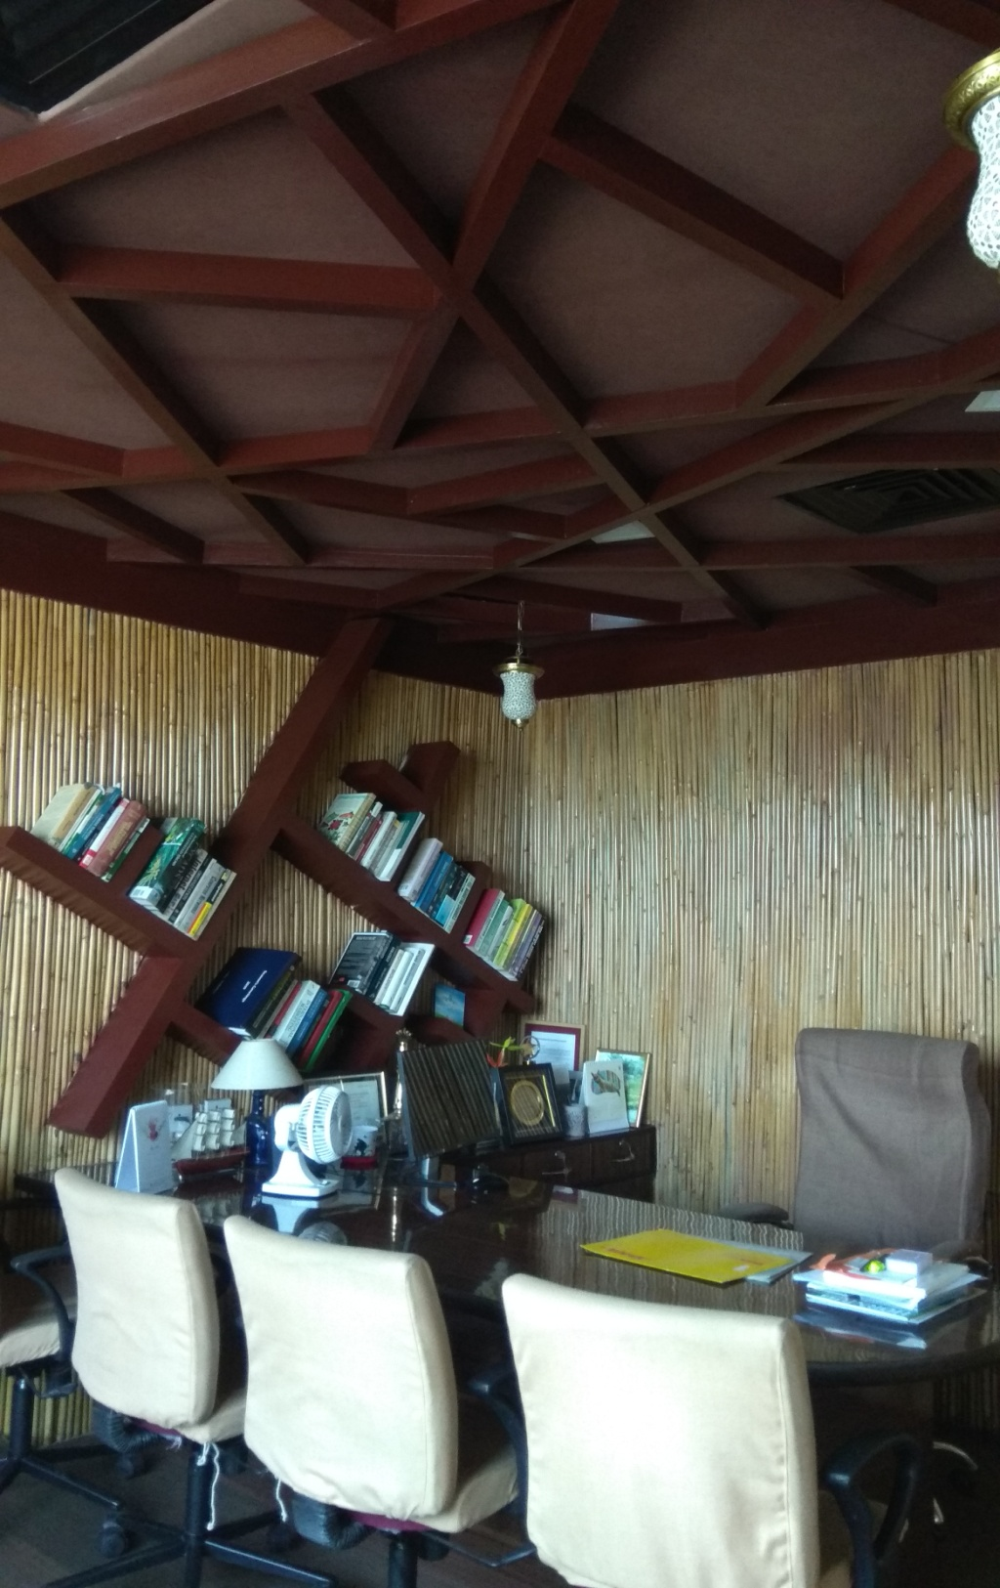
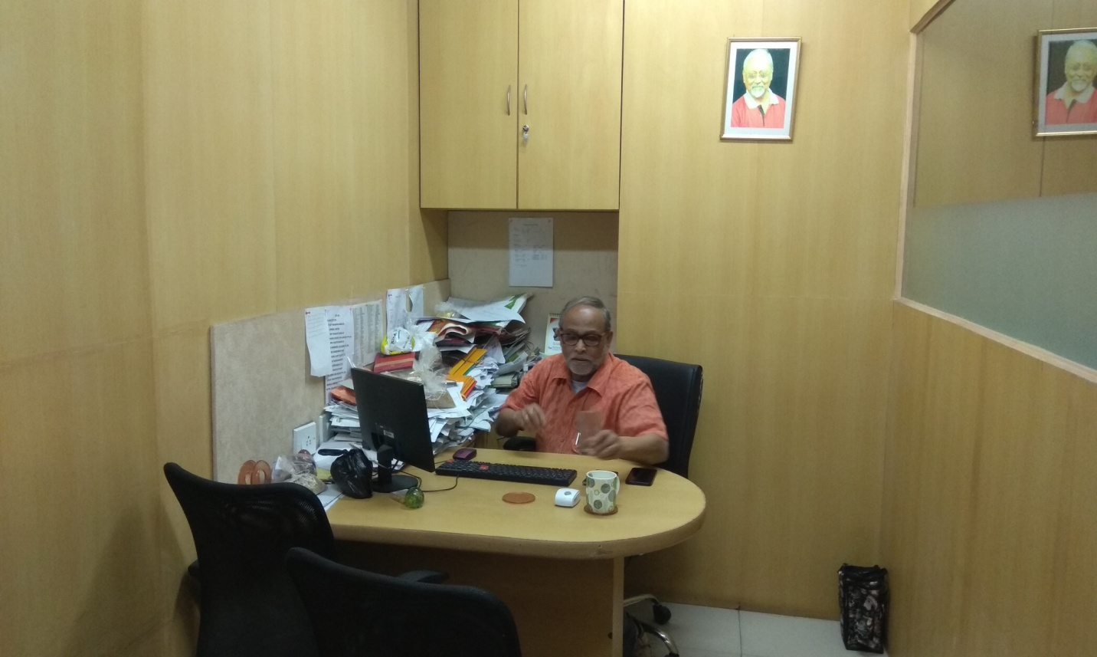
Pallishree Ltd., Head office, Merlin Infinity, Room-1205, Sec-V, Salt Lake

Slide 10
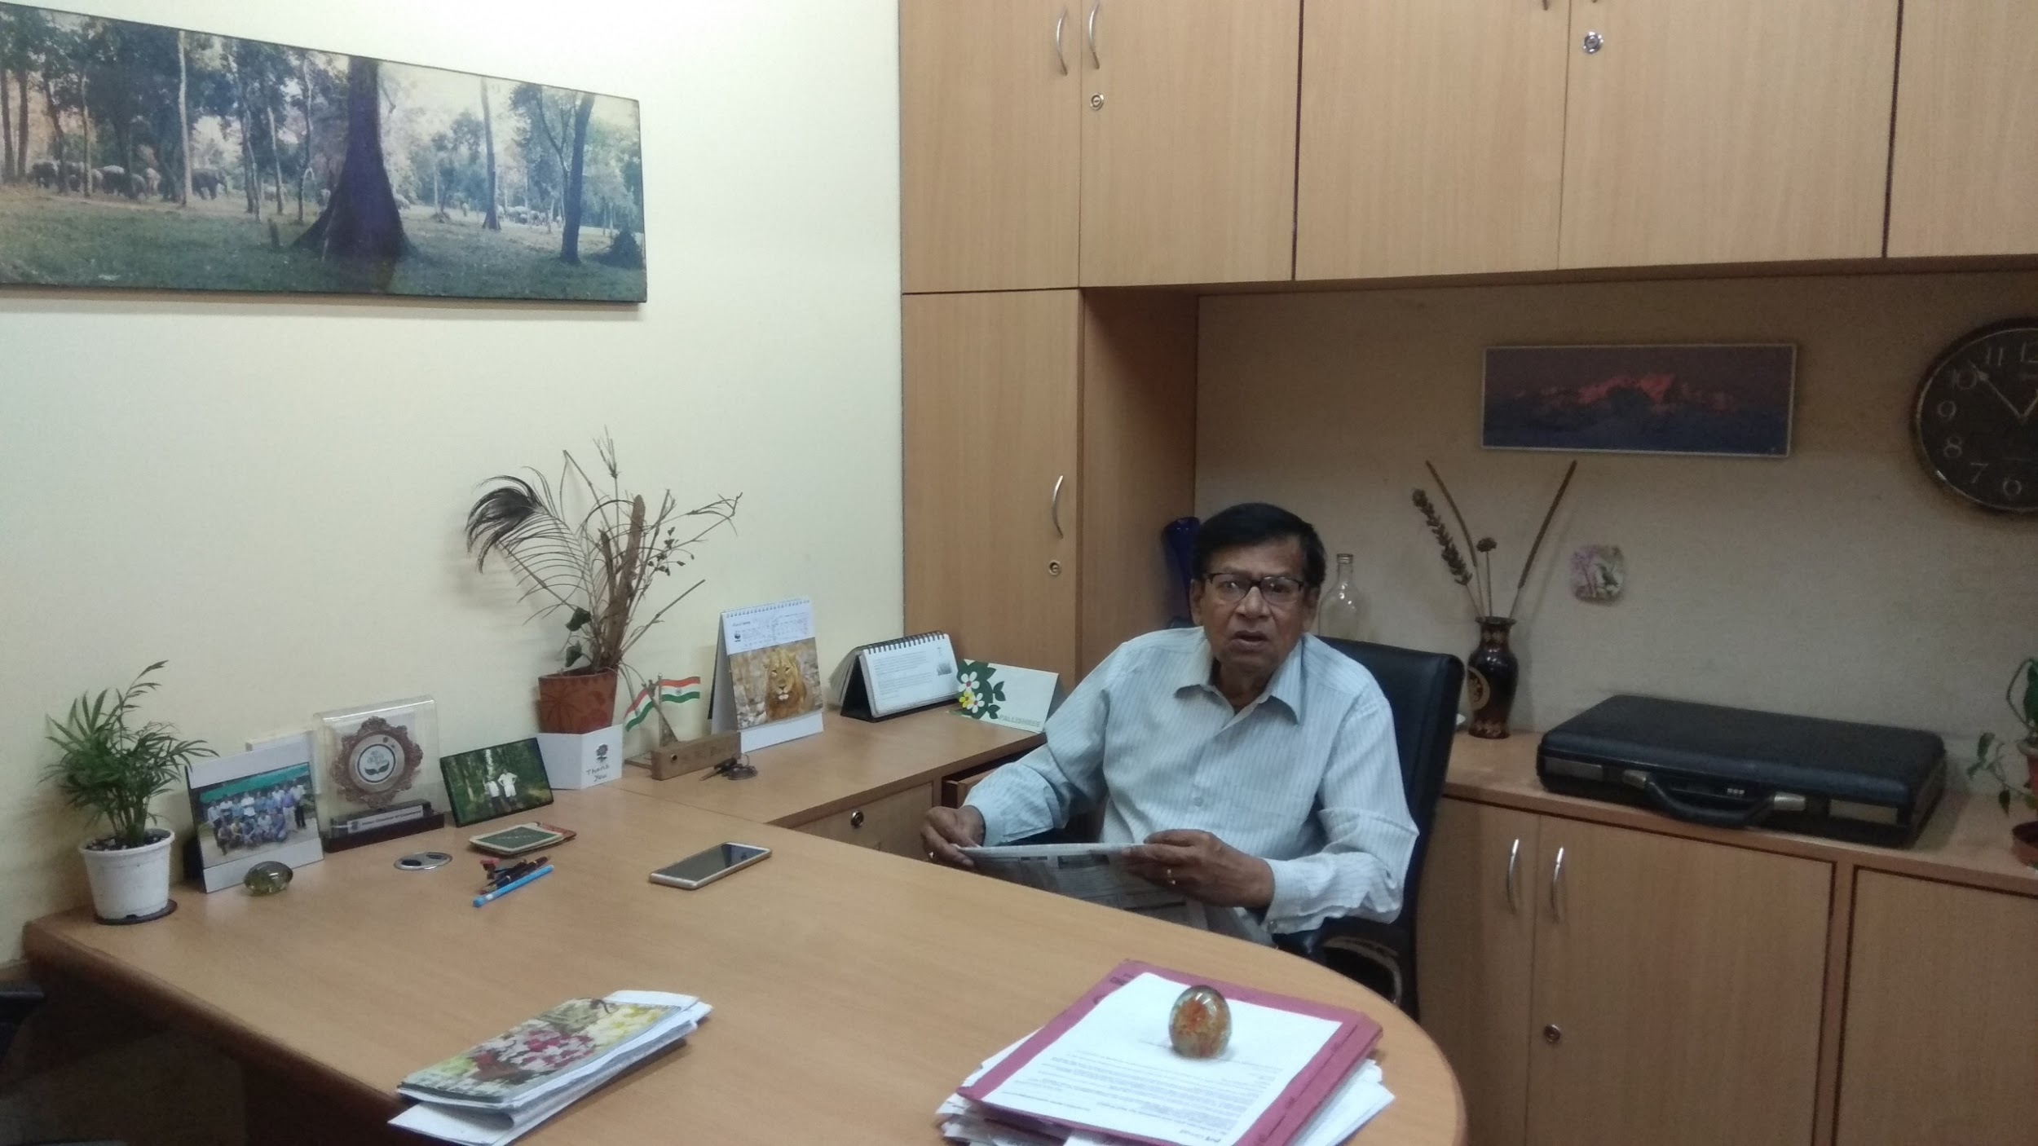
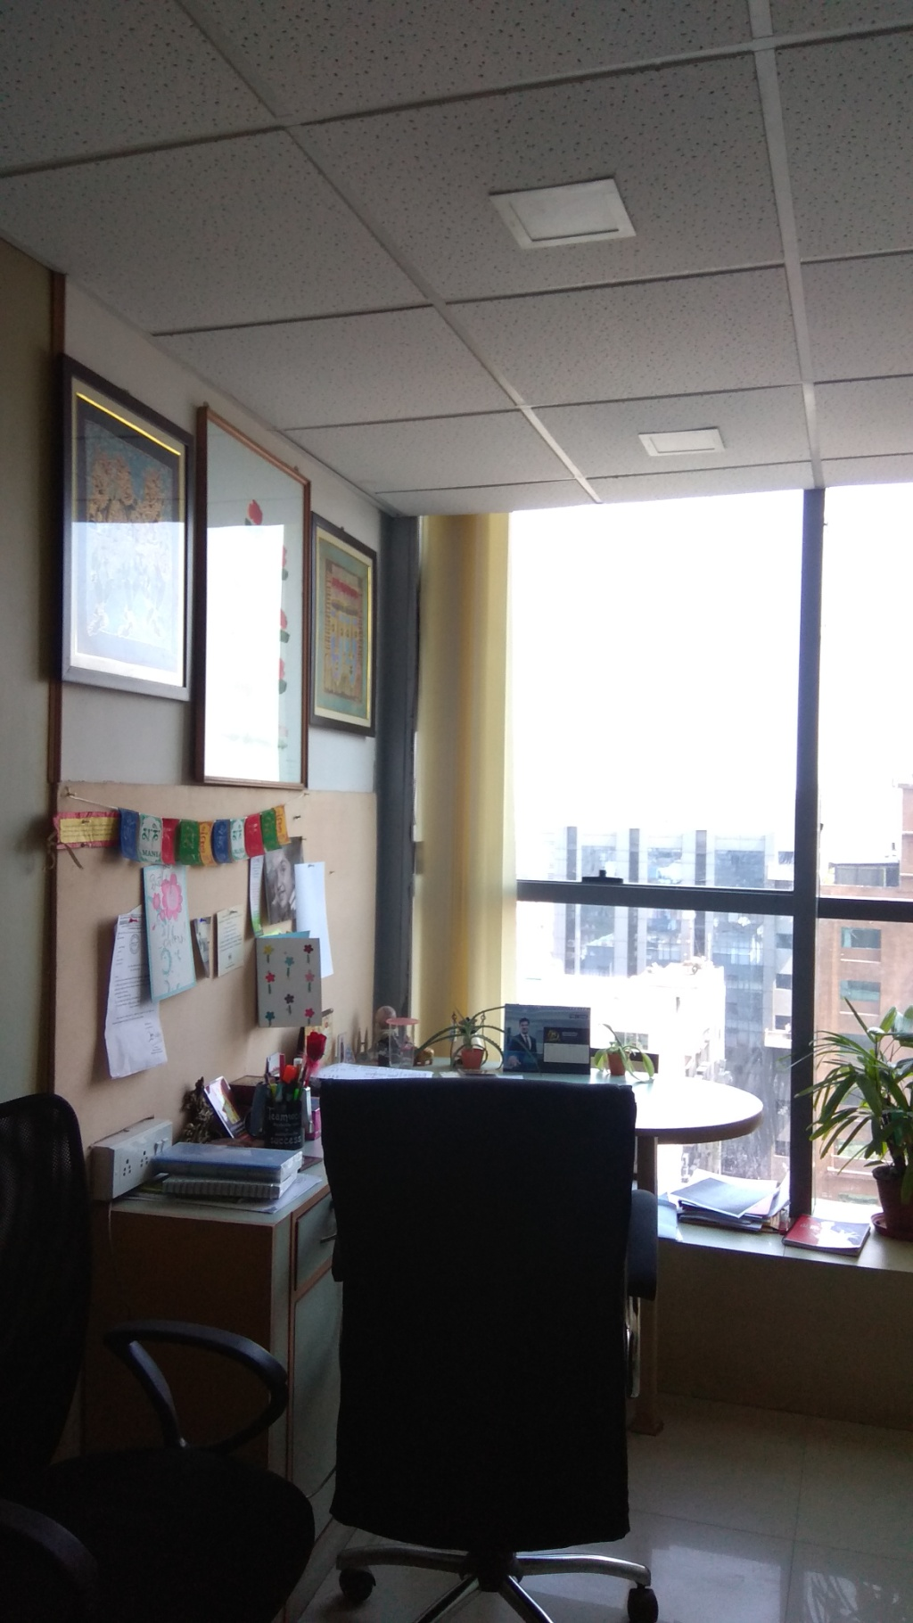
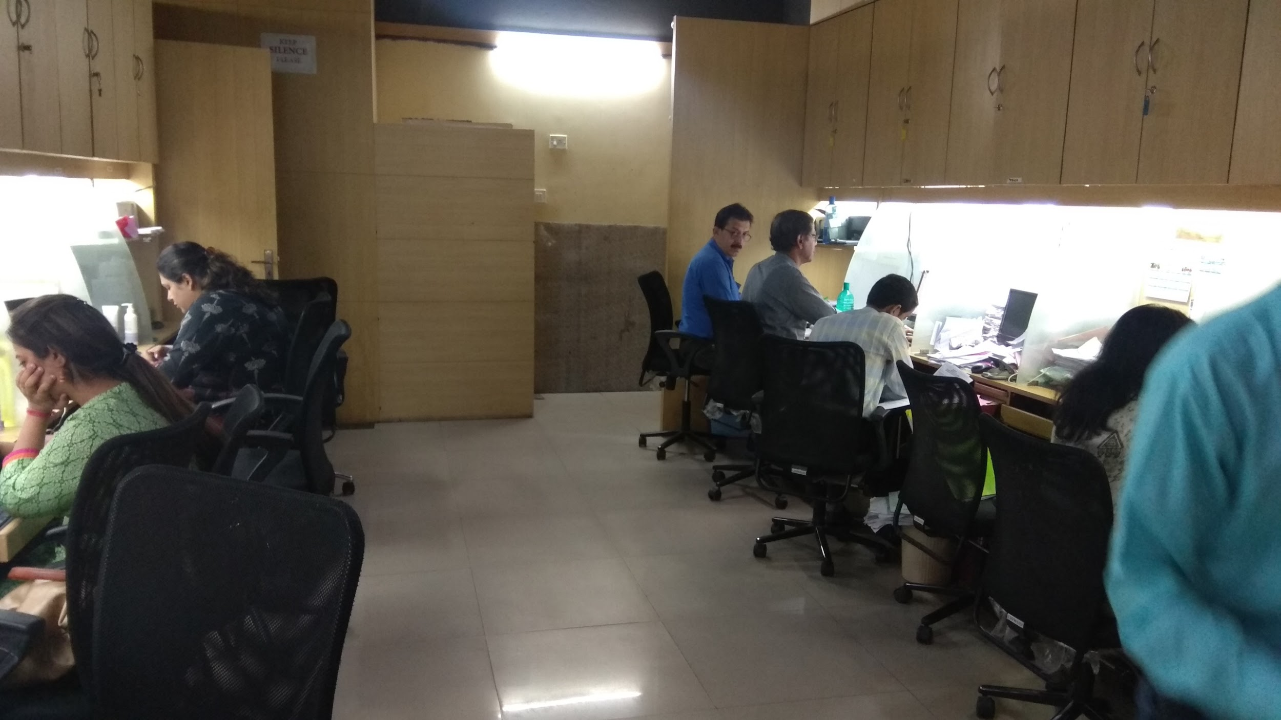
Pallishree Ltd., Head office, Merlin Infinity, Room-1205, Sec-V, Salt Lake

Slide 11
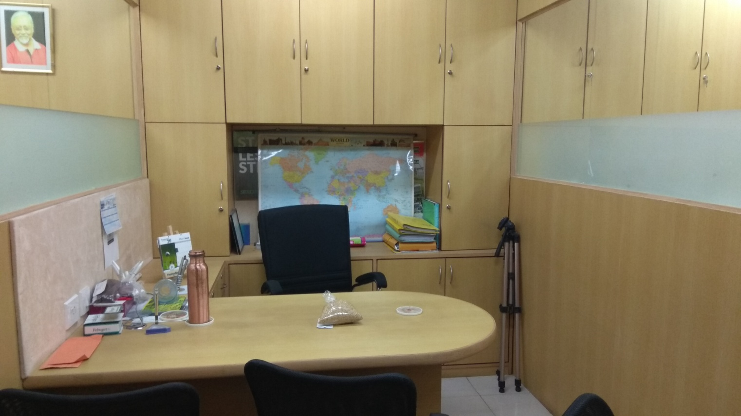
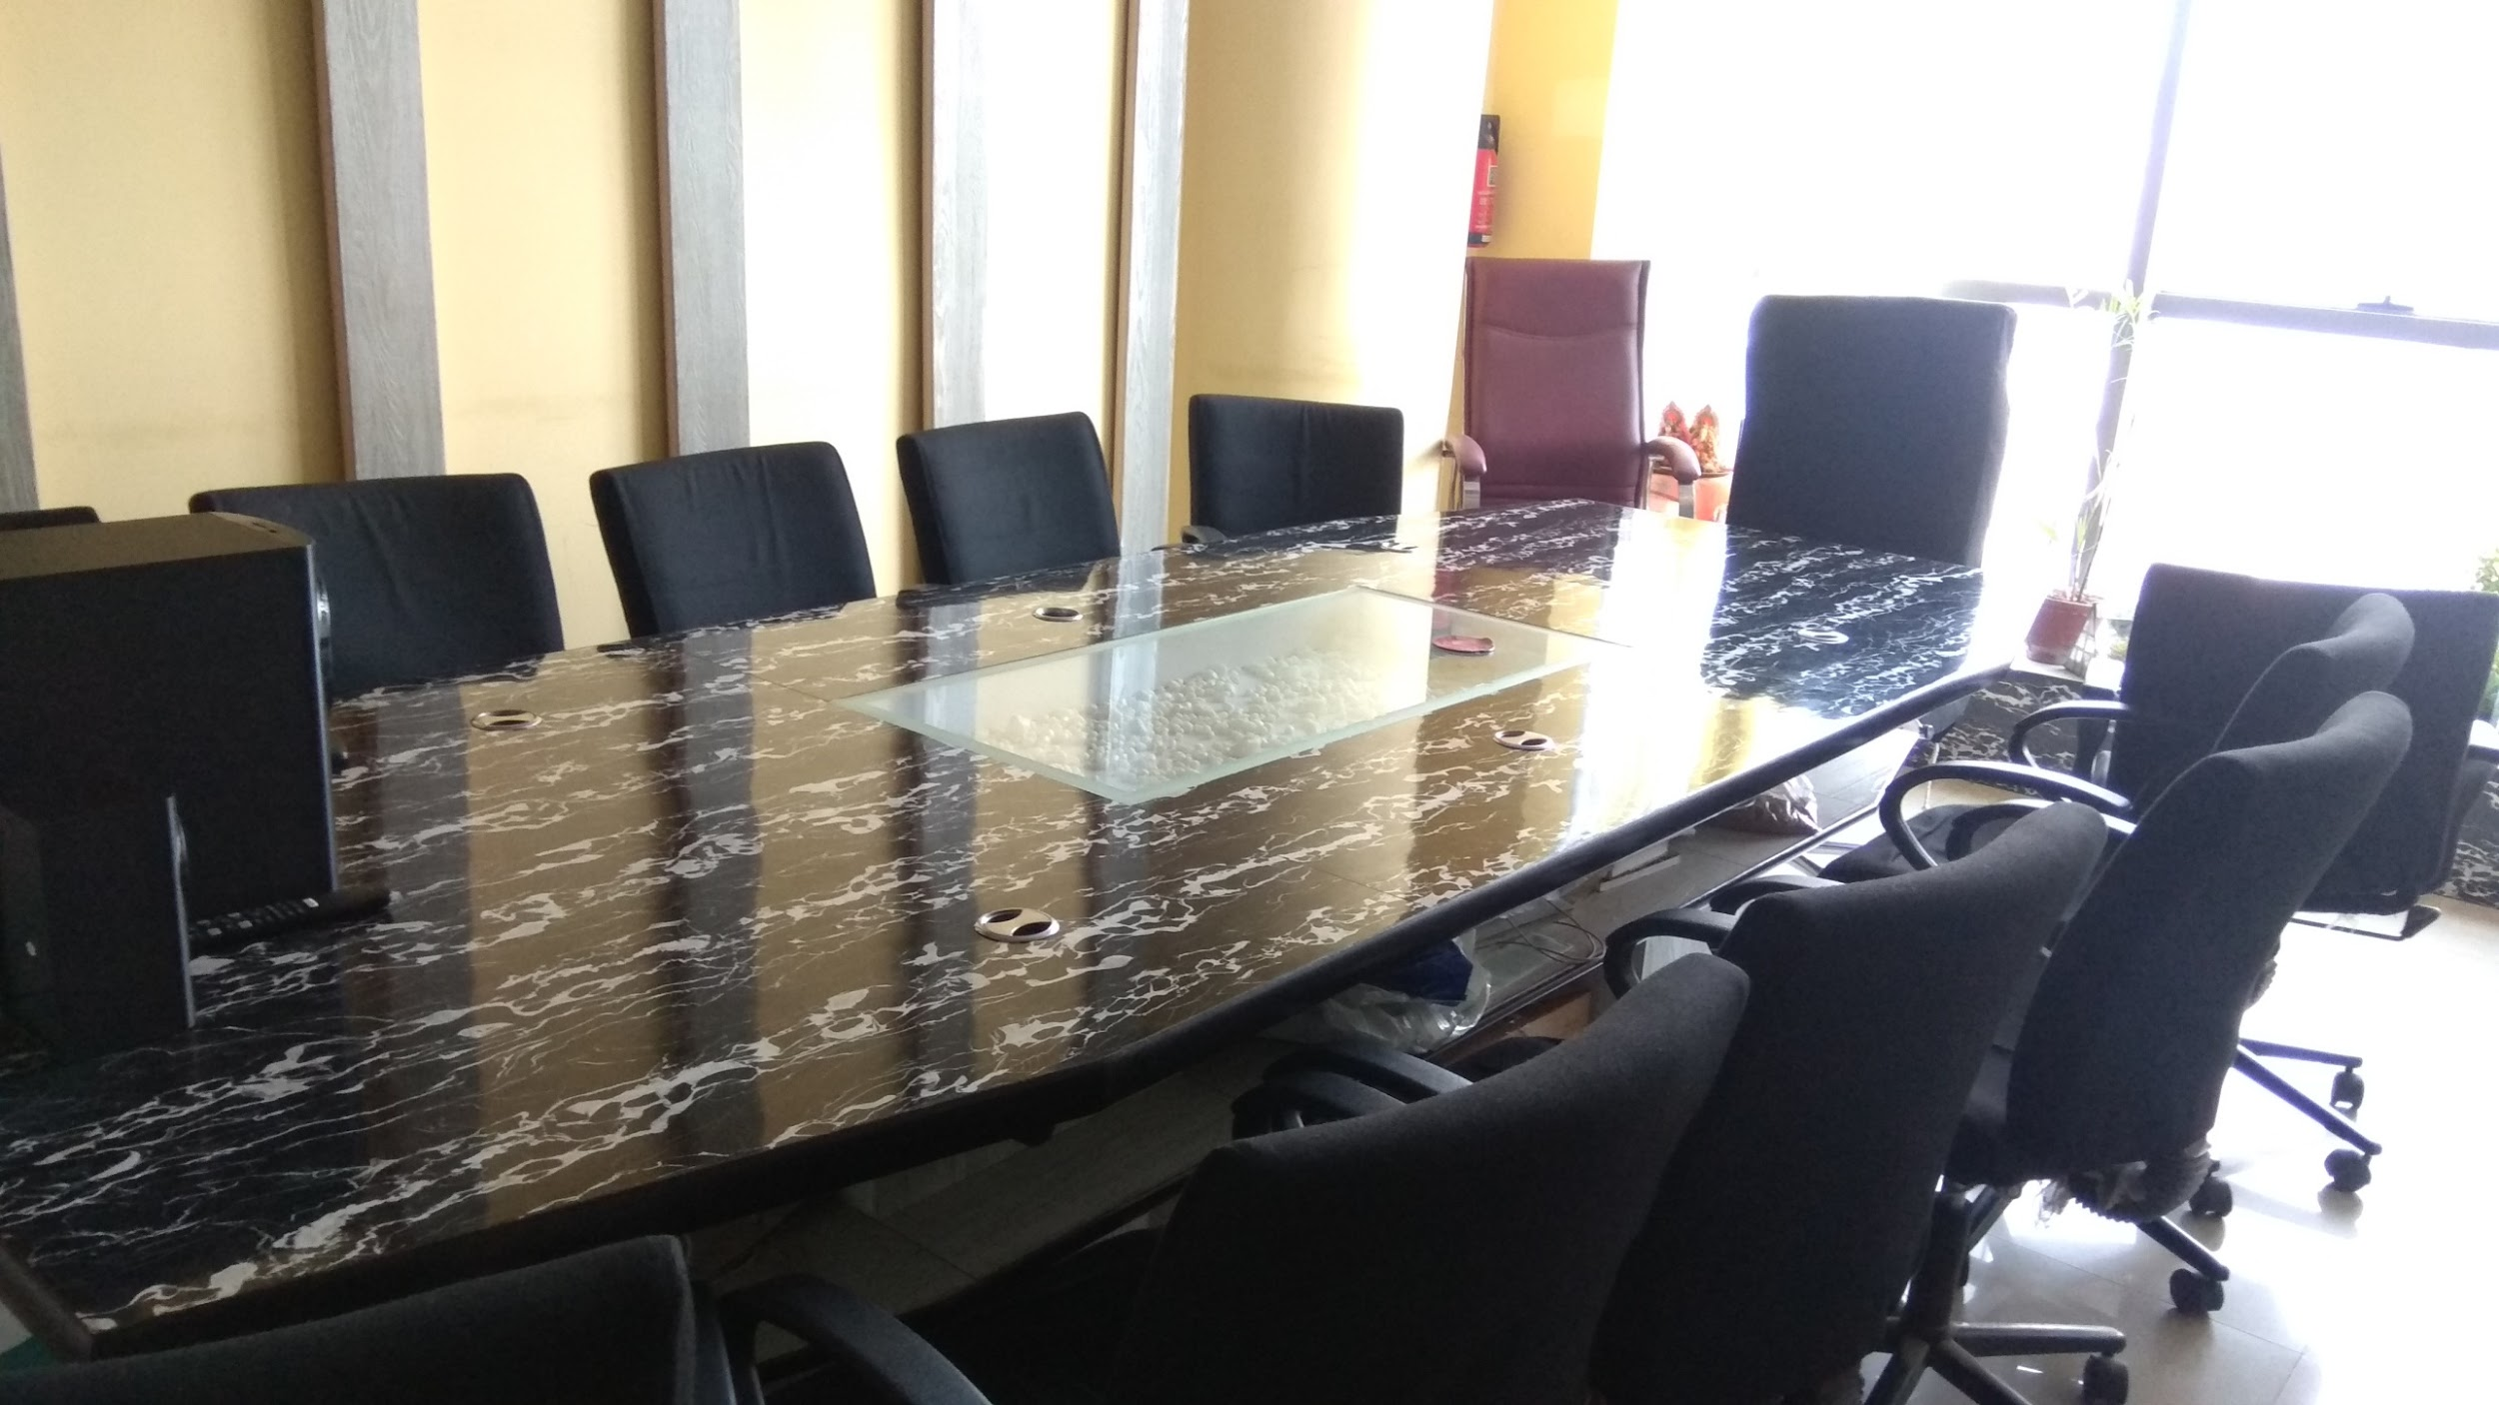
Pallishree Ltd., Head office, Merlin Infinity, Room-1205, Sec-V, Salt Lake

Slide 12
OFFICE INTERIOR DESIGN
SANTOSH CHAMBER
@
City Centre-II, Block-B, Room No. 404

Slide 13
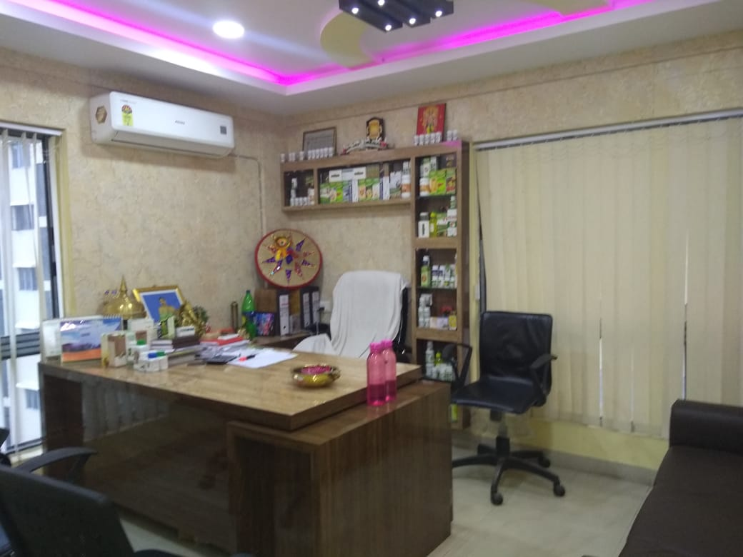
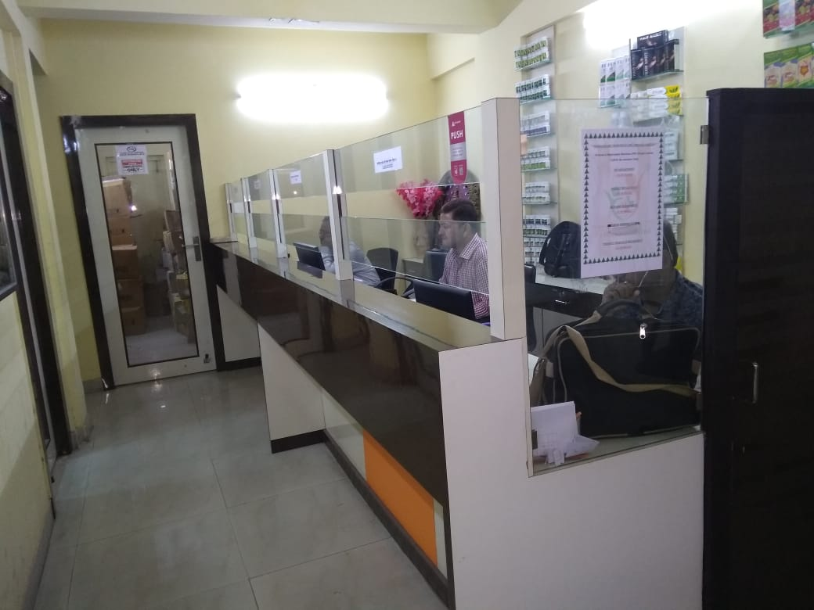
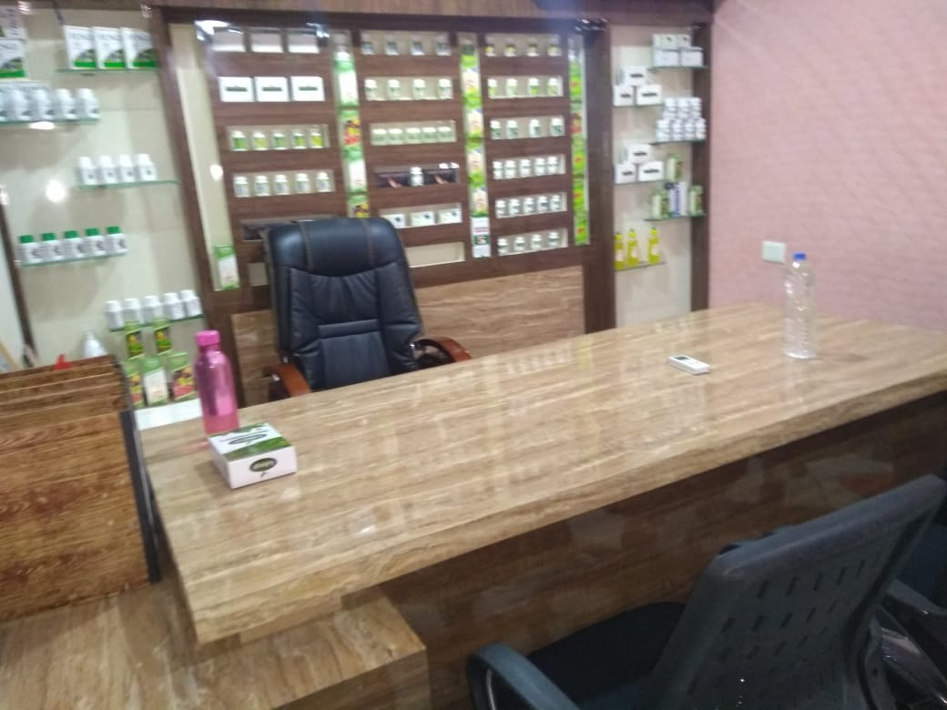
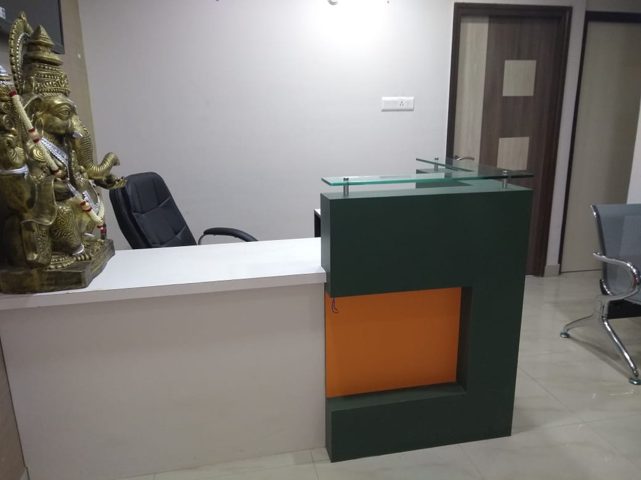
Santosh Chamber, City Centre-II, Block-B, Room No. 404

Slide 14
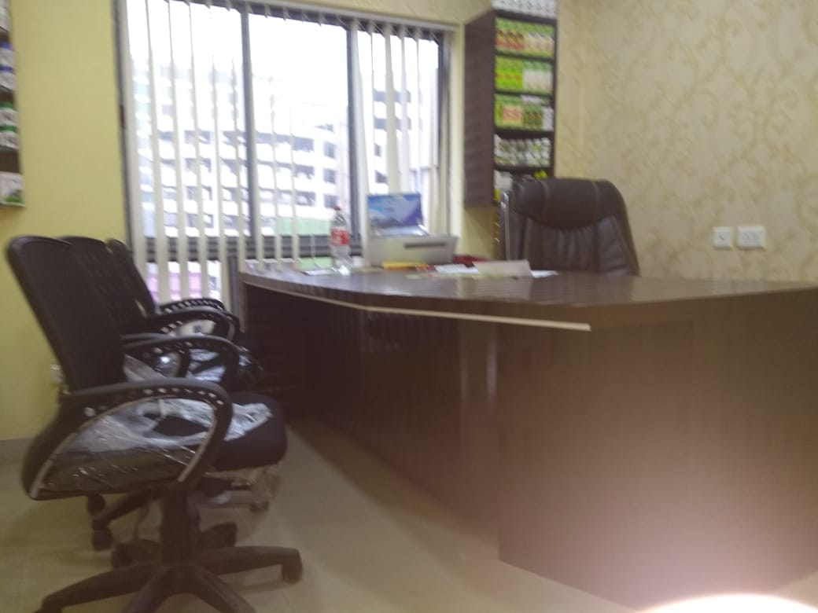
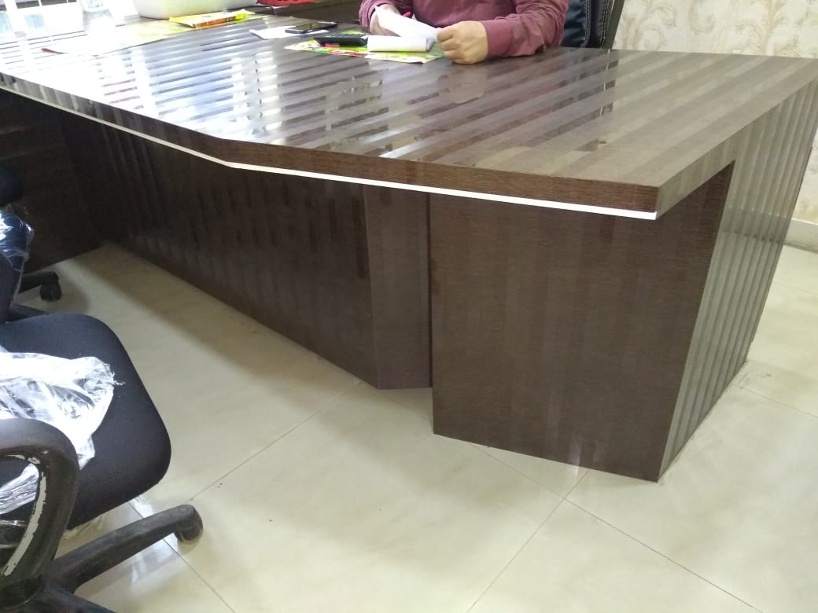
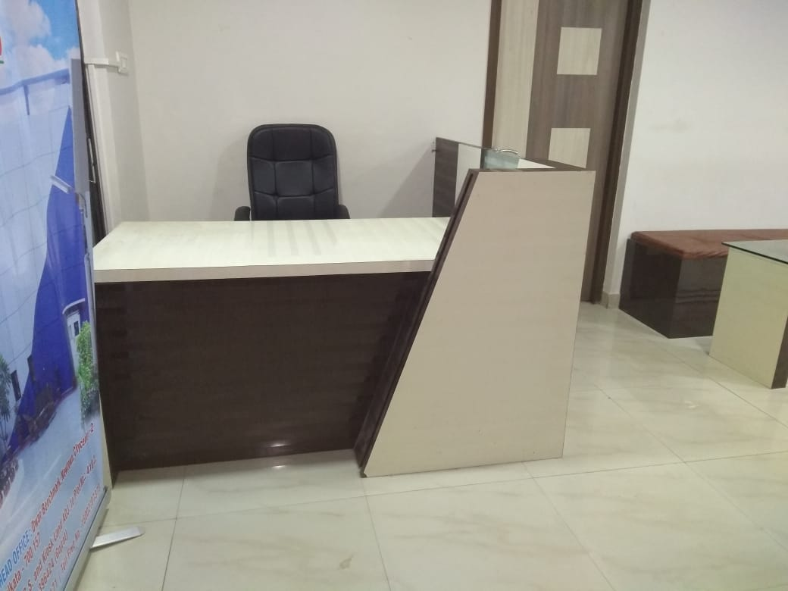
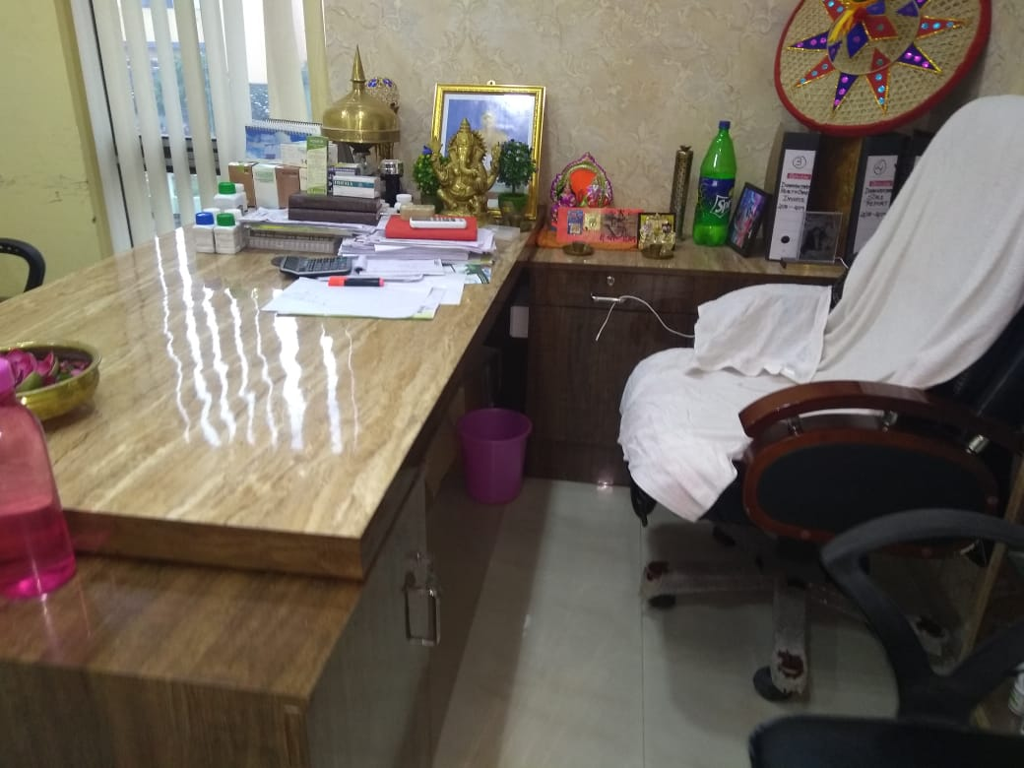
Santosh Chamber, City Centre-II, Block-B, Room No. 404

Slide 15
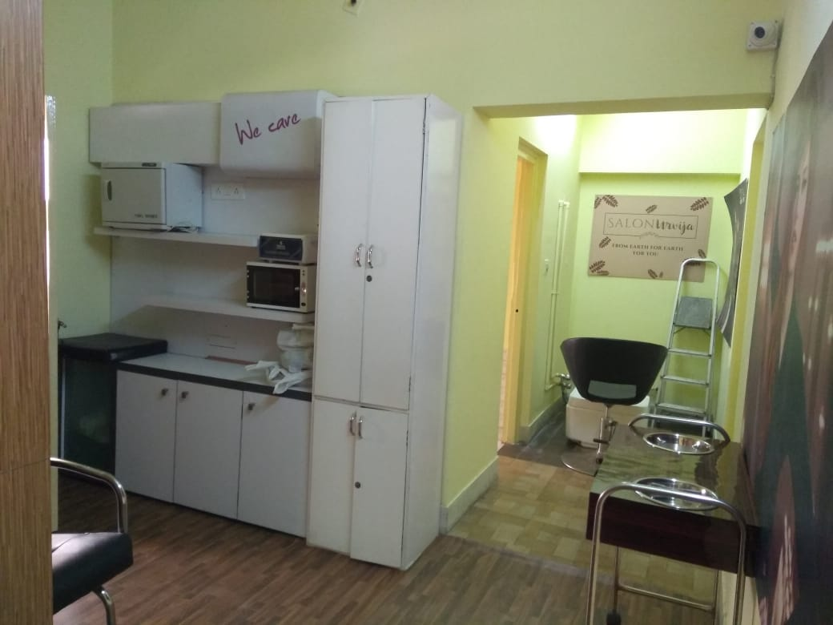
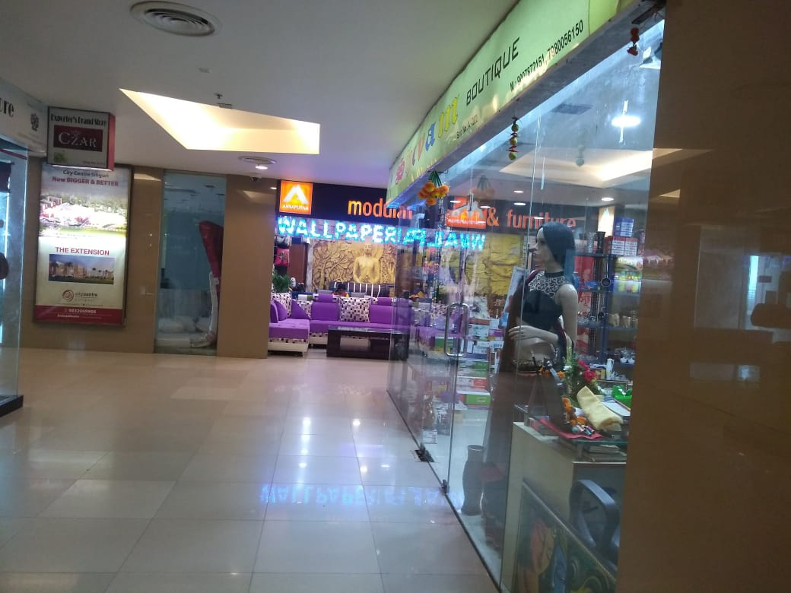
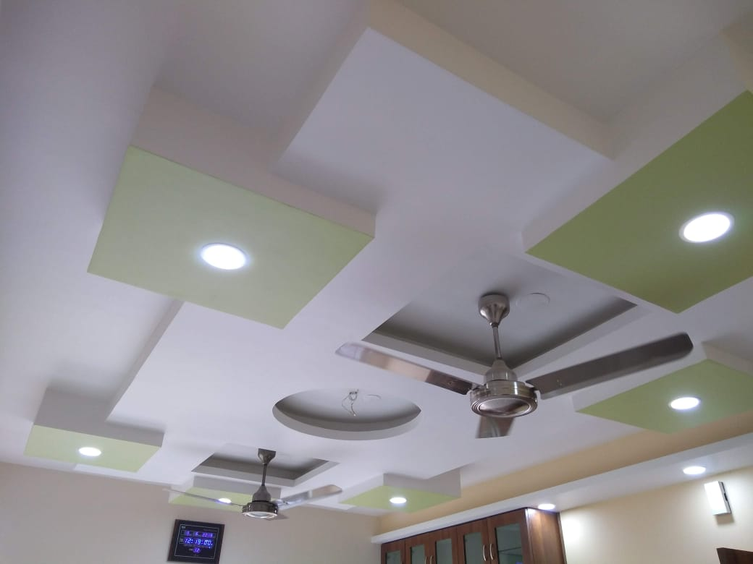
Santosh Chamber, City Centre-II, Block-B, Room No. 404

Slide 16
SALON DESIGN
SALON URVIJA
@
BD-85, Salt Lake City

Slide 17
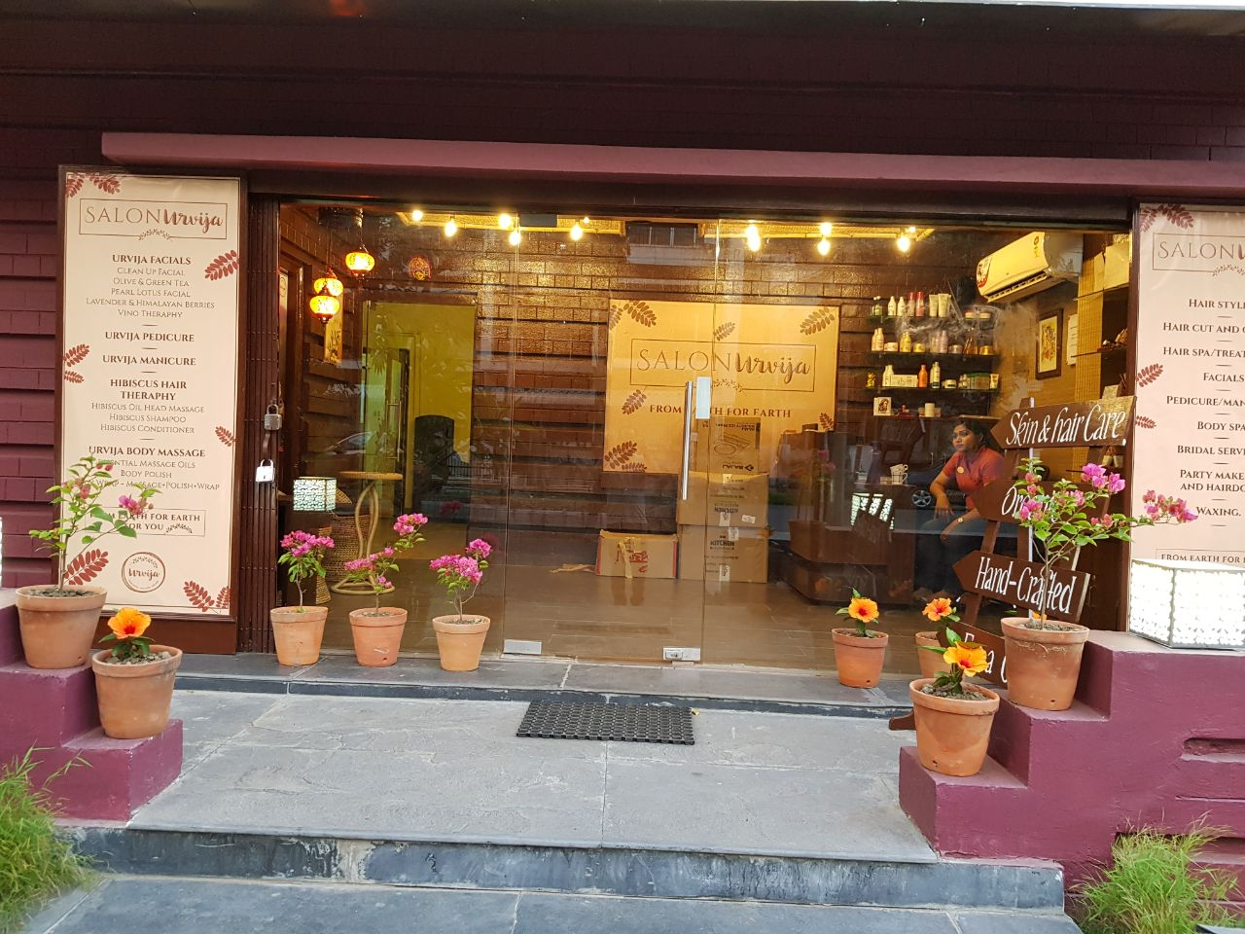
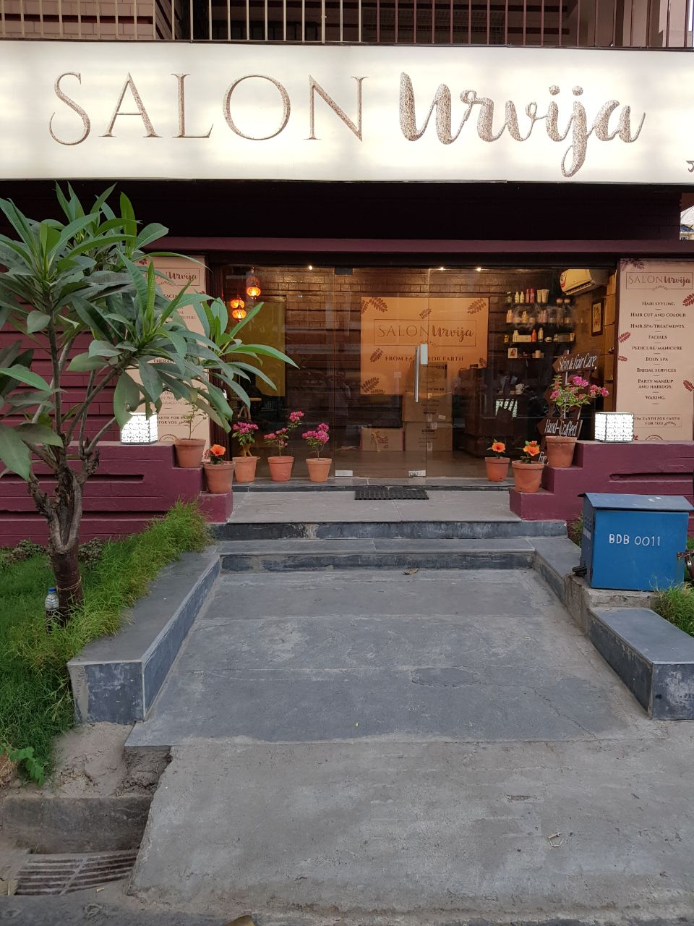
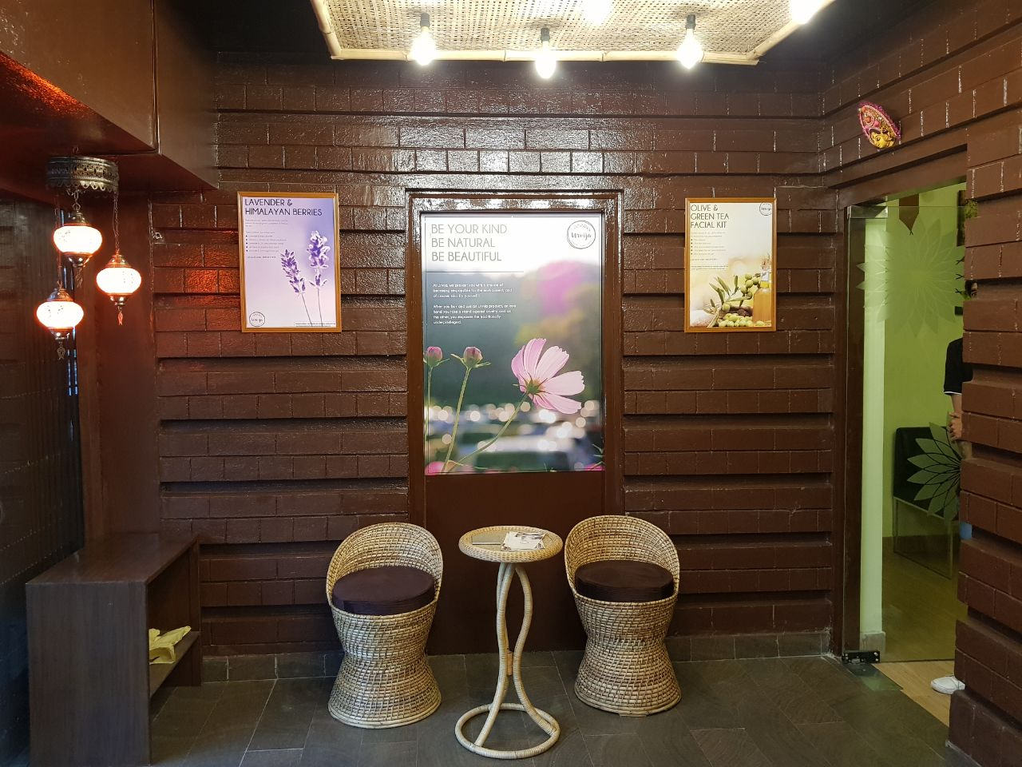
Salon Urvija, BD 85, Salt Lake City

Slide 18
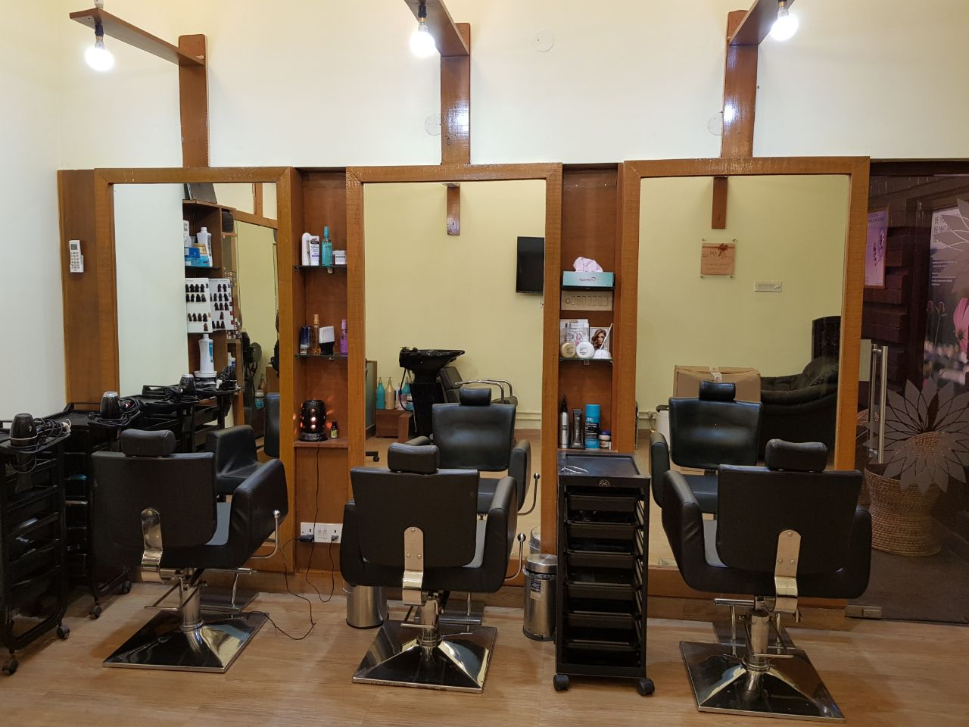
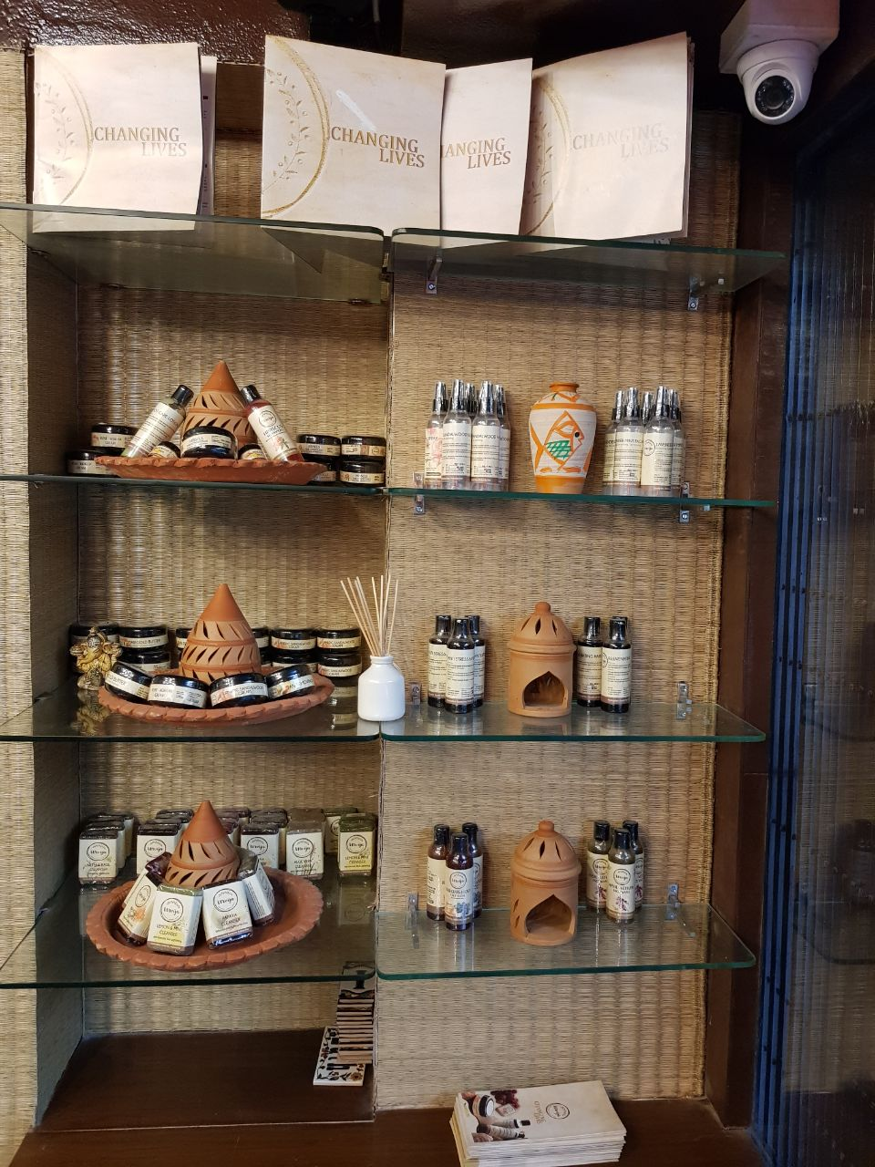
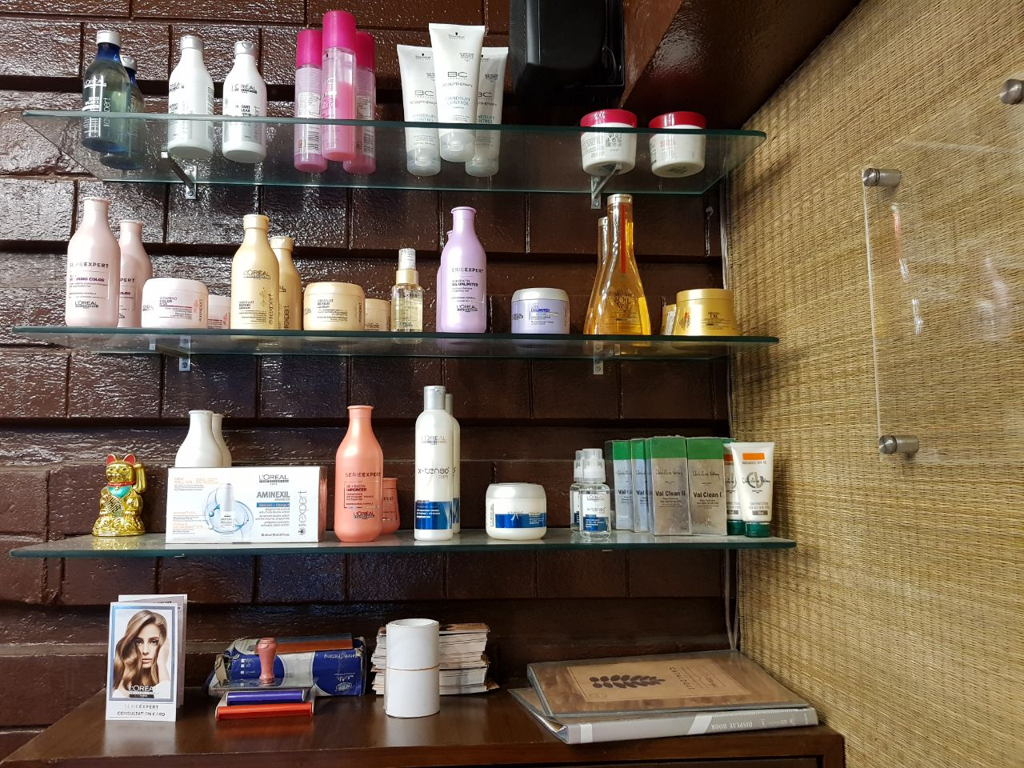
Salon Urvija, BD 85, Salt Lake City

Slide 19
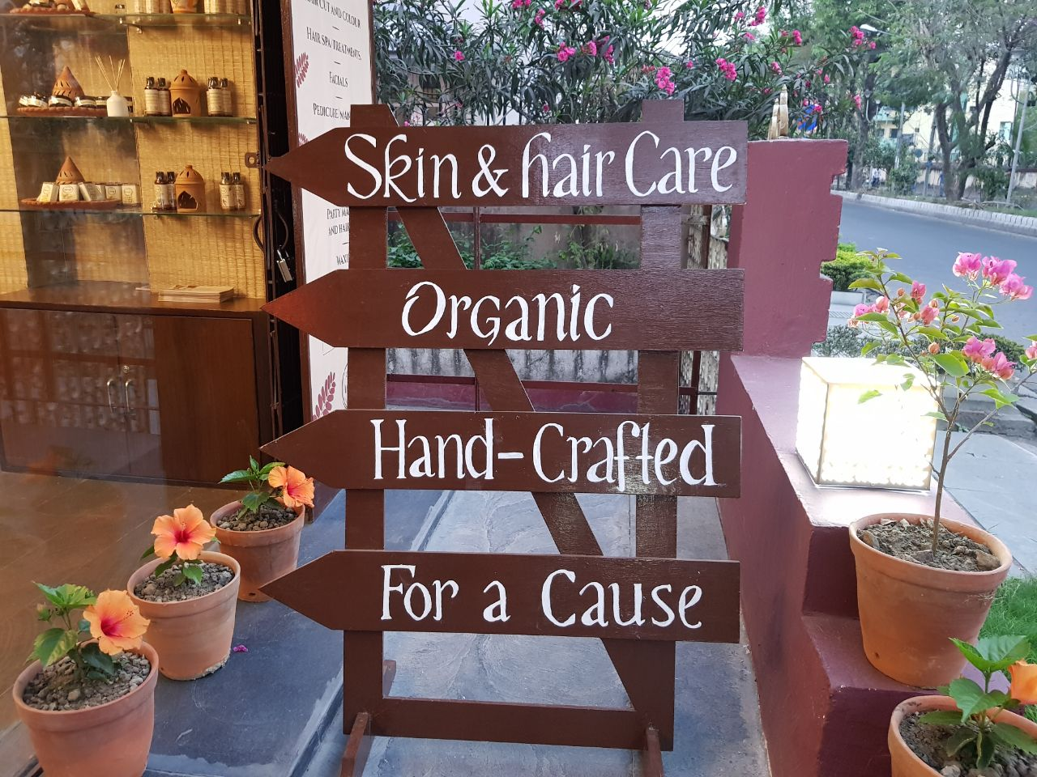
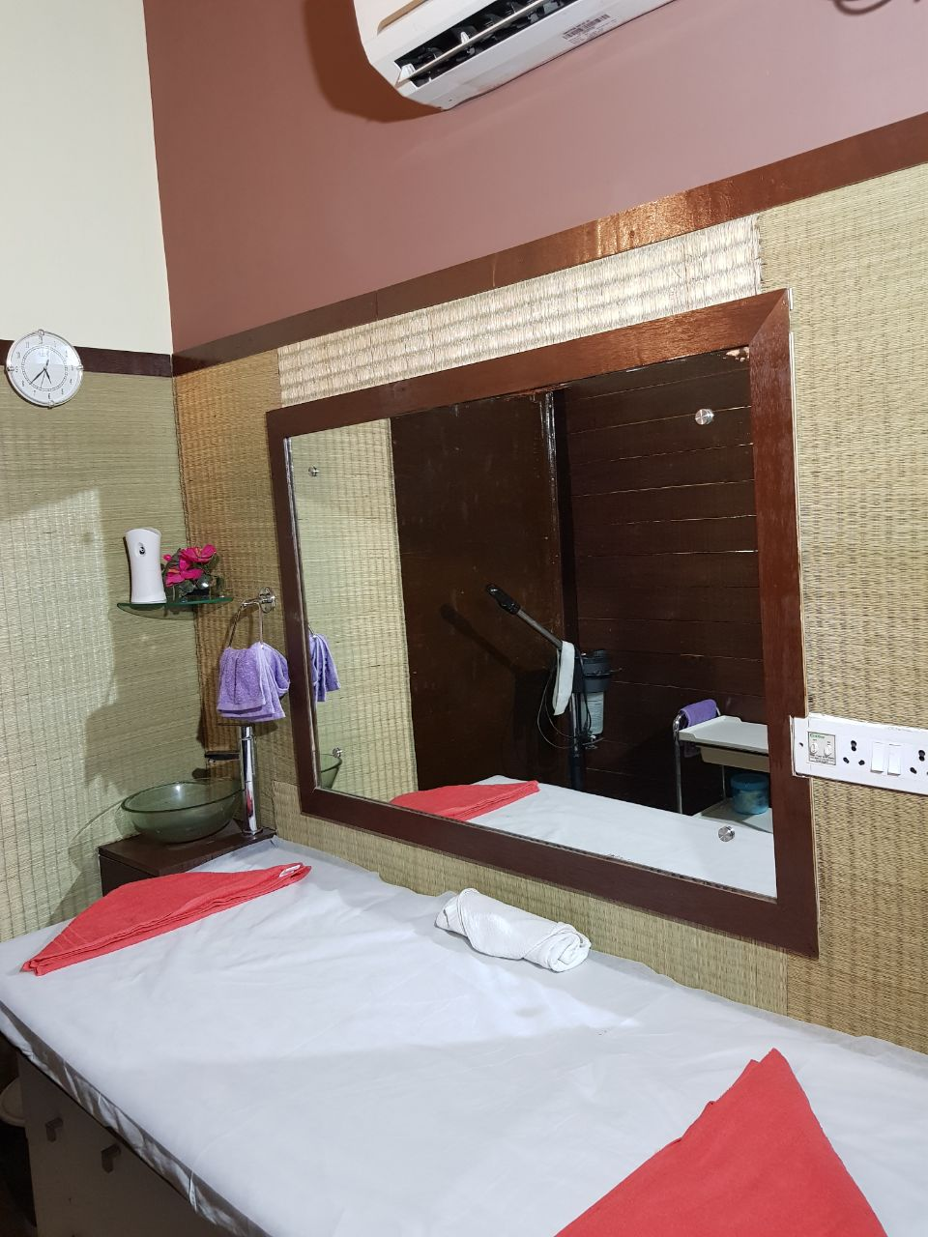
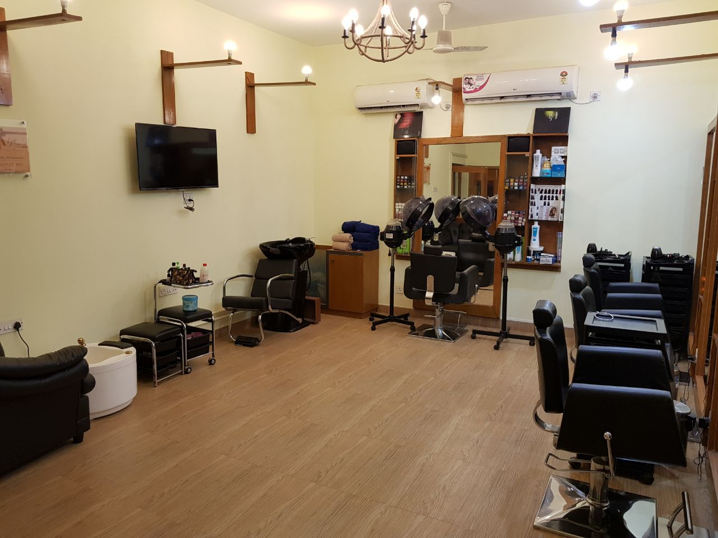
Salon Urvija, BD 85, Salt Lake City

Slide 20
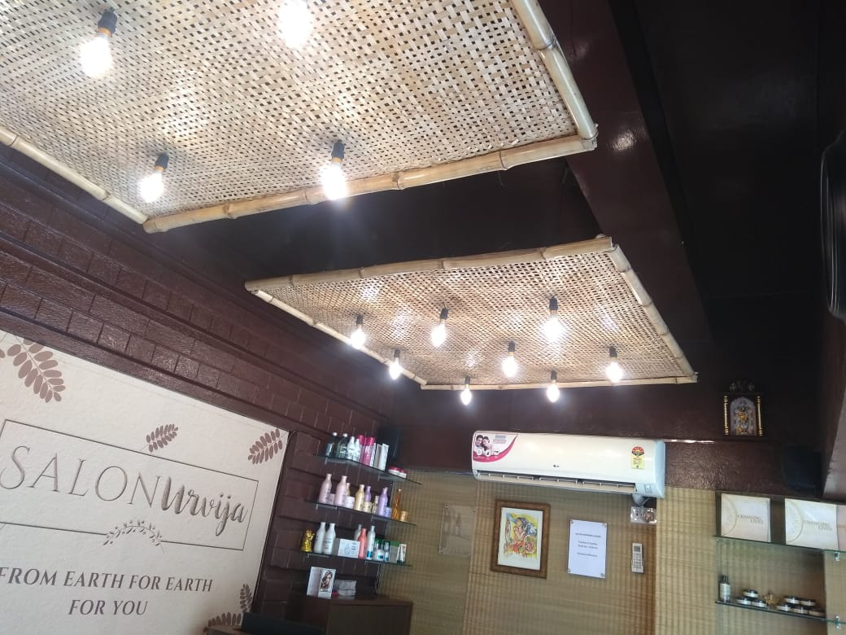
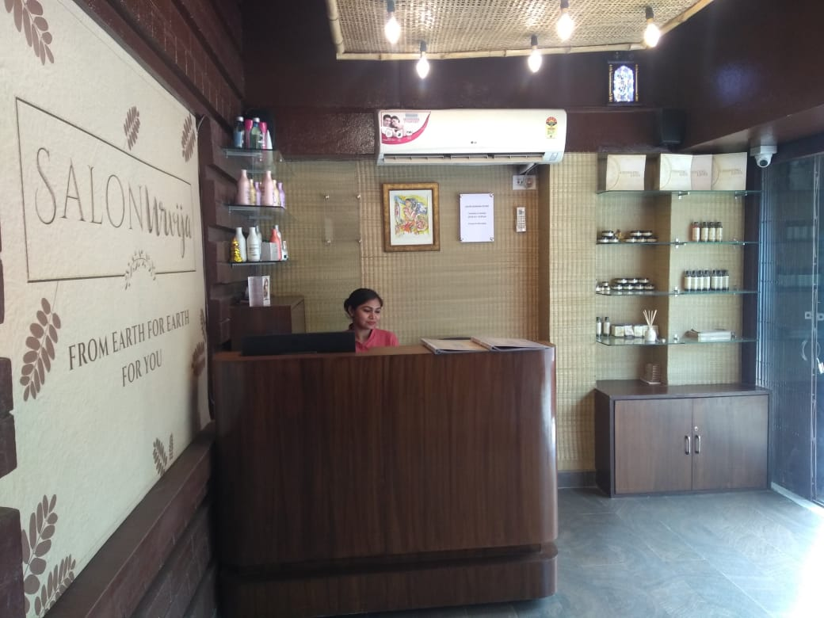
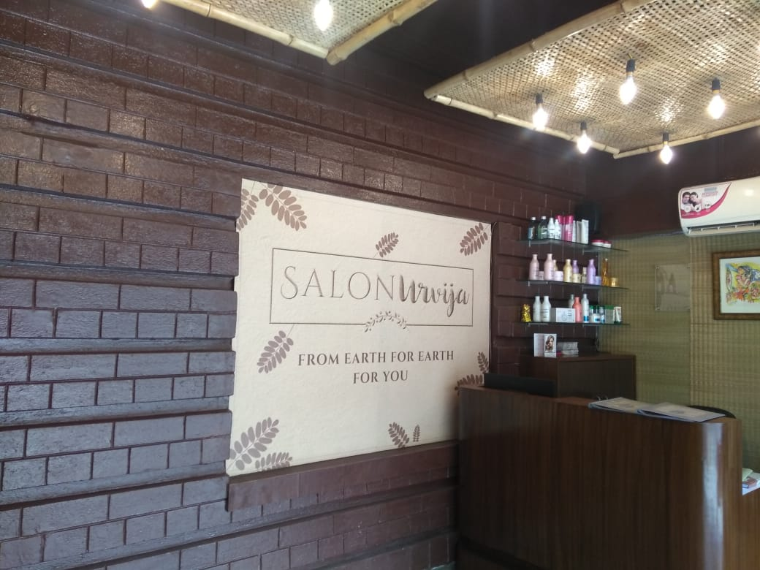
Salon Urvija, BD 85, Salt Lake City

Slide 21
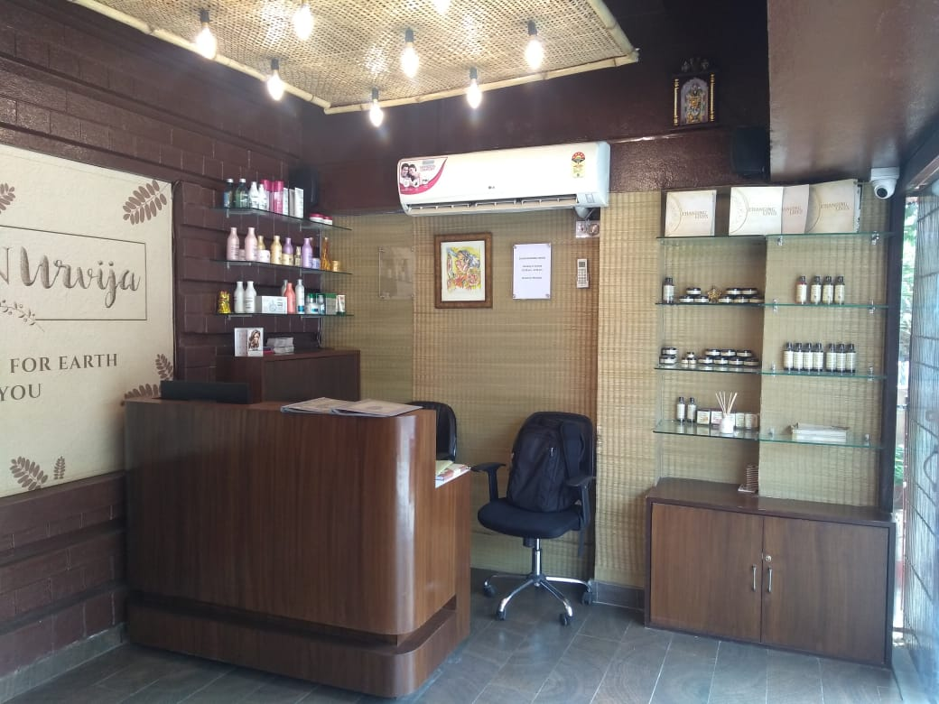
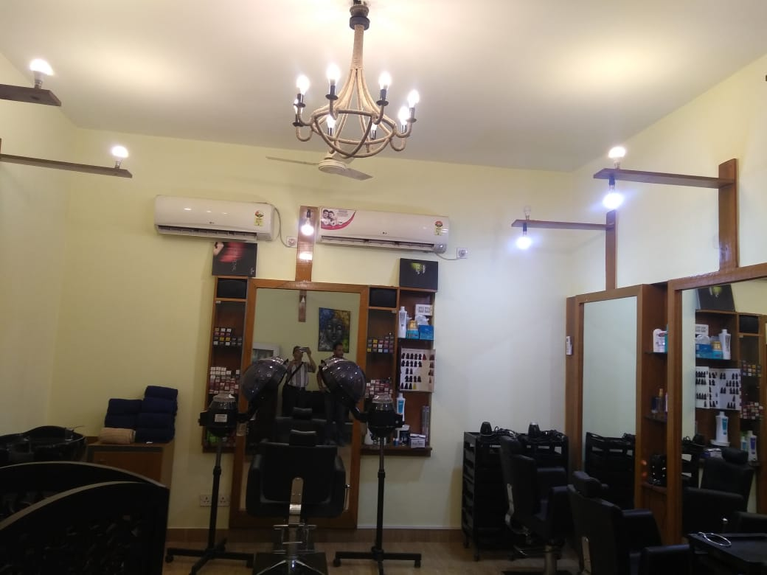
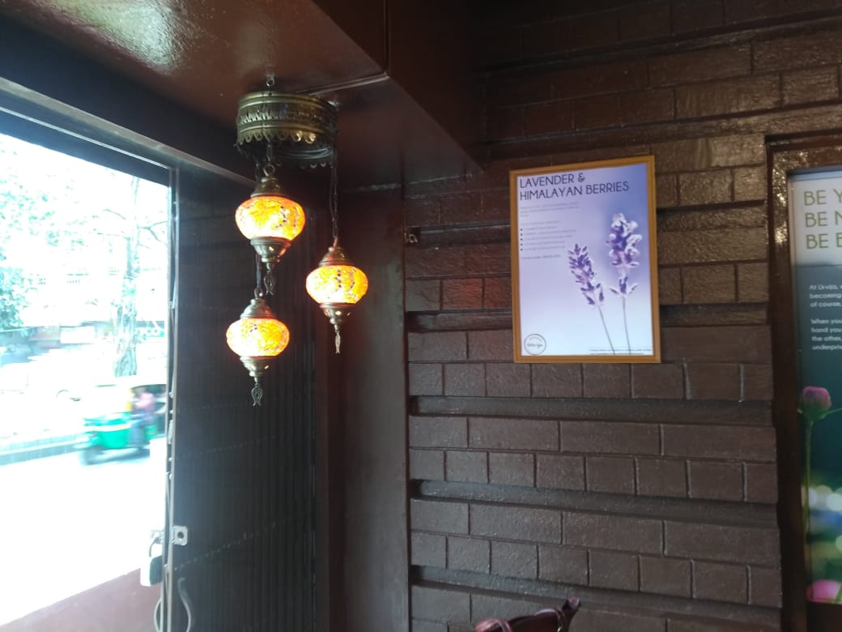
Salon Urvija, BD 85, Salt Lake City

Slide 22
RESIDENCE DESIGN
GREEN VIEW
@
New Town, Rajarhat

Slide 23
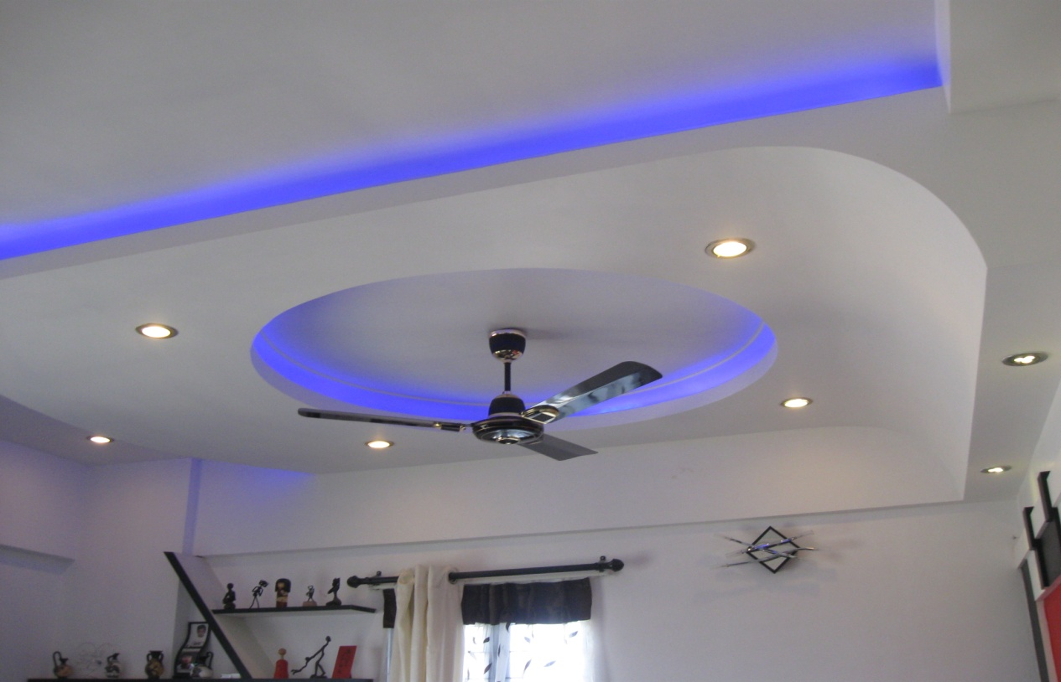
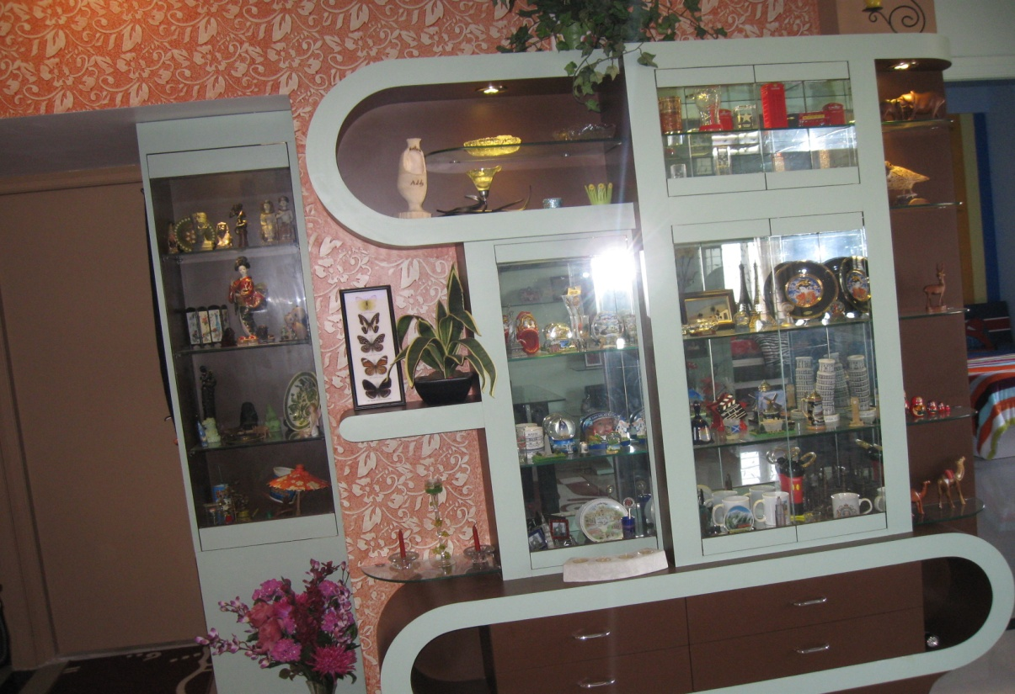
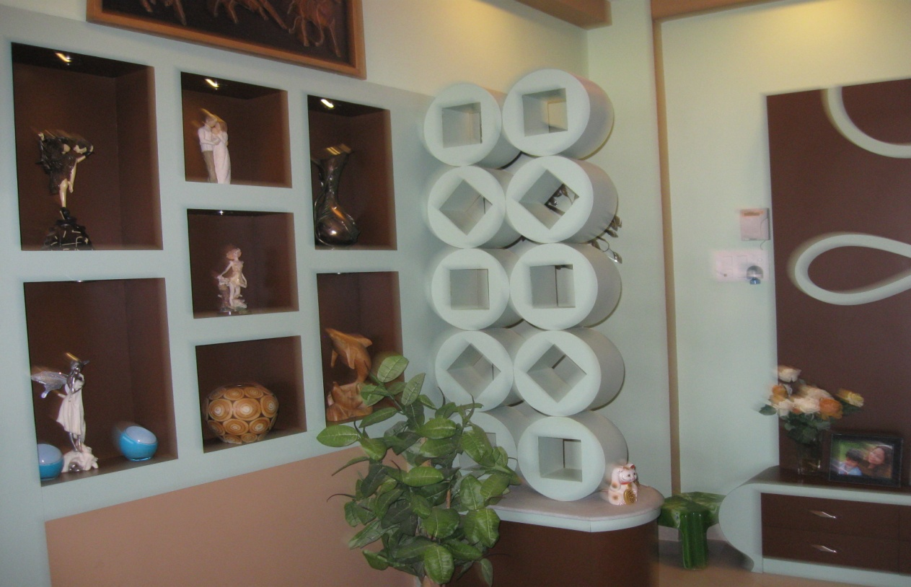
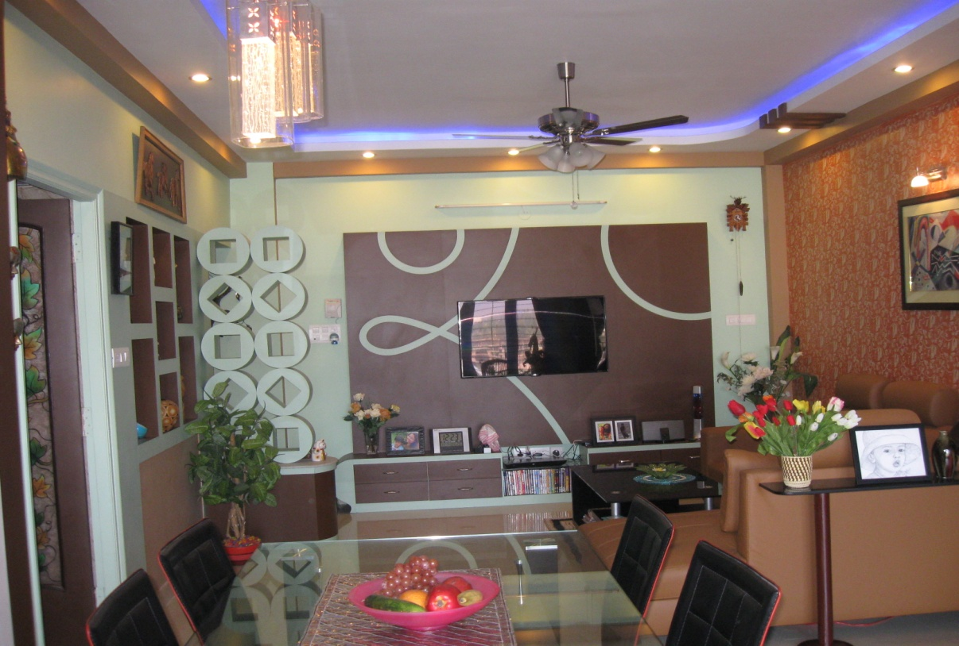
Green View, (Residence) at New Town, Rajarhat

Slide 24
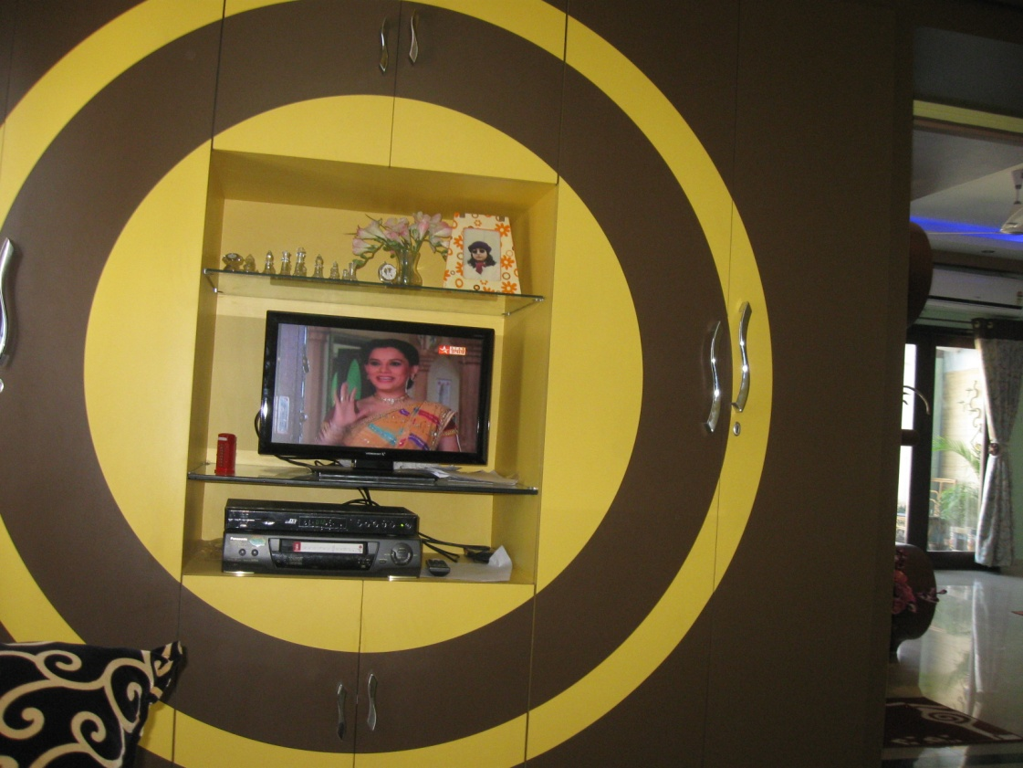
Green View, (Residence) at New Town, Rajarhat

Slide 25
Green View, (Residence) at New Town, Rajarhat

Slide 26
RESIDENCE DESIGN
Mr. Ukil’s Residence
@
New Town

Slide 27
Ukil, New Town AL-1, C-25

Slide 28
Ukil, New Town AL-1, C-25

Slide 29
RESIDENCE DESIGN
Mr. Pathak’s Residence
@
New Town

Slide 30
Pathak, New Town

