Slide 1


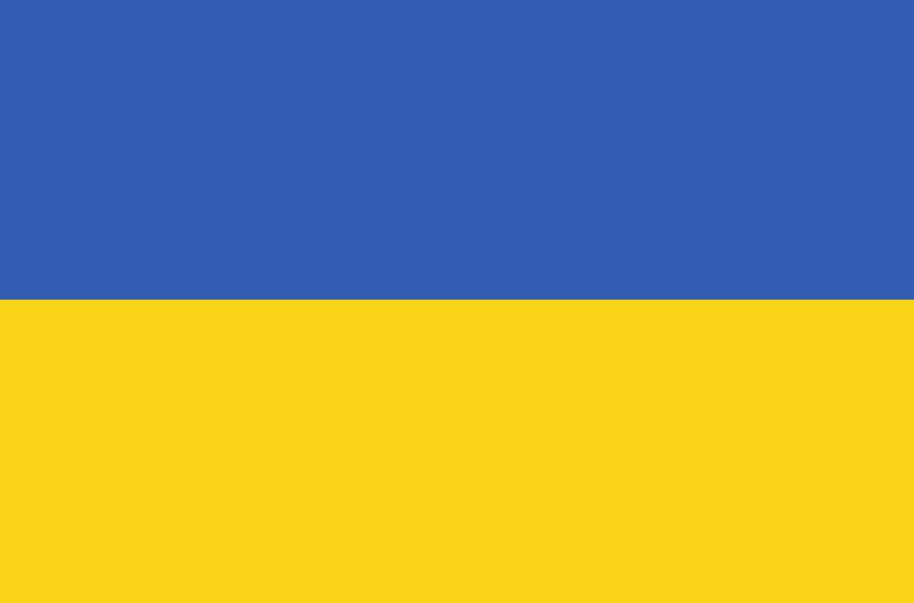

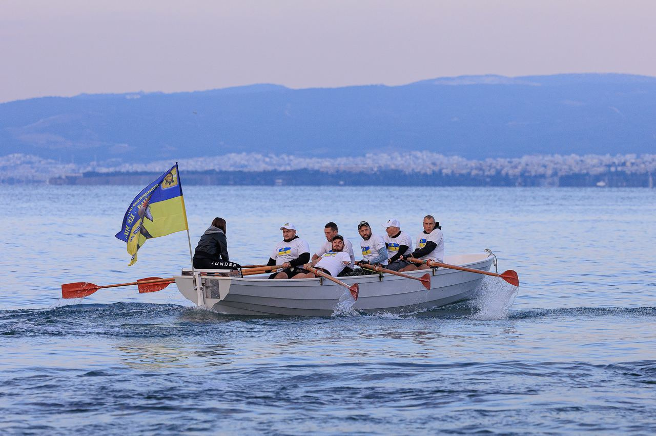


Sports Rehabilitation Program for Veterans from Ukraine in Greece
We join forces for recovery.
The sports rehabilitation program for veterans from Ukraine is implemented in Thessaloniki, Greece, at the Kalamaria Nautical Club.
10 days. 10 participants per program. Team strength, support, recovery
2026

Slide 2
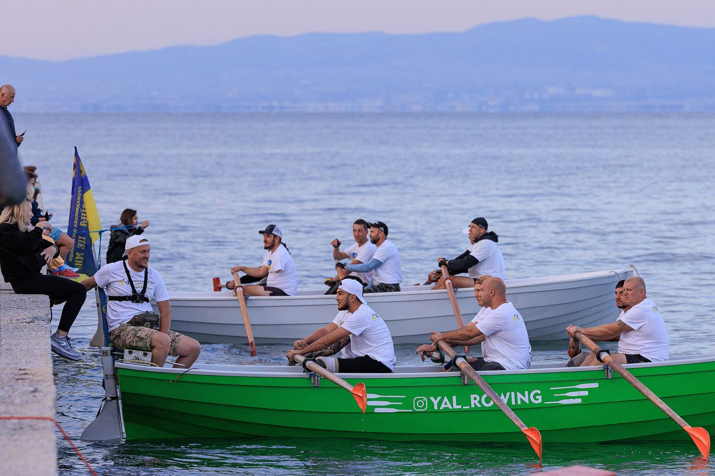


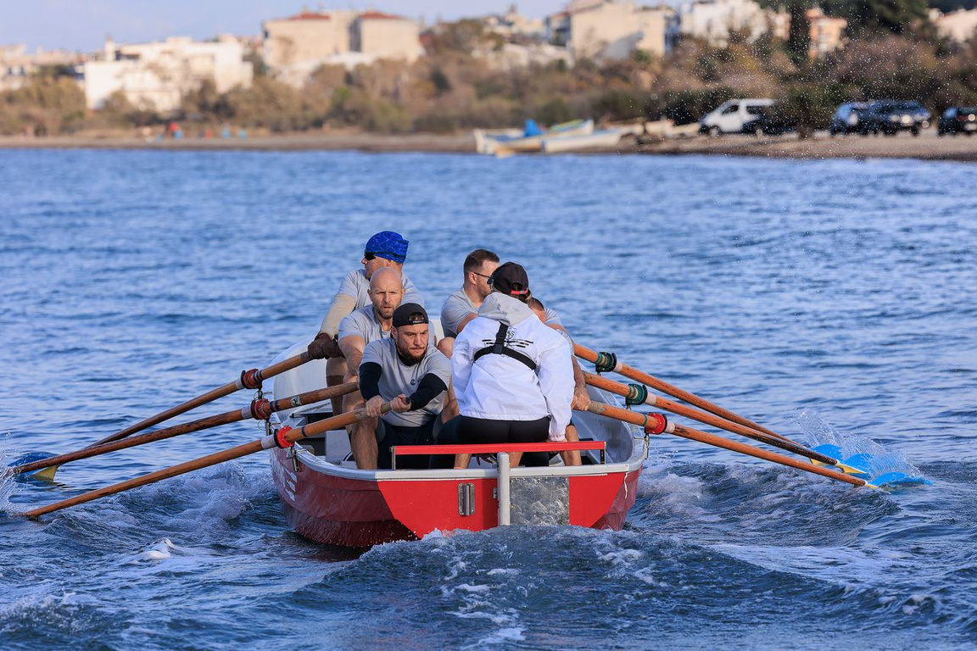
Program Mission
Our goal is to help those who defended Ukraine. We created this program to support the physical and psychological recovery of combat veterans.
Main Objectives :
  Restoration of physical fitness
  Strengthening morale
  Integration through sport
  Building international partnerships

Slide 3


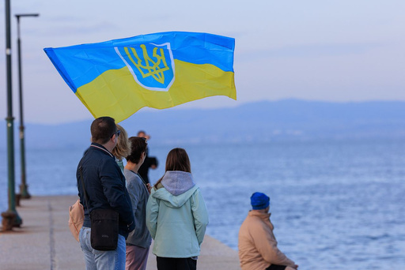
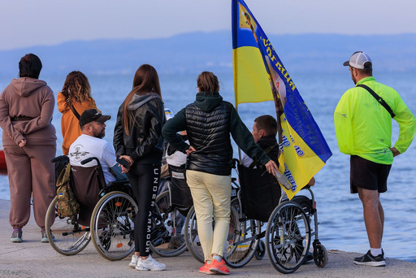
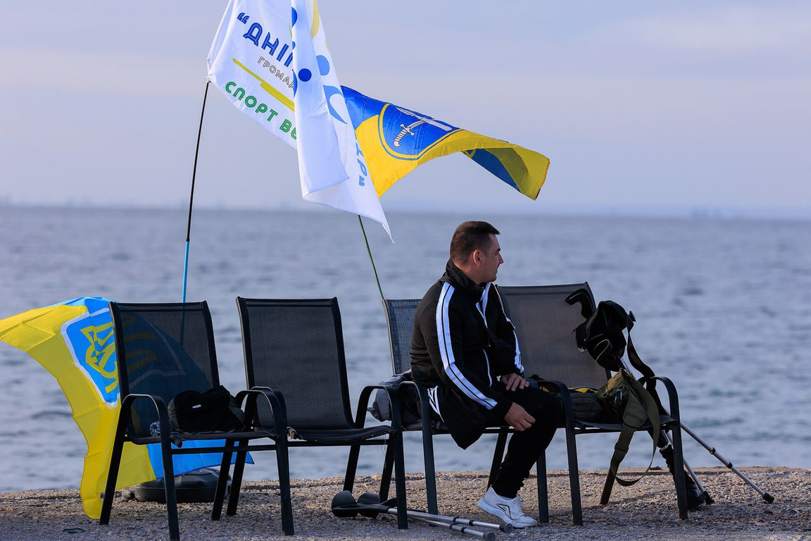
REHABILITATION PROGRAM
Objectives
What does the program include?
Yal rowing: training at sea
Spa treatments
Beach visits
Walks and breathing practices
Cultural activities and healthy nutrition
Support for war veterans, including their physical and social rehabilitation through participation in sports programs
Mission
Our mission is recovery through sport

Slide 4




October 2024 & 2025 — European Yal Rowing Championships in Greece
This championships became an important event for everyone. 120 athletes from Ukraine took part in the competition, including 20 war veterans. For them, it was not only a sporting event, but also a form of rehabilitation and integration into the sports community.
Strengthening physical health
Increased confidence
Physical activity, particularly yal rowing, contributes to the comprehensive improvement of physical condition. This sport engages all major muscle groups and improves endurance, coordination, and cardiovascular function
Participation in sports competitions and overcoming physical challenges help build inner confidence. Every kilometer covered, every wave overcome is proof that we are capable of more.
Building new connections
Improvement of emotional well-being
Yal rowing is a team sport that requires coordinated effort and mutual support. During training sessions and competitions, athletes have the opportunity to build new social connections, which is important for integration into society
Participation in teamwork and the achievement of shared goals bring positive emotions and a sense of self-worth. In addition, new experiences associated with travel and excursions help distract from negative thoughts and contribute to emotional recovery

Slide 5
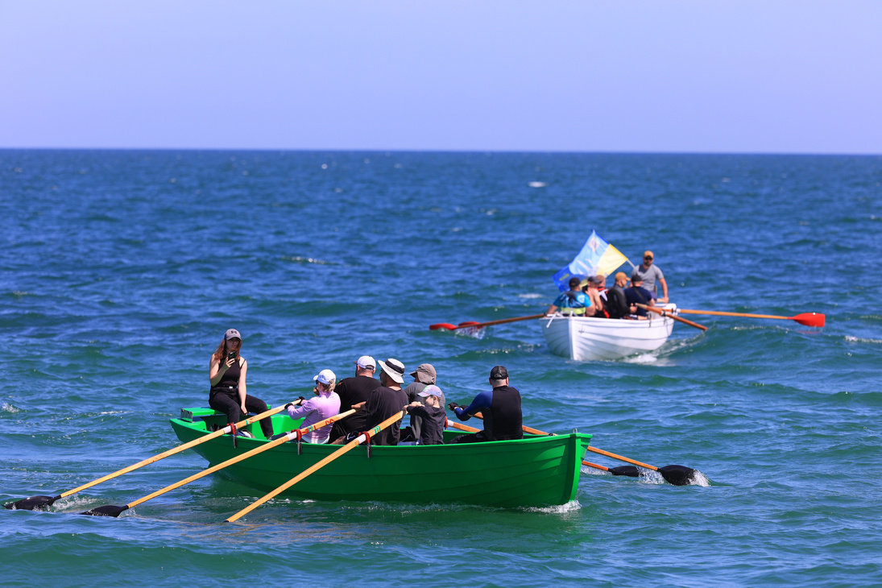
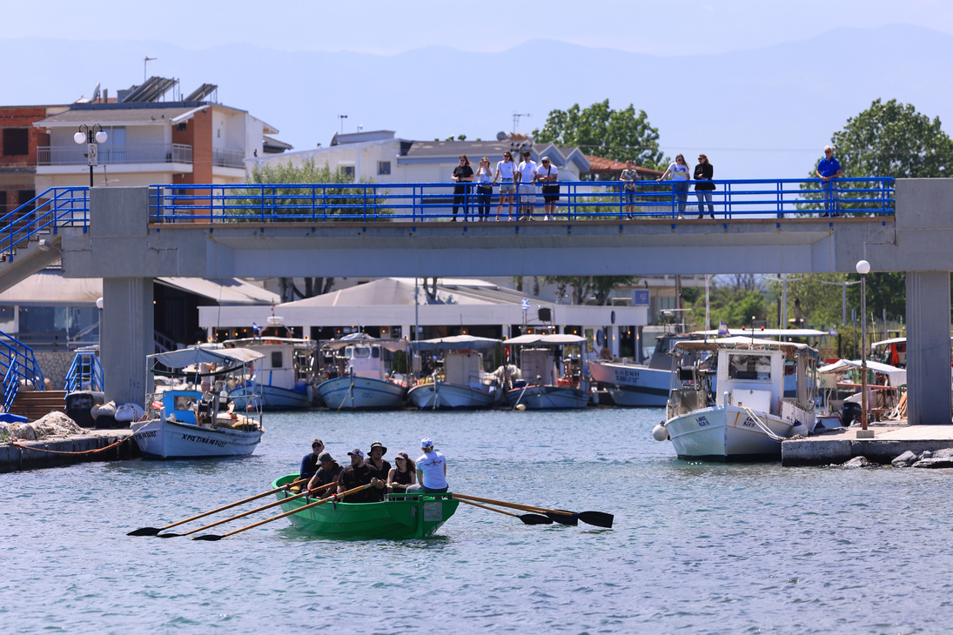
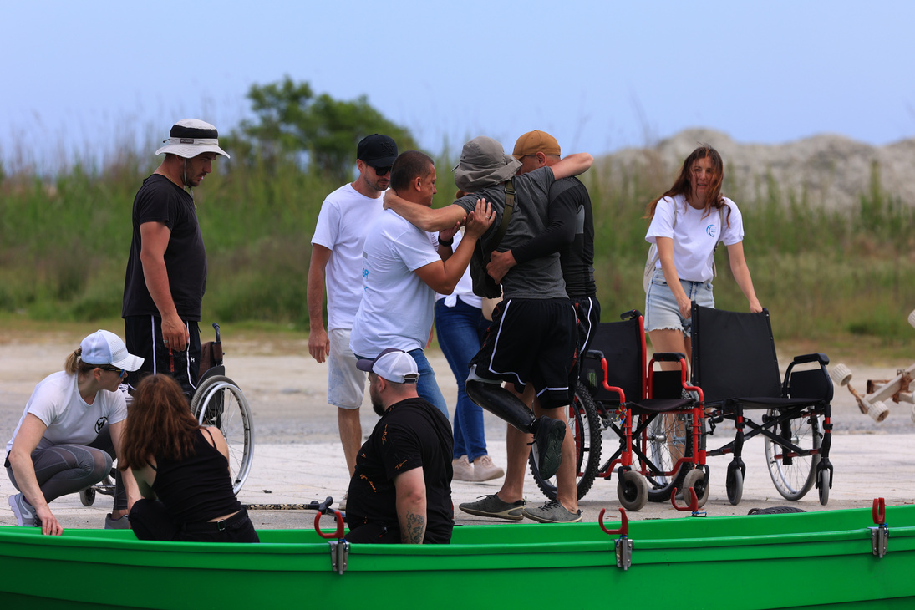
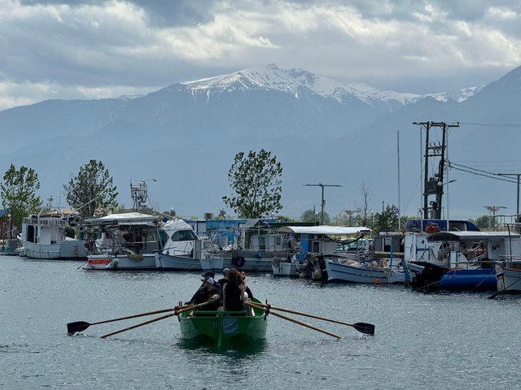
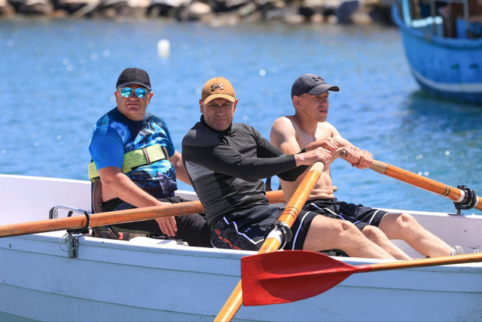
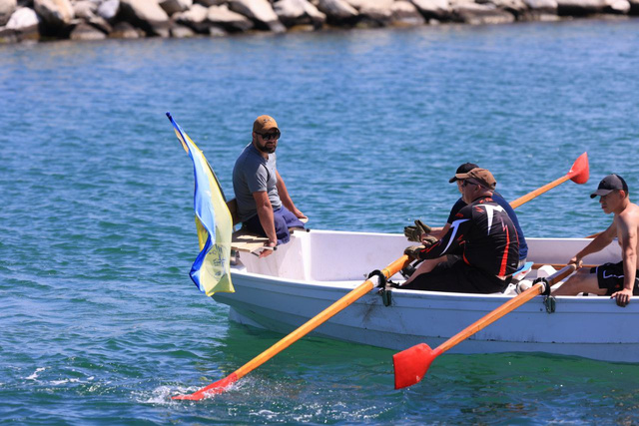
May 2025 — The Fortis program, completed by veterans from Ukraine in rowing yals along the coast of Mount Olympus
In May 2025, we organized a unique and deeply symbolic event — the Fortis voyage for Ukrainian veterans. The event took place in Greece, along the picturesque coast of the Aegean Sea, with the majestic view of Mount Olympus — a symbol of strength, faith, and immortality.

Slide 6
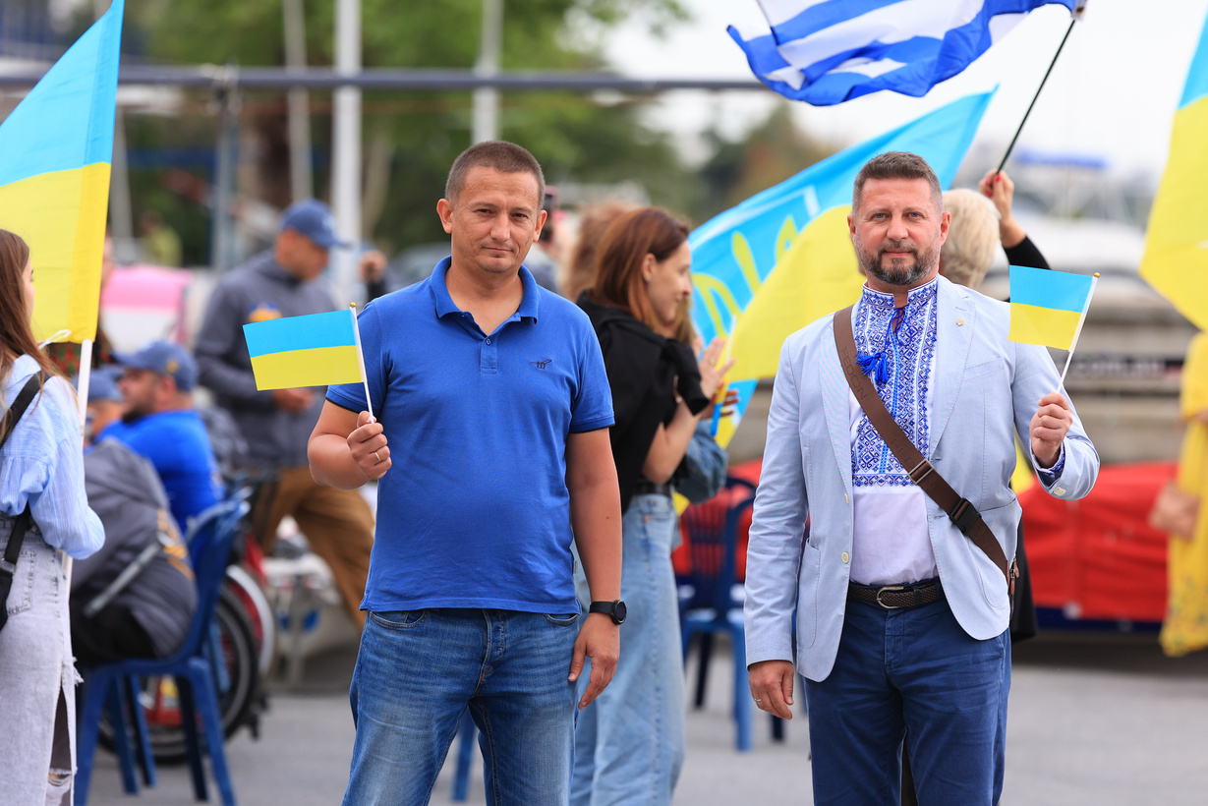
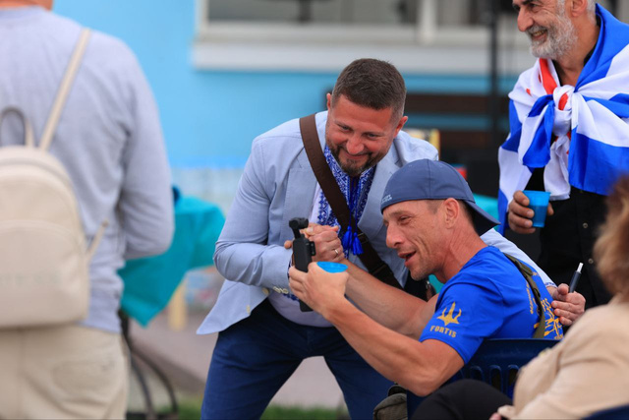
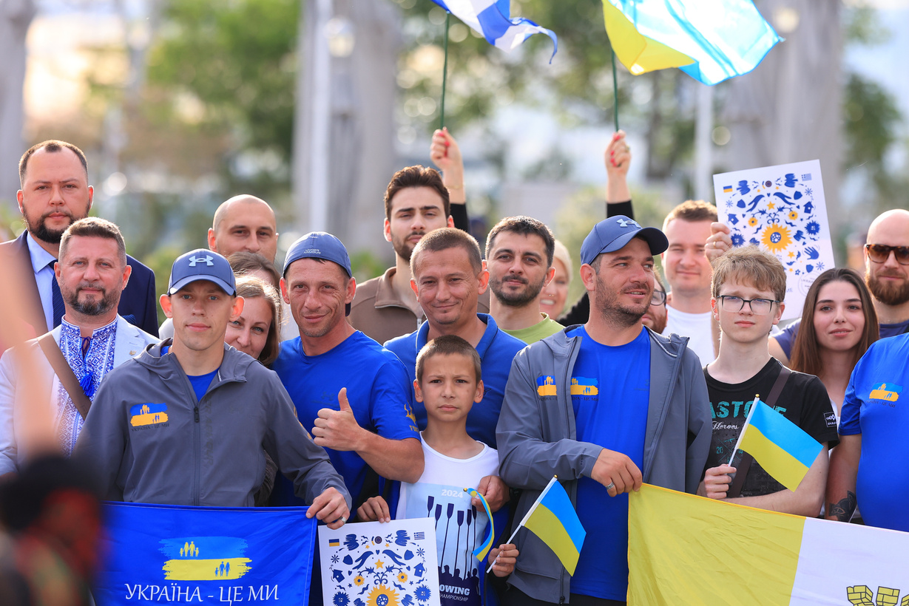
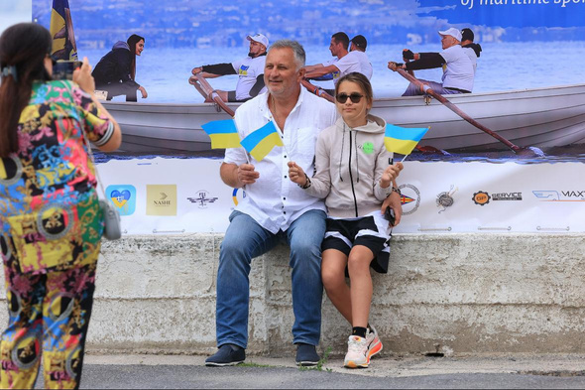
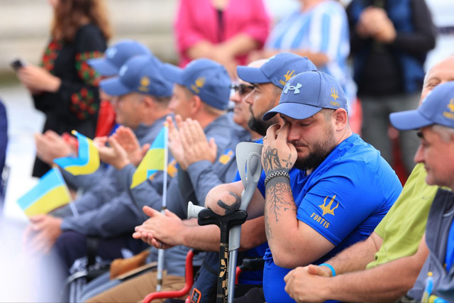
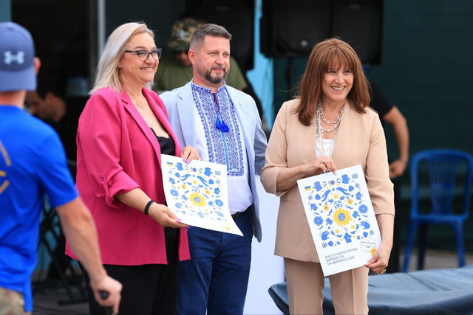
Ceremonial Program with Veterans in Greece: A Day of Unity, Gratitude, and Hope
In May 2025, a ceremonial event was held in Greece to mark the arrival of the Ukrainian veterans participating in the Fortis program. The event took place in a warm and moving atmosphere at the Kalamaria Nautical Club in Thessaloniki and became a true celebration of courage, unity, and support.

Slide 7
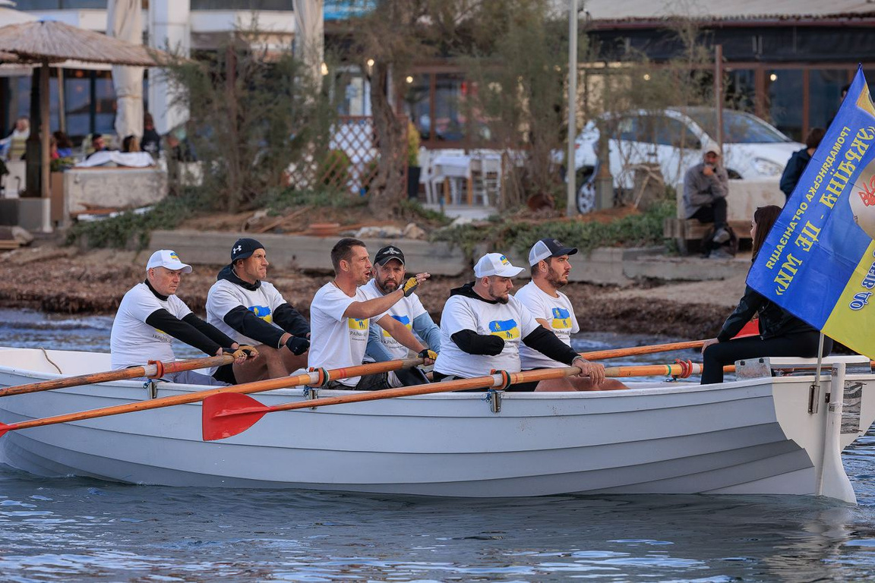

Rowing as the Foundation
Yal rowing is the heart of our program:
Evening training sessions
Individual and team rowing
Use of special yals — sports training craft on the water
The club provides storage and maintenance

Slide 8

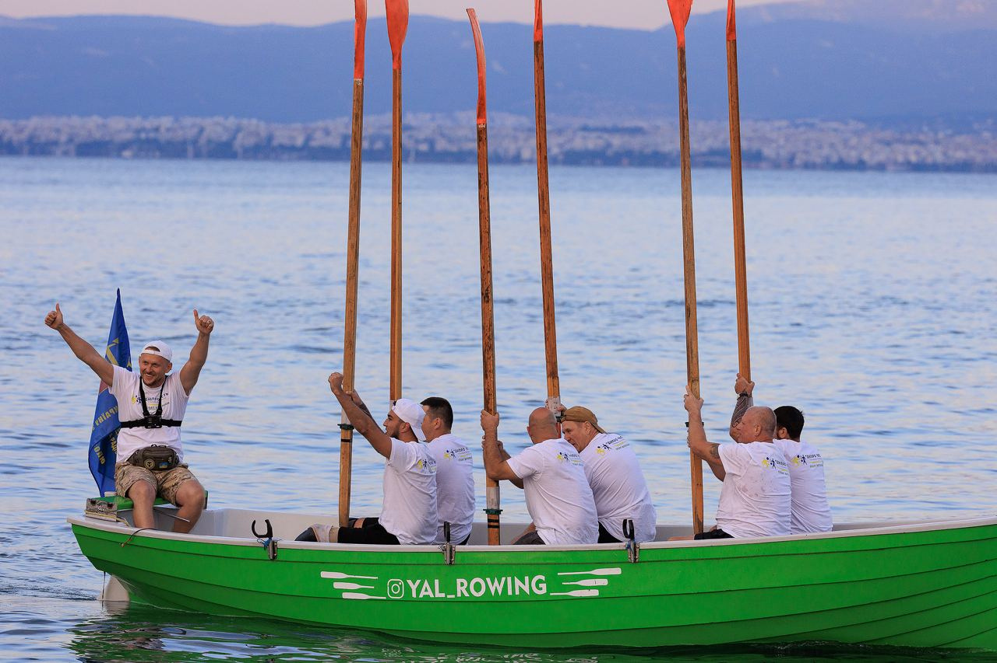
Gym and Swimming Pool
Physical recovery through training:
Modern gym: individual and group sessions
Involvement of adaptive physical training specialists
Rowing tank: safe improvement of rowing technique
Ideally suited for veterans recovering from injuries
Building International Sports Solidarity

Slide 9

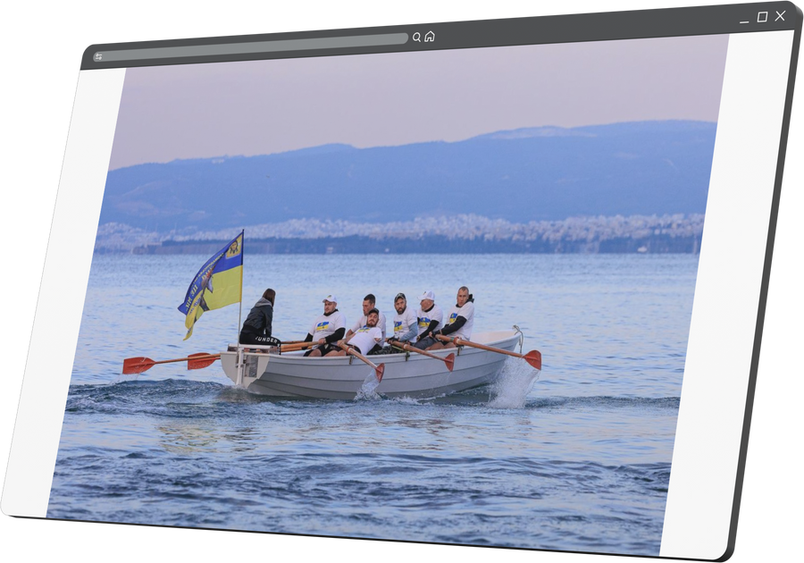
Spa and walks as part of rehabilitation
Rest and relaxation
  Spa treatments: massage, sauna, hydrotherapy, mud therapy
  Partnership arrangements with local spa centers
  Walks by the sea, breathing exercises
  Excursions and nature as a resource for recovery

Slide 10
How It Works
Ukraine
The rehabilitation center forms a group
Greece
The public organization is responsible for logistics, accommodation, and training

Slide 11
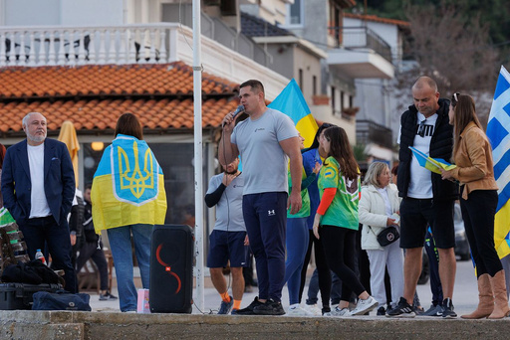
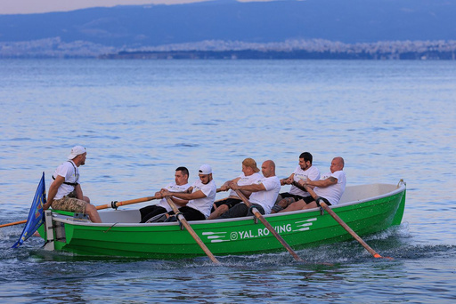
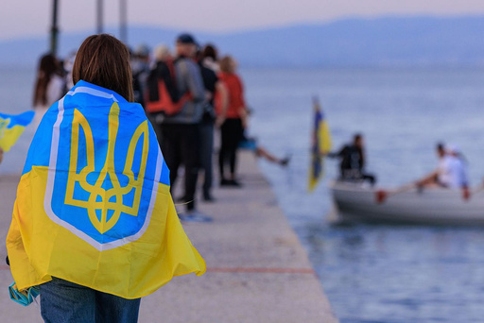
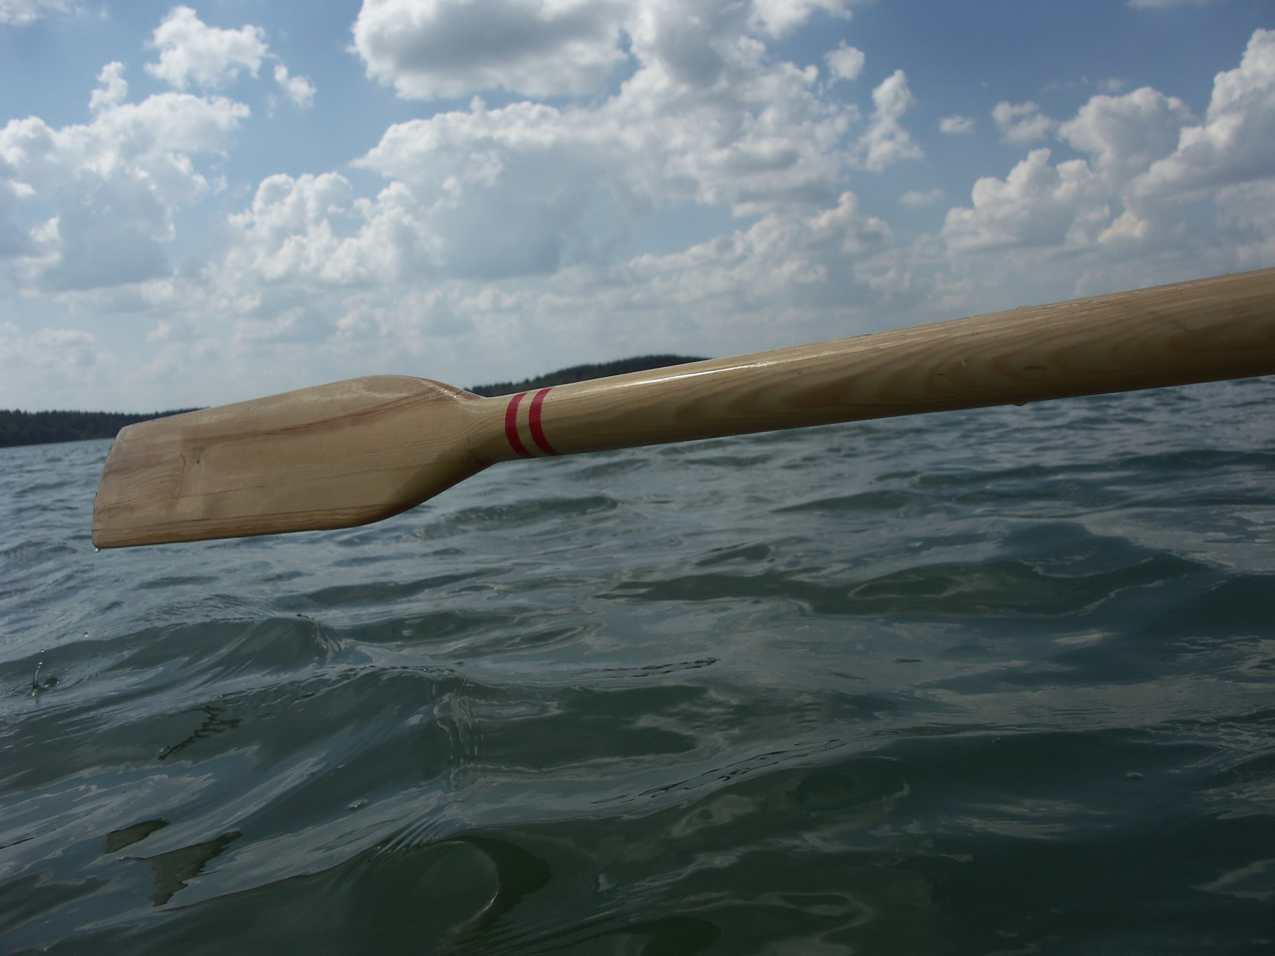
Expected Outcomes
Restoration of physical fitness
Psychological stabilization
Social integration
Promotion of sport among veterans
Strengthening international cooperation

Slide 12

Why It Matters
Not just sport. It is recovery
  Rowing as rehabilitation
  Sport is a bridge between cultures, people, and countries
  We do not just train muscles — we restore lives
  This is a way to return hope and support to those who need it

Slide 13
Prospects
Up to 5 program cycles per year
Expansion of the program to veterans’ families
Support from our partners
Development of partnerships in Greece and across Europe
International recognition as an example of effective rehabilitation

