Slide 1



Voice Over Private Coaching
Author: mega J Technologies
Created with Pi

Slide 2

CONTENTS
1. Introduction to Voice Professions
2. Anatomy and Physiology of the Voice
3. Basic Vocal Techniques
4. Reading and Interpretation
5. Practical Exercises and Tools
6. Daily Voice Over Routine

Slide 3
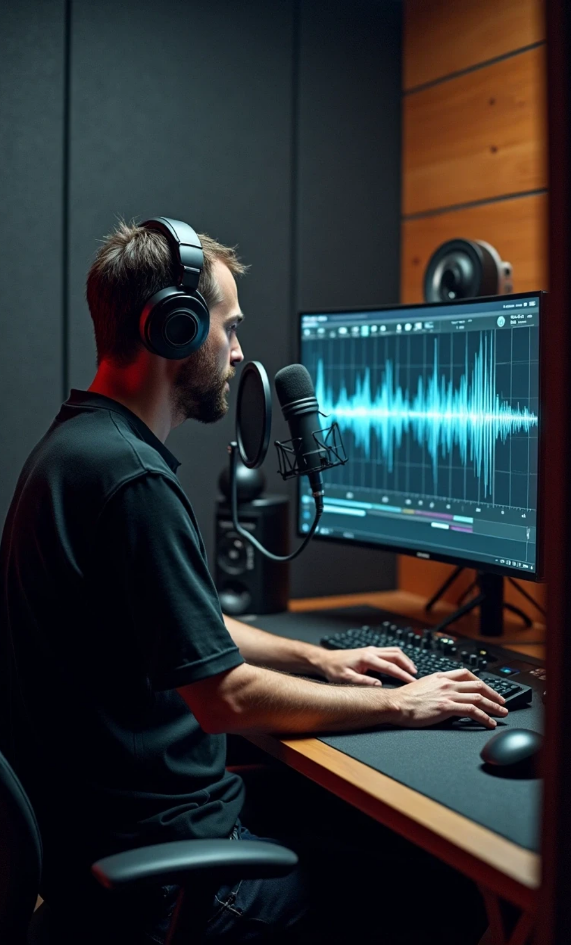







1. Introduction to Voice Professions
1
Voice Over
2
Dubbing
3
Narration
advertising, narration, radio spots, institutional
voice replacement of actors, lip synchronization
audiobooks, documentaries, voice guides
4
Vocal Animation
5
E-learning / Training
6
Corporate
corporate videos, credibility, and seriousness
animated characters, creativity
educational, neutral voice

Slide 4







2. Anatomy and Physiology of the Voice
Lungs
Diaphragm
Larynx & vocal cords
air reservoir for phonation
main engine, controlled breathing
vibration, pitch, and timbre
Resonators
Articulators
Nervous system
mouth, pharynx, nasal cavity
tongue, lips, teeth, palate
coordination of breathing and articulation

Slide 5





3. Basic Vocal Techniques
1
2
3
Posture: straight back, relaxed shoulders
Diaphragmatic breathing: controlled airflow
Clear articulation and diction
4
5
6
Voice placement and projection without straining
Vocal warm-up: sirens, vowels, tongue twisters
Hydration and vocal hygiene

Slide 6






4. Reading and Interpretation
Text breakdown: target, intention, style
Work on intonation and micro-dramaturgy
Management of rhythm and expressive pauses
Exercises: reading advertising and institutional scripts
Listening and guided self-correction

Slide 7
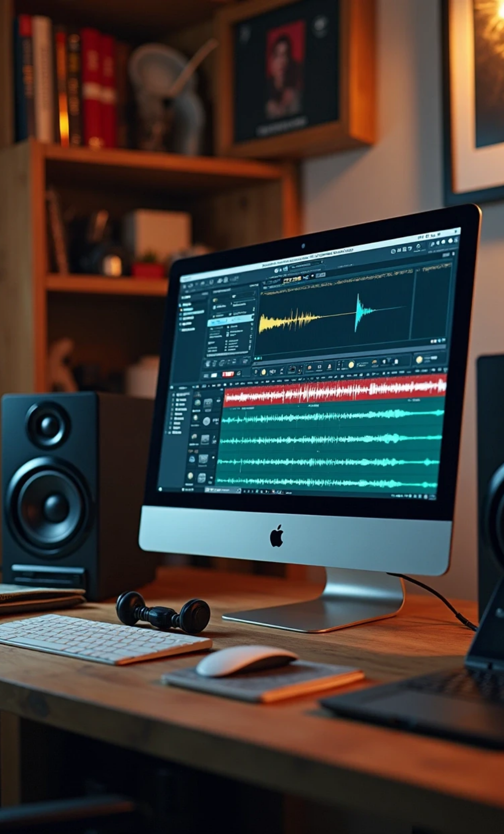







5. Practical Exercises and Tools
1
2
3
Reading aloud short texts
Recording and critical listening
Tongue twisters and intonation exercises
4
5
6
Applications: Voice Record Pro, Dolby On
Software: Audacity, Voice Tools
Platforms: Voices.com, Casting Call Club

Slide 8




6. Daily Voice Over Routine
Vocal warm-up
Reading aloud
10 min (breathing, sirens, vowels)
15 min (varied texts)
Quick recording
Active listening
5 min, self-listening
10 min, analysis of pro voice/excerpts
Hygiene
Weekly review
warm water, avoiding alcohol/tobacco
record 1–3 min, note 3 points for improvement

Slide 9
Thank You

