Slide 1
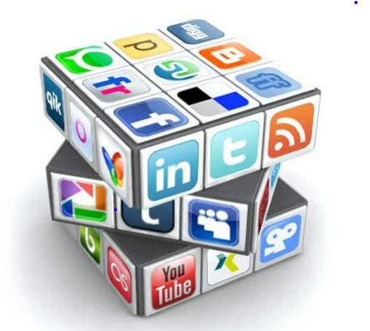
SOCIAL MEDIA MARKETING

Slide 2
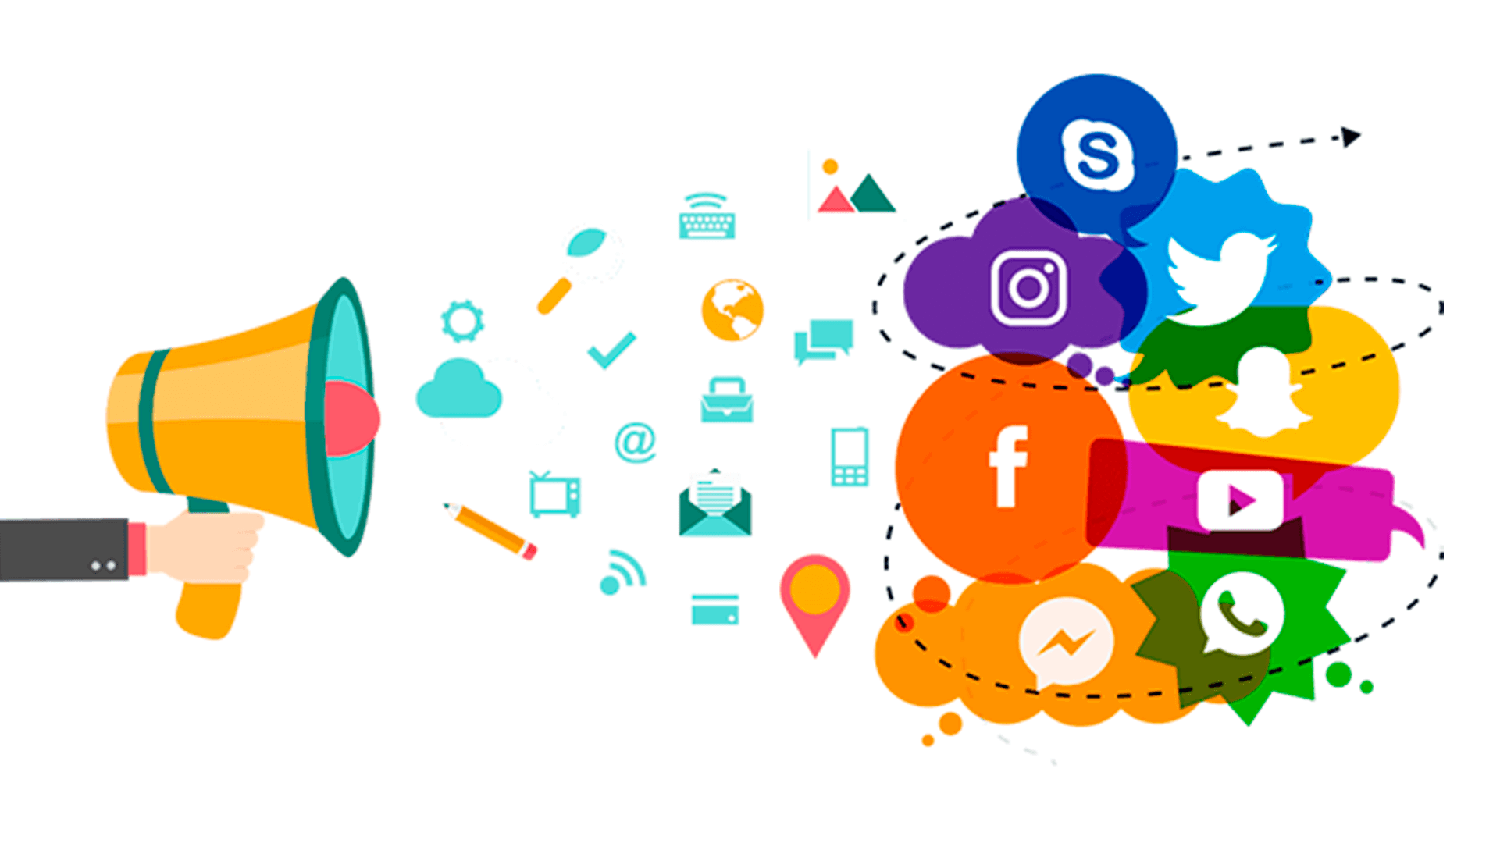
Contents
What is Social media ?
What is Social media marketing ?
Why Social media marketing ?
Importance of Social Media
Social Media Marketing Platforms
Advantages of Social Media Marketing
Disadvantages of Social Media Marketing
Social Media Marketing Strategy
Social Media Marketing Tools
Digital Marketing V/s Traditional Marketing

Slide 3
WHAT IS A SOCIAL MEDIA ?
Social Media refers to the content-based websites and applications designed to allow users to interact with each other and share created content quickly, efficiently and in real-time.
Social Media is a trendy way of electronic communication through which we can create our online communication sites to share information, images, ideas, audios, videos, and other content with our friends, business partners, relatives, as well as customers.
In simple words, we can say that social media is all about establishing communication between marketers and customers.

Slide 4
WHAT IS A SOCIAL MEDIA MARKETING ?
Social Media Marketing is a platform through which we can present our business in front of the audience.
The main goal of using social media marketing is to increase the website's traffic, increase likes, comments, and shares.
It is a platform that lets us participate in social networking.
We can share our posts on various social media platforms to improve business visibility. Today it is the best source for news updates, marketing, education, and entertainment.
It encourages participation and engagement.
Example: Facebook, Quora, Tiktok, Instagram, Twitter, Clubhouse, YouTube

Slide 5
Why Social Media Marketing?
There are the following reasons to use Social Media Marketing –
Social Media Marketing helps us to improve product visibility and brand awareness.
Social media marketing uses various social media marketing platforms such as Facebook, Twitter, Instagram, Youtube, and Snapchat to reach the target audience.
It offers cost-effective techniques to grow our business.
It helps us to improve search engine ranking.
It helps us to enhance brand authority.
Social Media Marketing provides an opportunity to gain new customer insights.
It helps us to increase top-funnel traffic.
It helps us to generate new leads.

Slide 6
Importance of Social media Marketing
Helps increase brand visibility online
Creates consumer awareness
Increases leads
Gives a platform to tell a brands story to the target audience
Leads to increased engagement
Helps gain insight on audience demographics
Helps drive conversions
It's cost-effective
‍

Slide 7
Social Media Marketing Activities
Content planning and creation
Content scheduling and publishing
Social media analytics
Social listening.
Community management
Social media advertising.

Slide 8
www.noteslearning.com
THE SOCIAL MEDIA MARKETING PROCESS
There are five steps to social media marketing process:
Fan Acquisition
Engagement
Amplification
Community
BRAND STRENGTH
(SALES)

Slide 9









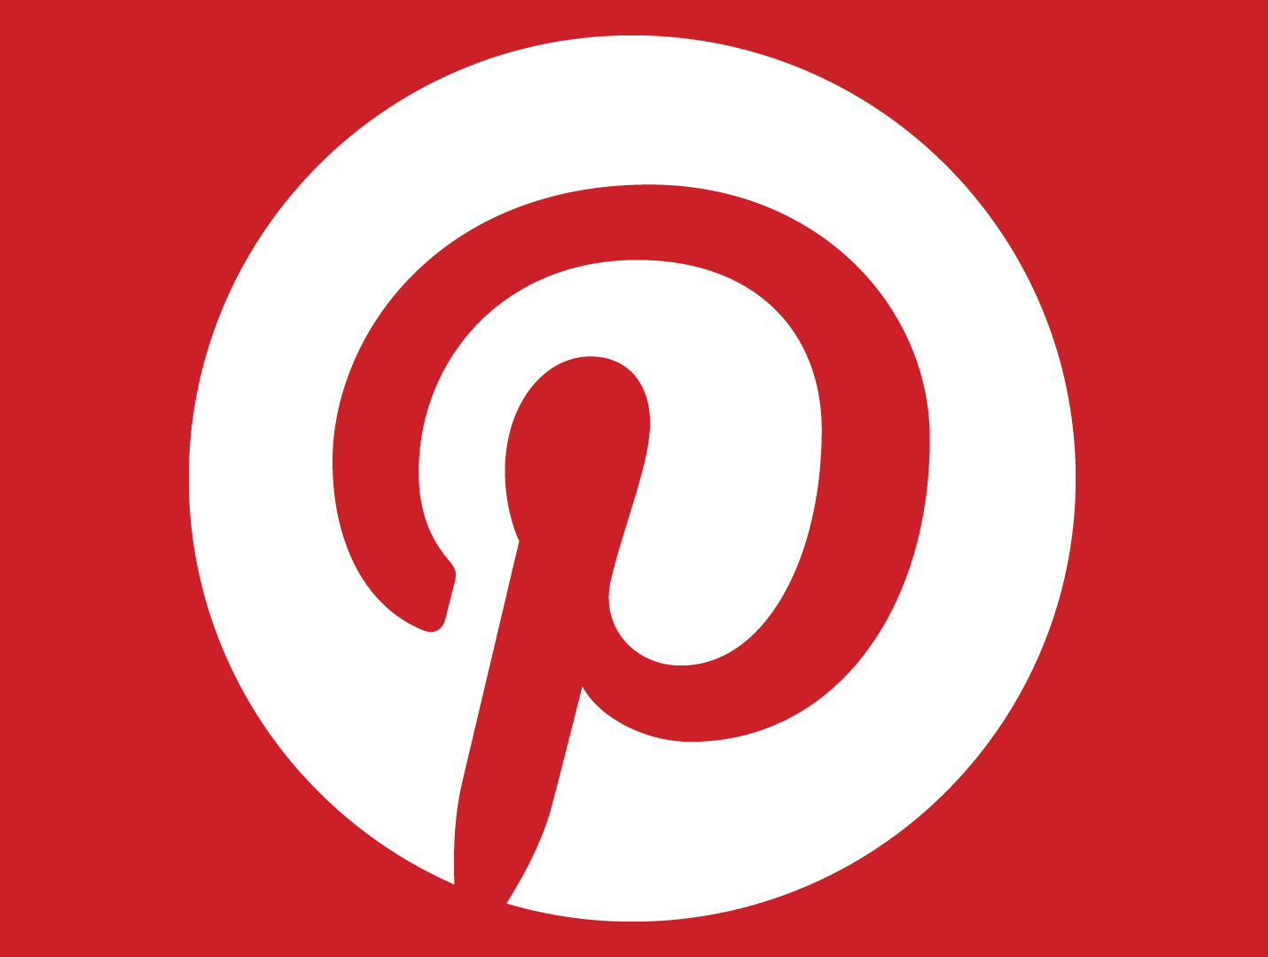
Social Media Marketing Platforms
TOP 10 SOCIAL NETWORKING SITES
FACEBOOK 5.7 billions monthly active users
YOUTUBE 2.0 billions monthly active users
WHATSAPP 2.0 billions monthly active users
INSTAGRAM 800 billions monthly active users
TIKTOK 689 millions monthly active users
SNAPCHAT 433 millions monthly active users
REDDIT 430 millions monthly active users
PINTEREST 416 millions monthly active users
TWITTER 353 millions monthly active users
LINKEDIN 310 millions monthly active users

Slide 10
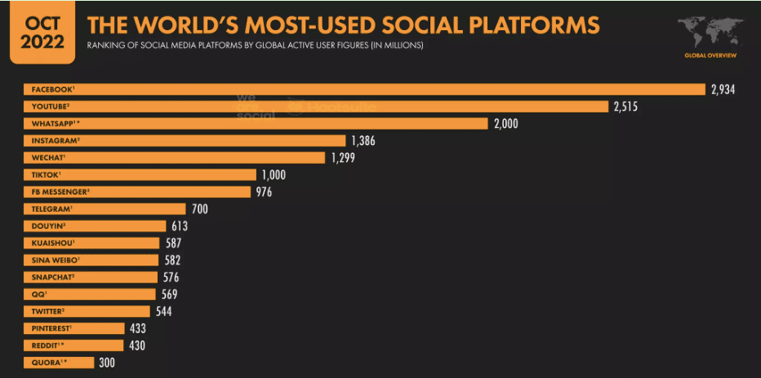

Slide 11

FACEBOOK
Daily active users - 3.45 billion
Monthly active users - 5.70 billion
Facebook is the best social media marketing platform, which is founded by Mark Zuckerberg on February 4, 2004.
It allows us to invite and connect with our friends, relatives, colleagues, and customers by sending them messages, images, audios, and videos.
It also allows us to like and comment on the posts, which are shared by them.
Organizations use Facebook to promote their brand, create awareness about their product, and reach out to a wider audience.

Slide 12
Advantages Of Using The Facebook Platform For Social Media Marketing
Facebook helps us to easily reach the targeted audience.
It allows us to share budget-friendly ads to the audience.
Using Facebook, we can learn and use a new market strategy at a low cost.
It provides various marketing platforms.
It allows organizations to communicate with clients.

Slide 13

Twitter
Daily active users - 145 million
Monthly active users - 353 million
Twitter is one of the most effective, popular, and fast-paced social media marketing platform created by Jack Dorsey, Noah Glass, Biz Stone, Evan Williams, and launched in July 2006.
It is an SMS-based communication platform, which allows registered users to read and write small messages called "tweets.“
Using Twitter, marketers can easily reach hundreds and thousands of customers to share the latest news and promote their brand.
The main disadvantage of using twitter is that we can use only use 280 characters for the message

Slide 14
Advantages Of Using The Twitter Platform For Social Media Marketing
It helps us to increase customer satisfaction.
It allows us to continuously send information in the form of small messages called "tweets.“
It helps us to establish a stronger relationship with customers.
It improves organic search engine ranking.
It is a very efficient platform for gathering feedback from customers.

Slide 15

INSTAGRAM
Daily active users - 500 million
Monthly active users - 800 million
Instagram is maintained by Facebook.
It is an effective tool to reach the audience and allows the marketer to share images, memes, and videos to promote their business.
According to a survey, 80% of accounts follow a business on Instagram.
It works flawlessly on mobile phones and tablets.
Recently Instagram introduces a new feature that is shared stories every day. This feature helps marketers to easily update their customers about new products on a daily basis.

Slide 16
Advantages Of Using The Instagram Platform For Social Media Marketing
Instagram's Global rank (Worldwide rank) is 5th on the internet.
Instagram helps marketers to enhance their branding.
It is a marketer-friendly platform.
It helps marketers to drive traffic and grow their business.
It helps marketers to acquire customers easily.
On Instagram, content is available in the form of images and videos, which helps customers to understand the product in a very simple way.
Instagram's brand engagement and visual content are ten times higher than Facebook.

Slide 17

LinkedIn
No. of registered users - 562 million
Monthly active users - 303 million
LinkedIn is the best B2B (Business 2 Business) social media marketing platform, which was founded in 2002.
It allows us to create profiles as a fresher or as a professional. It is a place that helps us to search for jobs, stay connected with professionals, recruit new employees, and discuss business ideas with experienced employees to promote our business.
A company profile on LinkedIn not only helps us to generate the local leads but also helps us to draw global leads.

Slide 18
Advantages Of Using The LinkedIn Platform For Social Media Marketing
It provides an opportunity to stay updated about new technologies.
It helps us to display and update our resume to search for new job opportunities.
It is a free platform that mainly focused on career development.
It helps to build and promote business brands.
It is used to generate more leads.

Slide 19

Pinterest
Monthly active users - 320 million
Daily active users - 120 million
Pinterest is a combination of the two words "Pin" (Thumbtack) and "Interest" (Interesting).
It is quite different from all other social media marketing platforms.
It is an image-pinning website introduced in 2009.
Currently, Pinterest becomes one of the largest visual social networks to share and discover ideas, images, recipes, videos, new brands, infographics, and more.

Slide 20
Advantages Of Using The Pinterest Platform For Social Media Marketing
It Pinterest is the fastest-growing platform for online content distribution.
It is mostly used to create brand awareness and increase website leads.
Its user-friendly platform allows us to create a visual profile for business and publish news.
Its visual-heavy social network helps us to build more traffic on our website at a low cost.

Slide 21

Youtube
No. of daily active users - 1 billion
No. of monthly active users - 2 billion
YouTube is an excellent free video-sharing platform for social media marketing.
It was created in 2005.
YouTube helps us to create and upload our videos on the valuable content and deliver it to the audience in the form of tutorials.
YouTube is like a platform where we can show our talent to attract the audience.
In YouTube, content mainly available in the form of Podcasts, Infographics, Presentations, and video series.
Note: YouTube is a mixture of both social media marketing and content marketing.

Slide 22
Advantages Of The Youtube Platform For Social Media Marketing
YouTube is the 2nd largest search engine and the 3rd most visited website.
It is the best and easiest way to learn new technologies.
It helps us to promote and sell our products worldwide.
It is completely free to use and helps to acquire qualified traffic.
It will expose you to connect with a huge audience.

Slide 23

Snapchat
No. of daily active users - 210 million
No. of monthly active users - 360 million
Snapchat is a great platform for adults.
It is free to download.
It allows us to create a new type of social media on a network.
Snapchat mobile app is used to share photos, videos, and doubles as messaging services for users.
It is most known due to the fact that messages and content disappear on it.
Users can either send the content directly to another user or upload this content as their "story," which is viewable to users till the next 24 hours.

Slide 24
Advantages Of The Snapchat Platform For Social Media Marketing
It allows us to share and collect snaps from specific events to create stories on the social media platform.
It is used to add a filter on photos to make them more attractive.
It allows customers to interact with other experienced customers to know about the pros and cons of a product.
Using Snapchat, customers can directly communicate with companies.
It is a user-friendly platform for newcomers.

Slide 25
Advantages of Social Media Marketing
1. Increase Brand Awareness
2. Generates more inbound traffic on websites
3. Helps us to reach a large audience
4. Improve Brand Loyalty & Customer engagement
5. Makes our customers Up-To-Date
6. Cost-efficient
7. Improve Search Engine Ranking
8. Faster and Easier Communication

Slide 26
Disadvantages of Social Media Marketing
1. Time-consuming: Time is the major issue in social media marketing because every startup takes a lot of time to expand the business.
2. Receives negative feedback from the audience: The audience shares both their positive and negative experience in the social media platform, which is visible to all other audiences.
3. Needs qualified personnel: To focus on business issues, we have to recruit qualified personnel to manage our business accounts and traffic. This implies that we have to spend more money to hire them.
4.Exposure to competitors: Social media marketing allows us to take research on our competitor's strategy. However, your competitors can still connect with your business methodology through your social media marketing platform.

Slide 27
Social Media Marketing Strategy
1.Set the objectives/goals
2. Know everything about your target audience
3. Research the competition
4. Select the right social media platform for audience
5. Set brand guidelines
6. Build your initial presence
7. Plan the type of content that you want to share with your audience
8. Create a social media content calendar
9. Run Advertisements on the social media platform to promote your products and services
10. Test and evaluate your results

Slide 28
Social Media Marketing Strategy
1.Set the objectives/goals:-
First, set the objective that you want to achieve using Social Media Marketing. In general, there are the following 9 goals that every social media marketer wants to achieve:
Increase brand awareness
Generate new leads
Grow revenue by increasing sales or signups
Generate traffic to our website
Boost band engagement
Build a community around the business
Offers social customer services
Increase mentions in the press
Listen to conversations about your brand

Slide 29
Social Media Marketing Strategy
2. Know everything about your target audience:-
Once you define your objective, then know about your audience that what they want to see on a social media platform, which type of content they generally like and share. This strategy helps you to know about your potential fans, customers, and followers that you really want to achieve and need.
There are the following things that you should know about your audience -
Who are they? (Example: their age, gender, location, interest, etc.)
In which field they are interested? (Example: Entertainment, content, case studies, education, electronics, etc.)
In which social media platform, they are generally online? (Example: Facebook, Instagram, Snapchat, and more)
How do they consume the content? (Example: read social media posts, watch videos, etc.)
For example, more than 75% of teenagers are on Facebook, Instagram, and Snapchat.

Slide 30
Social Media Marketing Strategy
3. Research the competition:-
Research your competitor's social medial marketing activity every day to reach the audience.
Spend most of the time to research the following questions -
What kind of content are they publishing?
In which platform they are most active?
What hashtags do they use?
What is the tone of their voice?
What type of communication they have with their target audience?
How much time they generally spend on social media platforms?
You can also conduct a competitive analysis to understand what your competitors are doing to target the audience and expand their industry.

Slide 31
Social Media Marketing Strategy
4. Select the right social media platform for audience:-
We should have to analyze which social media platform is the most valuable for our business, which social media platform is the most effective for our audience, and where our target audience hags out.

Slide 32
Social Media Marketing Strategy
5. Set brand guidelines:-
It is one of the most important steps for social media marketing strategy.
There are the following social media marketing brand guidelines -
Brand voice
Use of emojis
Use of hashtags
Protocol on interacting with the audience
Banned words/topics

Slide 33
Social Media Marketing Strategy
6. Build your initial presence:-
Building an initial presence includes a small introduction about your business, which mainly includes small business information, a few images, and our first post to target the audience.
There are the following steps include in the stage of initial presence -
Enter business information - It includes an overview of your business, contact details, and link to your website.
Upload images - It includes a recognizable profile image such as a logo. Always remember that image is designed in the proper size and responsible for both desktop and mobile views.
Create your first post - It is the most visible page for your audience, so always create this page more interactive and good looking.
Follow your contacts - First, start following with those loyal customers who frequently like and follow your account and posts to grow your business.

Slide 34
Social Media Marketing Strategy
7. Plan the type of content that you want to share with your audience:-
Content is one the most effective way to achieve our objectives on social media platforms, so always plan to share effective, valuable, informative, and high-quality content with your audience.
There are the following various types of content are available on the social media platforms -
Photos
Videos
Graphics
Articles
Livestreams
Stories

Slide 35
Social Media Marketing Strategy
8. Create a social media content calendar:-
A content calendar helps us to see how frequently we are publishing content for our audience.

Slide 36
Social Media Marketing Strategy
9. Run Advertisements on the social media platform to promote your products and services:-
All social media platforms allow us to run various advertisements (paid as well as unpaid) on social media to increase the size of our business and audience.
There are the following types of ads that you run on the social media platform -
Storewide discounts - It allows the audience to select and purchase products as well as services at a discounted price.
New product promotions - The main aim to run these ads is to aware the audience about newly released products.
New customer deals - It is designed to encourage the audience to purchase their products from your site.
Events/Webinar promotions - It is used to invite the audience to join your events to increase their attention.

Slide 37
Social Media Marketing Strategy
10. Test and evaluate your results:-
You can evaluate the use of a social media platform based on the following parameter -
Followers/Likes - It is used to analyze the size of our social media audience.
Reach - It displays how many people seeing your social media posts.
Engagements - It shows the number of Likes, comments, and shares that we received on our content.
Clicks - It shows the number of clicks that we received on our post.

Slide 38
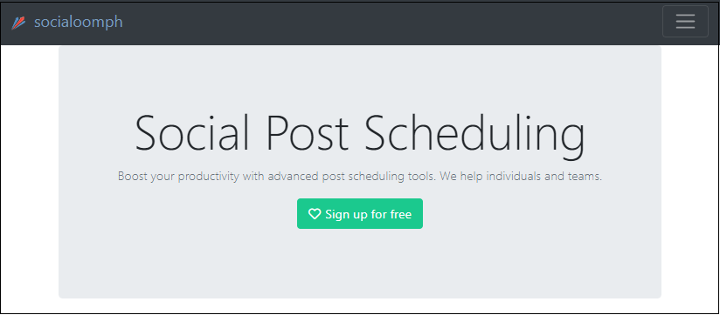
Social Media Marketing Tools
1.SocialOomph:-
Website: https://www.socialoomph.com/

Slide 39
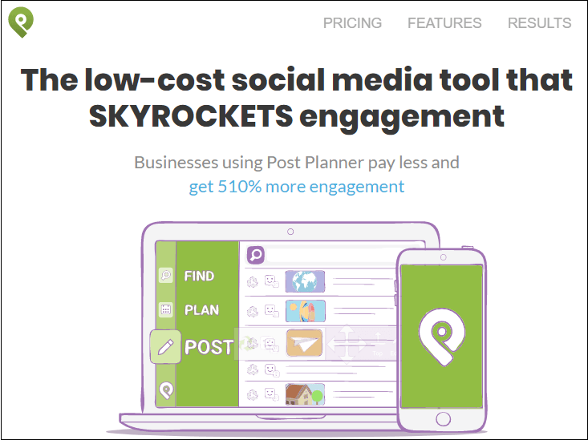
Social Media Marketing Tools
2. PostPlanner:-
Website: https://www.postplanner.com/

Slide 40
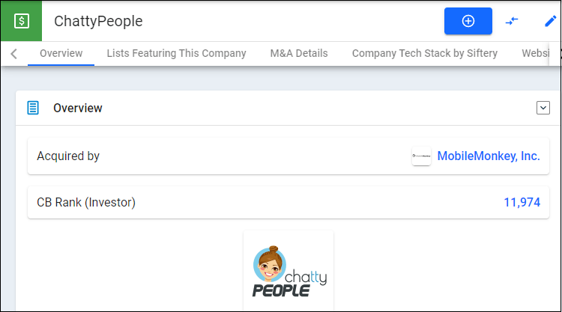
Social Media Marketing Tools
4. Chattypeople:-
Website: https://www.crunchbase.com/organization/chattypeople

Slide 41
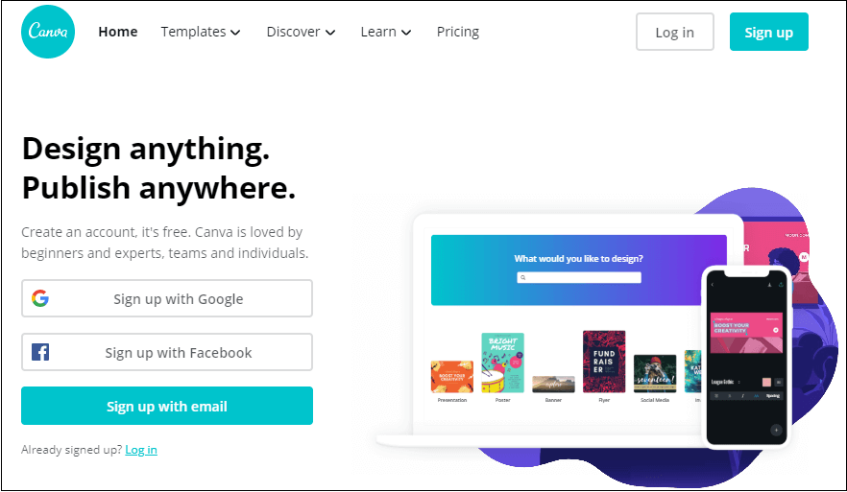
Social Media Marketing Tools
5. Canva:-
Website: https://www.canva.com/

Slide 42
Social Media Marketing Tools
5. Canva:-
Website: https://www.canva.com/

Slide 43
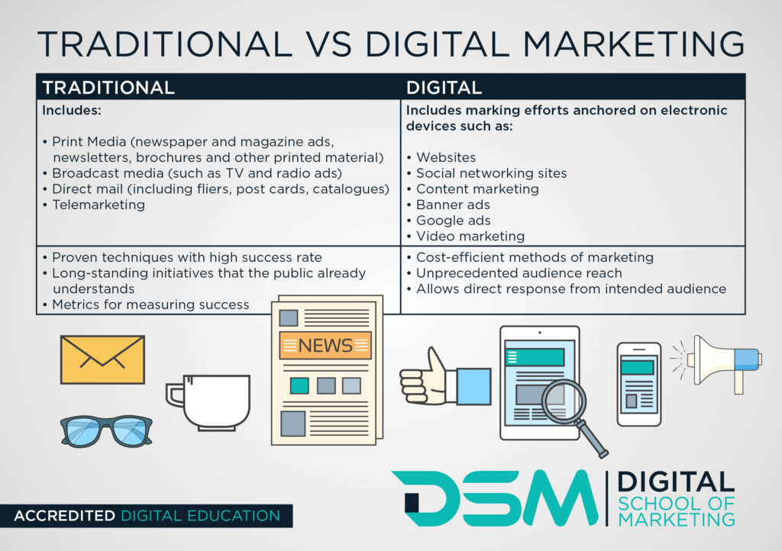

Slide 44

ANY Questions???

Slide 45
THANK YOU !!!

