Slide 1
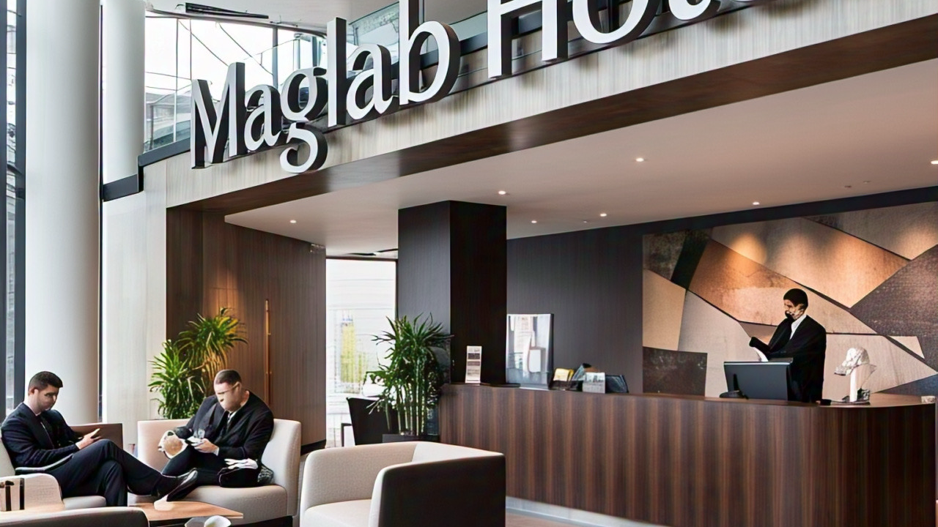
Maglab Hotel & Suites
You are welcome !! We appreciate your Hard work !!
Presentation By GRAce Larbi Boateng

Slide 2
Coperate Owner
Mr. Robert Larbi Duodu
Chief Executive Officer (C.E.O)
Grace Larbi Boateng
Interim Operational Manager
Sarah tetteh
Hous keeping Supervisor on ground
( )
Restaurant Manager
Professional Chef and Cook
Waiters
Assisstance
Front Desk Attendace
Laundry, Grounds keeper
Interim Operational Manager
Sarah tetteh

Slide 4
OUR Vision & Mission
Maglab Hotel is 30 years old which continues to preserve traditional gliding over the years and to promote the highest standard striving for excellence as three-star facilities providing exquisite hotel services from accommodations food and beverage services to satisfy clients’ demand. Our hotels are ideal and address business community.

Slide 5
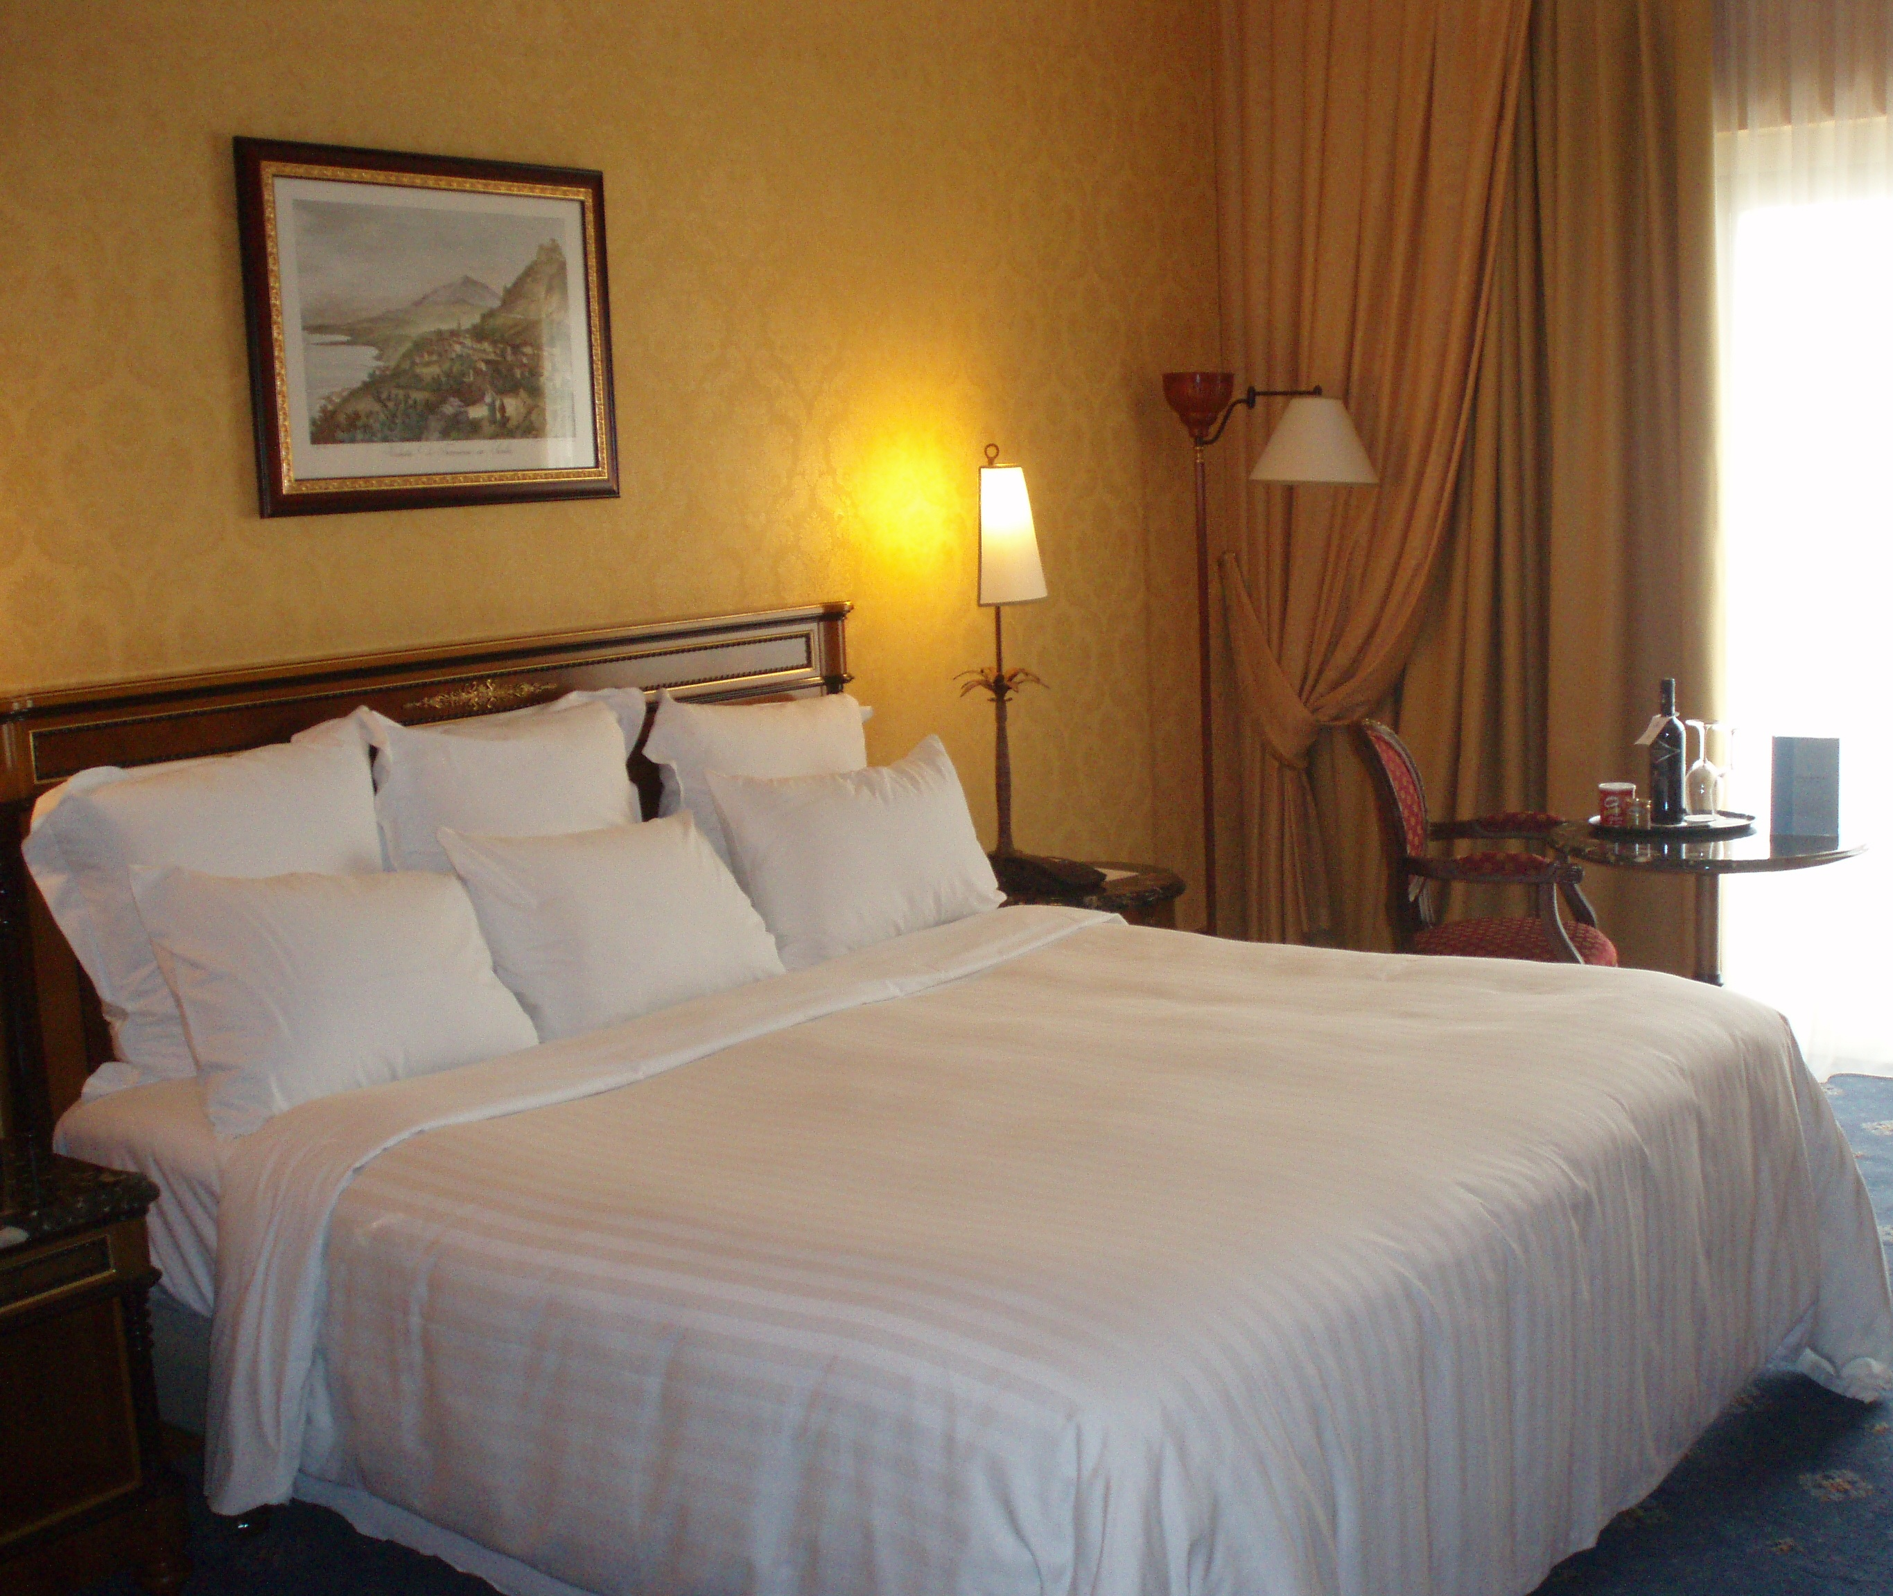
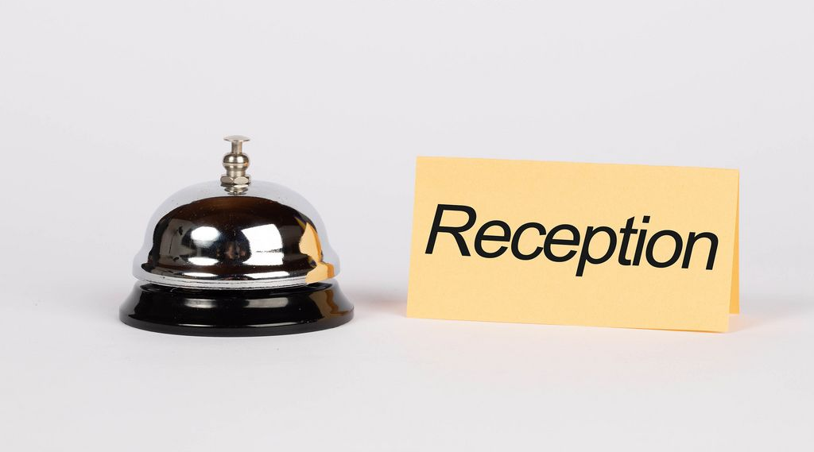
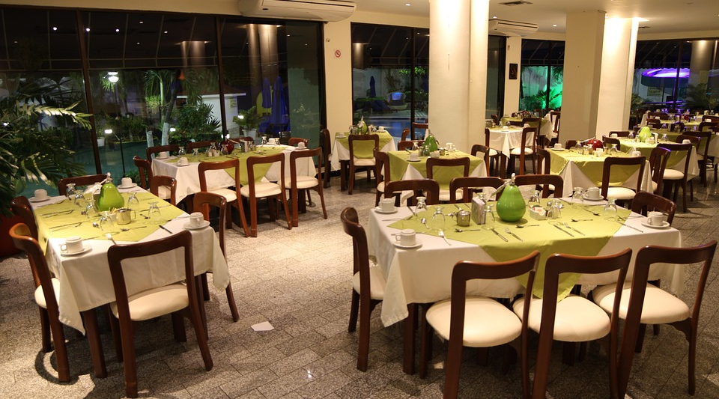
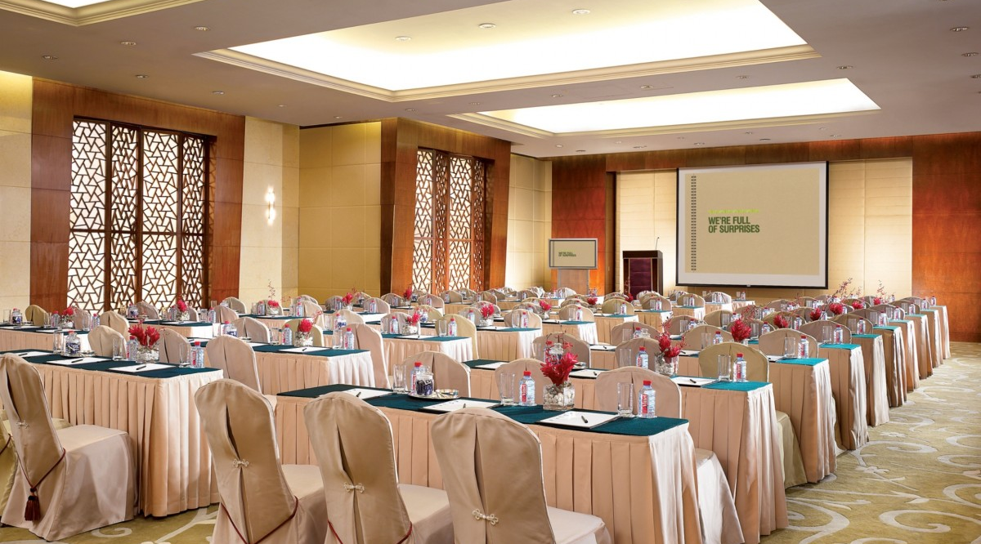
Our Facilities
We have what it takes to make a hotel home away from home. With our qualified and staff, you are sure of your quality service, warm and friendly environment. Our accommodating personnel assures you of value for services. A 24-hour reception with a resting bar that will offer you several choices of drinks to your taste.
This Photo by Unknown Author is licensed under CC BY

Slide 6
GUESTROOMS AND AMMENITIES (what we have to offer )
Our guest rooms are tailored to satisfy guests demand from single rooms, double rooms, Executive and Suites. All guestrooms are en-suite with hot and cold baths fixed in suites for your comfort.
In addition, our guestrooms are outstandingly clean and equipped with multi-channel DSTV programs and entertaining programs. Our rooms are fully air conditions to create a cooling, relaxing, productive and healthy indoor space, regardless of the outside weather conditions; comfortable environment; A refrigerator /mini fridge to cool your wine on special occasions or cool your drinks or snacks for your late-night craving or a secure place to store medications. A television for your entertainment and convenience.
There is one thing that you may enjoy, the spectacular view of some part from the privacy of your balcony to enjoy indigenous culture of Ghanaians.

Slide 7
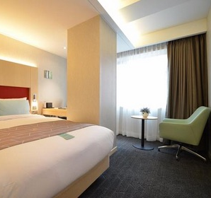
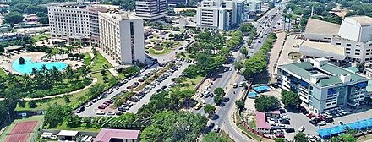
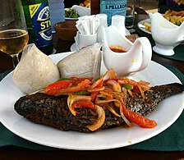
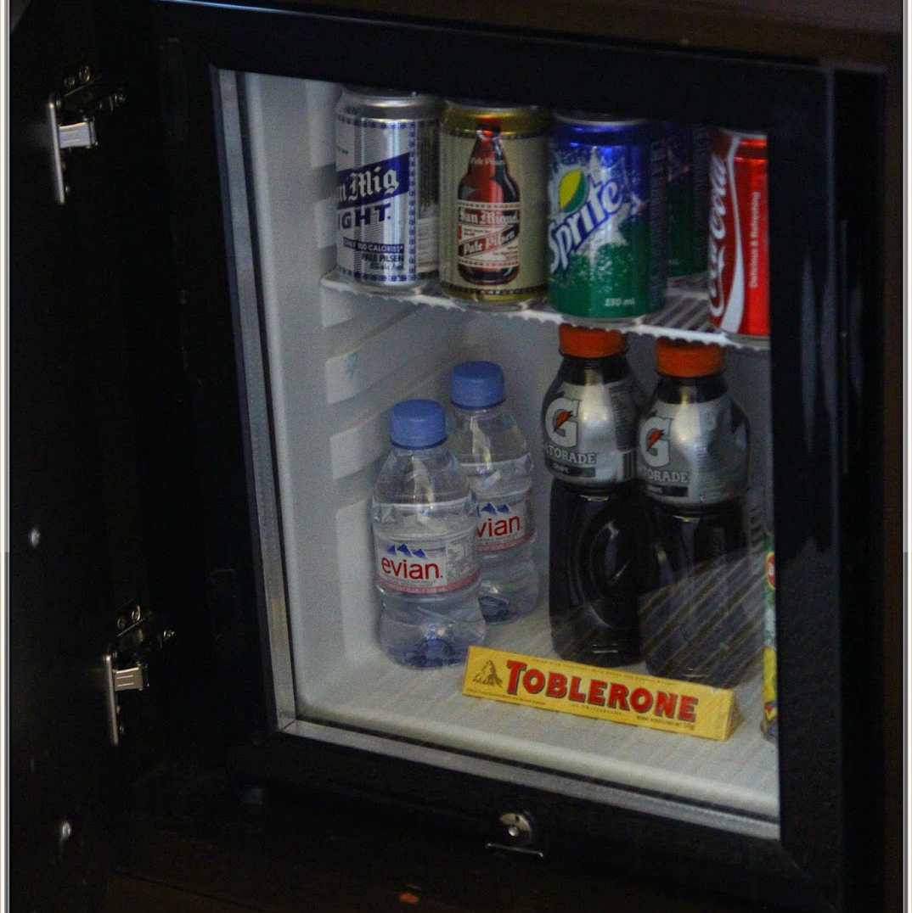

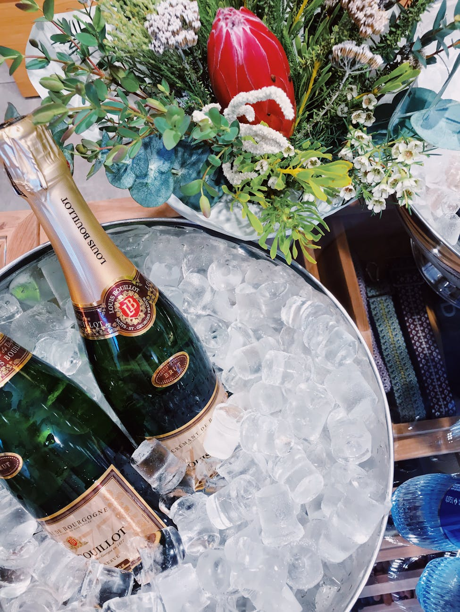

Slide 8
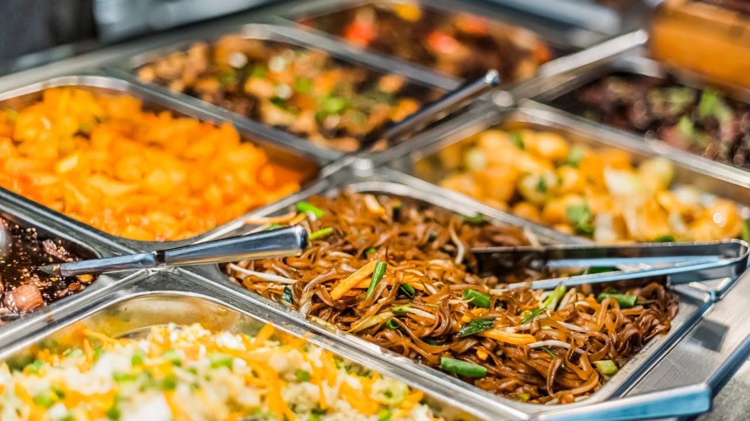
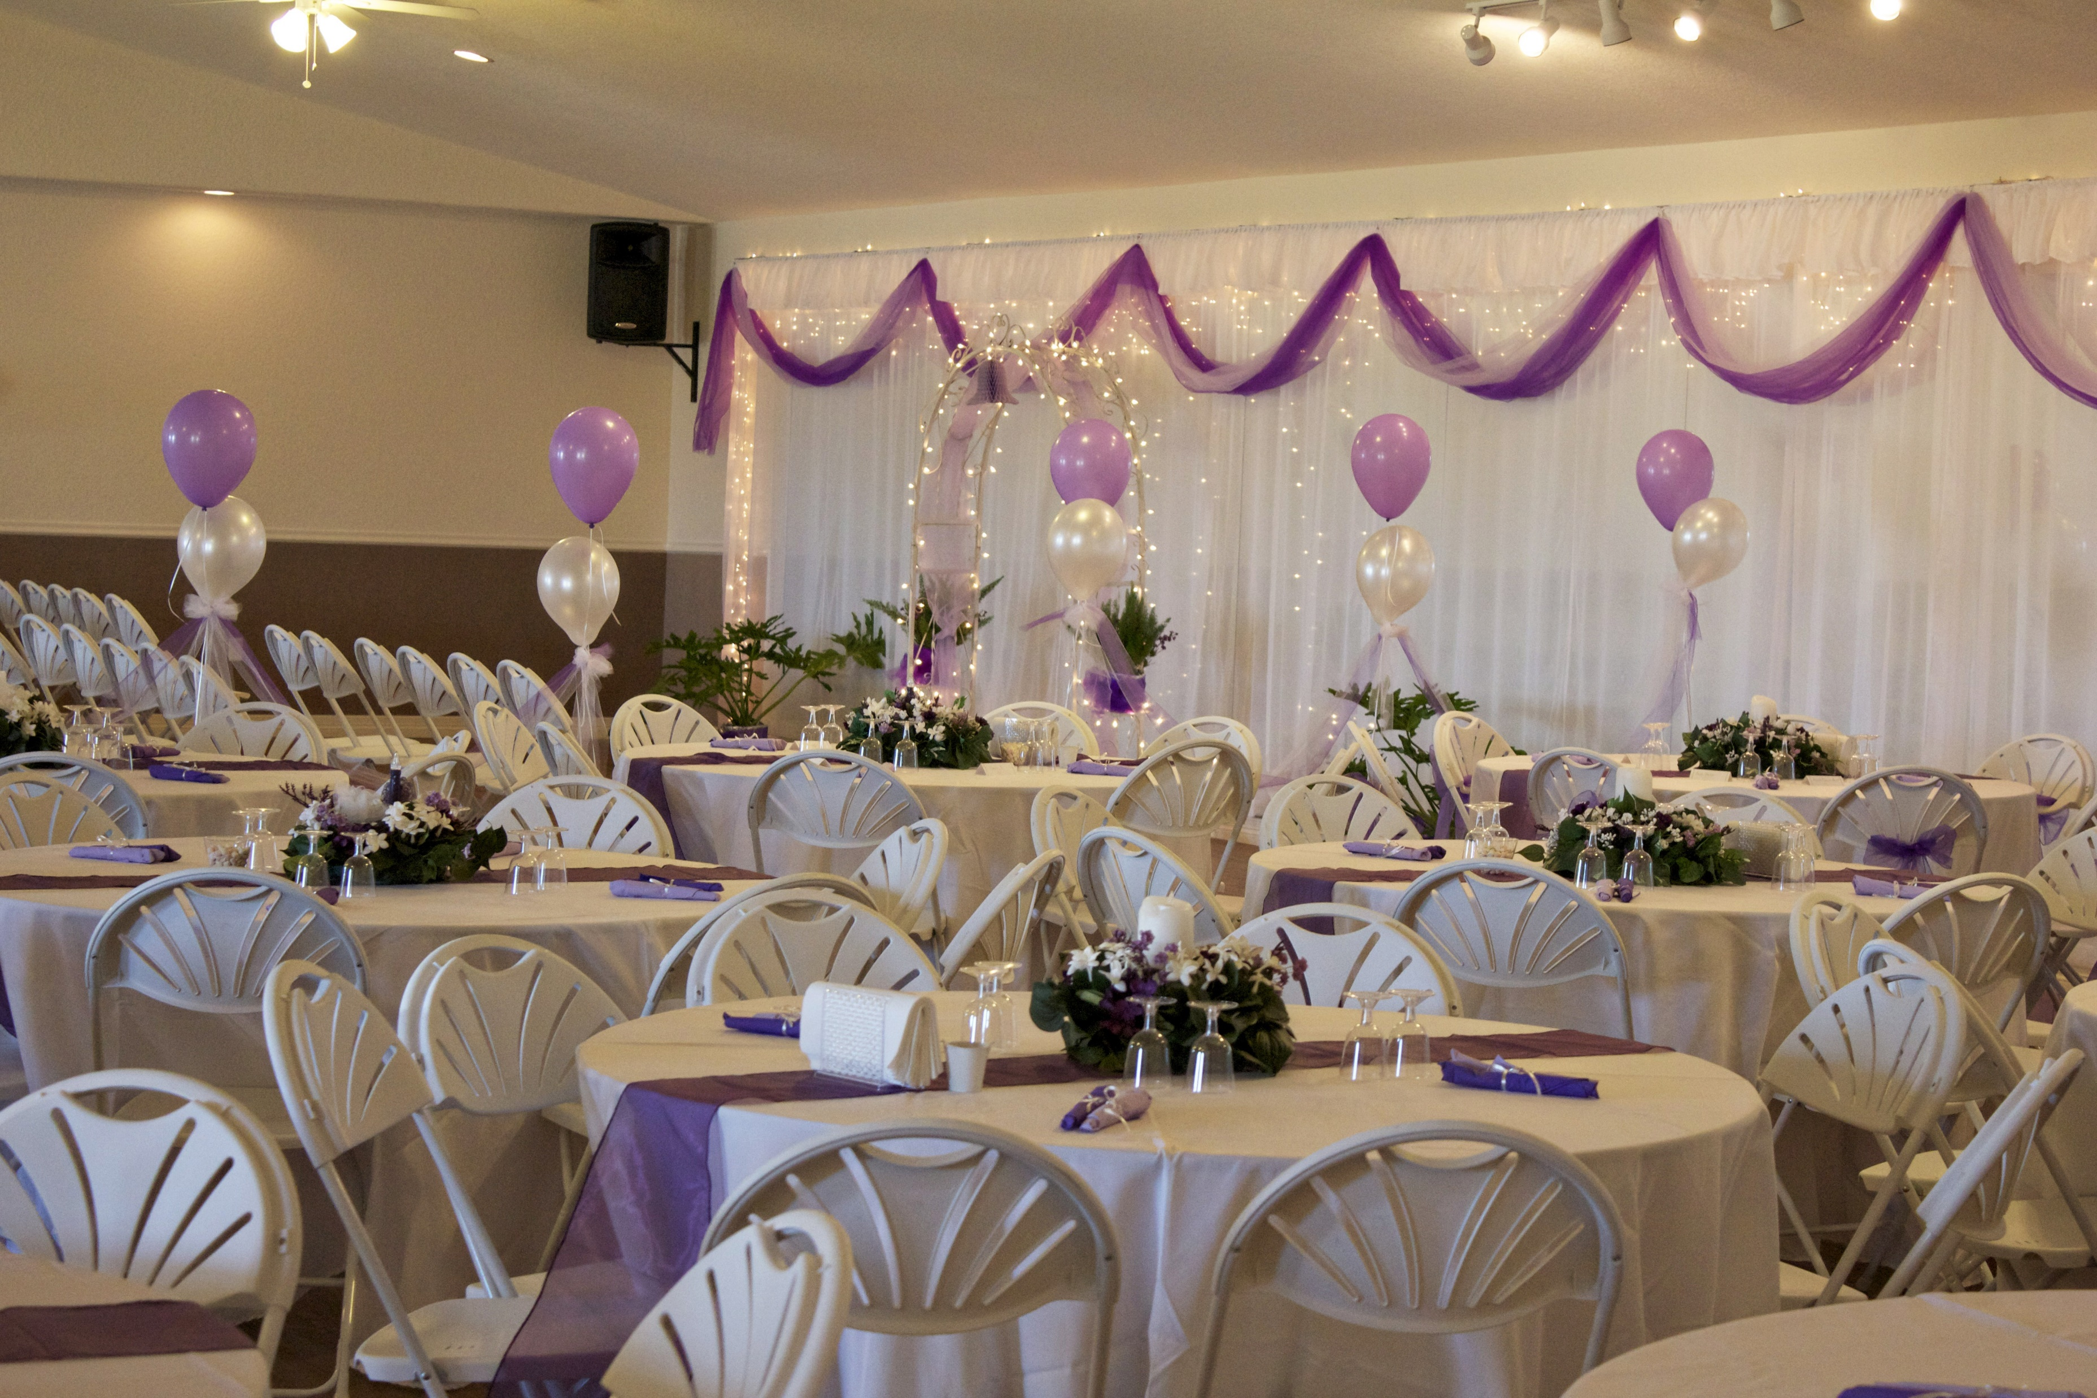
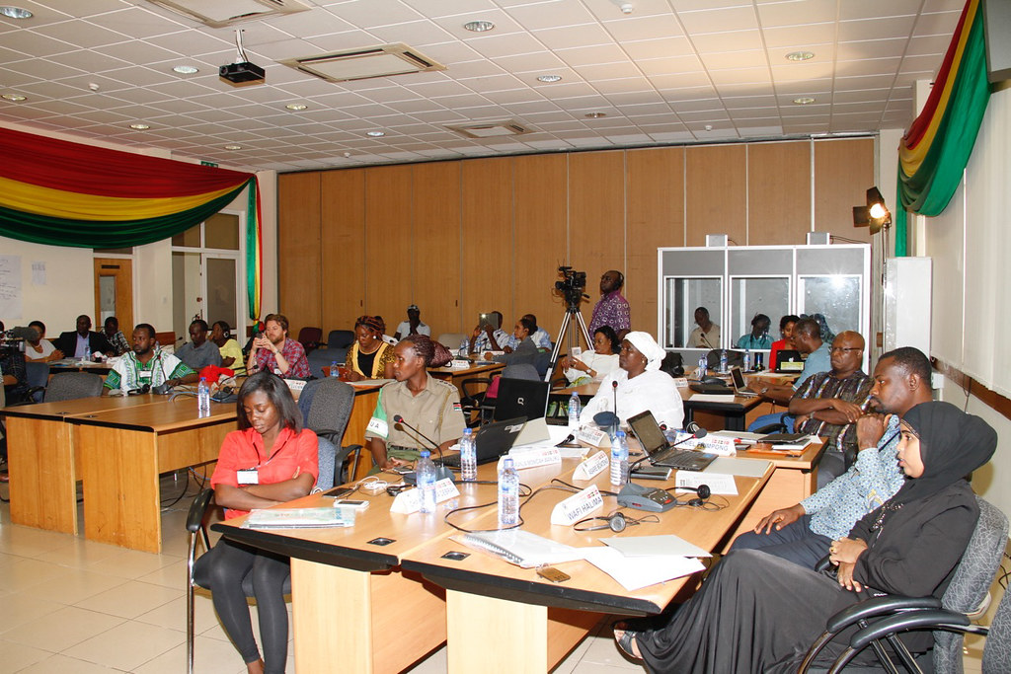
RESTAURANTS AND BAR Our cuisine has blend traditions with contemporary cooking, and we serve Authentic Ghanaian and Dishes and provide continental, Italian and Chinese menu a ‘la carte We in addition provide the services
Banquets and Wedding Receptions
Outside Catering and any Other Parties
We provide sitting arrangement in our restaurants for group for special occasions
Our cuisine will go an extra mile to deliver to your taste any kind of meal at choice even if it is not on our restaurant menu to make you feel at home.

Slide 9
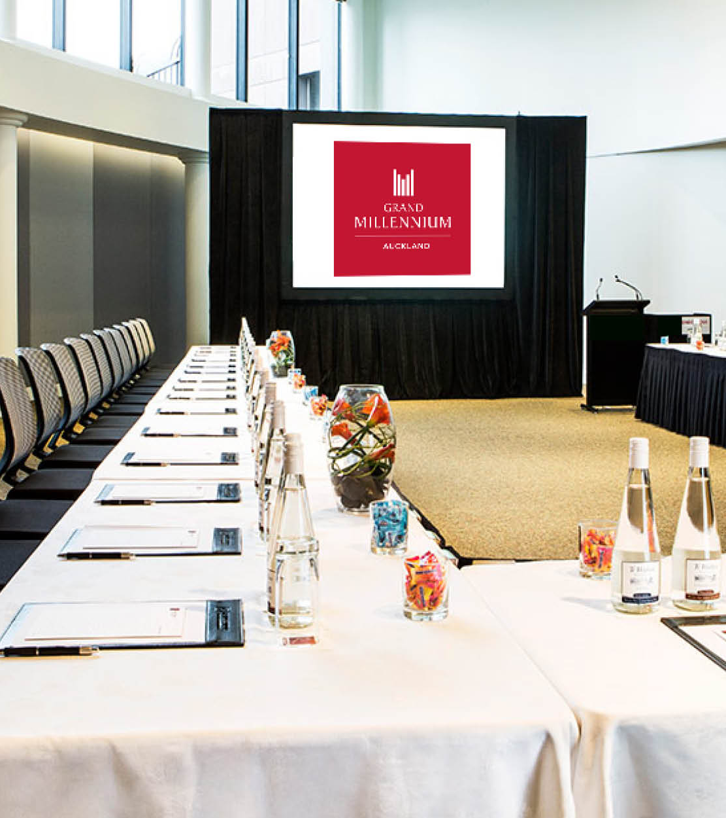
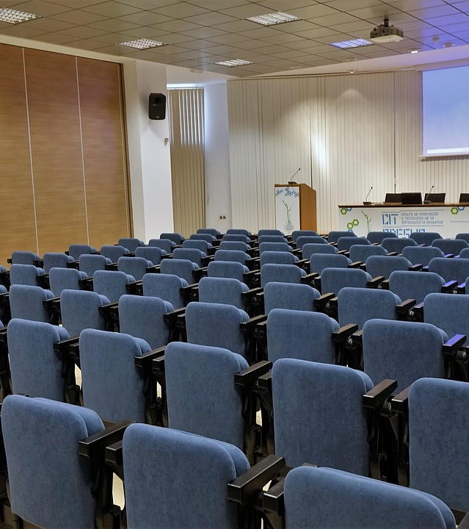
Conference Hall. Our two conference halls can host up to 50 and 100 capacities respectively with theater sitting arrangement including facilities. We do organize all kinds of set ups to each conference and its sitting arrangement. We also have flexible conference package arrangement to suite your budget, we additionally have corporate arrangement with organizations who do long term business with us.

Slide 10
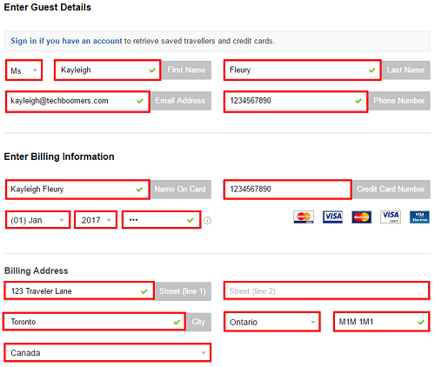
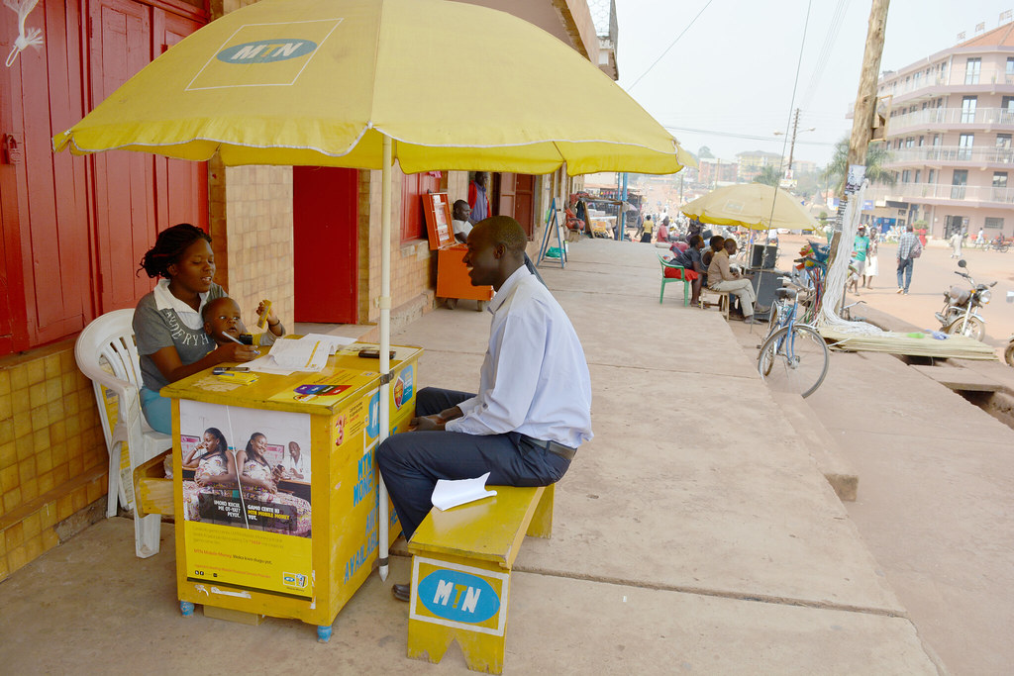
There are 40 rooms total (5 single, 14 double rooms, 5 executives and 5 suites) 20 staff Booking and Payment should be easy and convenient. Name, telephone number and email address rooms> single ,double , exec, or suite amount – Pay . to Momo – including Momo charges

Slide 11

Let’s talk about our hotel rules For Our ESTEEMED GUEST

Slide 12
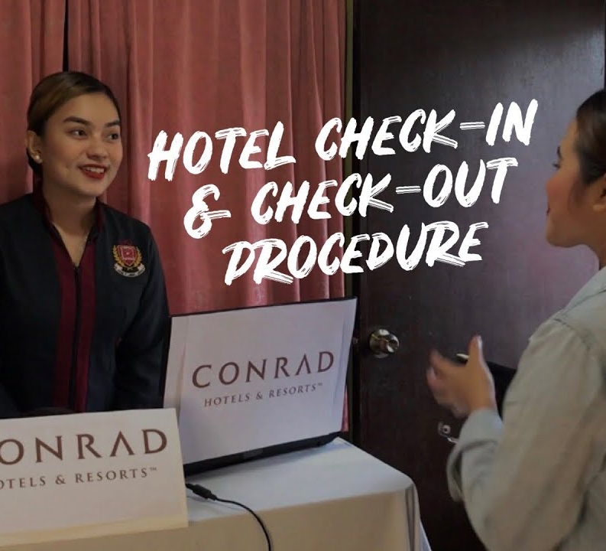

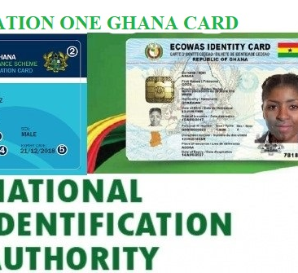
Registration and Payment
Check-in/Check-out - Check-in time: 10:00 AM (GMT) - Check-out time: 12:00 PM (GMT) prompt
- Present your ID card at the front desk for data entry. - Settle all bills upon check-in before using any facilities - No refunds for reserved and paid rooms, even if the customer changes their mind

Slide 13

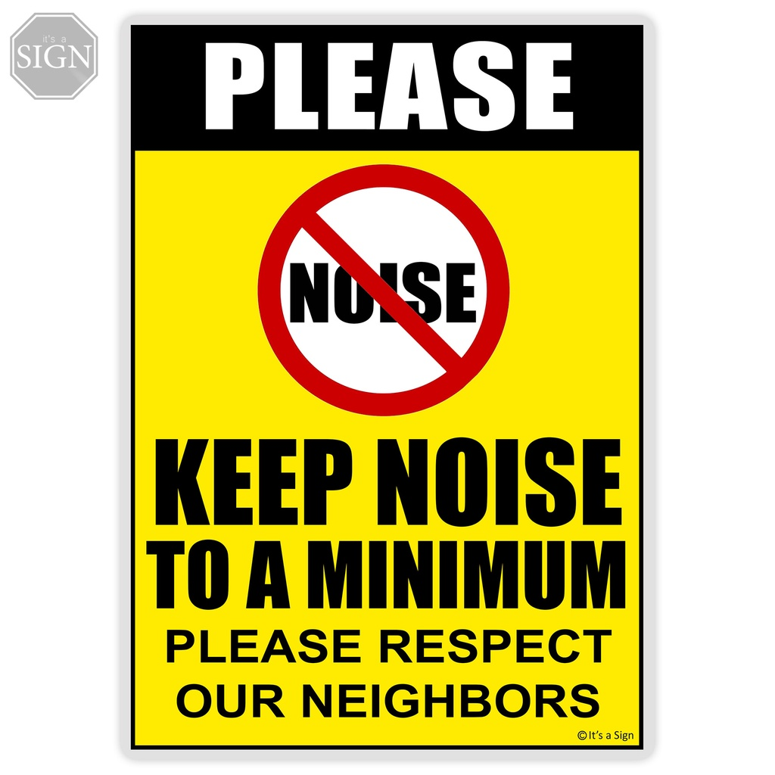




Guest conduct
Keep noise levels minimal in rooms - Maintain low volume on TVs and devices - No smoking allowed in rooms, corridors, and public areas - No pets allowed - Turn off electronic switches and taps when leaving your room - Contact the Front Desk for assistance with gadgets
- Turn off electronic switches and taps when leaving your room - Contact the Front Desk for assistance with gadgets- Deposit room keys at the front desk when leaving the hotel premises - Guests bear full responsibility for misplaced keys outside the hotel - Report any damages to hotel property to the Front Desk promptly

Slide 14



Slide 15
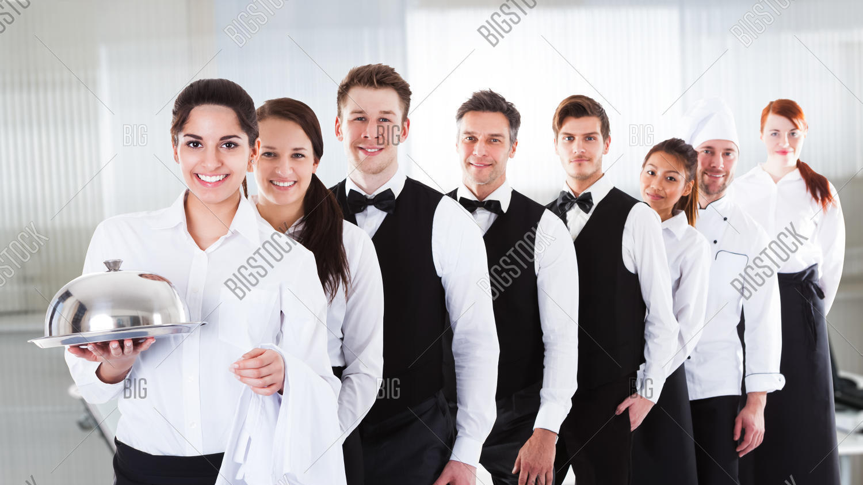
Staff Rules:
Uniform and Grooming: All staff members are required to wear their uniforms (decent black skirt or trousers with a white shirt) and maintain a high standard of personal grooming while on duty.
Hair neatly braided or combed for the ladies, well-trimmed beard and hair cut for men.

Slide 16
More rules
ID Badges: Staff will be provided with ID cards; members must always wear their ID badges while on duty.
Respect: Every staff must show respect and should be respected. Utmost respect for with colleagues and guests
Confidentiality: Staff members must maintain confidentiality regarding guest information and hotel operations.
Customer Service: Staff members must provide exceptional customer service, responding promptly to guest requests and resolving issues efficiently.
Safety and Security: Staff members must be aware of and follow all safety and security protocols, including emergency procedures and fire evacuation drills.
Work ethics: Staff members should not be seen idling on the compound or sleeping idly on any of the couches. Refer to the monthly roaster for activities
8. Attendance: Staff are expected to sign in when they report to work and sign out when they close from work.
9. Termination of Appointment: The appointment of a staff shall immediately be terminated if he/she is found, 1. Stealing, 2. Fighting or Arguing with another staff or customer, 3. Conflict of Interest, 4. Misusing the Hotels Property
10. Absence: Staff shall not absent from work without timely permission from the Supervisor or Manager.

Slide 17
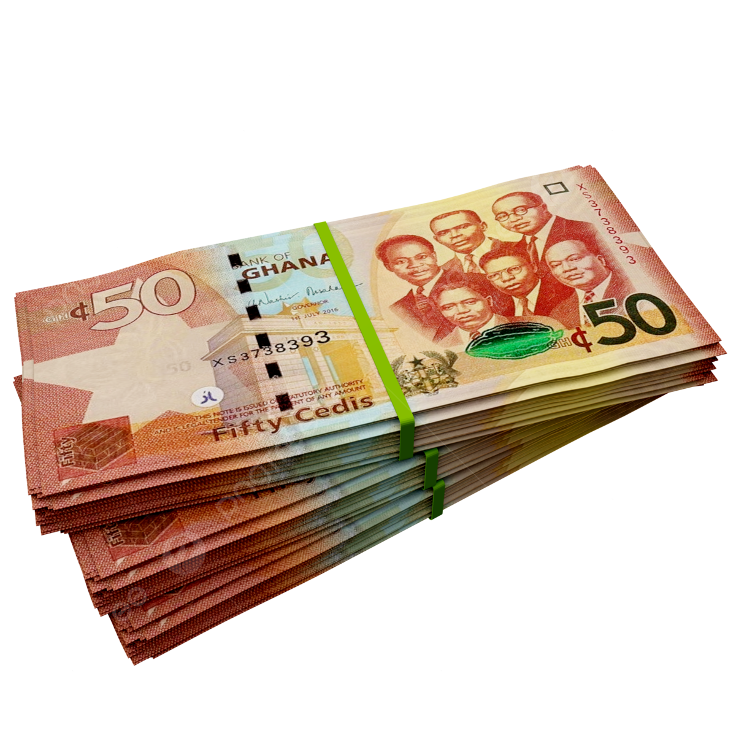

Let’s talk Money!! Evaluation is now!!! There may be a 10%- 20% increase depending on your evaluation.

Slide 18
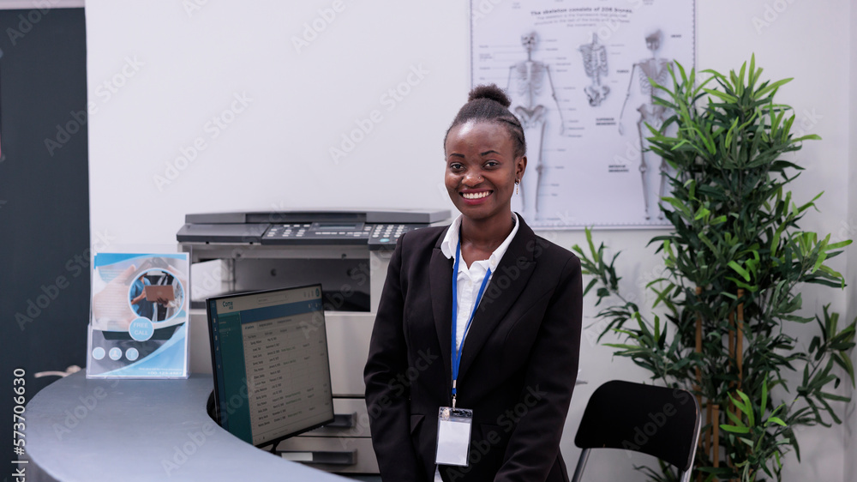
Duties of Hotel Receptionist
A hotel receptionist's duties encompass managing reservations, welcoming guests, handling check-in and check-out, and providing general hotel information. They also process payments, answer inquiries, and ensure a positive guest experience.
Greeting and Welcoming Guests: Make a positive first impression and ensure guests feel welcome.
Check-in and Check-out: Assist guests with registering, assigning rooms, and processing departure.
Reservation Management: Handle reservations, both phone and online, and manage cancellations.
Providing Information: Offer information about the hotel, its amenities, services, and local attractions.
Processing Payments: Handle cash and credit card transactions, verify information, and maintain accurate billing records.
Answering Inquiries: Address guest questions and concerns promptly and efficiently.
Maintaining a Positive Atmosphere: Ensure a welcoming and professional environment for all guests.
Managing Phone Calls: Answer and direct phone calls to the appropriate department.
Record Keeping: Maintain accurate records of reservations, check-ins, and payments.
Problem Solving: Address guest complaints and requests, escalating issues as needed.

Slide 19
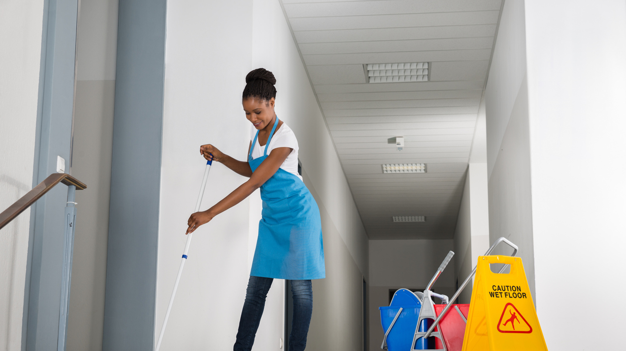
Duties of Hotel Housekeeper
A hotel housekeeper's duties primarily revolve around maintaining the cleanliness and tidiness of guest rooms, public areas, and back-of-house spaces. This includes tasks like cleaning rooms, changing linens, replacing toiletries, and addressing guest requests. Housekeepers also play a role in reporting maintenance issues and ensuring the proper use and care of cleaning equipment. Guest Room Cleaning:
Cleaning and tidying: -This includes dusting, vacuuming, sweeping, and mopping floors, cleaning bathrooms, and tidying up guest rooms.
Changing linens: -Housekeepers are responsible for removing dirty linens, changing sheets and pillowcases, and replacing towels.
Restocking amenities: -This involves replenishing toiletries, coffee/tea supplies, and other guest amenities.
Addressing guest requests: -Housekeepers may be asked to provide extra towels, pillows, or other items as requested by guests.
Common Area Maintenance:
Cleaning public spaces: - This includes hallways, lobbies, elevators, and other common areas.
Maintaining cleanliness of public restrooms: - This involves cleaning and sanitizing restrooms in public areas.

Slide 20
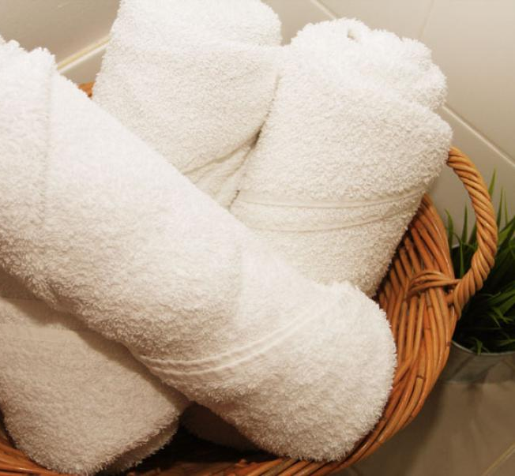
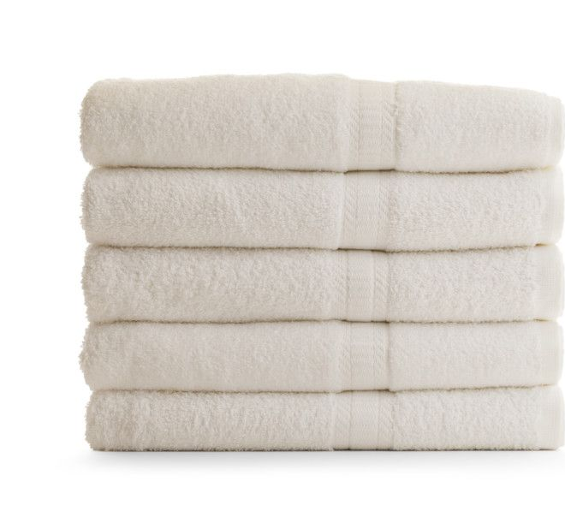
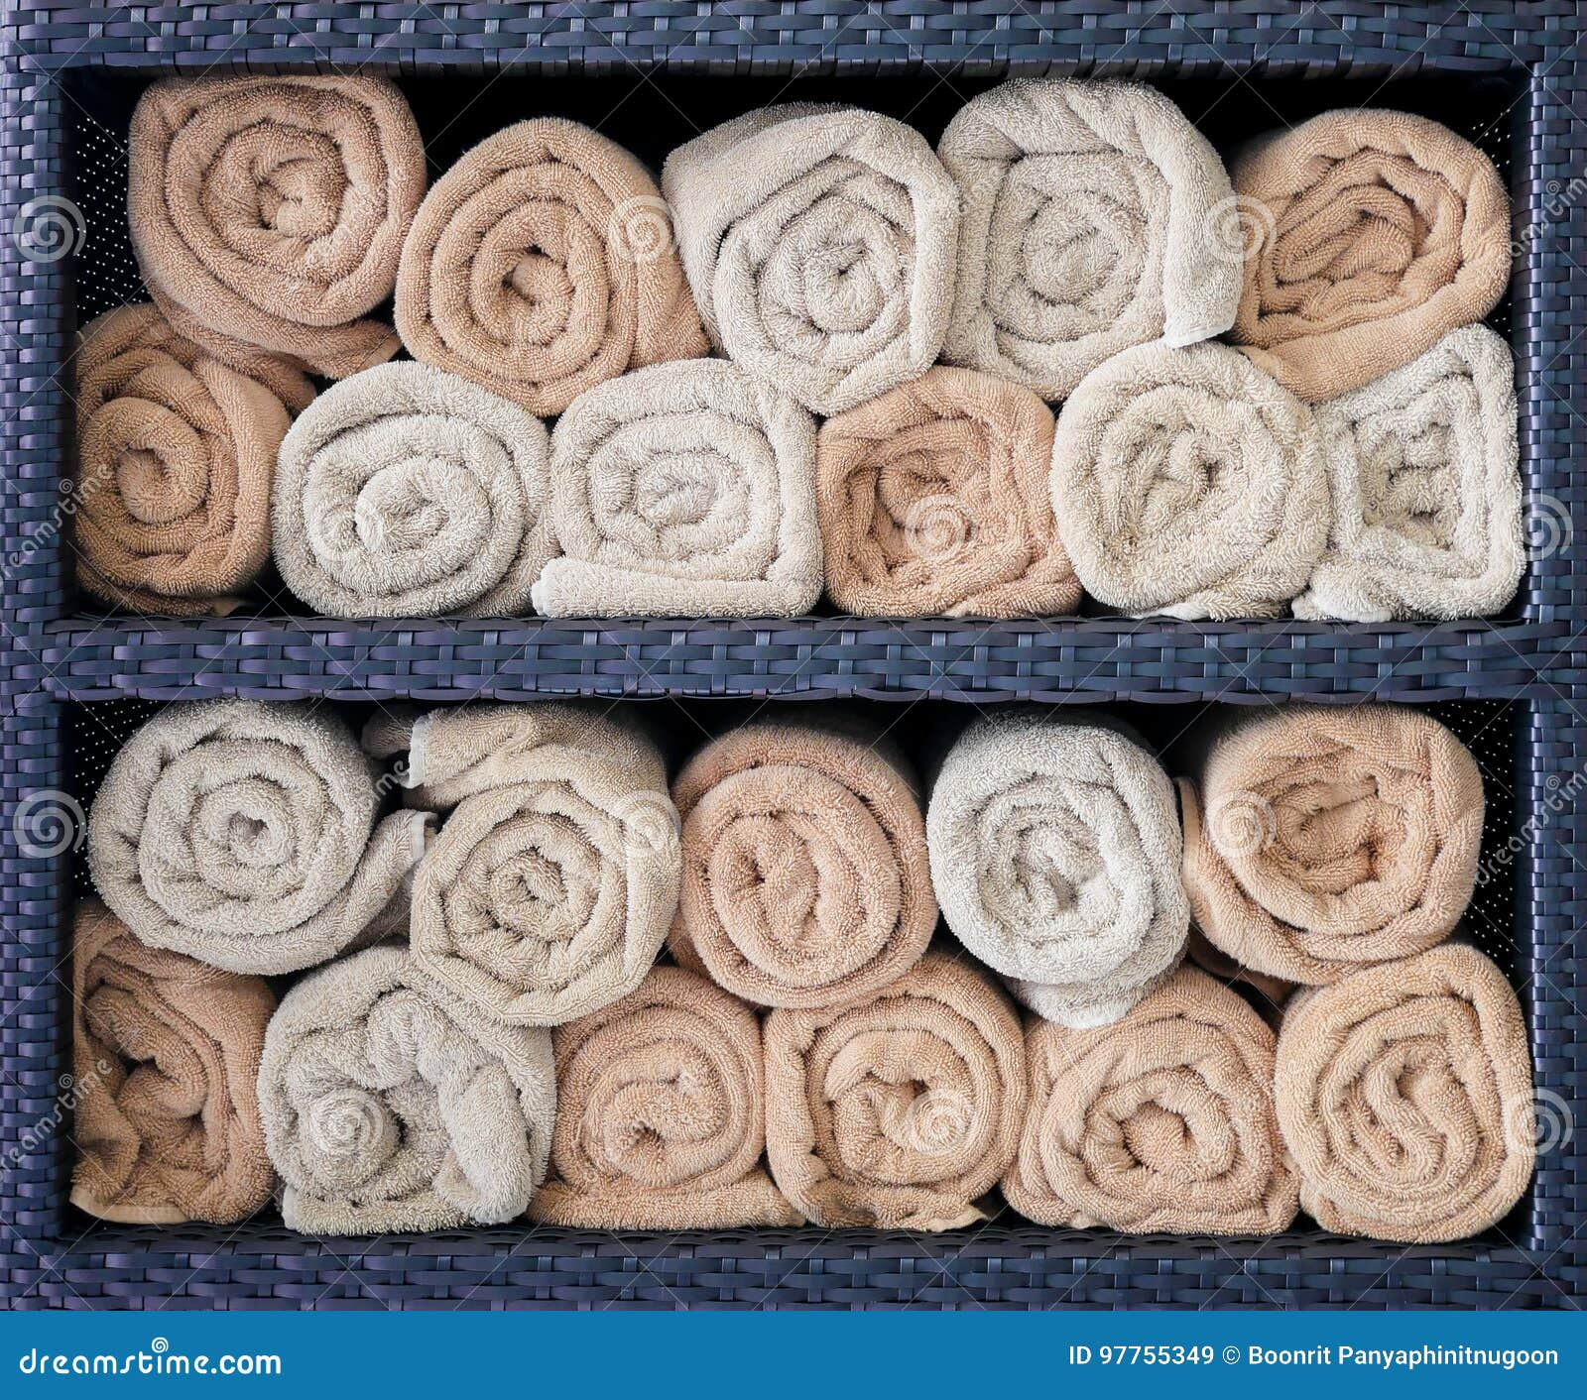
How to correctly fold towels And bed sheets

Slide 21
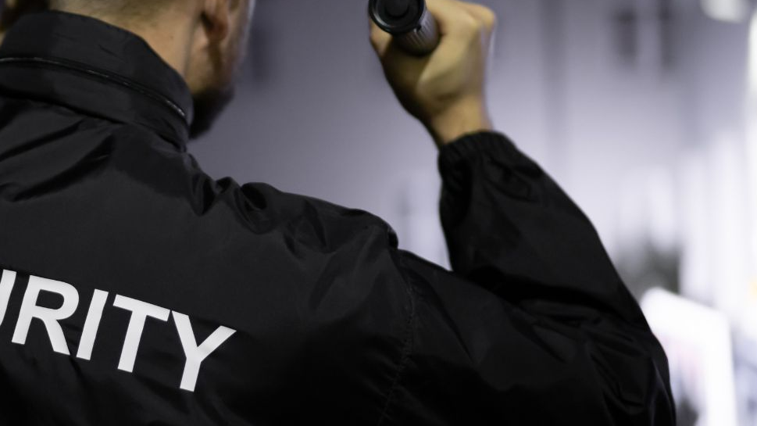
Security Officer Duties
Hotel security officers are responsible for ensuring the safety and security of guests, staff, and the hotel property. Their duties include patrolling the premises, monitoring surveillance equipment, controlling access, responding to emergencies, and resolving conflicts. They also handle tasks like reporting incidents, maintaining security logs, and assisting with lost and found items.
Security and Safety:
Patrolling:-Regularly patrolling both the interior and exterior of the hotel to identify and address potential threats or safety hazards.
Surveillance: Monitoring surveillance equipment (CCTV cameras) to detect suspicious activity and respond accordingly.
Access Control: Managing entry and exit points to ensure only authorized personnel gain access to the property.
Emergency Response:-Responding to emergencies like fires, medical incidents, or security threats, and coordinating with other emergency responders.
Incident Reporting:- Documenting all incidents, including thefts, accidents, and other safety concerns, and preparing detailed reports for the hotel management

Slide 22

Maintenance team

