Slide 1
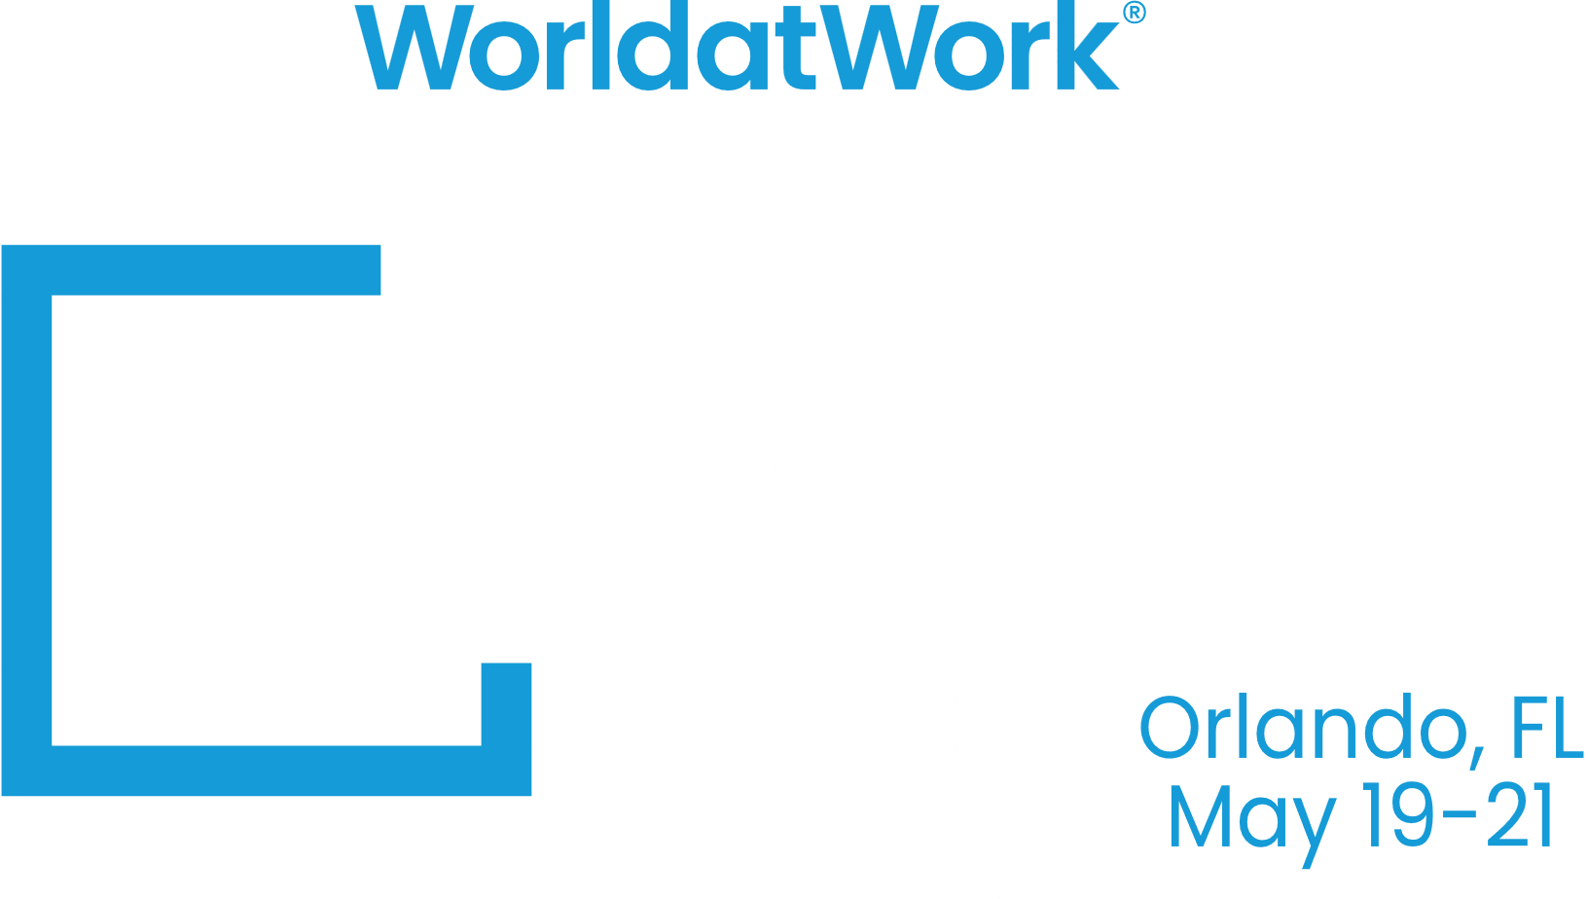
Automate Your Employee Support with a Custom Chatbot
Josh Lemon
Sr Dir Global Total Rewards | Resideo
Notes:
I'm Josh Lemon, and I lead the Total Rewards team at Resideo. Like many of you, I’ve spent a lot of time thinking about how we can better support employees—especially when it comes to answering the same benefits or compensation questions over and over again.
Today, I’m here to show you how a simple, custom chatbot can take a huge load off your plate—by giving employees instant, accurate answers, even outside of business hours.
And the best part? You don’t need to know a single line of code. In the next 30 minutes, you’ll see just how easy it is to build and launch your own chatbot—one that’s tailored to your Total Rewards function and ready to use in minutes. Let’s dive in.

Slide 2
xx
Learn How to Build a Chatbot
AGENDA
Customize Your Chatbot
Risks and Best Practices
Notes:
Key Takeaways from the session today:
Learn how to build and deploy a functional chatbot in minutes without requiring any programming skills.
Understand how to tailor chatbot responses to address specific Total Rewards topics, such as benefits, compensation, and onboarding support.
Discover how chatbots can automate employee support tasks, saving time and enhancing communication in your Total Rewards function.
During our time together, we’ll build a chatbot, I’ll show you how you can further customize it, and towards the end we’ll talk about risks and best practices so you can get the most out of the chatbots you build for your organization.

Slide 3
Why chatbots for Total Rewards?
Great Total Rewards programs only matter if people understand them—and chatbots make that understanding instant, accessible, and scalable for everyone.

Slide 4
What We’ll Build Today
Quick Start Guide
Step 1: Choose your platform
Step 2: Upload training materials to the knowledge base
Step 3: Customize the chatbot
Welcome message
Branding
Custom Instructions
Step 4: Test the chatbot
Step 5: Deploy
Chatbot: Rae (Rewards Assistance Engine)
Purpose: Provide basic assistance on comp and benefits programs at ABC Company
Notes:
Today we are going to build Rae, a chatbot that will be useful in answering questions for a fictional firm called ABC Company.
In order to prepare for this demo, I’ve used Google’s Gemini 2.5 Pro to put together some documents we’ll use to train Rae, including:
Comprehensive Benefits FAQ document
Benefits Pricing Supplement
Medical Plan Supplement
Compensation Philosophy
Job Leveling Guide
These documents won’t answer every question imaginable, but they will give us a good training set that we can use to demonstrate how useful a custom chatbot can be in your organization.
In the 1-page resource guide that comes with this course, you’ll receive a list of chatbot options, but for this demonstration we’ll be using Chatbase.co.

Slide 5
Features Used in Rae
Connect:
Public, Embed
Chat Bubble: Icon you click to enter chat
iFrame: creates a section for the chat specifically
Settings:
Name: Rae
AI: GPT-4o mini, AI agent instructions (small role modification), Temperature: Reserved
Chat Interface: Several customizations
Sources:
Benefits FAQs
Medical Plan Supplement
Benefits Pricing Supplement
Compensation Philosophy
Job Leveling Guide
Analytics, Actions, Contacts:
Not used
Notes:
AI Instructions added to Role Section: When providing an answer, ask a follow-up question, "Does this response fully address your question?" If the user agrees it fully addresses the question, then thank the user for speaking with you. If the user is not fully satisfied, ask if they can clarify the question or if they would like to be referred to a person that can assist them. Be sure to include contact information for internal HR as well as any vendor contact information when providing it.
---
Chat Interface:
Initial Message: Hi, I’m Rae, and AI-powered chatbot designed to answer questions you have about ABC Company’s Compensation and Benefits programs. How can I help you?
Suggested Messages:
What are my medical plan options?
What is the company 401(k) match?
How many job levels are there?
Footer: Rae provides helpful info, but if there's a conflict with official plan documents, the plan documents will always take precedence.
Display Name: Rae
Profile Picture: Premade file
Chat Icon: Premade file
User Message Color: HEX – #009CDE (W@W light blue), sync user message color with agent header (checked)
Chat Bubble Button Color: HEX – #009CDE, will make the down arrow this color to collapse the chatbot
*all other settings left at defaults

Slide 6
Tips to Expand Functionality
Add multiple data sources (docs, PDFs, web pages, text)
Branding and tone customization
Set fallback/redirect rules for complex inquiries
Highly recommend including a disclaimer like, “Rae provides helpful info, but if there's a conflict with official plan documents, the plan documents will always take precedence.”
Integrate with Slack, intranet / SharePoint, social accounts, websites, or Teams*,
Pilot Internally First
*For integration with Teams, you may find Copilot Studio to be a more effective chatbot solution
Notes:
As you build out your chatbot(s), consider what you’re trying to accomplish, how you’re using them, and how your employees will want to engage. Be sure to include as much helpful material as possible when training your chatbot.
Make your chatbot feel like part of your Total Rewards ecosystem. Use consistent tone, visuals, and naming to build familiarity. Employees are more likely to trust and use something that feels official—not like a third-party bot tacked on.
Always include a disclaimer—just like we built into Rae. Make it clear that, Responses are for informational purposes only. In the case of any conflict, the official plan documents govern. This protects your company and sets clear expectations for employees.
Expand the use of your chatbot by including creative integrations
Before going live company-wide, pilot your chatbot with your HR or Total Rewards team. Let them try to break it. You’ll get great feedback and avoid awkward rollout moments.

Slide 7
Risks and Best Practices
Privacy & data protection tips
Don't replace human HR—enhance it
Keep content updated and chatbot trained
Notes:
Now I’d like to share a few comments about risks and best practices:
First, don’t feed your chatbot sensitive or confidential employee data—think PII, PHI, or internal documents with restricted access. Always check if the chatbot platform stores or trains on your data. Ideally, choose platforms that offer data isolation or enterprise-grade security. Typically, your cyber security team can help you assess this.
A chatbot should enhance—not replace—your human HR touch. If the answer is nuanced, emotional, or policy-dependent, the chatbot should hand off the conversation or direct employees to a person or resource. Feel free to add to the custom instructions to provide instructions on how to contact your HR department if the user doesn’t receive the answer they’re seeking or if the information is not part of the chatbot’s knowledge base. You may need to include specific testing to dial in the instructions that help with this piece.
Your chatbot is only as accurate as the information it’s trained on. If you upload outdated benefit guides or draft documents, the chatbot may share incorrect info. Set a process to review content sources regularly—especially after plan year changes or vendor updates. Best Practice: Maintain a 'source of truth' file for chatbot training, establish a cadence for reviewing it.

Slide 8
Key Takeaways
You can build and launch a chatbot in minutes – no coding required.
Custom chatbots can reduce repetitive questions and improve communication.
Start small, keep it accurate, and build from there.
Notes:
Today, you’ve seen firsthand how accessible these tools are. This isn’t a two-month project. You can go from idea to working prototype over lunch. And that unlocks a whole new set of possibilities for our Total Rewards teams.
Whether it’s benefits, compensation terms, onboarding tasks, or policies, these bots can handle the basics—freeing you up to do the strategic work you were actually hired to do.
You don’t need to launch with 200 questions answered. Start with your benefits guide. Add content over time. Focus on accuracy and helpful tone. Build trust first, and the usage will follow.
The future of Total Rewards isn’t just more data—it’s better delivery. Tools like this make your expertise easier to access, and that’s what great employee experience is all about.

Slide 9
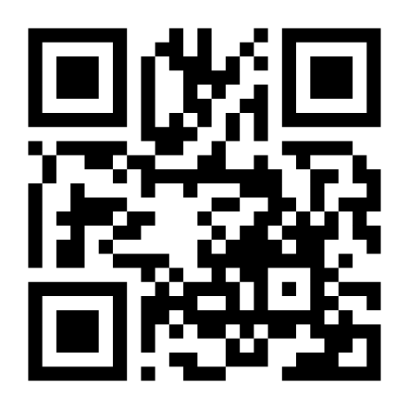
Talk to Rae and Download the Tipsheet
Visit JoshLemonAI.com

