Slide 1


v6.23
FINANCIAL LITERACY
-CONCEPTS-

Slide 2



TODAY'S REALITIES
ALARMING DEBT
$1.8 TRILLION National Student Loan Debt
(Over $40K Per Student)
$1.32 TRILLION National Credit Card Debt
($7.7K Per Holder)
DISTURBING LACK OF FINANCIAL EDUCATION
The lack of financial knowledge cost
Americans more than $438 Billion in 2022
SHAKEY RETIREMENT
Average 401(k) Balance if you're
45-54 years old is roughly $179K
www.usdebtclock.org
https://www.ifac.org/knowledge-gateway/contributing-global-economy/discussion/cost-financial-illiteracy#:~:text=The%20average%20estimated%20amount%20of,than%20%24436%20billion%20in%202022.
https://www.usatoday.com/money/blueprint/retirement/average-401-k-balance-by-age/

Slide 3
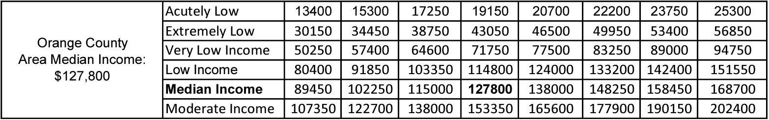
2023
CA DEPARTMENT OF HOUSING & COMMUNITY DEVELOPMENT
DIVISION OF HOUSING POLICY DEVELOPMENT
https://www.hcd.ca.gov/sites/default/files/docs/grants-and-funding/income-limits-2023.pdf

Slide 4
6 Steps of
Financial Literacy
6) INVEST
5) BORROW
STEP 1 | EARN: Everyone knows how to make money. Whether it’s getting a job, starting a side hustle, or making passive income.
4) PROTECT
STEP 2 | SAVE: It’s not about how much money we make. It’s about how much we keep and save in the right places.
3) SPEND
STEP 3 | SPEND: Are you spending wisely on things you need? Or are you spending unconsciously on things you want?
2) SAVE
STEP 4 | PROTECT: Will your obligations be fulfilled when you lack the ability to work due to illness, disability, or death?
STEP 5 | BORROW: Have you opened your first credit card? Learning the art of borrowing credit will help you a lot in the future.
1) EARN
STEP 6 | INVEST: Your money should be working for you rather than the other way around. But what are my options and how much risk can I handle?

Slide 5
SILENT KILLER
OF MONEY
1) TAXES
2) INFLATION
3) FEES & PENALTIES

Slide 6
WHAT THE
WEALTHY DO
1) PROTECT AGAINST MARKET DOWNTURN
2) CAPITALIZE ON OPPORTUNITIES
3) HAVE MORE THAN ONE INCOME STREAM (DIVERSIFY)
4) LEVERAGE OTHERS BECAUSE TIME IS OUR GREATEST ASSET

Slide 7
COMPOUND INTEREST
Rate of
Return
0%
2%
6%
10%
10
$30,000
$32,849
$39,542
$47,812
20
$60,000
$72,892
$110,356
$171,825
30
$90,000
$121,704
$237,175
$493,482
40
$464,286
$1,327,778
$120,000
$181,206
Years
*Example Shows: Savings $250 Per Monthly Compounded Annually
https://www.investor.gov/financial-tools-calculators/calculators/compound-interest-calculator

Slide 8
TAX NOW
ACCOUNT TYPES:
401(K) IRA
403(B) TSP
___________________________________
PRO:
TAX DEFERRED
CON:
TAX LATER
ACCOUNT TYPES:
Savings Accounts
CDs (Certificate of Deposit)
_________________________________
PRO:
LIQUID
CON:
TAXABLE
TAX LATER
TAX NEVER
ACCOUNT TYPES:
ROTH CASH VALUE
IRA LIFE INSURANCE
___________________________________
PRO:
TAX ADVANTAGED
CON:
NO WRITE-OFF

Slide 9
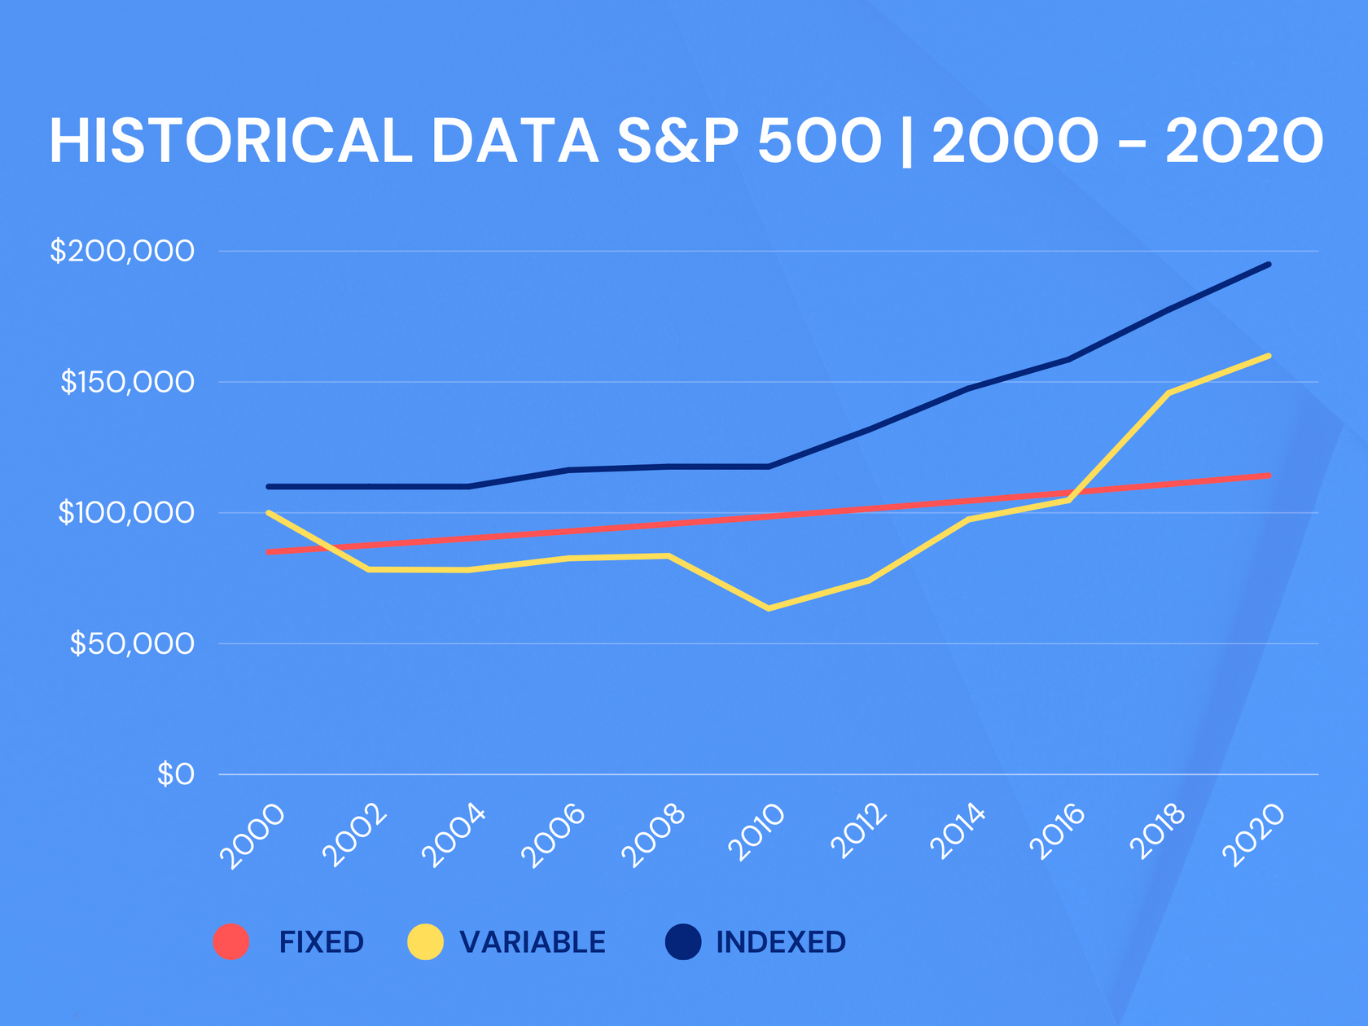
DIVERSIFICATION

