Slide 1


NANJING JIGUANG
Exclusive Global Technical Licensor for Vertex Thailand – Automotive Workshop Engineering & Matched Industrial Consumable Services
ESTABLISHED 2009 | NANJING, CHINA

Slide 2




CORPORATE STRATEGIC ENTITIES
Nanjing Jiguang (China)
Vertex Industrial (Thailand)
Technical Source: Est. 2009. Sole IP owner for all workshop handling equipment and matched industrial consumable technical specifications.
Local Implementation: Registered March 2026. Controlled by the same ultimate individual. Exclusive platform for authorized local project execution.
UII Industries Limited (UK)
UII Lifting Solutions Inc. (US)
European Brand Liaison: Rebranded in 2023. Acts solely for brand communication. Zero R&D, design, or formula development capacity.
North American Affiliate: Registered 2025. Focused strictly on brand consultation. No technical IP transfer or equity linkage with Nanjing Jiguang.

Slide 3





GLOBAL OWNERSHIP ARCHITECTURE
Single Ultimate Natural Controller
Holds majority shares and serves as Legal Representative for both Nanjing Jiguang Machinery Equipment Co., Ltd. and Vertex Industrial (Thailand) Co., Ltd.
Nanjing Jiguang
Core R&D Center
(100% Owner of UK)
Vertex Thailand
Exclusive Local
Execution Platform
UII US Office
Consultation Only
(No Cross-Equity)

Slide 4

STRATEGIC GROWTH MILESTONES
2009
Nanjing Jiguang founded; construction of core R&D base for auto systems and consumable standards.
2023
Completed acquisition of UK entity; renamed to UII Industries Limited for unified brand operation.
2025
UII Lifting Solutions registered in US for North American market brand coordination.
March 2026
Vertex Industrial (Thailand) registered in Chonburi; controller ensures unified technical control.
July 2026
Nanjing Jiguang issues permanent technical authorization to Vertex for full drawings and specs.

Slide 5
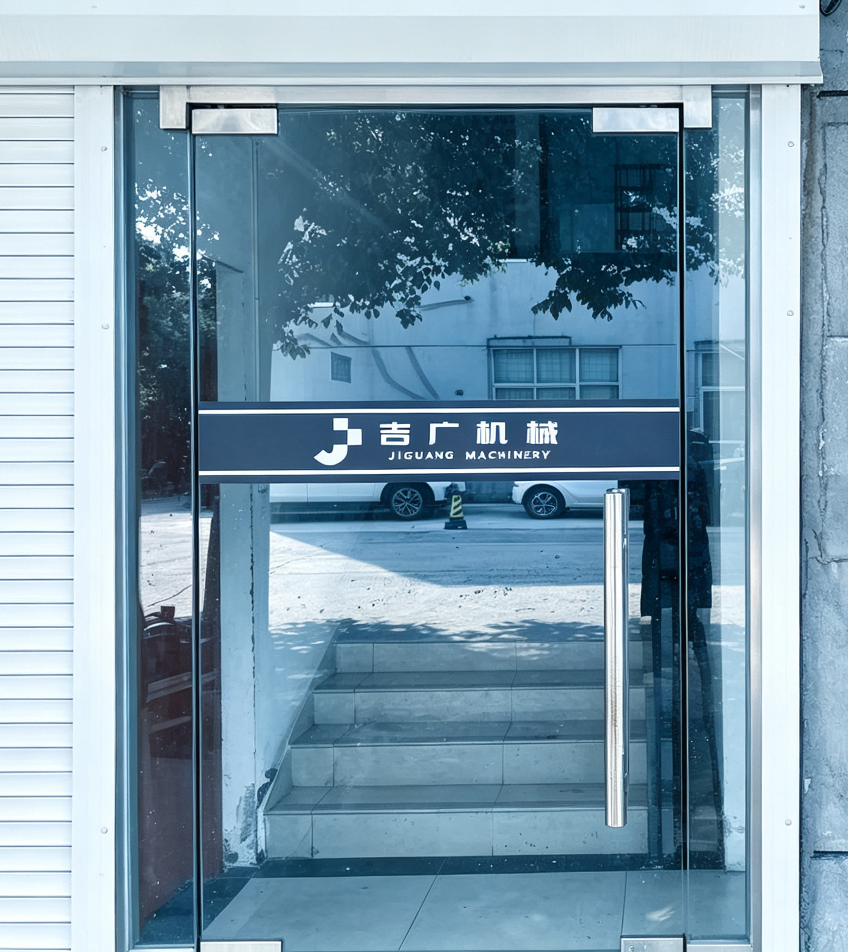
TECHNICAL ORIGIN
Independently developed by internal R&D team of Nanjing Jiguang Machinery Equipment Co., Ltd.
All electromechanical renovation designs, layout drawings, and construction standards are researched and owned by Nanjing Jiguang.
UK and US brand liaison offices hold no proprietary IP and do not participate in Thailand project implementation or technical transfer.

Slide 6

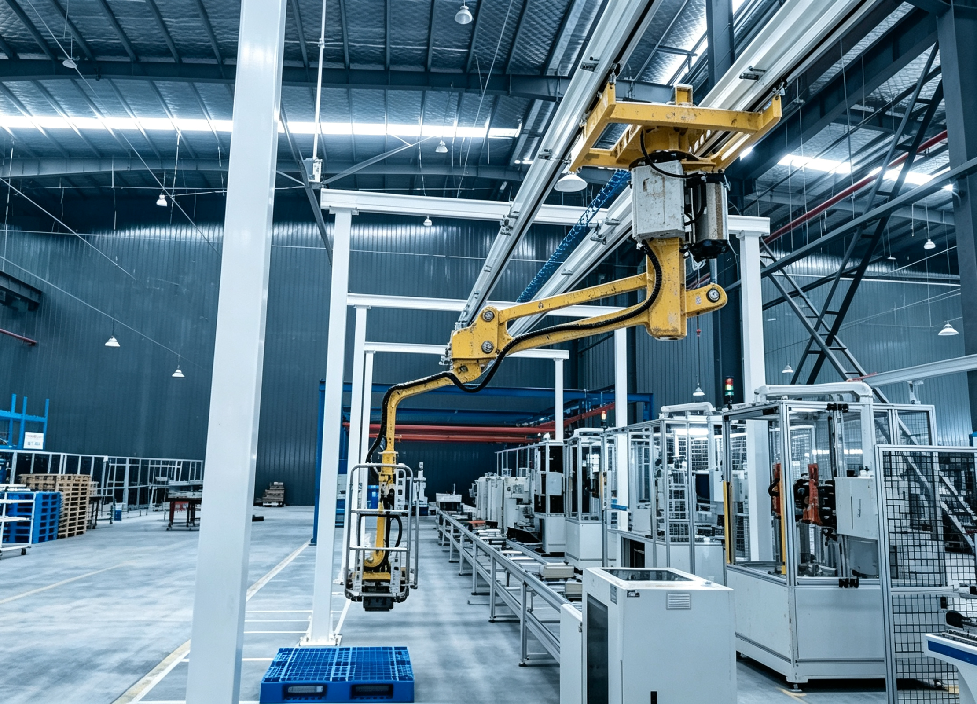
HANDLING SOLUTIONS
Independently developed by internal R&D team of Nanjing Jiguang Machinery Equipment Co., Ltd.
•
Hard Arm Manipulators: Max 500kg lifting with precision torque control.
•
Flexible Cable Units: Optimized ergonomics for high-cycle assembly tasks.
Matched industrial consumable technical standards are fully authorized to Vertex Thailand for supporting after-sales service.
Consumables are only supplied as supporting accessories for factory renovation projects; separate independent sales is not permitted.

Slide 7
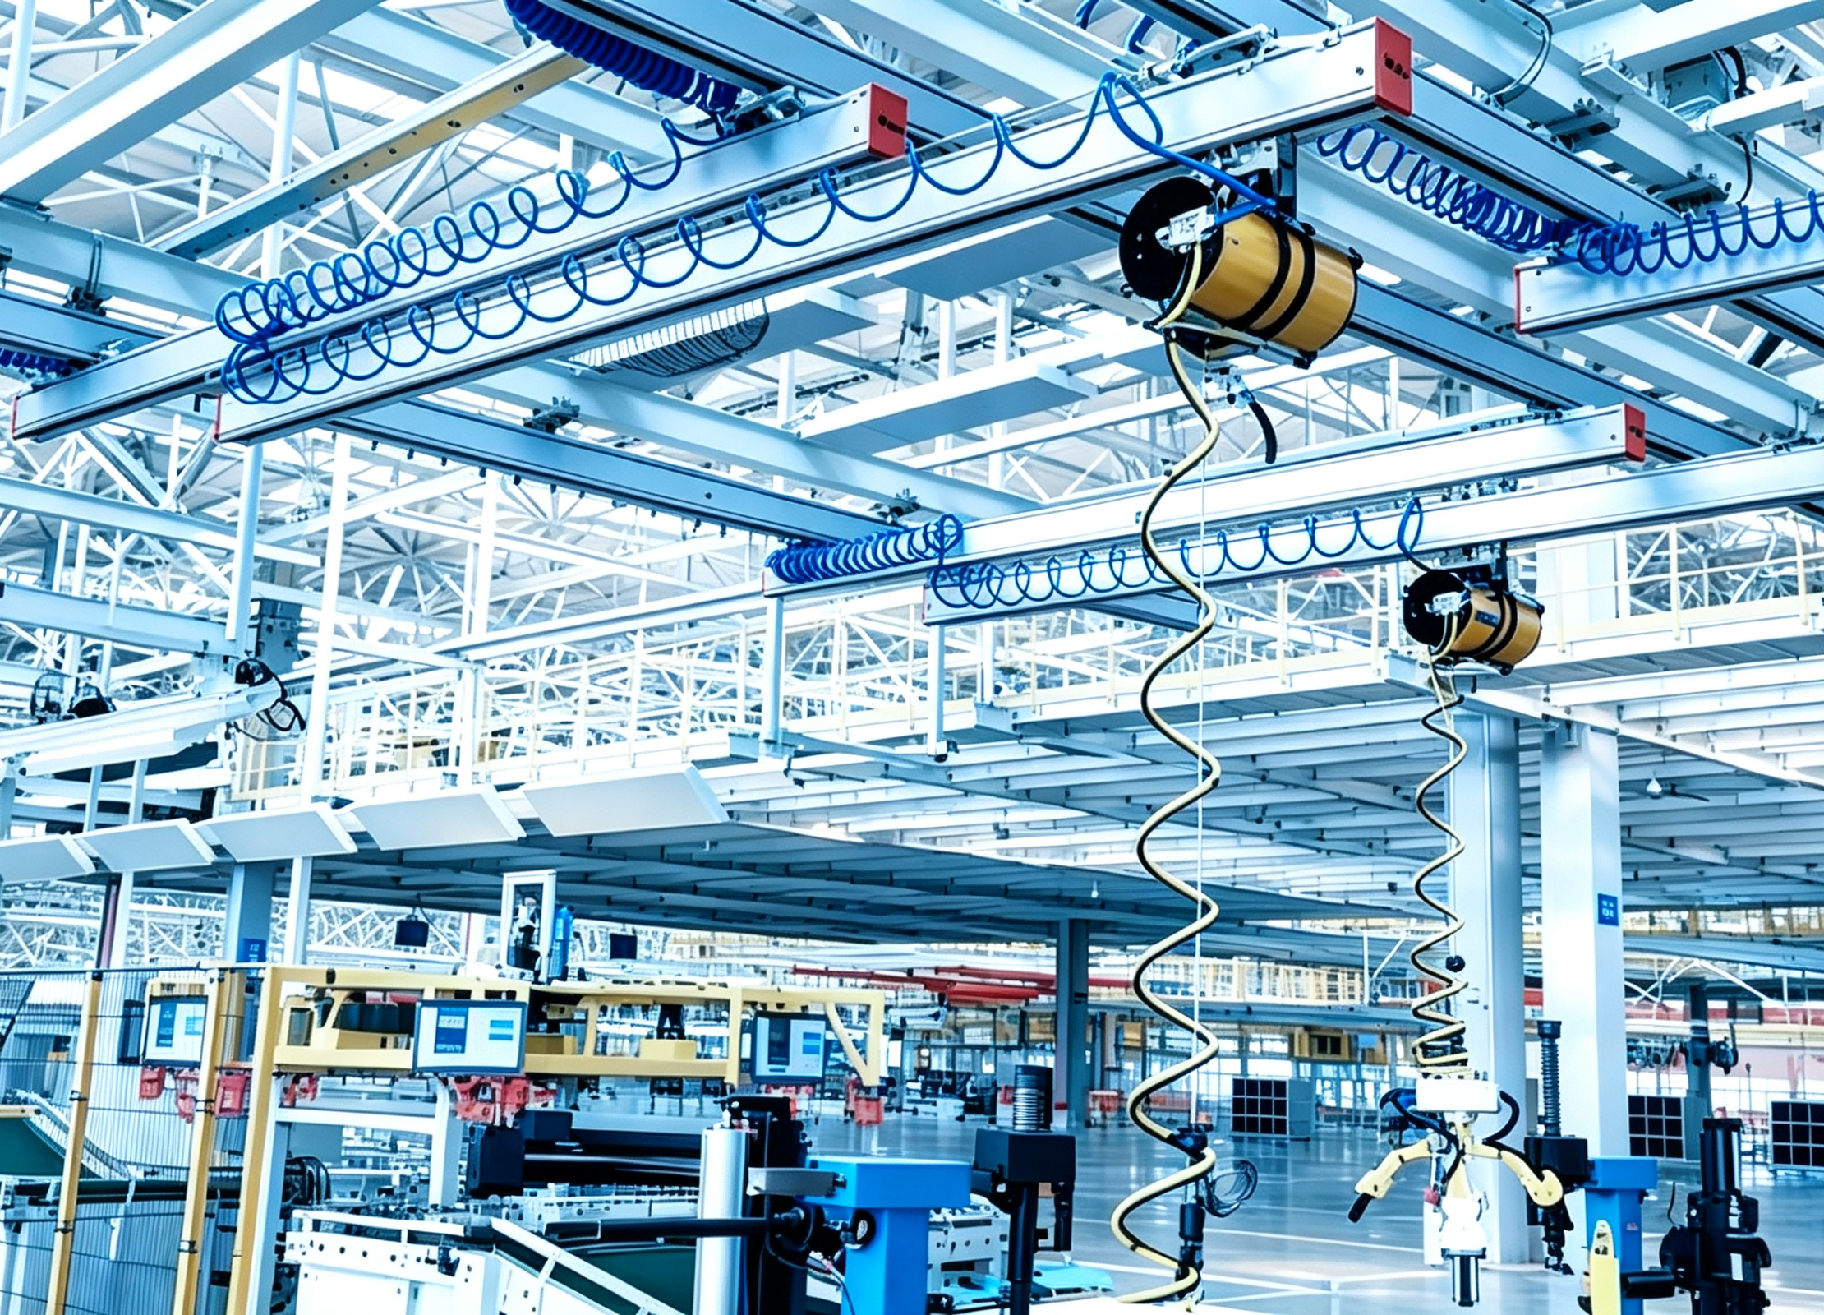
WORKSHOP RAIL SYSTEMS
Independently developed by internal R&D team of Nanjing Jiguang Machinery Equipment Co., Ltd.
•
KBK Aluminum Rails: Ultra-smooth overhead tracks for car body and seat installation.
•
Anti-Torsion Arms: Specialized support for reactive high-torque assembly.
Consumables are only supplied as supporting accessories for factory renovation projects; separate independent sales is not permitted.

Slide 8
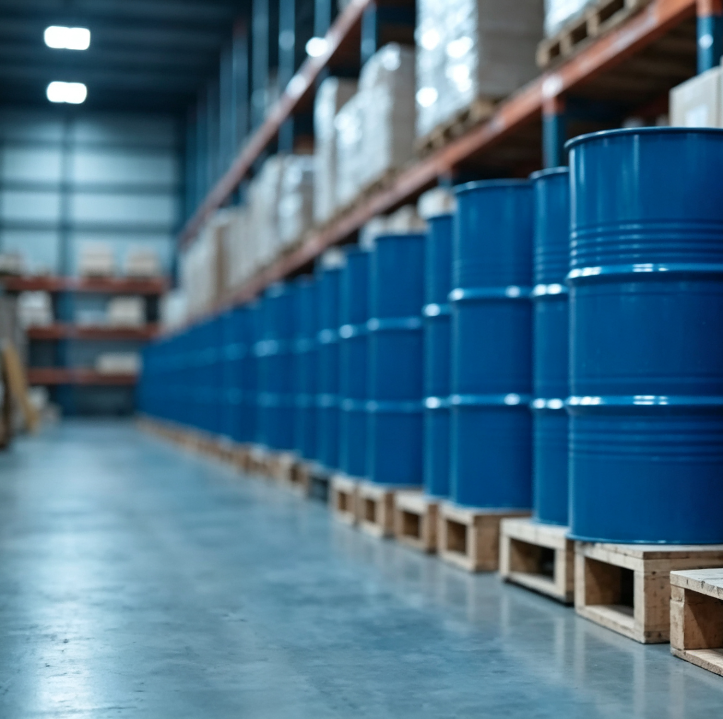

CONSUMABLE TECHNOLOGY
Independently developed by internal R&D team of Nanjing Jiguang Machinery Equipment Co., Ltd.
Vertex Thailand shall source all hydraulic oil, high-temperature mold release agent and protective packaging materials from qualified local Thai suppliers following Nanjing Jiguang’s proprietary technical standards.
All industrial consumables can only be provided as matching supporting accessories for self-operated factory renovation projects; independent wholesale, retail or separate sales are strictly prohibited.

Slide 9
PROJECT MILESTONES
Major Client | Nanjing Designed Scope | Implementation Mode
Changan Mazda | Aluminum Rail (800m) & Torsion Arms | Integrated Workshop Renovation
Dongfeng Honda | 14 Sets Flexible Manipulator Systems | Electromechanical Integration
Caterpillar | General Assembly Renovation Total Package | Full Plant Optimization Solution
NIO | Motor & Stator Handling Manipulators | High-Precision EV Line Support
SAIC MAXUS | 12 Sets Reaction Torsion Arm Systems | Workshop Productivity Support
*All renovation schemes designed by Nanjing Jiguang Machinery Equipment Co., Ltd. can be replicated by Vertex Thailand under exclusive technical license.

Slide 10






THAI DBD SCOPE ALIGNMENT
Engineering Design
Installation & MRO
Consumable Matching
Workshop layout and electromechanical construction standards developed by Nanjing base.
All on-site technical training and maintenance provided under Nanjing HQ certification.
Local Thai procurement based on Nanjing’s proprietary formulas for assembly plants.

Slide 11



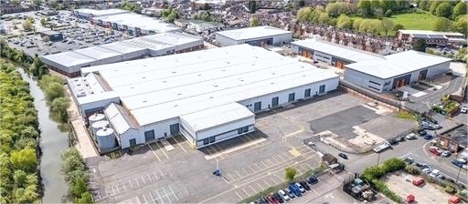
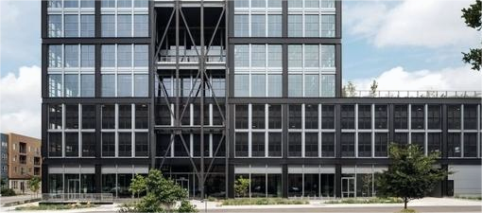
GLOBAL LIAISON OFFICES
UII Industries Ltd (UK)
UII Lifting Solutions (US)
Neither entity holds proprietary technical drawings & core standards, and UII Industries Ltd (UK) will not provide independent technical authorization or on-site project guidance for Thailand’s factory projects.
UII Lifting Solutions (US) does not own any core technical IP, and shall not issue technical approvals or conduct on-site engineering supervision for Thai local projects.

Slide 12

THANK YOU
NANJING JIGUANG MACHINERY EQUIPMENT CO., LTD.
jiguang-machinery.com
info@jiguang-machinery.com
Vertex Thailand Co., Ltd.
Mandatory DBD FBL Compliance Statement
All workshop electromechanical design drawings, equipment structures and matched industrial consumable technical specifications are independently researched and owned by Nanjing Jiguang Machinery Equipment Co., Ltd. VERTEX INDUSTRIAL SUPPLY & ENGINEERING (THAILAND) CO.,LTD carries out local engineering and auxiliary material supply under exclusive permanent technical authorization. All hydraulic oil, mold release agent and protective packaging materials are purchased from qualified local Thai suppliers following Nanjing’s standards. These consumables are provided strictly as matching supporting accessories for self-operated factory renovation projects; independent wholesale, retail and sales to irrelevant third parties are completely prohibited. UK and US liaison offices hold no technical IP and do not participate in Thailand project operations.

