Slide 1


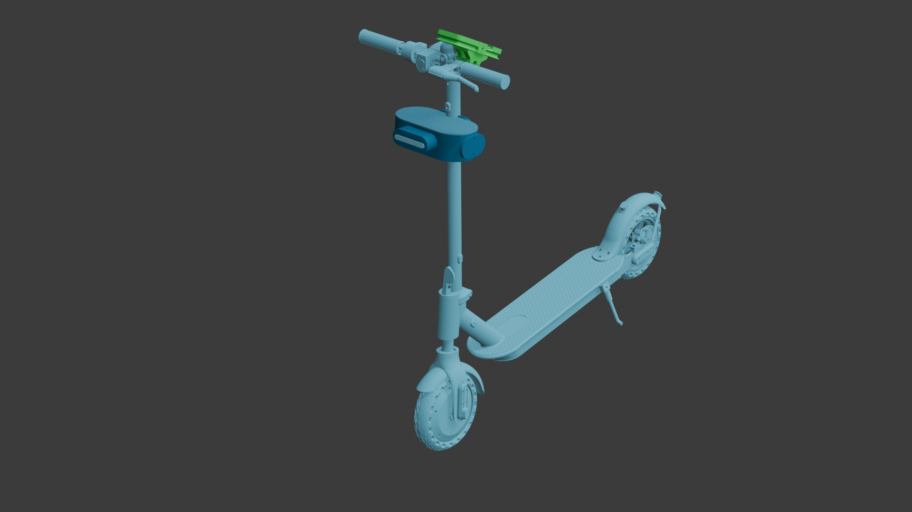

HCAS Alert Indicators
Human Collision Avoidance System — A multi-sensory feedback architecture designed to deliver intuitive, direction-aware, and priority-driven alerts through haptic, visual, and audio signals.
FEEDBACK DESIGN SYSTEM

Slide 2
SENSORY CHANNELS
Three Pillars of Alert Delivery
HCAS fuses three independent sensory channels into a unified feedback system — each encoding a different dimension of situational awareness.
Haptic
Visual LED
Audio
Encodes direction and proximity through pulse patterns and vibration intensity on the body.
Encodes severity via color and blink speed — green, yellow, and red at a glance.
Encodes urgency through tone patterns — single beeps to continuous alarm signals.

Slide 3
Directional Haptic Language
Direction Mapping
Pulse Pattern Language
Left Vibration
Short Pulses
Hazard detected on the left side
Low-level warning — stay alert
Right Vibration
Rapid Pulses
Hazard detected on the right side
Elevated urgency — take action
Both Sides
Continuous Vibration
General or frontal danger ahead
Critical danger — immediate response required

Slide 4
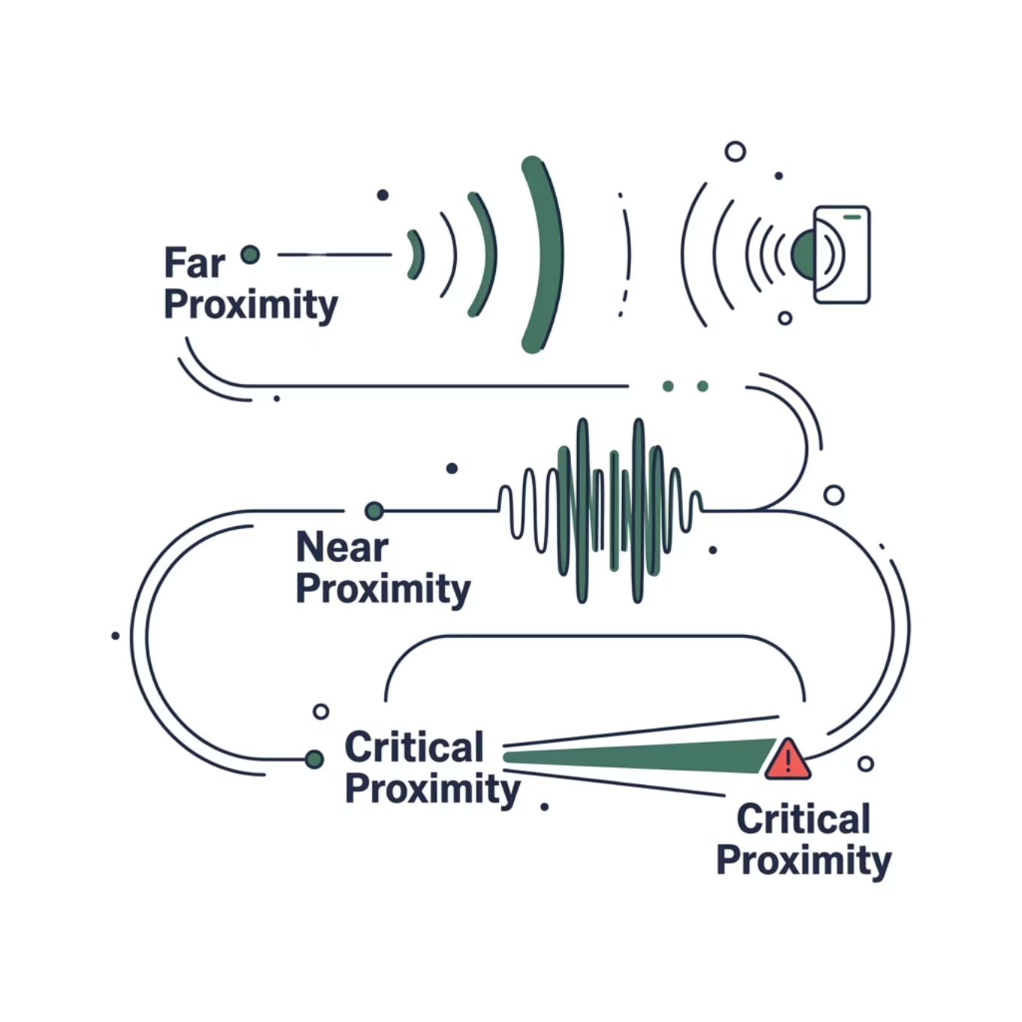

PROXIMITY & VISUAL FEEDBACK
Distance-Based Signals + Smart LED Behavior
Smart LED Color System
The LED array communicates hazard severity at a glance, even in peripheral vision:
Blink speed mirrors urgency. Animated light flow indicates hazard direction across the device surface.
🟢 Green
🟡 Yellow
🔴 Red
Clear — no immediate threat
Caution — hazard detected nearby
Critical — collision risk imminent

Slide 5

INTELLIGENCE LAYER
Adaptive Escalation & Multi-Sensory Fusion
Adaptive Escalation Logic
Alerts begin at minimal intensity and escalate only when risk persists — avoiding unnecessary alarm fatigue while ensuring critical events are never missed.
Why Multi-Sensory Fusion?
Relying on a single channel creates single points of failure — noise blocks audio, bright light washes out LEDs. Fusing all three senses:
Reduces average reaction time
Compensates for environmental interference
Encodes richer situational data simultaneously
Stage 1
Stage 2
Stage 3

Slide 6
Context-Aware & Motion-Aware Feedback
Moving Toward Hazard
Moving Away from Hazard
Temporal Escalation
Alert intensity increases dynamically as the user's trajectory converges with the threat — maximizing urgency when it matters most.
Alert intensity decreases as the user diverges from the threat, reducing unnecessary feedback and cognitive load.
Alert frequency increases over time if the hazard is unresolved, creating a mounting sense of urgency that drives faster reaction.

Slide 7
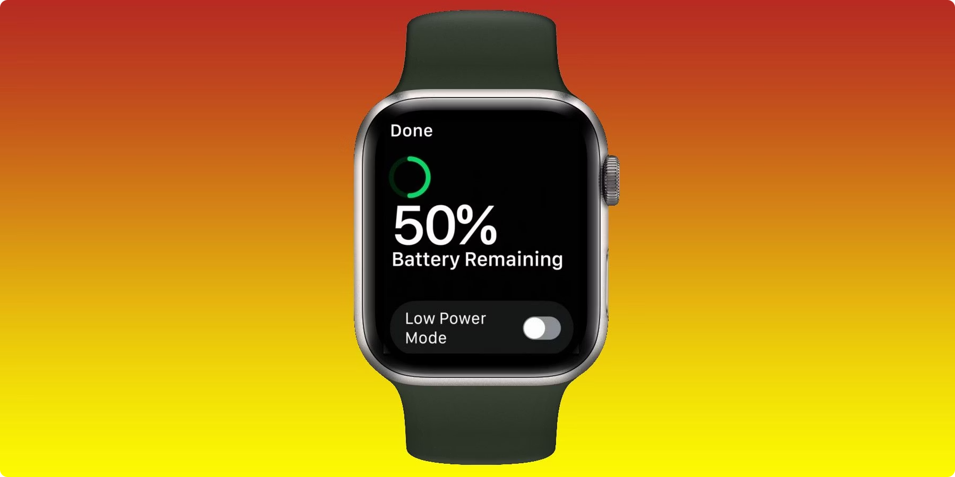
SYSTEM RESILIENCE
Smart Filtering, Silent Mode & Energy Management
1
False Alert Reduction
Transient signals below a persistence threshold are ignored — only sustained threats trigger alerts, cutting unnecessary noise.
2
Silent Mode
Audio alerts are substituted with stronger haptic feedback in noisy or quiet environments — maintaining full effectiveness without sound.
3
Energy-Aware Alerting
When battery is low, brightness, audio, and vibration intensity are reduced. Critical alerts are always preserved and prioritized.

Slide 8
Priority-Based Alert System
When multiple simultaneous hazards are detected, HCAS presents only the highest-risk alert — preventing sensory overload and keeping feedback clear, focused, and actionable.
Single Alert Rule
No Overload
Actionable Output
Only the dominant threat is surfaced at any moment
Competing signals are suppressed to preserve clarity
Every alert delivered is one the user can immediately act on

Slide 9
www.Analysion.com

