Slide 1
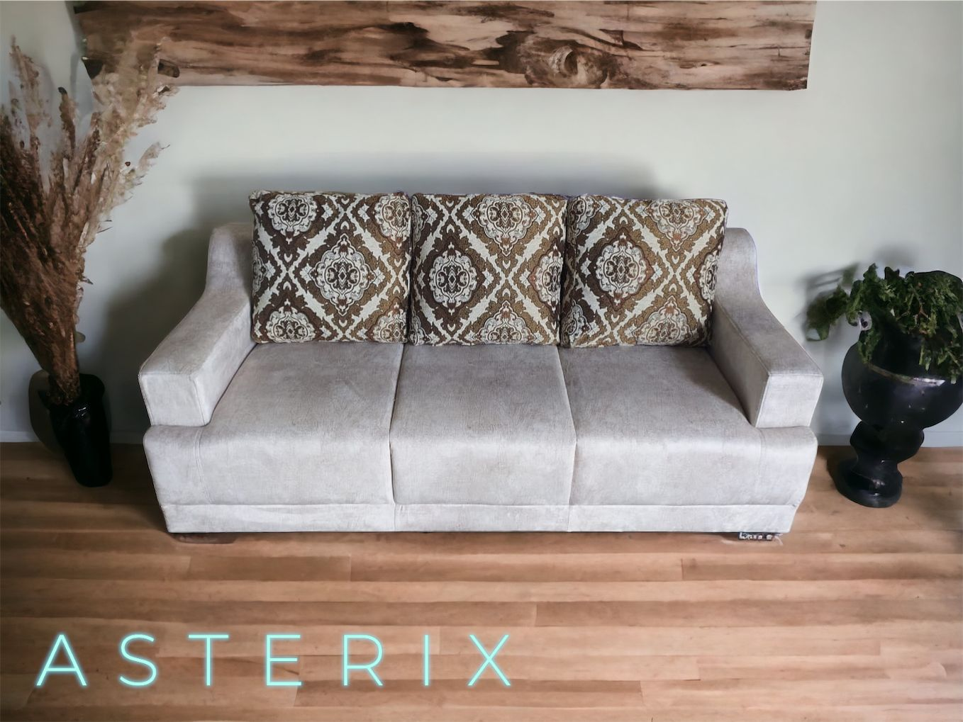

A S T E R I X
➢SEAT WIDTH –
-1 STR –31”
-2 STR –51”
-3 STR –71”
➢SEAT DEPTH -33”
➢SEAT HEIGHT -17”
3+1+1 – 39995/-
(GST EXTRA)

Slide 2
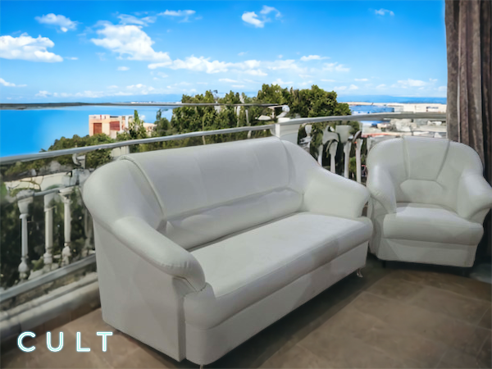
C U L T
➢SEAT WIDTH –
-1 STR –35”
-2 STR –55”
-3 STR –75”
➢SEAT DEPTH -33”
➢SEAT HEIGHT -17”
3+1+1 – 38950/-
(PLUS GST EXTRA)

Slide 3
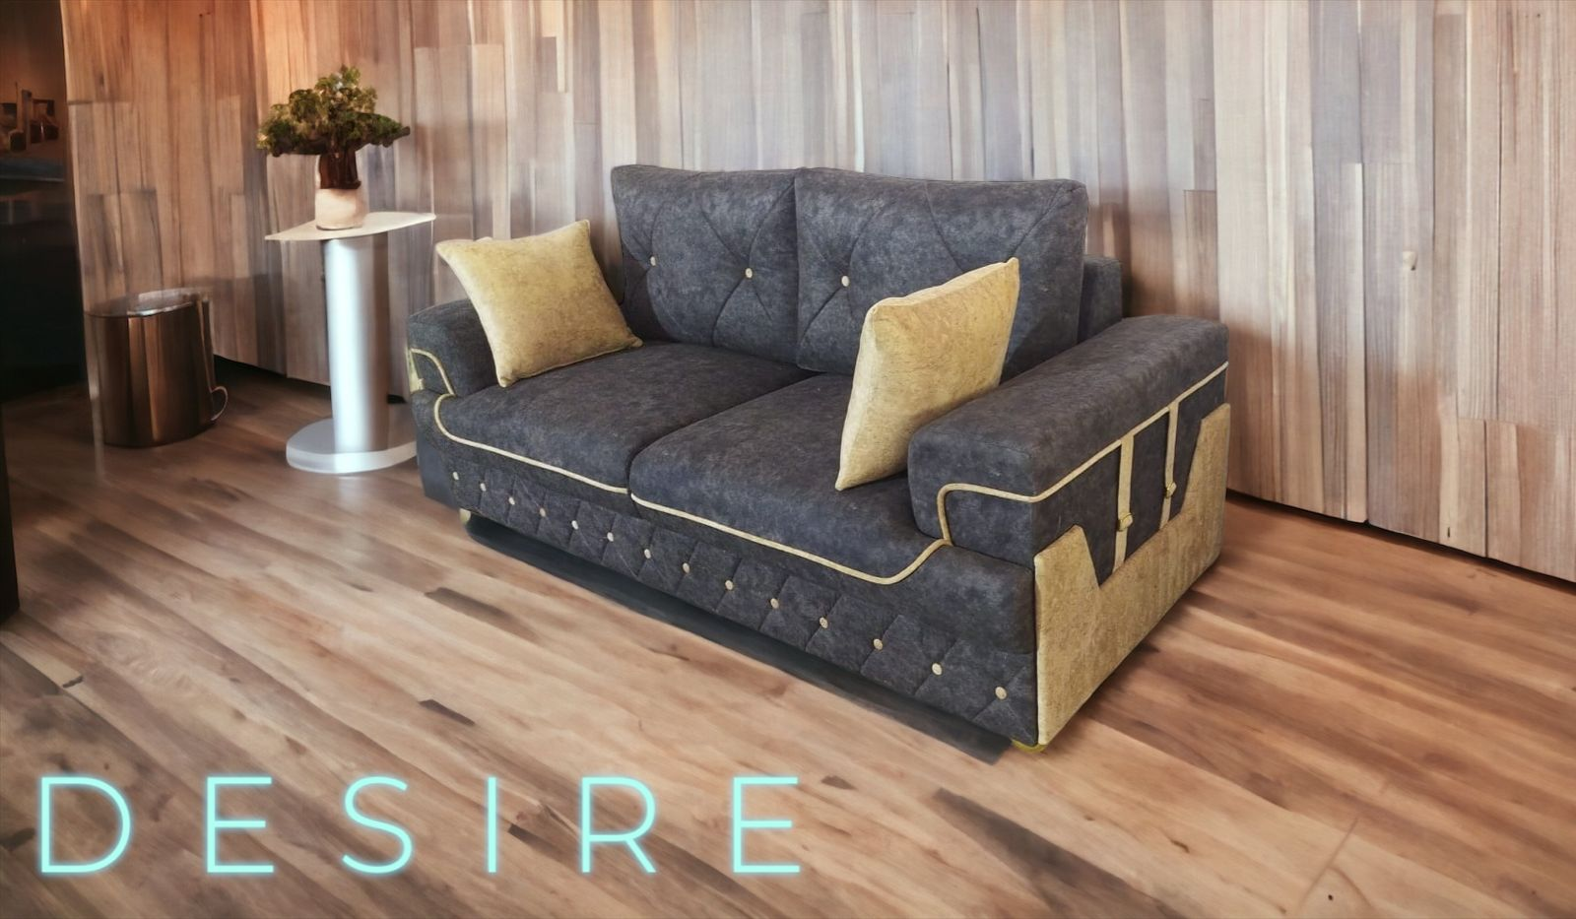
D E S I R E
➢SEAT WIDTH –
-1 STR –43”
-2 STR –63”
-3 STR –83”
➢SEAT DEPTH -35”
➢SEAT HEIGHT -17”
3+1+1 – 54090/-
(PLUS GST EXTRA)

Slide 4

B A L I
➢SEAT WIDTH –
-1 STR – 32”
-2 STR – 52”
-3 STR – 72”
➢SEAT DEPTH – 33”
➢SEAT HEIGHT – 17”
3+1+1 – 46415/-
(PLUS GST EXTRA)

Slide 5
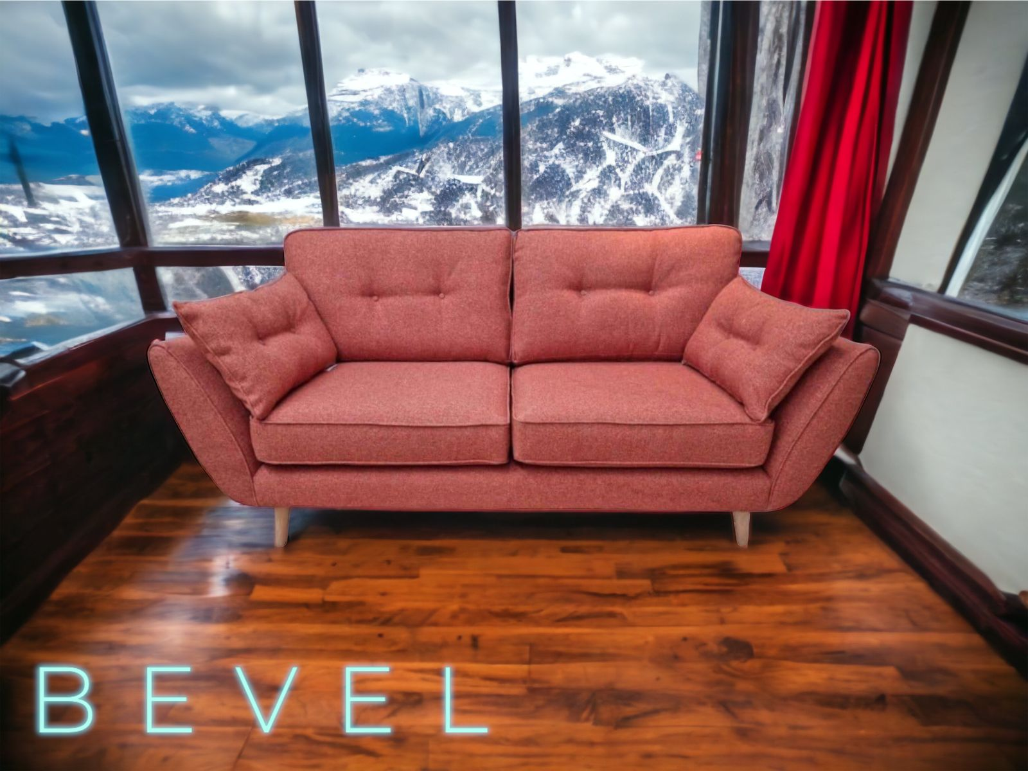
B E V E L
➢SEAT WIDTH –
-1 STR – 38”
-2 STR – 58”
-3 STR –78”
➢SEAT DEPTH – 33”
➢SEAT HEIGHT – 17”
3+1+1 – 51053/-
(PLUS GST EXTRA)

Slide 6
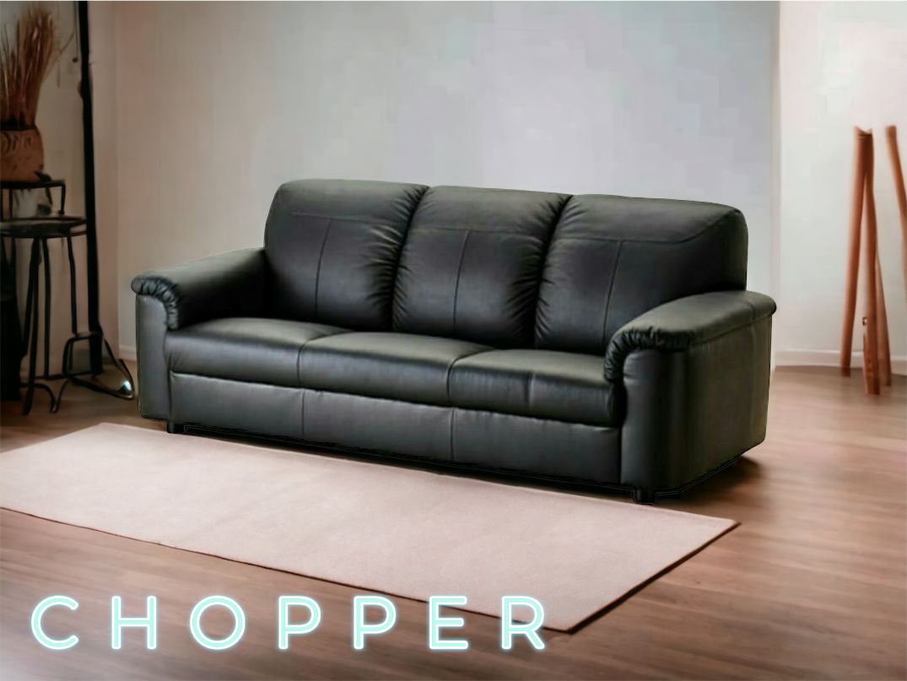
C H O P P E R
➢SEAT WIDTH –
-1 STR –38”
-2 STR –58”
-3 STR –78”
➢SEAT DEPTH -33”
➢SEAT HEIGHT -17”
3+1+1 – 56890/-
(PLUS GST EXTRA)

Slide 7
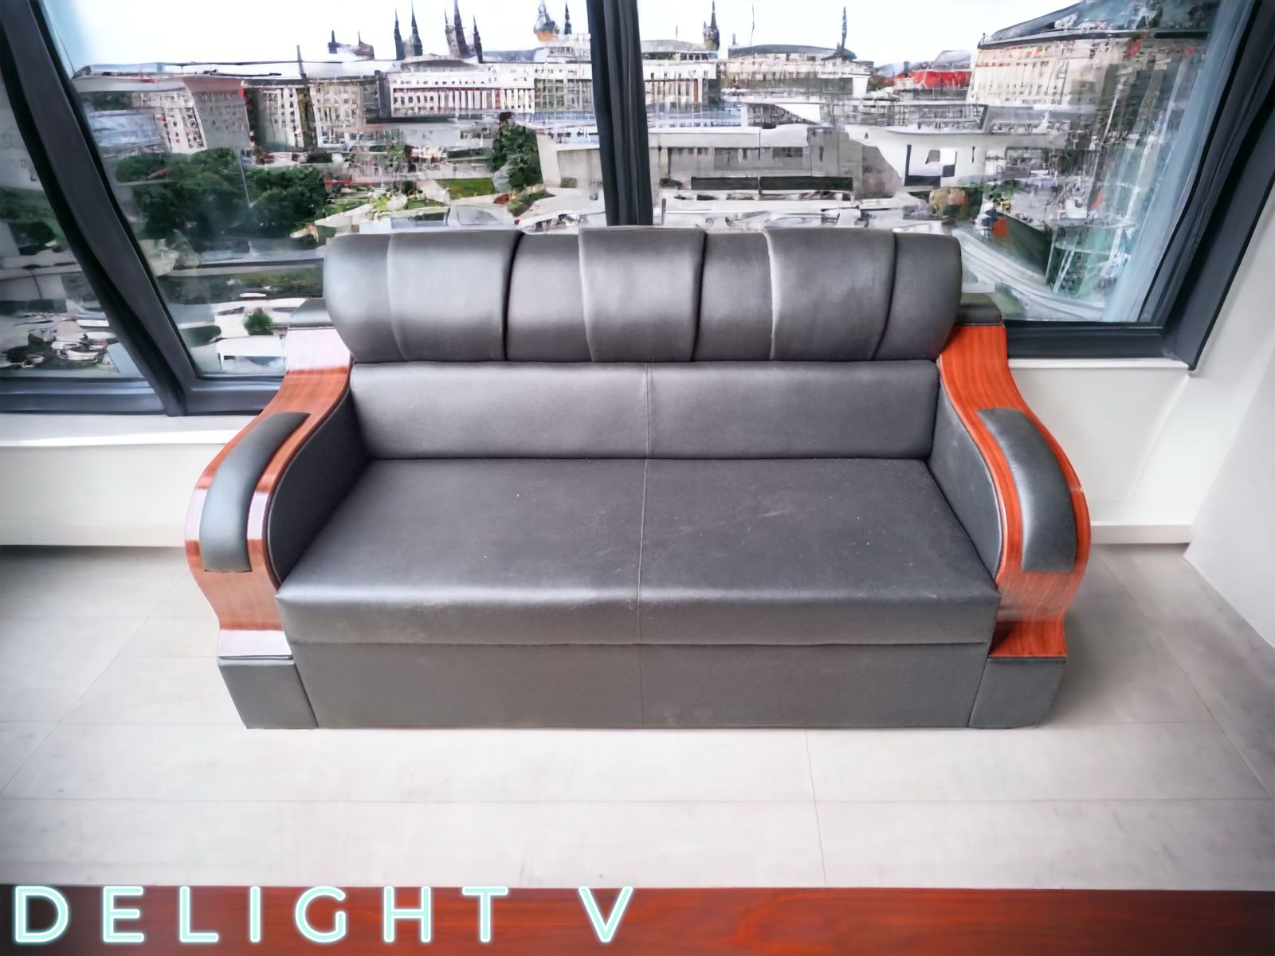
D E L I G H T V
➢SEAT WIDTH –
-1 STR –35”
-2 STR –55”
-3 STR –75”
➢SEAT DEPTH -33”
➢SEAT HEIGHT -17”
3+1+1 – 52565/-
(PLUS GST EXTRA)

Slide 8
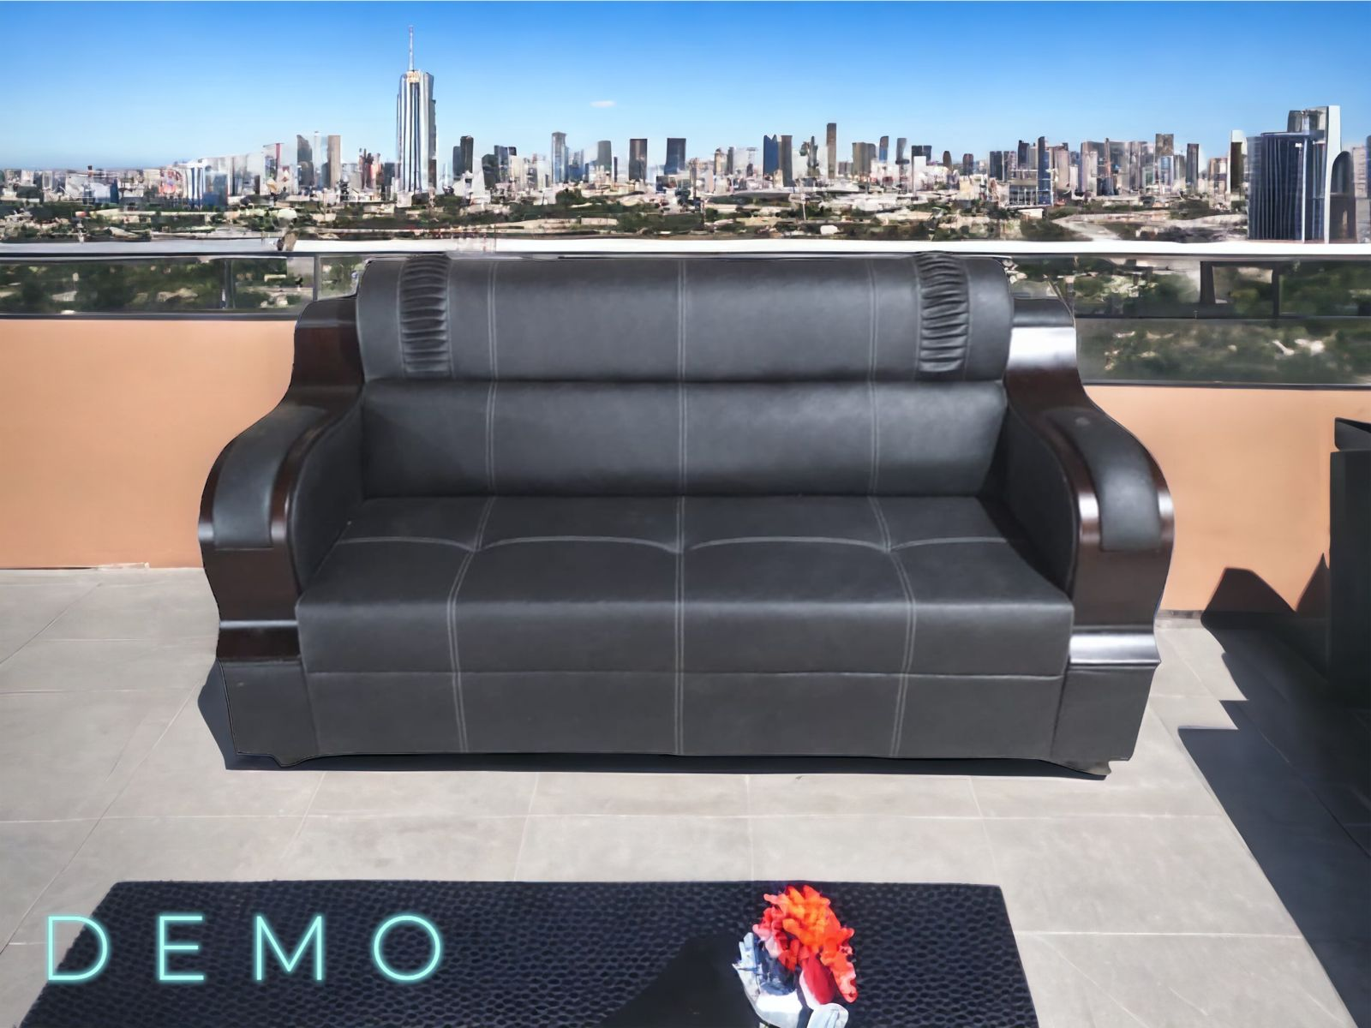
D E M O
➢SEAT WIDTH –
-1 STR –35”
-2 STR –55”
-3 STR –75”
➢SEAT DEPTH -33”
➢SEAT HEIGHT -17”
3+1+1 – 52565/-
(PLUS GST EXTRA)

Slide 9
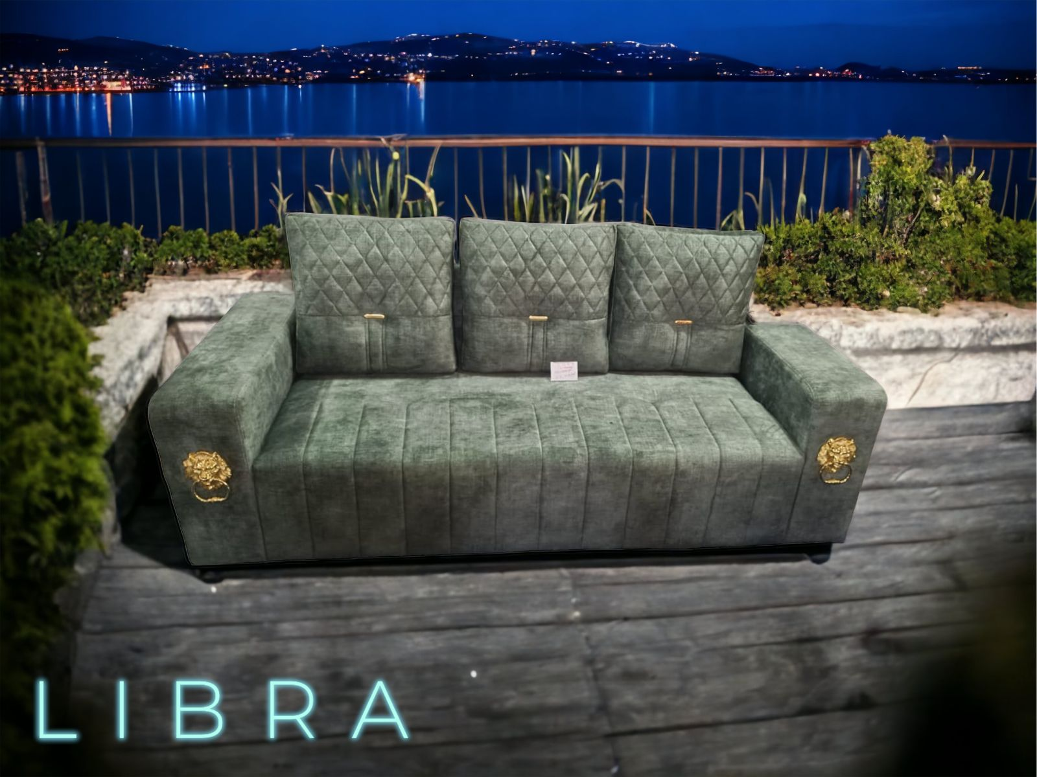
L I B R A
➢SEAT WIDTH –
-1 STR –36”
-2 STR –56”
-3 STR –76”
➢SEAT DEPTH -33”
➢SEAT HEIGHT -17”
3+1+1 – 48539/-
(PLUS GST EXTRA)

Slide 10
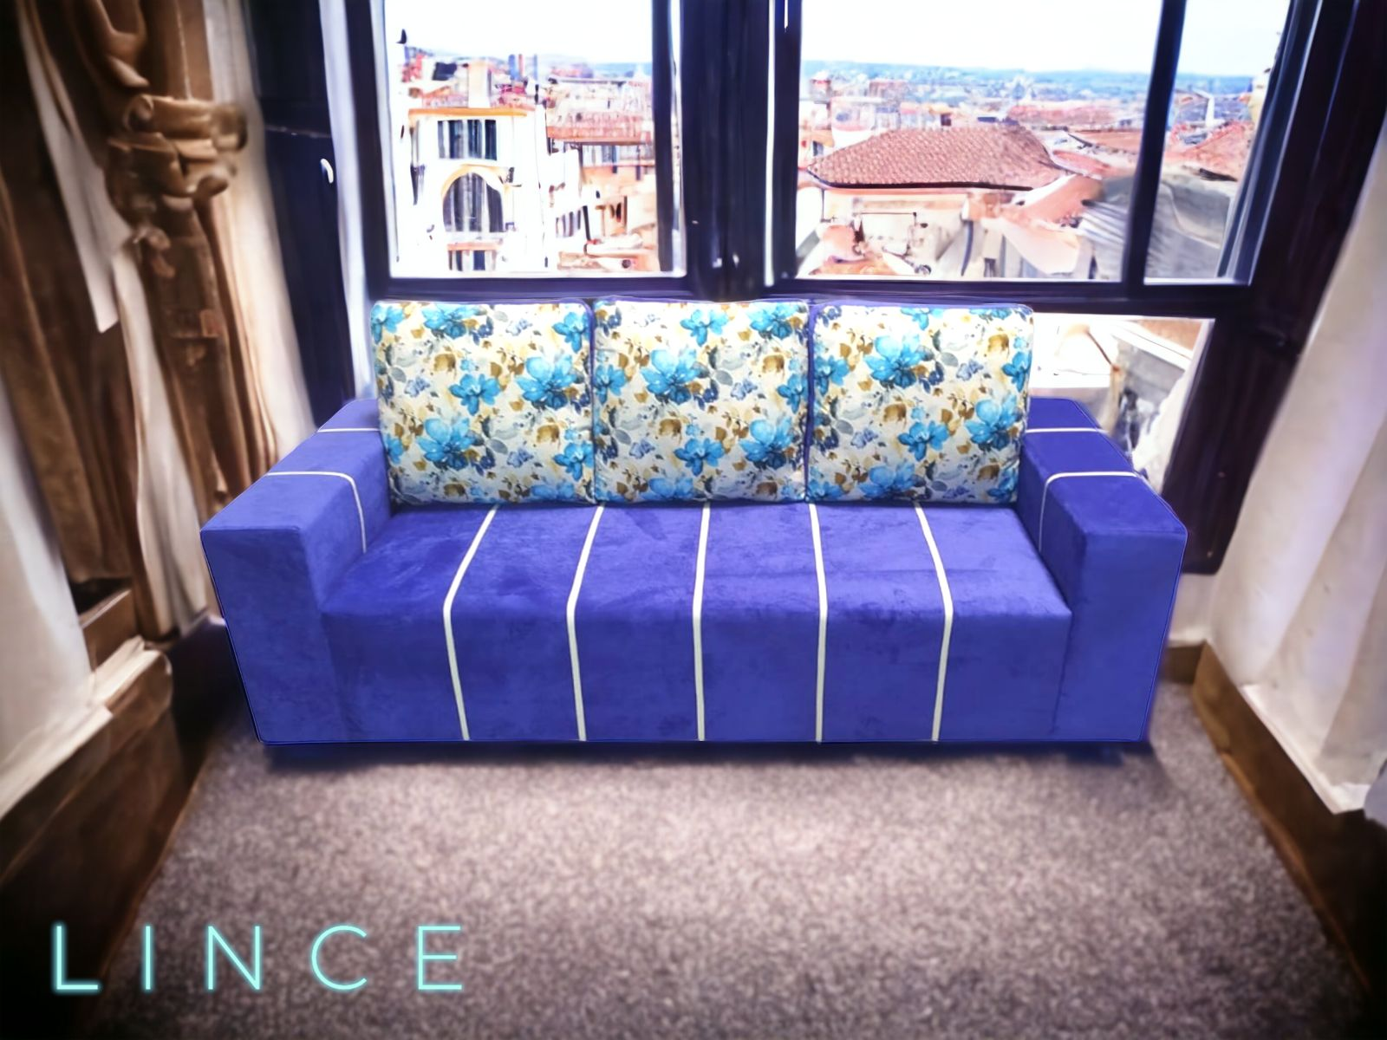
L I N C E
➢SEAT WIDTH –
-1 STR –34”
-2 STR –54”
-3 STR –74”
➢SEAT DEPTH -34”
➢SEAT HEIGHT -17”
3+1+1 – 44008/-
(PLUS GST EXTRA)

Slide 11
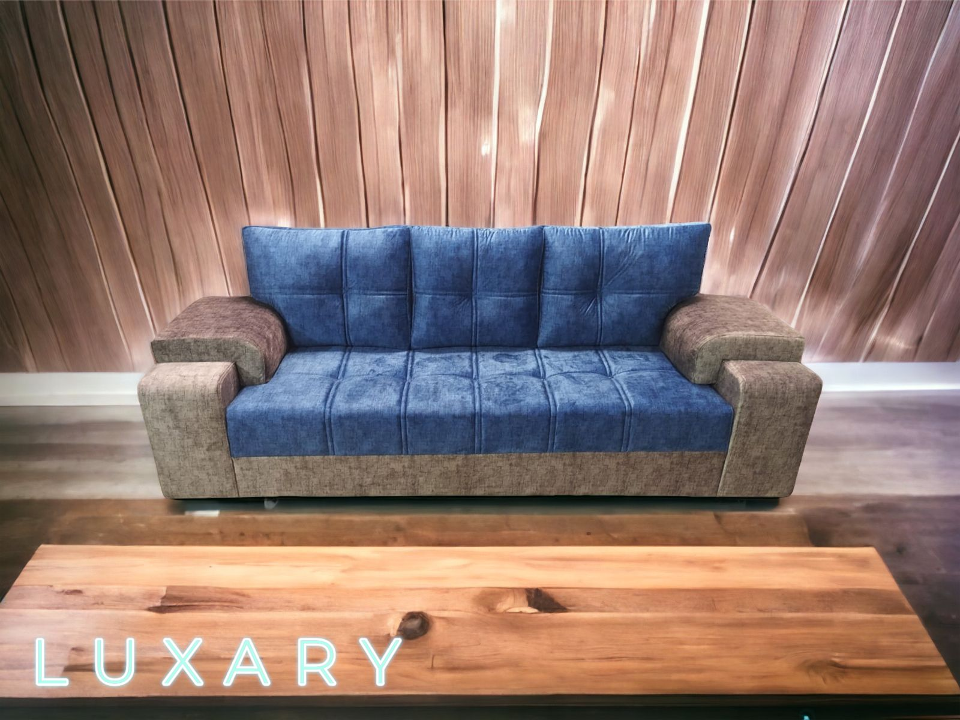
L U X A R Y
➢SEAT WIDTH –
-1 STR –31”
-2 STR –61”
-3 STR –81”
➢SEAT DEPTH -35”
➢SEAT HEIGHT -17”
3+1+1 – 51289/-
(PLUS GST EXTRA)

Slide 12
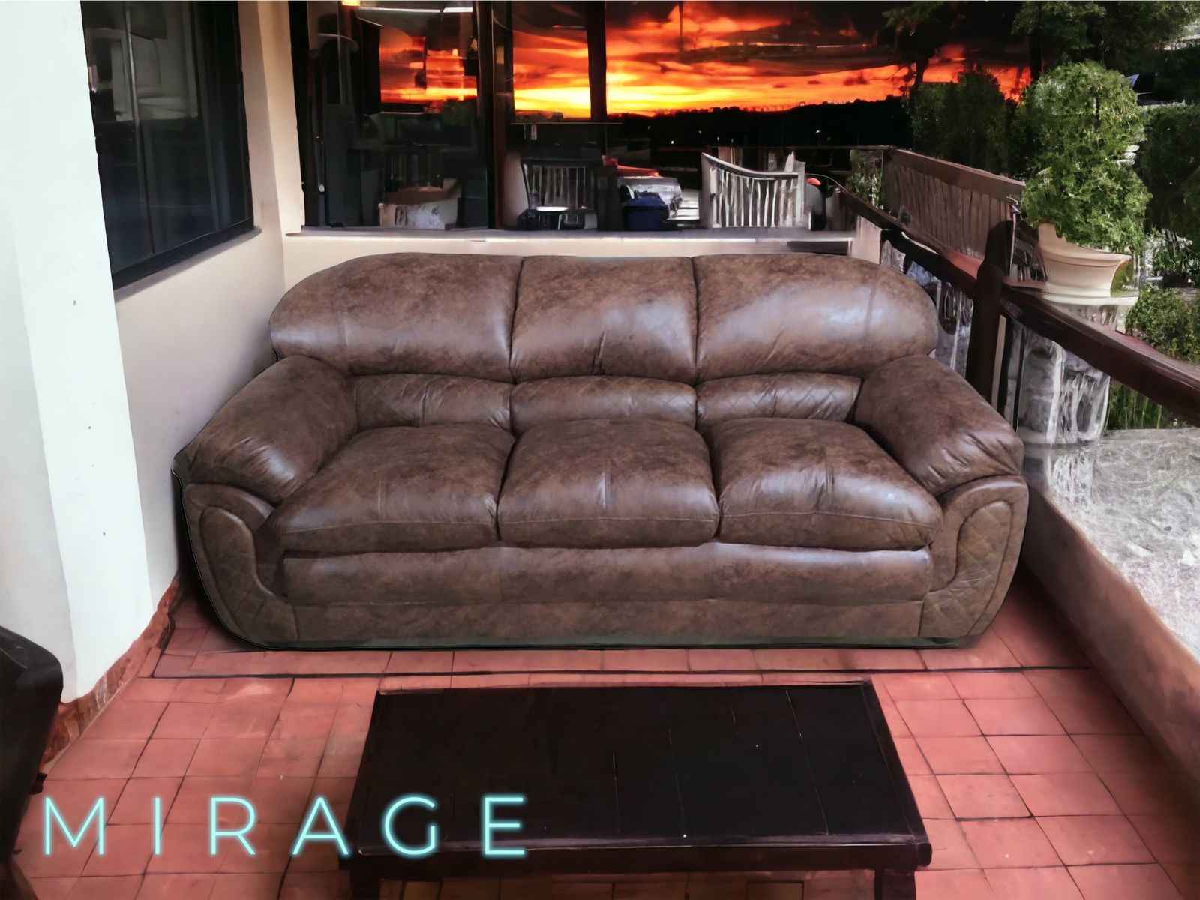
M I R A G E
➢SEAT WIDTH –
-1 STR –35”
-2 STR –55”
-3 STR –75”
➢SEAT DEPTH -33”
➢SEAT HEIGHT -17”
3+1+1 – 56500/-
(PLUS GST EXTRA)

Slide 13
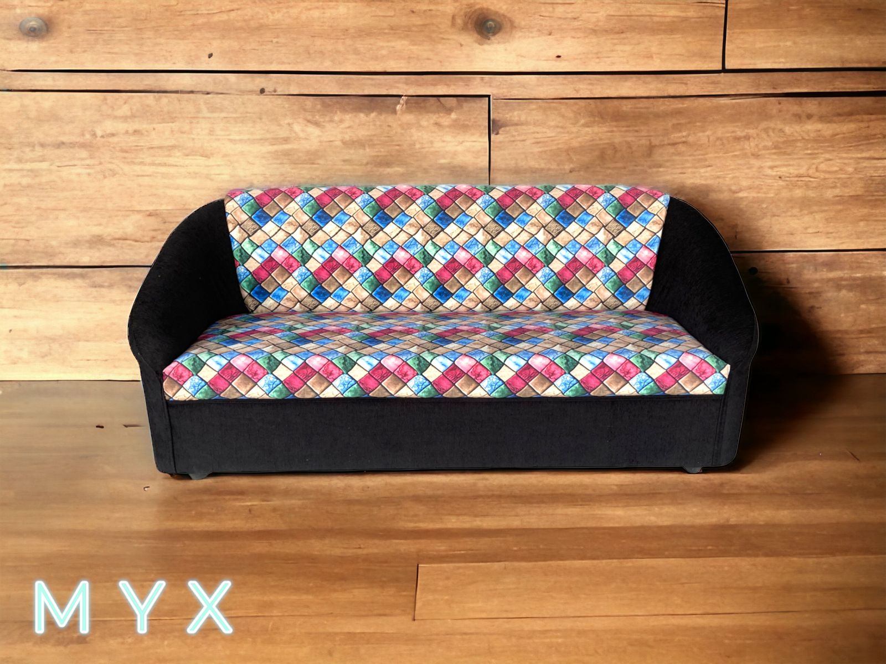
M Y X
➢SEAT WIDTH –
-1 STR – 30”
-2 STR –50”
-3 STR –70”
➢SEAT DEPTH – 28”
➢SEAT HEIGHT – 16”
3+1+1 – 34136/-
(PLUS GST EXTRA)

Slide 14
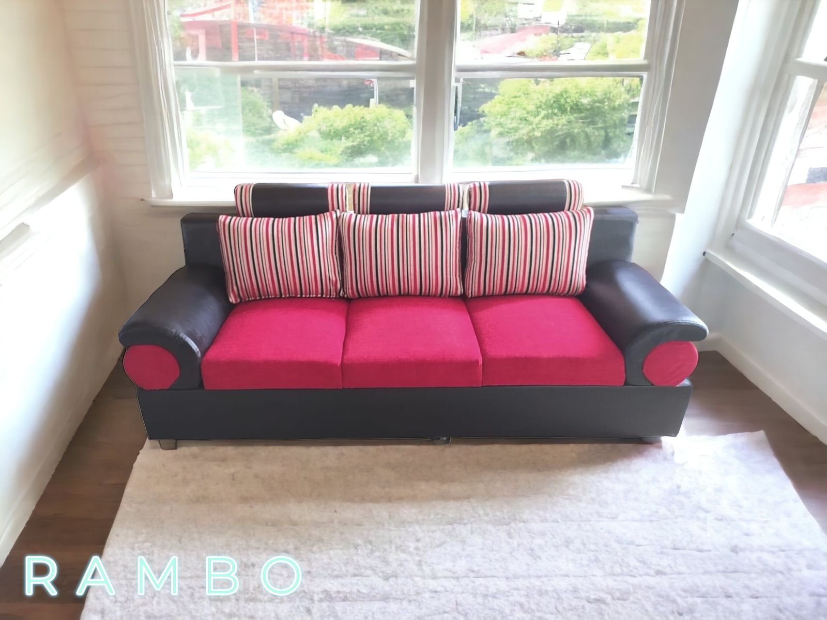
R A M B O
➢SEAT WIDTH –
-1 STR – 40”
-2 STR –60”
-3 STR –80”
➢SEAT DEPTH -33”
➢SEAT HEIGHT -17”
3+1+1 – 48990/-
(PLUS GST EXTRA)

Slide 15
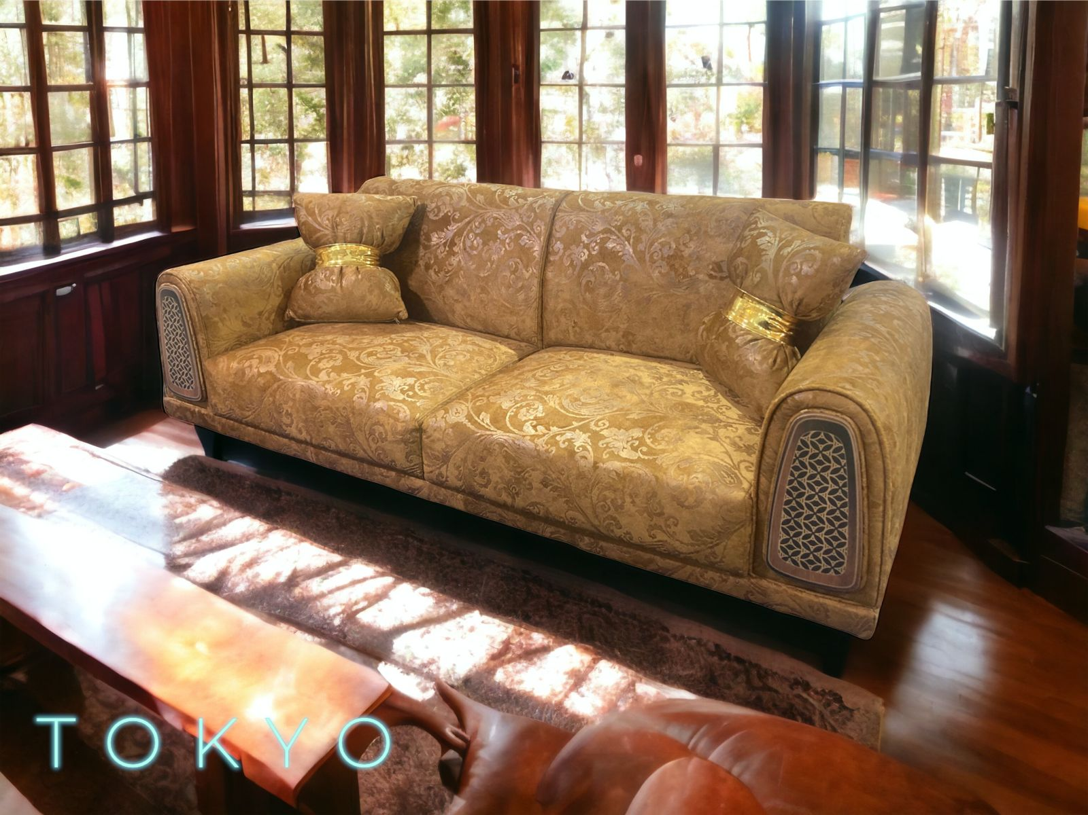
T O K Y O
➢SEAT WIDTH –
-1 STR – 37”
-2 STR –57”
-3 STR –77”
➢SEAT DEPTH – 31”
➢SEAT HEIGHT -17”
3+1+1 – 54720/-
(PLUS GST EXTRA)

Slide 16
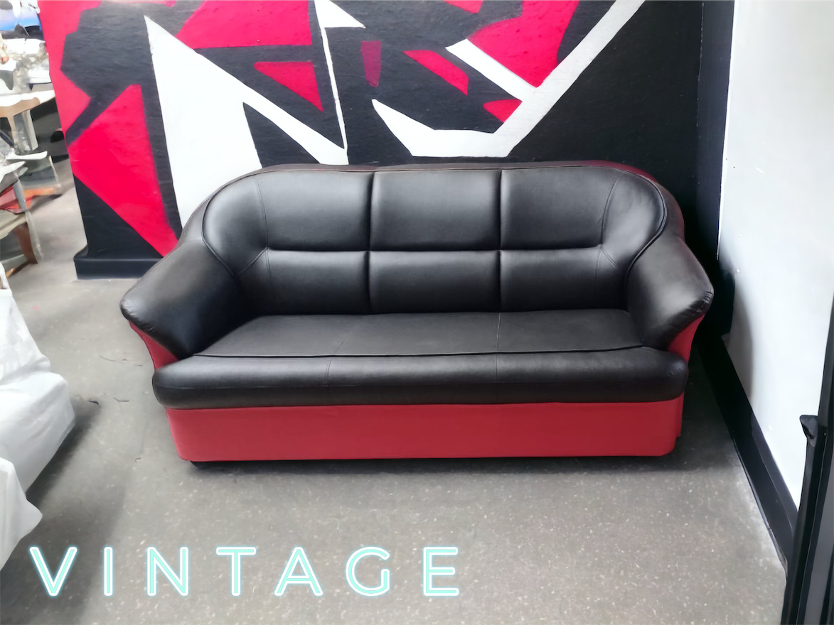
V I N T A G E
➢SEAT WIDTH –
-1 STR –35”
-2 STR –55”
-3 STR –75”
➢SEAT DEPTH -31”
➢SEAT HEIGHT -17”
3+1+1 –48040/-
(PLUS GST EXTRA)

Slide 17
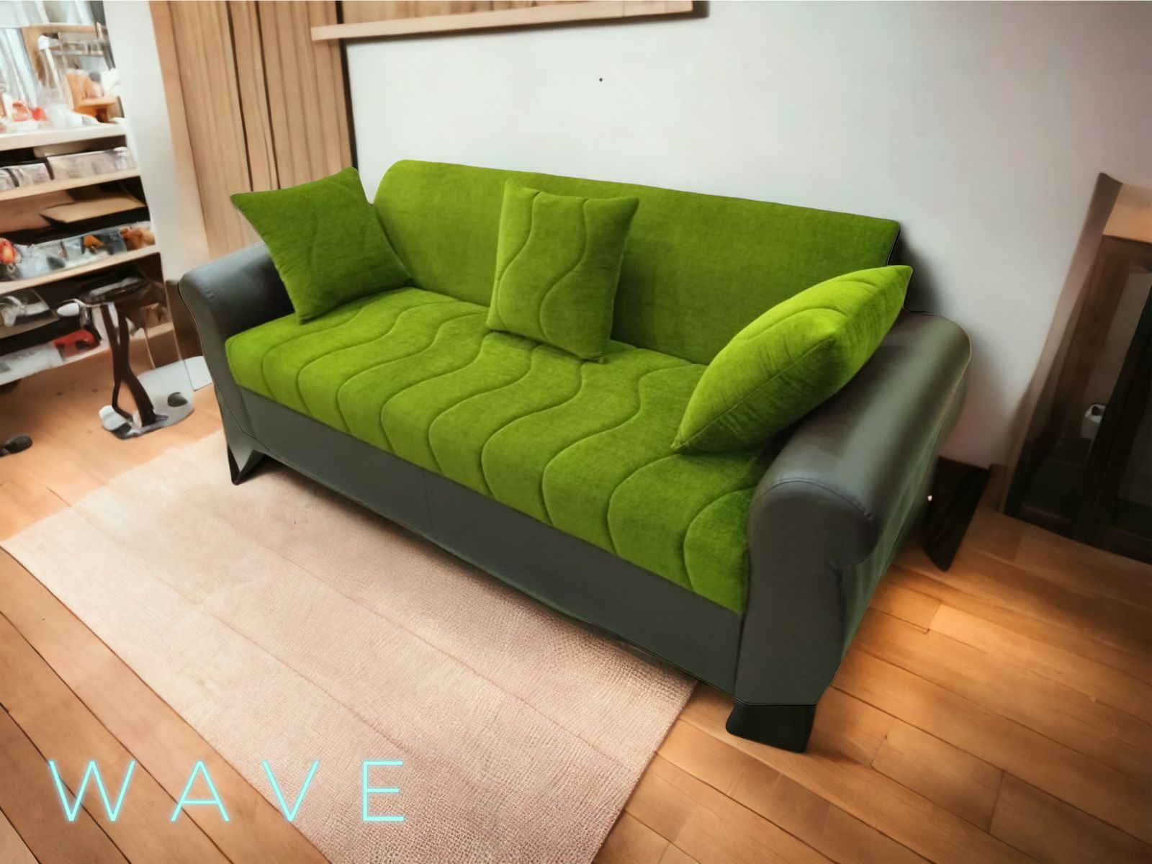
W A V E
➢SEAT WIDTH –
-1 STR –36”
-2 STR –56”
-3 STR –76”
➢SEAT DEPTH -36”
➢SEAT HEIGHT -17”
3+1+1 – 38690/-
(PLUS GST EXTRA)

Slide 18
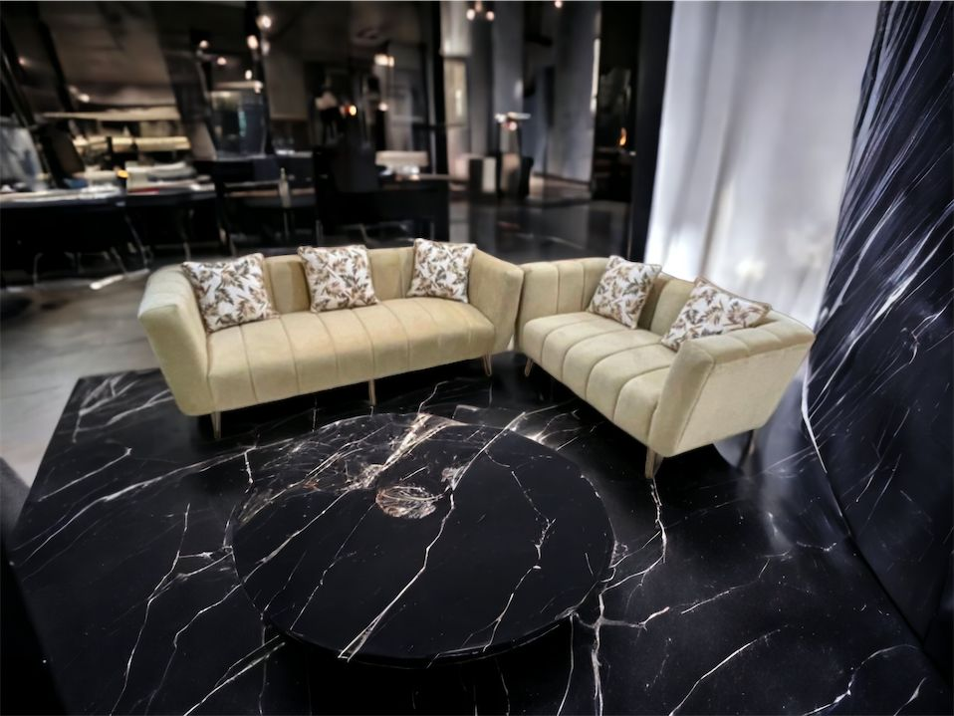
P R O F I L E
➢SEAT WIDTH –
-1 STR – 34”
-2 STR – 54”
-3 STR – 74”
➢SEAT DEPTH – 32”
➢SEAT HEIGHT -17”
P R O F I L E
3+1+1 – 48675/-
(PLUS GST EXTRA)

Slide 19
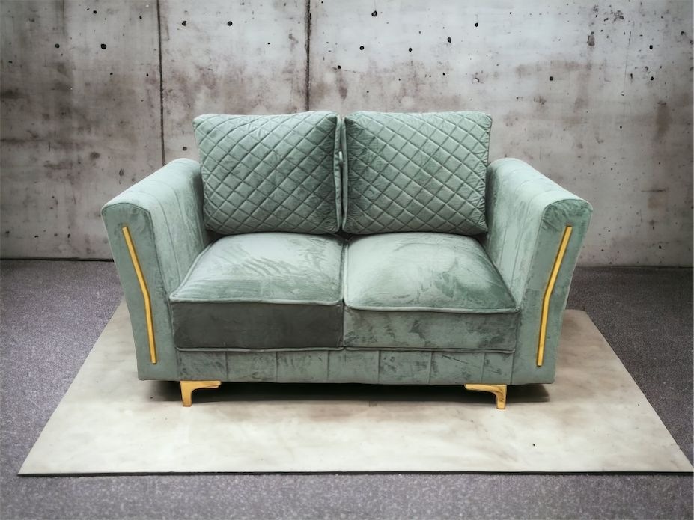
Z E N
➢SEAT WIDTH –
-1 STR – 33”
-2 STR – 53”
-3 STR – 73”
➢SEAT DEPTH – 33”
➢SEAT HEIGHT -17”
Z E N
3+1+1 – 56329/-
(PLUS GST EXTRA)

Slide 20
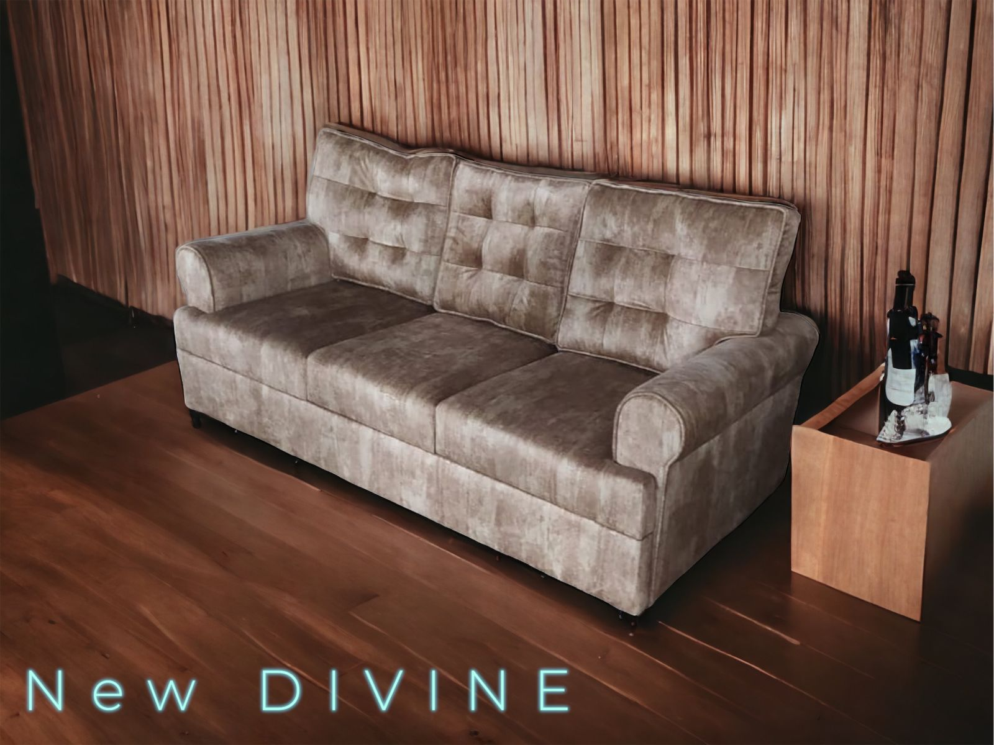
N E W D I V I N E
➢SEAT WIDTH –
-1 STR –35”
-2 STR –55”
-3 STR –75”
➢SEAT DEPTH -32”
➢SEAT HEIGHT -17”
3+1+1 – 48675/-
(PLUS GST EXTRA)

Slide 21
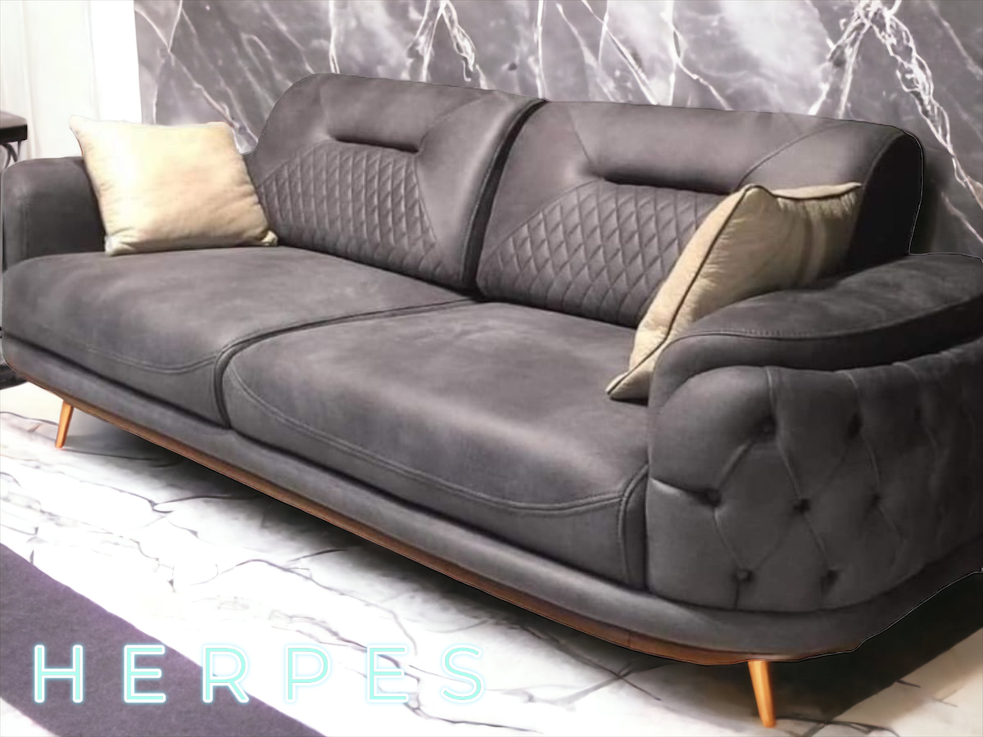
H E R P E S
➢SEAT WIDTH –
-1 STR – 38”
-2 STR – 58”
-3 STR – 78”
➢SEAT DEPTH – 36”
➢SEAT HEIGHT – 17”
3+1+1 – 65250/-
(PLUS GST EXTRA)

Slide 22
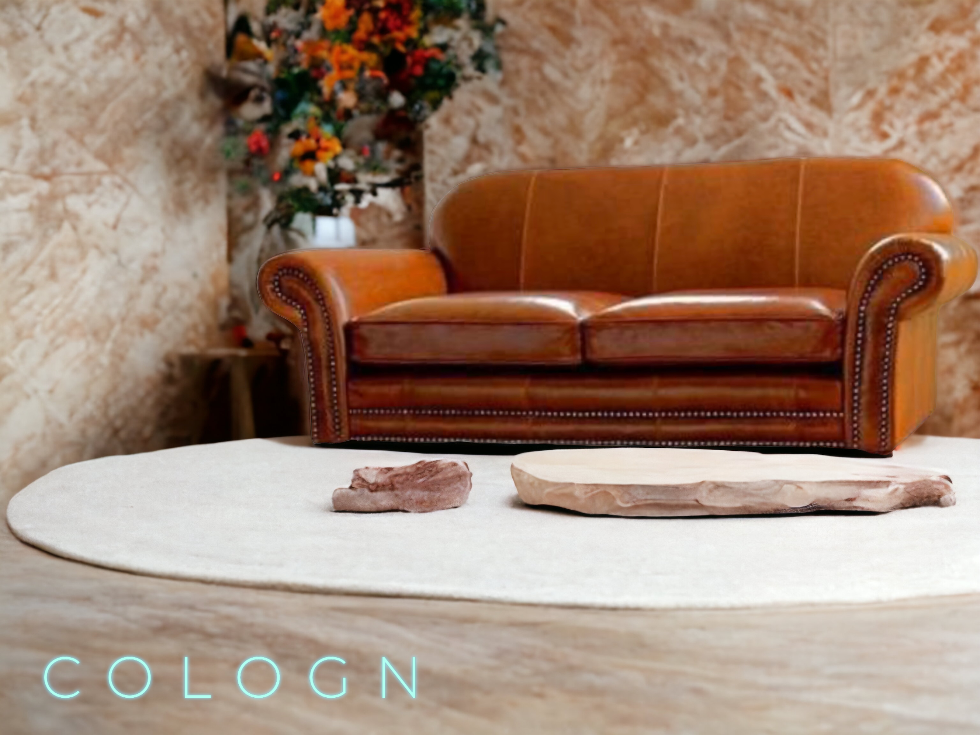
C O L O G N
➢SEAT WIDTH –
-1 STR –36”
-2 STR –56”
-3 STR –76”
➢SEAT DEPTH -36”
➢SEAT HEIGHT -17”
3+1+1 – 48675/-
(PLUS GST EXTRA)

Slide 23
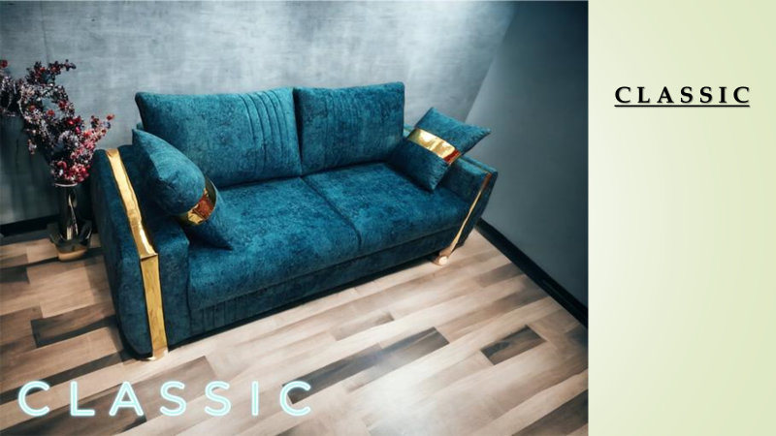

➢SEAT WIDTH –
-1 STR –34”
-2 STR –54”
-3 STR –74”
➢SEAT DEPTH -35”
➢SEAT HEIGHT -17”
3+1+1 – 49515/-
(PLUS GST EXTRA)

Slide 24
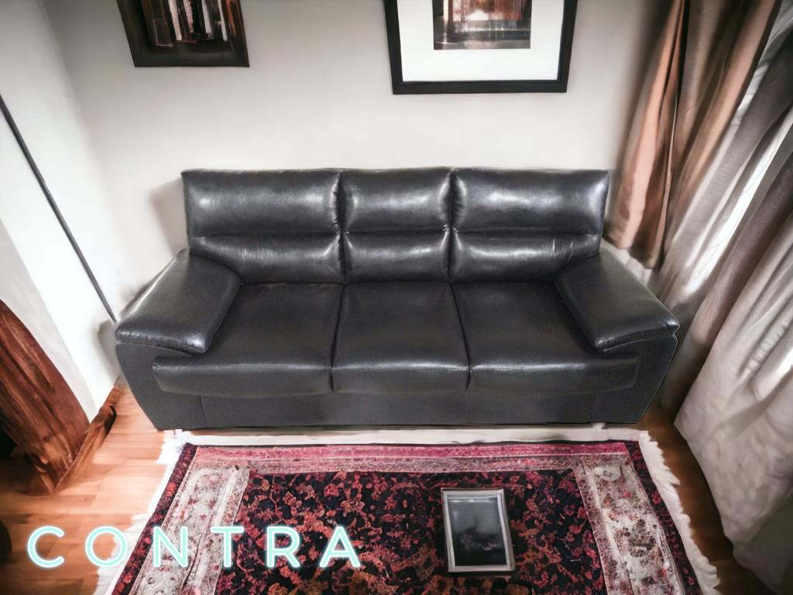
C O N T R A
➢SEAT WIDTH –
-1 STR –35”
-2 STR –55”
-3 STR –75”
➢SEAT DEPTH -33”
➢SEAT HEIGHT -17”
3+1+1 – 54090/-
(PLUS GST EXTRA)

Slide 25
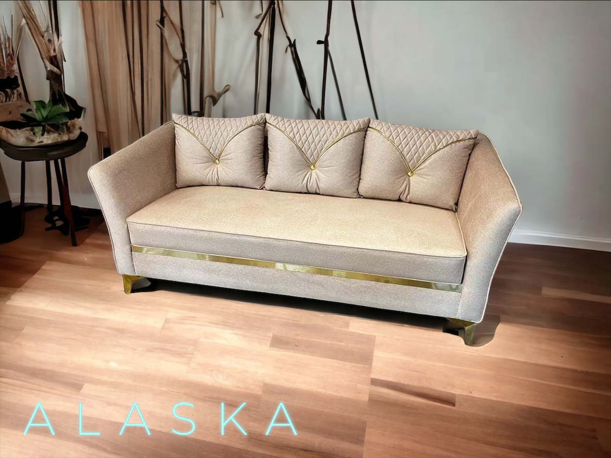
A L A S K A
➢SEAT WIDTH –
-1 STR – 32’’
-2 STR – 52’’
-3 STR – 72”
➢SEAT DEPTH - 34’’
➢SEAT HEIGHT - 17’’
3+1+1 – 52880/- (550 MTR)
3+1+1 – 21200/- (200 MTR)
(PLUS GST EXTRA)

Slide 26
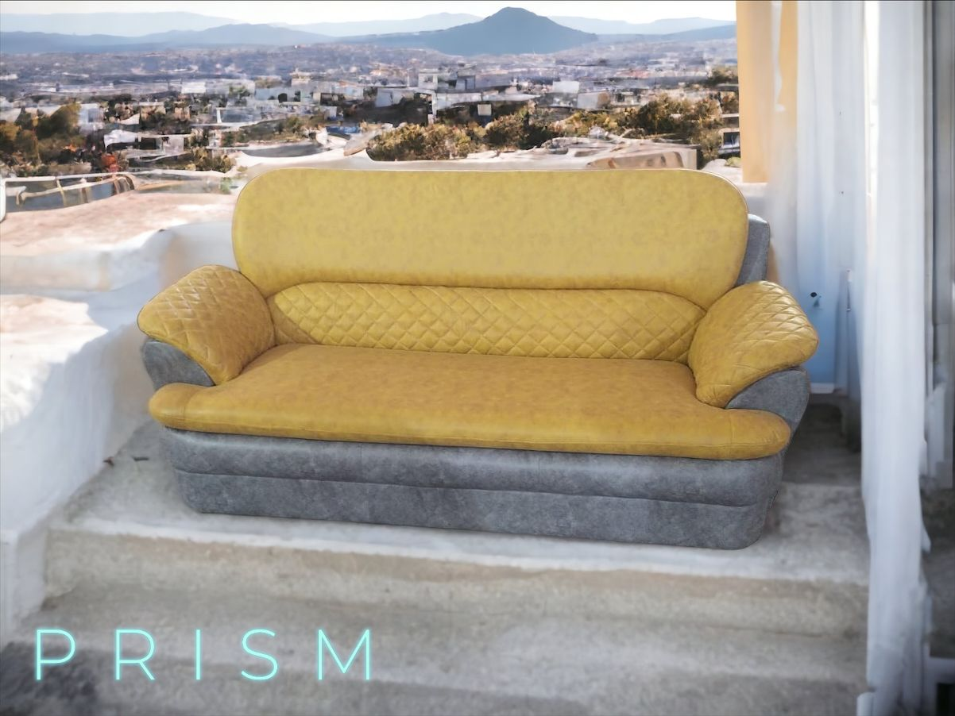
P R I S M
➢SEAT WIDTH –
-1 STR –35”
-2 STR –55”
-3 STR –75”
➢SEAT DEPTH -35”
➢SEAT HEIGHT -17”
3+1+1 – 48150/-
(PLUS GST EXTRA)

Slide 27
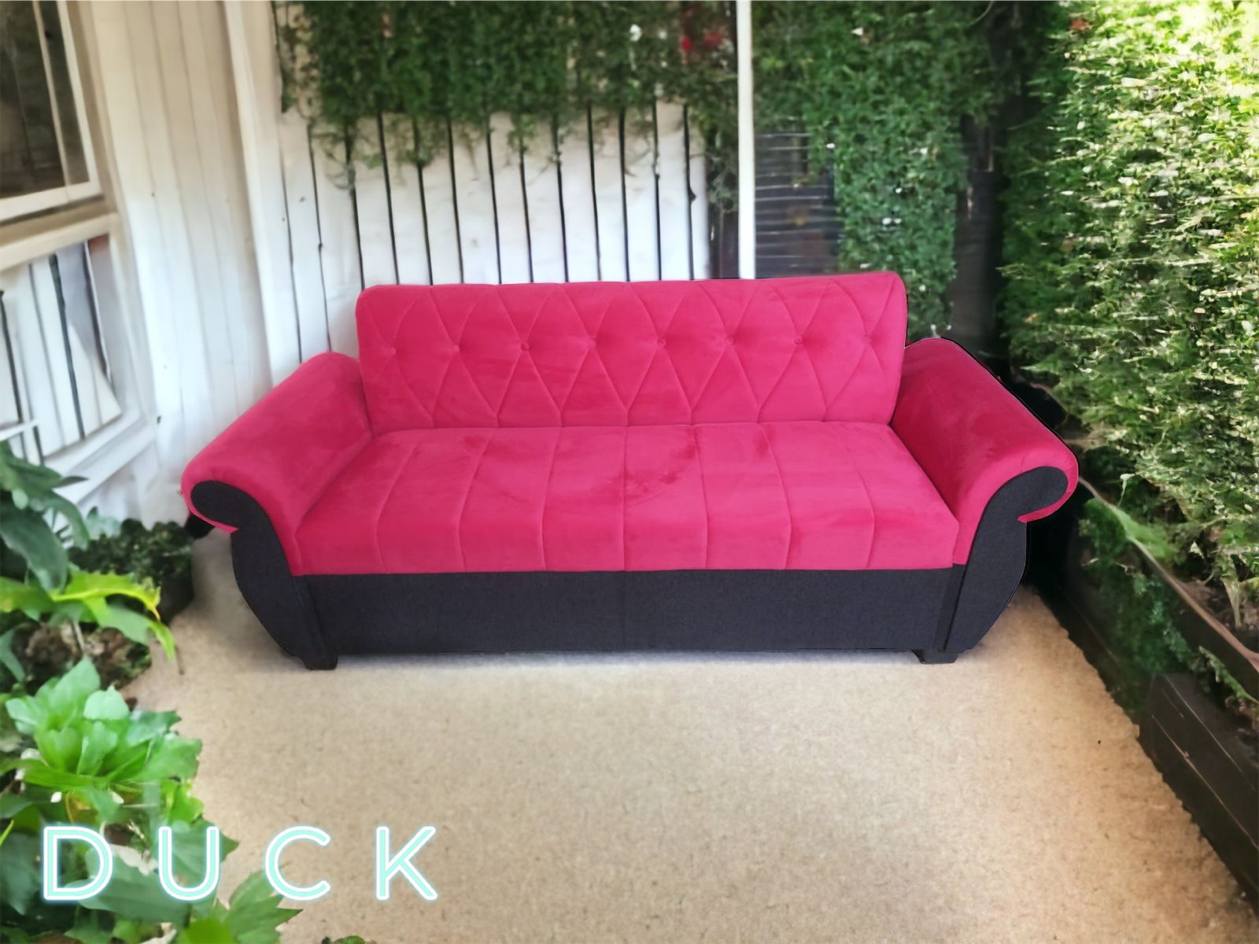
D U C K
➢SEAT WIDTH –
-1 STR –36”
-2 STR –56”
-3 STR –76”
➢SEAT DEPTH -36”
➢SEAT HEIGHT -17”
3+1+1 – 39475/-
(PLUS GST EXTRA)

Slide 28
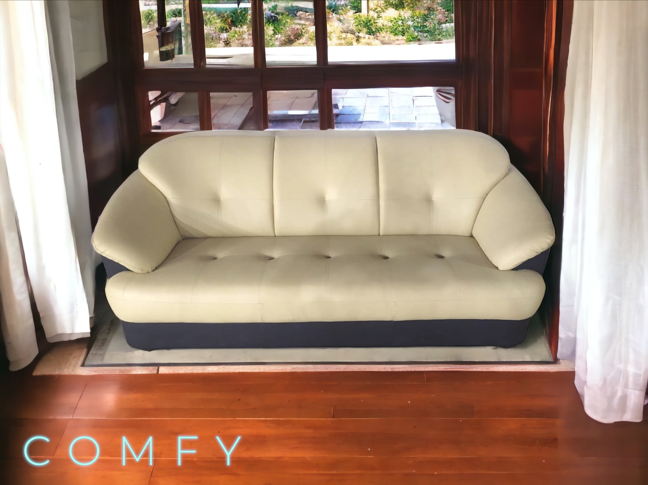
C O M F Y
➢SEAT WIDTH –
-1 STR – 37”
-2 STR – 57”
-3 STR – 77”
➢SEAT DEPTH – 32”
➢SEAT HEIGHT -16”
3+1+1 – 42840/-
(PLUS GST EXTRA)

Slide 29
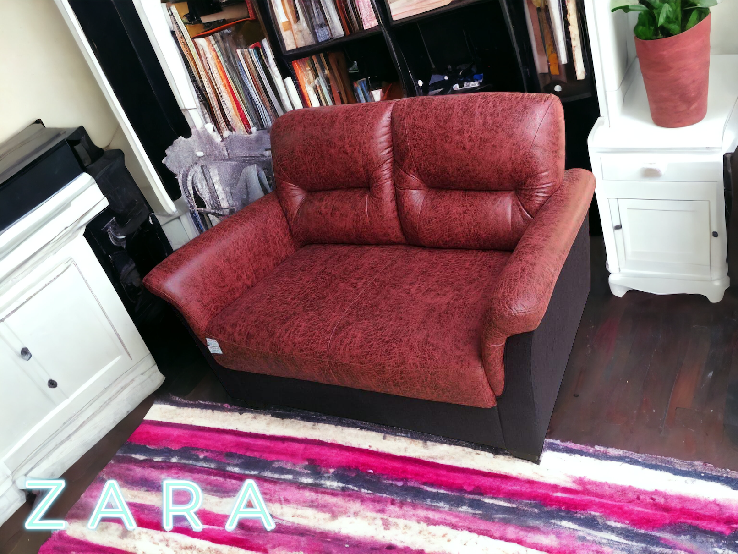
Z A R A
➢SEAT WIDTH –
-1 STR – 30”
-2 STR –50”
-3 STR – 70”
➢SEAT DEPTH – 36”
➢SEAT HEIGHT – 17”
3+1+1 – 48970/-
(PLUS GST EXTRA)

Slide 30
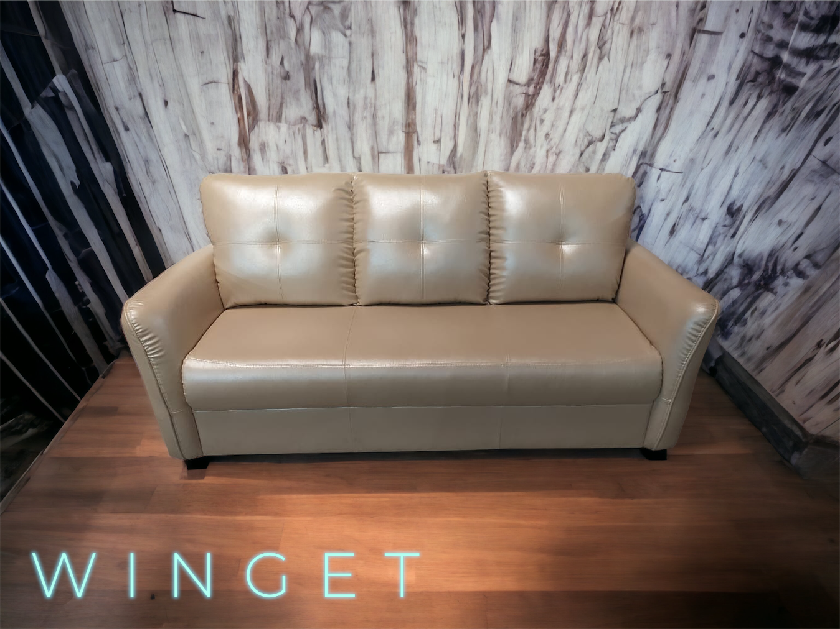
W I N G E T
➢SEAT WIDTH –
-1 STR – 32’’
-2 STR – 52’’
-3 STR – 72’’
➢SEAT DEPTH – 33’’
➢SEAT HEIGHT – 17”
3+1+1 – 44890/-
(PLUS GST EXTRA)

Slide 31
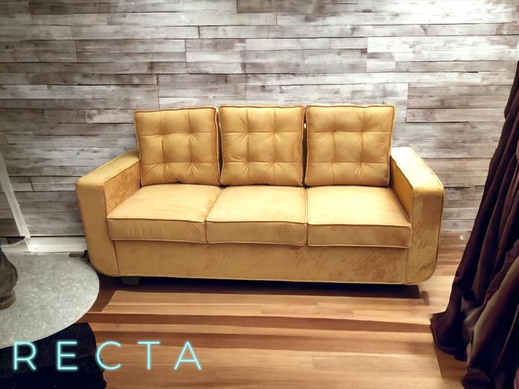
R E C T A
➢SEAT WIDTH –
-1 STR – 30”
-2 STR – 50”
-3 STR – 70”
➢SEAT DEPTH -33”
➢SEAT HEIGHT -17”
3+1+1 – 48040/-
(PLUS GST EXTRA)

Slide 32
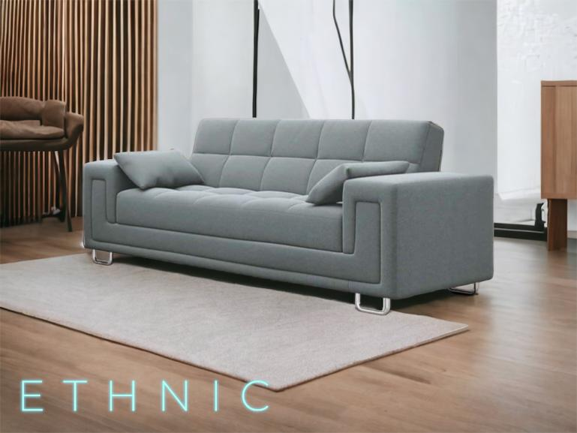
E T H N I C
➢SEAT WIDTH –
-1 STR – 31”
-2 STR –51”
-3 STR –71”
➢SEAT DEPTH -31”
➢SEAT HEIGHT -17”
3+1+1 – 45943/-
(PLUS GST EXTRA)

Slide 33
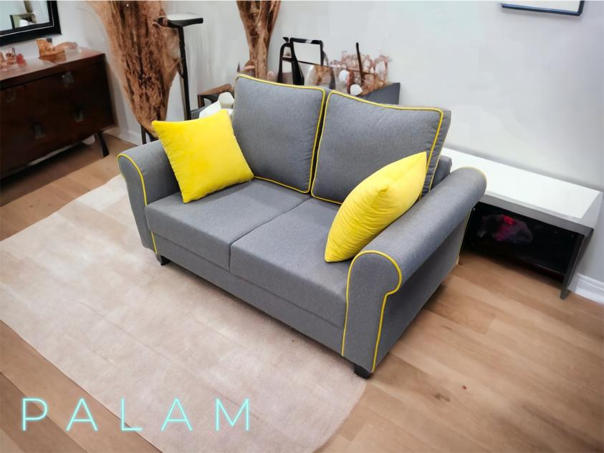
P A L A M
➢SEAT WIDTH –
-1 STR –35”
-2 STR –55”
-3 STR –75”
➢SEAT DEPTH -32”
➢SEAT HEIGHT -16”
3+1+1 – 49570/-
(PLUS GST EXTRA)

Slide 34
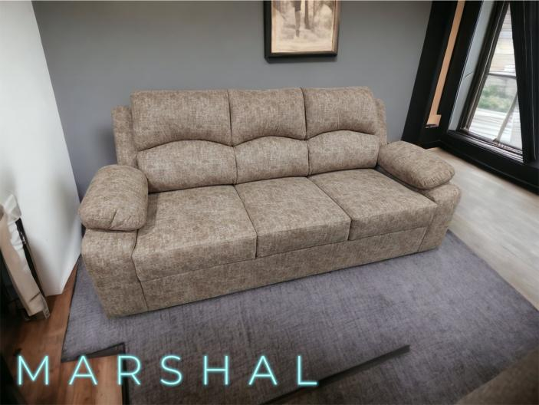
M A R S H A L
➢SEAT WIDTH –
-1 STR –31”
-2 STR –51”
-3 STR –81”
➢SEAT DEPTH -35”
➢SEAT HEIGHT -17”
3+1+1 – 60400/-
(PLUS GST EXTRA)

Slide 35
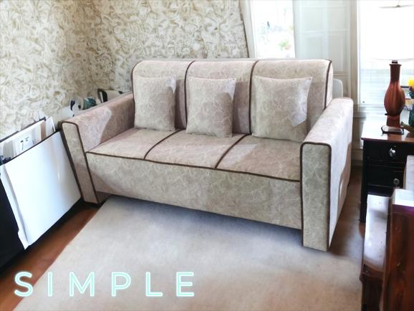
S I M P L E
➢SEAT WIDTH –
-1 STR – 31’’
-2 STR – 51”
-3 STR – 71”
➢SEAT DEPTH – 30’’
➢SEAT HEIGHT – 17’’
3+1+1 – 38370/-
(PLUS GST EXTRA)

Slide 36
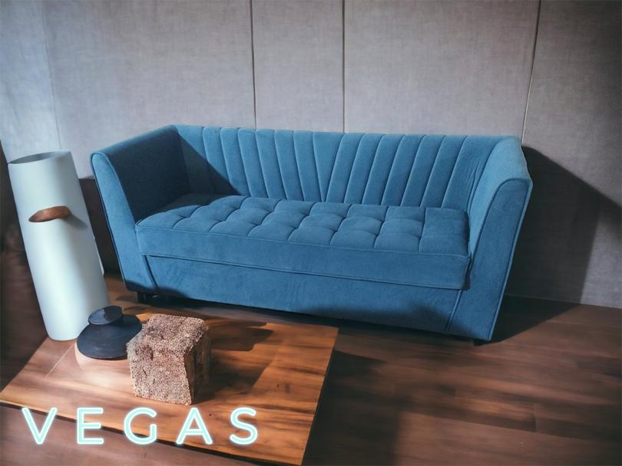
V E G A S
➢SEAT WIDTH –
-1 STR – 33”
-2 STR – 53”
-3 STR – 73”
➢SEAT DEPTH – 27”
➢SEAT HEIGHT -16.5”
3+1+1 – 38937/-
(PLUS GST EXTRA)

Slide 37
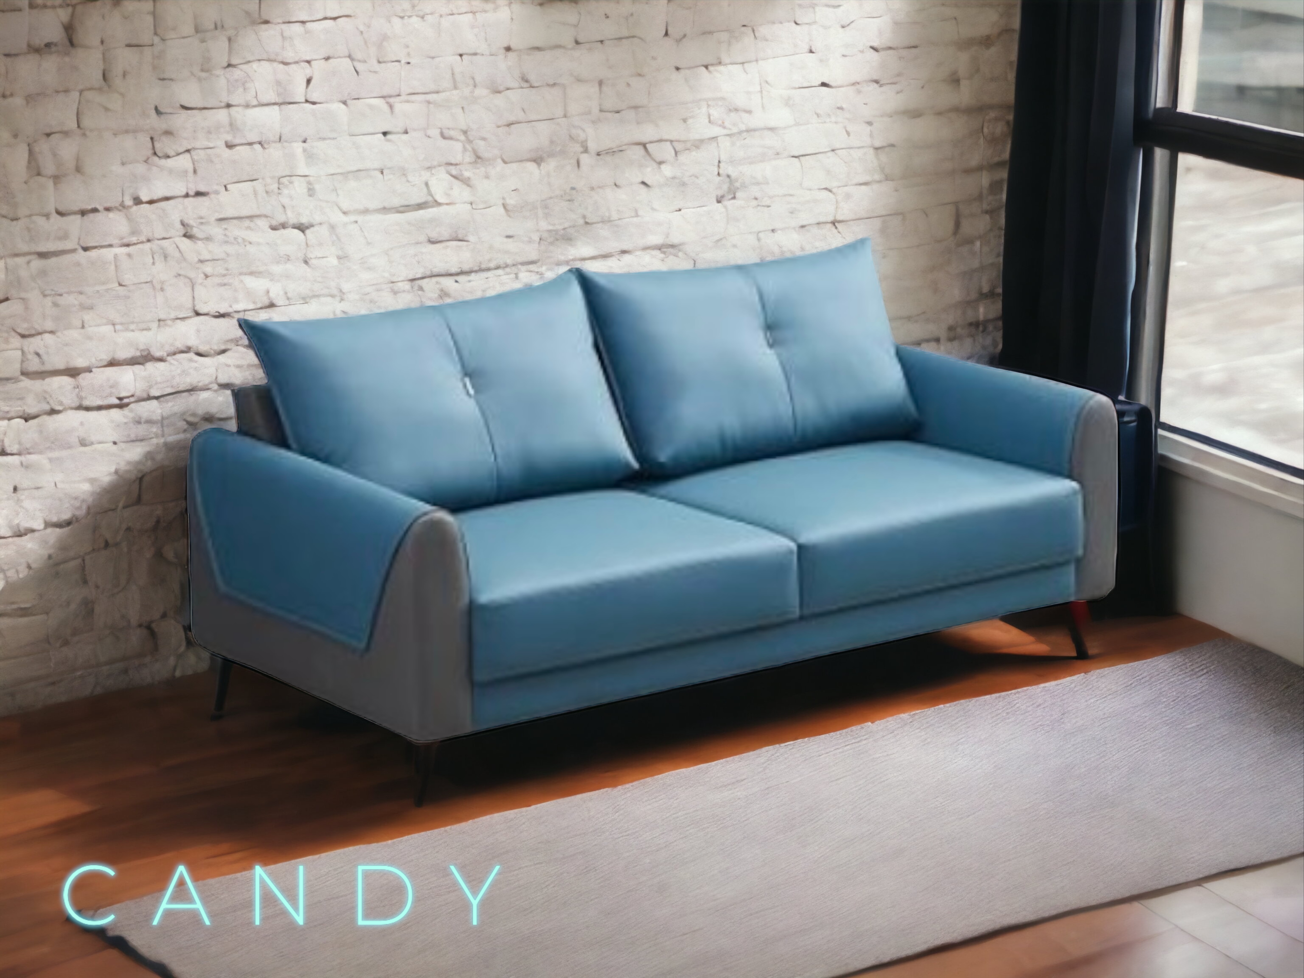
C A N D Y
➢SEAT WIDTH –
-1 STR – 30”
-2 STR – 50”
-3 STR – 70”
➢SEAT DEPTH – 33”
➢SEAT HEIGHT -17”
3+1+1 – 45785/-
(PLUS GST EXTRA)

Slide 38
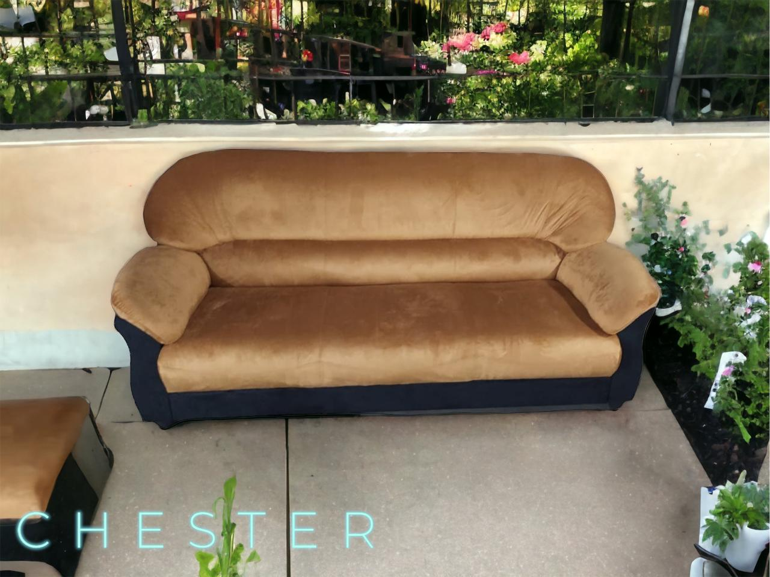
C H E S T E R
➢SEAT WIDTH –
-1 STR – 31”
-2 STR – 51”
-3 STR – 71”
➢SEAT DEPTH – 30”
➢SEAT HEIGHT – 16”
3+1+1 – 42213/-
(GST EXTRA)

Slide 39
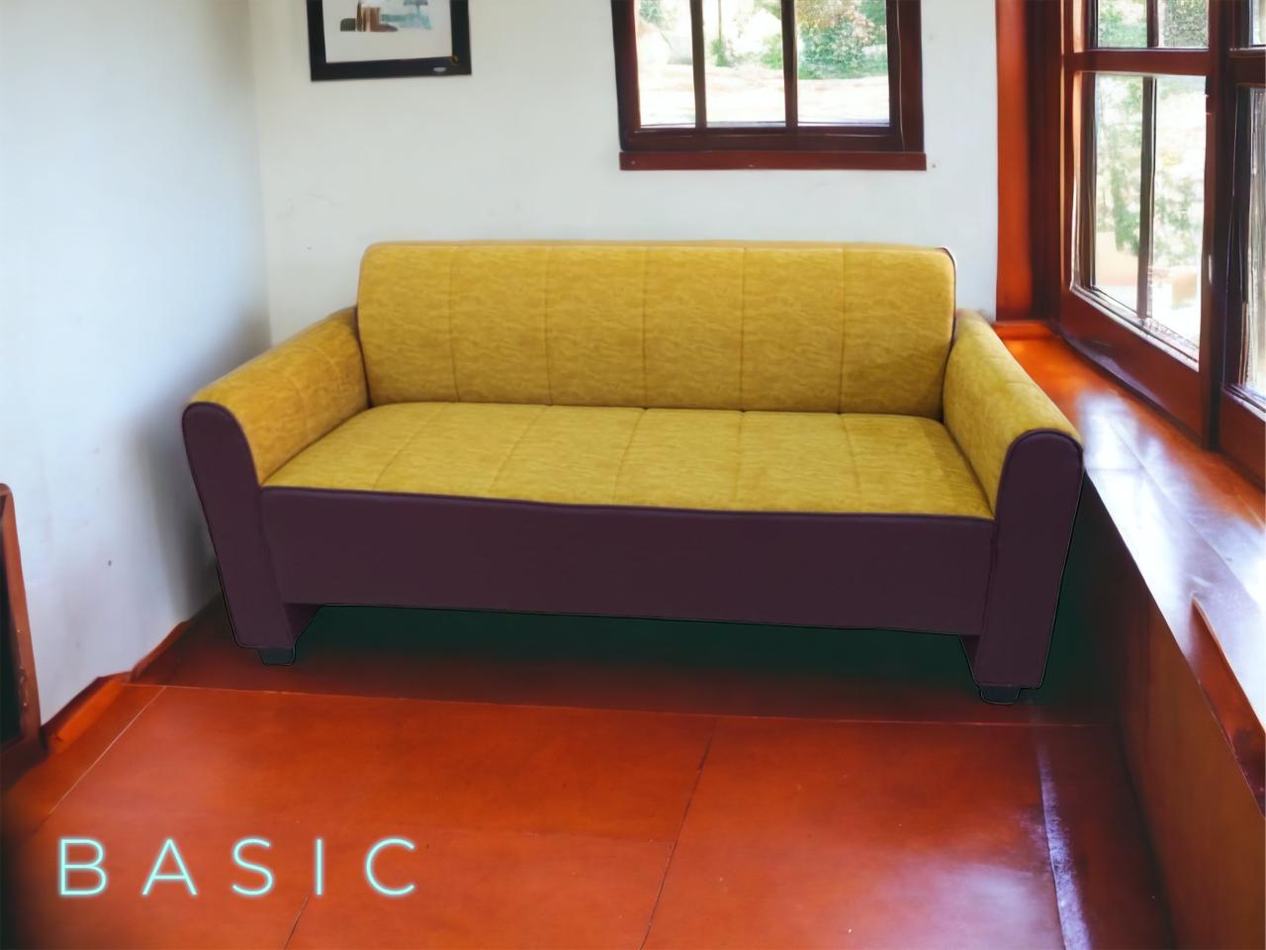
B A S I C
➢SEAT WIDTH –
-1 STR – 31’’
-2 STR – 51”
-3 STR – 71”
➢SEAT DEPTH – 30’’
➢SEAT HEIGHT – 17’’
3+1+1 – 36690/-
(PLUS GST EXTRA)

Slide 40
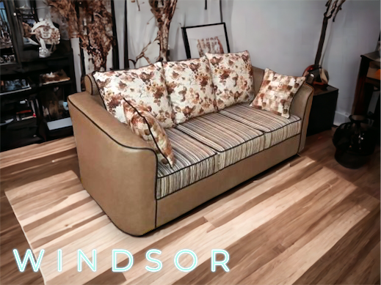
W I N D S O R
➢SEAT WIDTH –
-1 STR – 34”
-2 STR – 54”
-3 STR – 74”
➢SEAT DEPTH – 36”
➢SEAT HEIGHT – 16.5”
3+1+1 – 44200/-
(PLUS GST EXTRA)

Slide 41
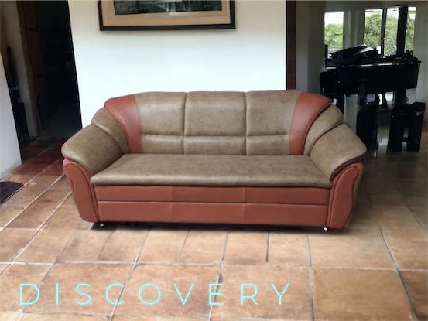
D I S C O V E R Y
➢SEAT WIDTH –
-1 STR – 40”
-2 STR –60”
-3 STR –80”
➢SEAT DEPTH -32”
➢SEAT HEIGHT -16”
3+1+1 – 52500/-
(PLUS GST EXTRA)

Slide 42

R E C R O N I C
➢SEAT WIDTH –
-1 STR –31”
-2 STR –51”
-3 STR –81”
➢SEAT DEPTH -35”
➢SEAT HEIGHT -17”
3+1+1 – 65500/-
(PLUS GST EXTRA)

Slide 43
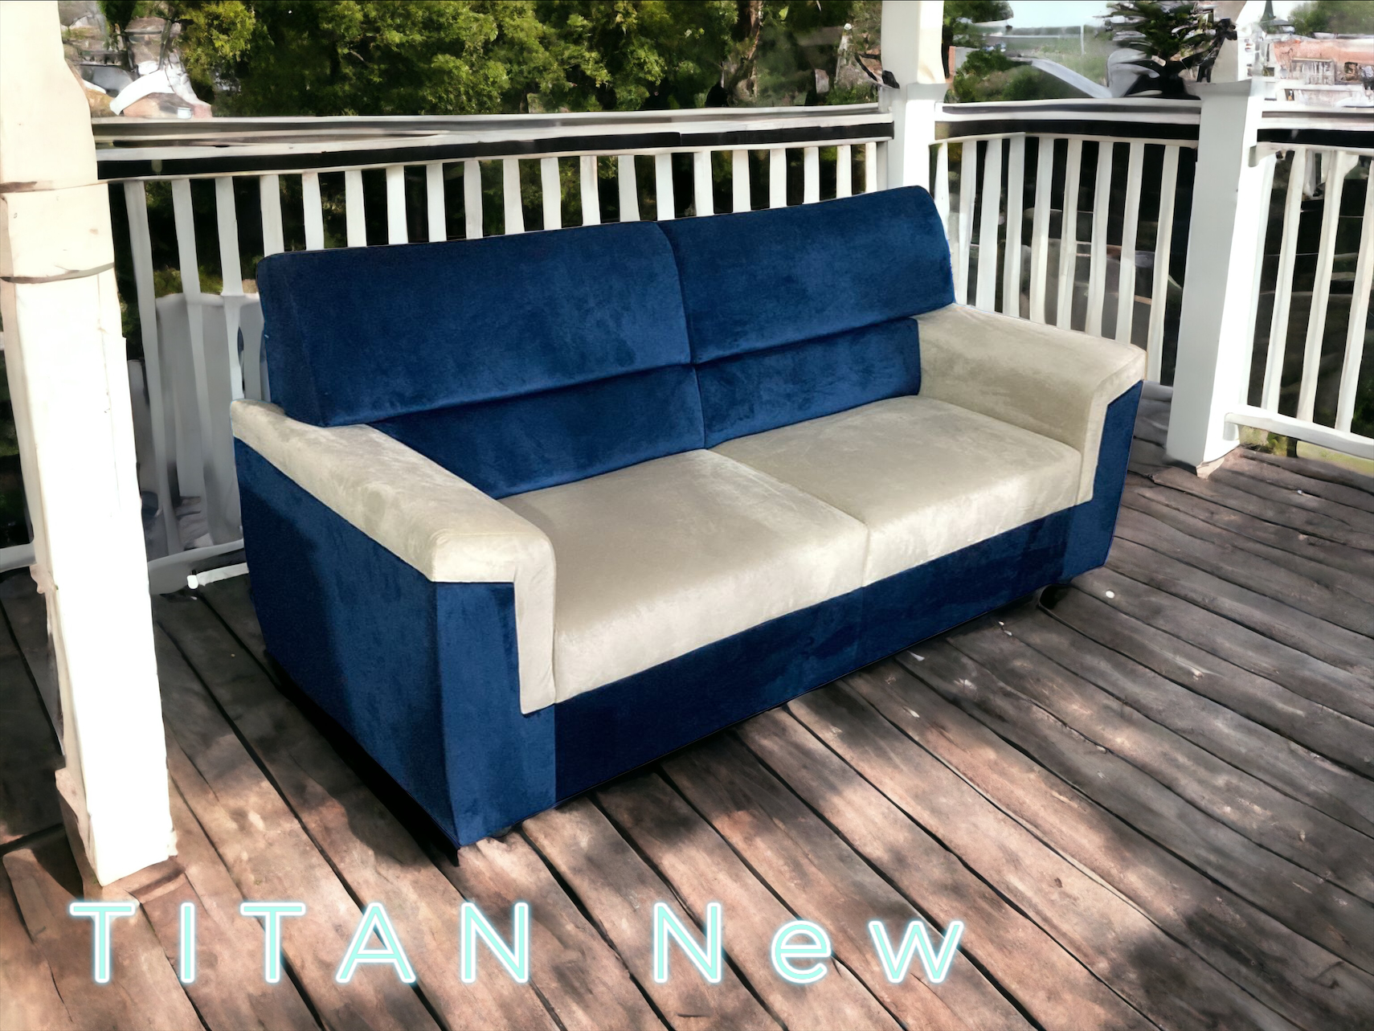
T I T A N N E W
➢SEAT WIDTH –
-1 STR – 30”
-2 STR – 50”
-3 STR – 70”
➢SEAT DEPTH – 32”
➢SEAT HEIGHT - 17”
3+1+1 – 48500/-
(PLUS GST EXTRA)

Slide 44
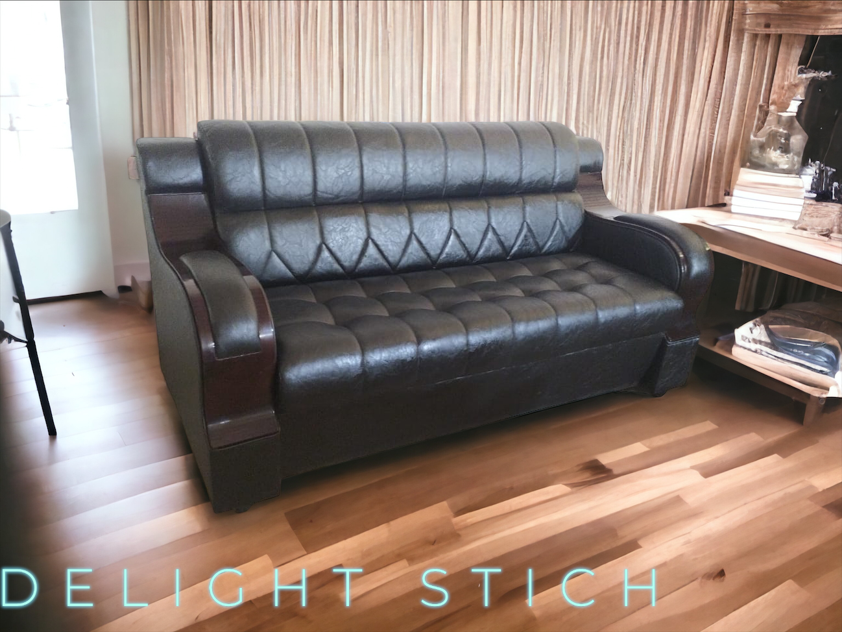
D E L I G H T
S T I C H
➢SEAT WIDTH –
-1 STR –35”
-2 STR –55”
-3 STR –75”
➢SEAT DEPTH -33”
➢SEAT HEIGHT -17”
3+1+1 – 52500/-
(PLUS GST EXTRA)

