Slide 1



Lithium-Ion Battery Backup System
Detailed Project Report — Design and Sizing of a Li-Ion Based Battery System for Reliable Power Backup at the Office of the Kerala State Electricity Regulatory Commission
PREPARED BY HARISANKAR S., INTERN, KSERC

Slide 2
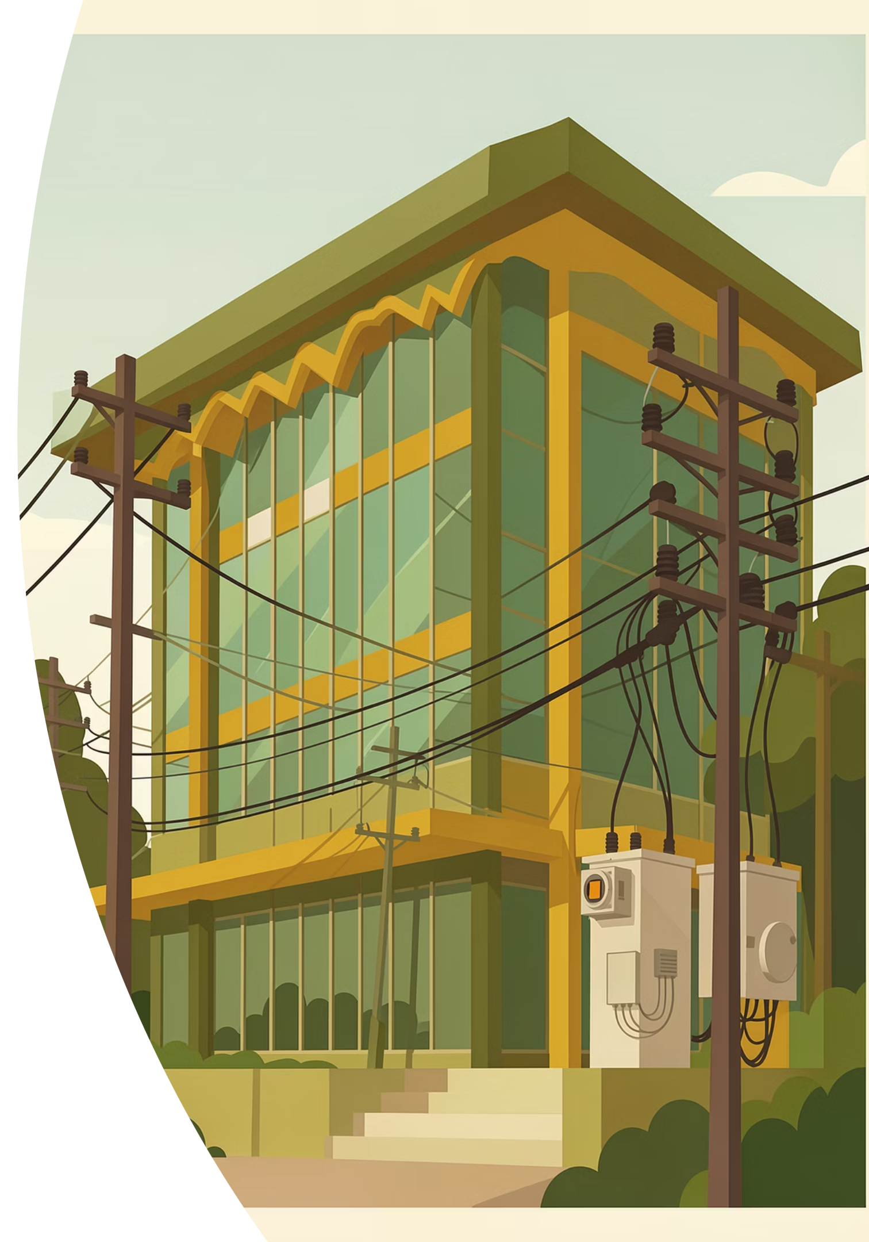
Introduction & Objectives
KSERC proceedings are primarily held online — a stable power supply is critical to prevent disruptions to judicial and administrative sessions. The existing 160 kVA DG set is non-operational, and the 5.2 kVA lead-acid inverter system is insufficient for broader critical loads.
Floor-wise Load Analysis
Identify and prioritise critical loads across all floors
Flexible Backup Durations
Design for 2-hour and 4-hour backup scenarios
Li-Ion Technology
Higher efficiency, longer lifecycle, modular and compact
Scalable & Future-Ready
Provisions for future load expansion and integration with existing system
Page 1

Slide 3
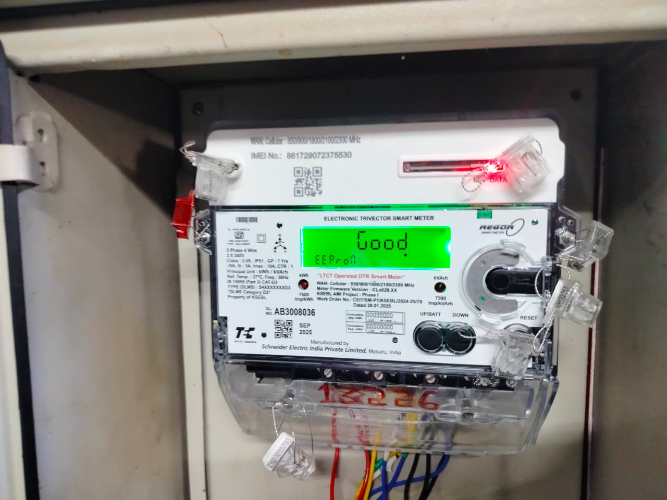

Existing Power Supply & Smart Metering
The office at Vellayambalam, Thiruvananthapuram is supplied by KSEB under a three-phase commercial connection (75 kW connected load). Monthly consumption ranged from 1,840–5,000 units across 2024–2026, with peak demand in summer months.
A Schneider make smart meter was commissioned on 21st February 2026 under the RDSS project, enabling real-time monitoring of demand and consumption patterns.
Jan 2026: 2,520 units (81 units/day) | Feb 2026: 3,360 units (120 units/day)
Page 2

Slide 4
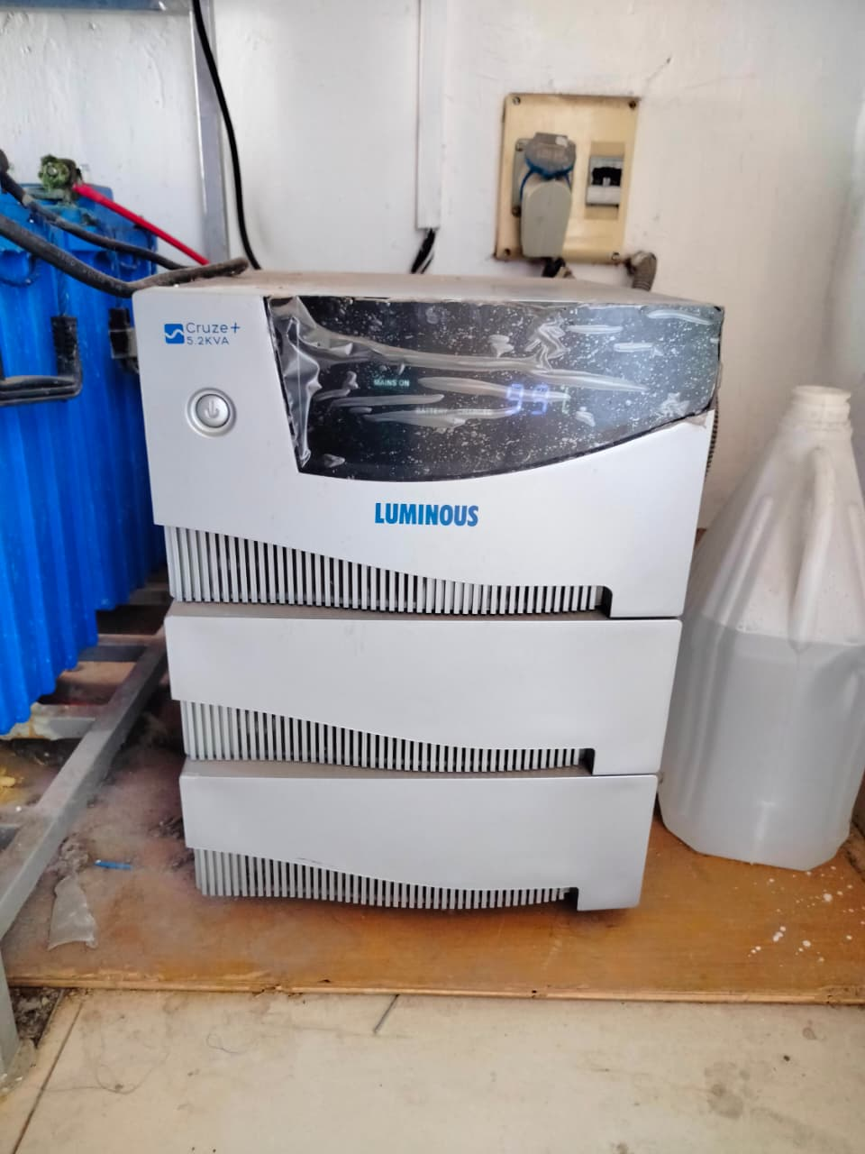
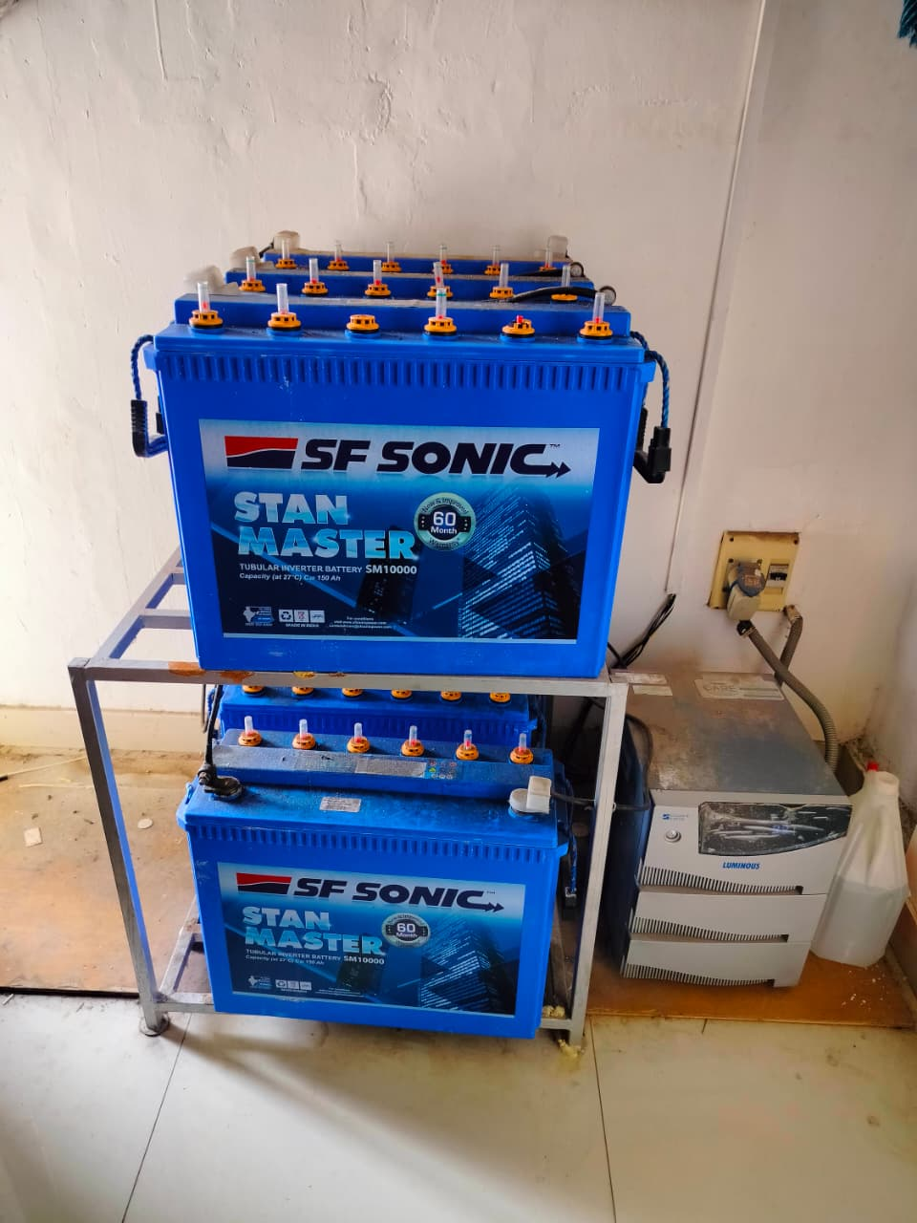

Existing Backup Systems
Luminous Cruze+ Inverter (5.2 kVA)
Six 12 V, 150 Ah lead-acid batteries in series (72 V DC). Provides ~4 hours backup for Chairman's office, Members' offices, court hall, and printers.
Battery bank is ~8 years old — degraded performance, reduced backup duration, increased maintenance.
160 kVA DG Set
Currently non-operational due to technical issues. High fuel consumption, noise, emissions, and manual intervention make DG sets obsolete for reliable backup.
Page 3

Slide 5
Floor-wise Load Assessment
Total connected load of the building is 67.288 kW. Critical load (excluding most ACs) totals 31 kW, concentrated
in the Basement and First Floor.
25.2kW
15.5kW
Basement
First Floor
Highest total load; Court Hall ACs are critical
Chairman & Members' Chambers, offices
24.5kW
2.1kW
Second Floor
Ground Floor
Accounts, SC offices, System Admin, Printer room
Minimal load — Compliance Examiner, Security
Basement Critical Loads
First Floor Critical Loads
16.385 kW (incl. Court Hall ACs)
9.935 kW (incl. Chairman & Members ACs)
Second Floor Critical Loads
Ground Floor Critical Loads
4.284 kW
0.394 kW
Page 4

Slide 6
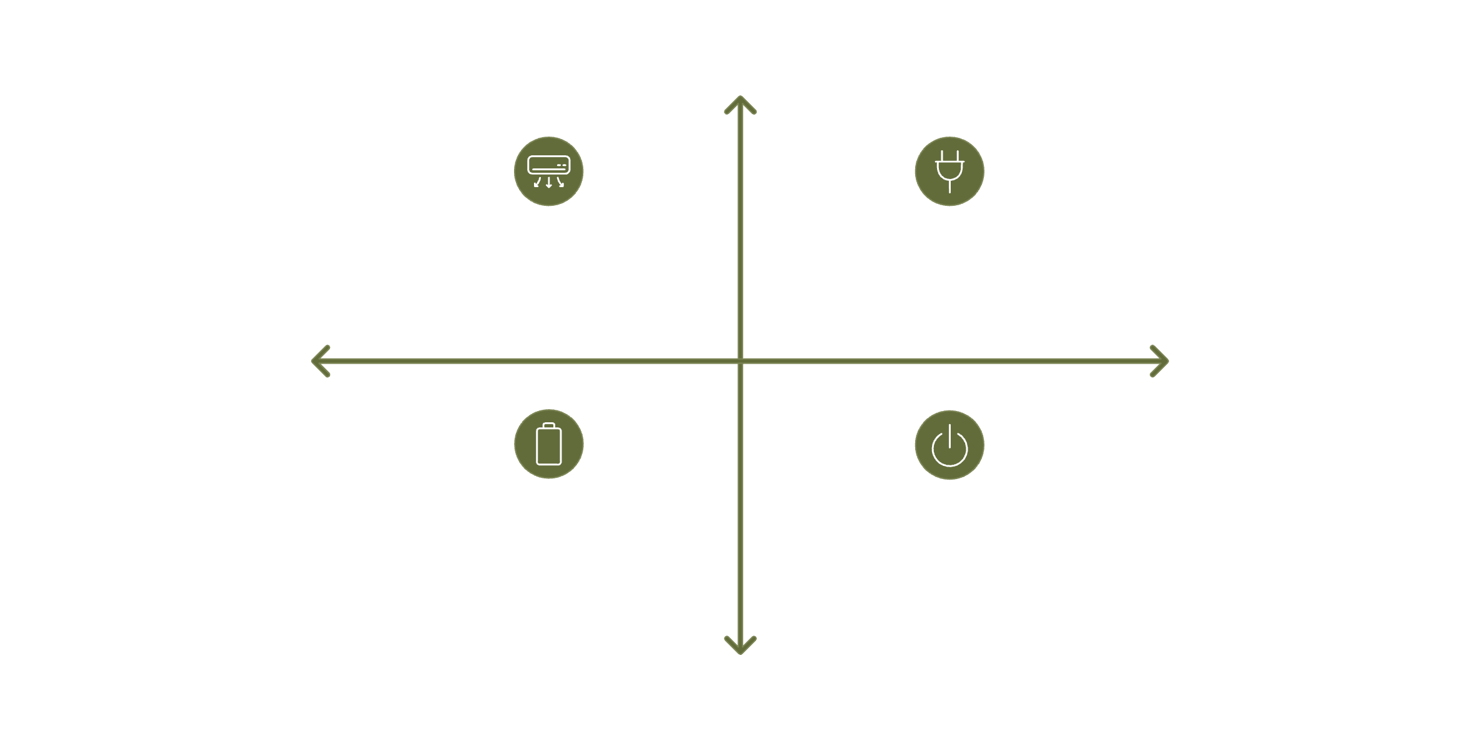
Inverter & Battery Sizing — Operating Scenarios
High Load
Case 1: With AC — 31 kW / 38.75 kVA
Case 3A: With AC + Existing Inverter — 26.7 kW / 33.4 kVA
New System Only
With Existing Inverter
Case 2: Without AC — 17 kW / 21.25 kVA
Case 3B: Without AC + Existing Inverter — 12.7 kW / 15.9 kVA
Low Load
Page 5

Slide 7
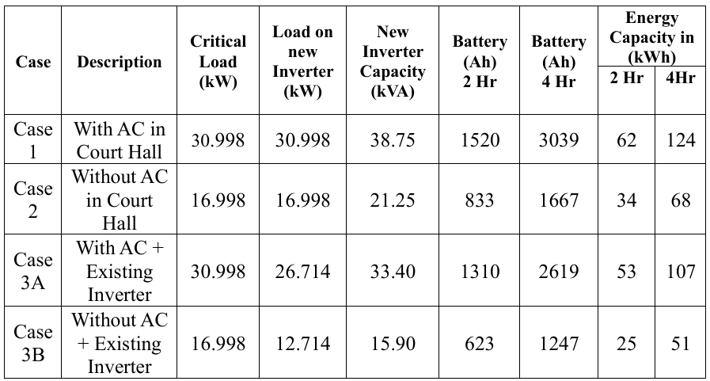
Inverter & Battery Sizing — Operating Scenarios
All calculations are based on a 48 V system voltage and 85% overall efficiency. Integrating the existing 5.2 kVA inverter to supply the Second Floor (4.284 kW) reduces the load on the new system in Cases 3A and 3B.
Page 6

Slide 8
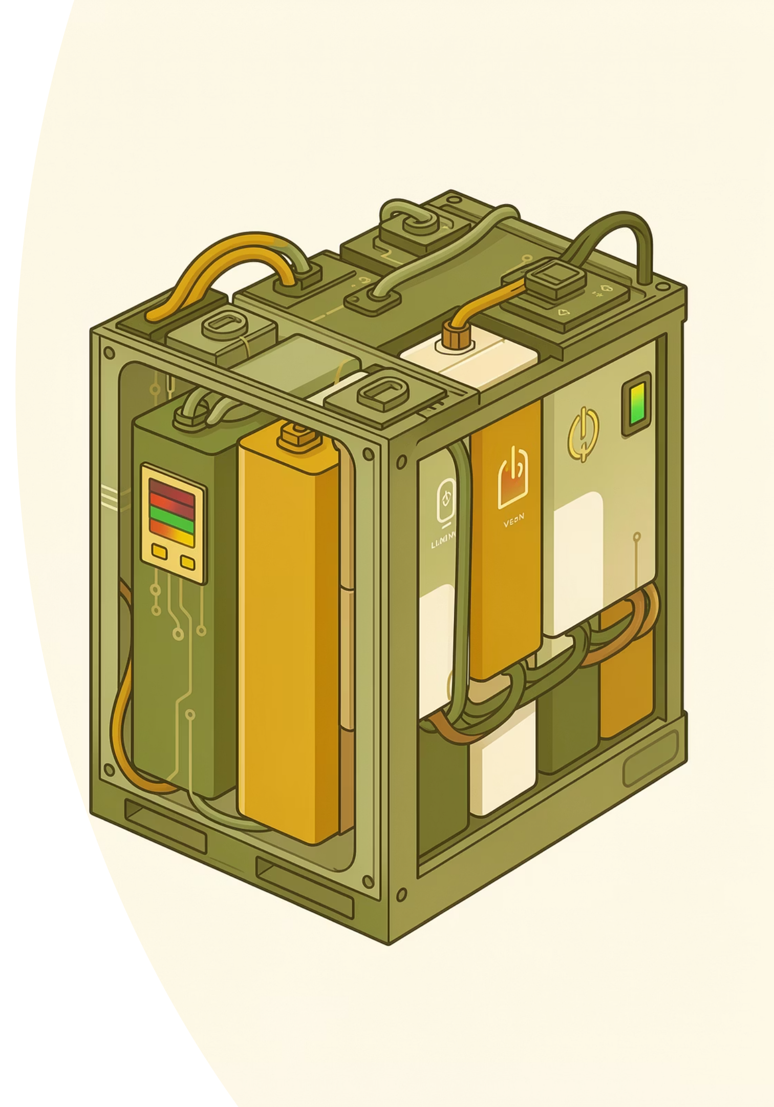
Battery Technology: Li-Ion vs Lead-Acid
Lead-Acid
Lithium-Ion (Recommended)
Lower initial cost
Shorter cycle life
Higher maintenance
Lower energy density
Longer charging time
Higher energy density & efficiency
Longer cycle life, deeper discharge
Minimal maintenance
Faster charging, modular design
More economical over system lifetime
Page 7

Slide 9

Cost Implications
Recommended Configuration
DG Set Comparison
15 kW inverter + 30 kWh Li-Ion battery — ~2 hours backup for critical loads (without AC). Estimated cost: ₹7,00,000 + GST.
15 kVA DG: ₹4–6 lakhs capital + ₹336/hour fuel cost. 30 kVA DG: ₹8–12 lakhs + ₹480–576/hour fuel cost. Additional costs: foundation, acoustic enclosure, exhaust, and servicing.
A 30 kW / 60 kWh system is available at ~₹16,00,000 + GST but entails substantially greater investment without proportionate benefit under the current load profile.
The inverter-based system has minimal operating costs — only battery charging electricity — making it far more economical over the long term.
The 15 kW system integrates effectively with the existing inverter, avoiding over-sizing and unnecessary capital expenditure.
Page 8

Slide 10

Energy Conservation Measures
Replace Old AC Units
1
Non-inverter ACs near printer area (2nd floor) and Compliance Examiner's office are inefficient. Replace with modern inverter-type, high star-rating ACs.
BLDC Fan Replacement
2
Replace 22 conventional fans (70 W) with BLDC fans (28 W). Saves 147.84 units/month (₹1,079/month). Investment: ₹66,000. Payback: ~5 years.
LED Tube Replacement
3
Replace fluorescent tubes (2.268 kW) with LEDs (1.26 kW). Saves 161.28 kWh/month (₹1,177/month). Investment: ₹17,550. Payback: ~1.24 years.
Page 9

Slide 11
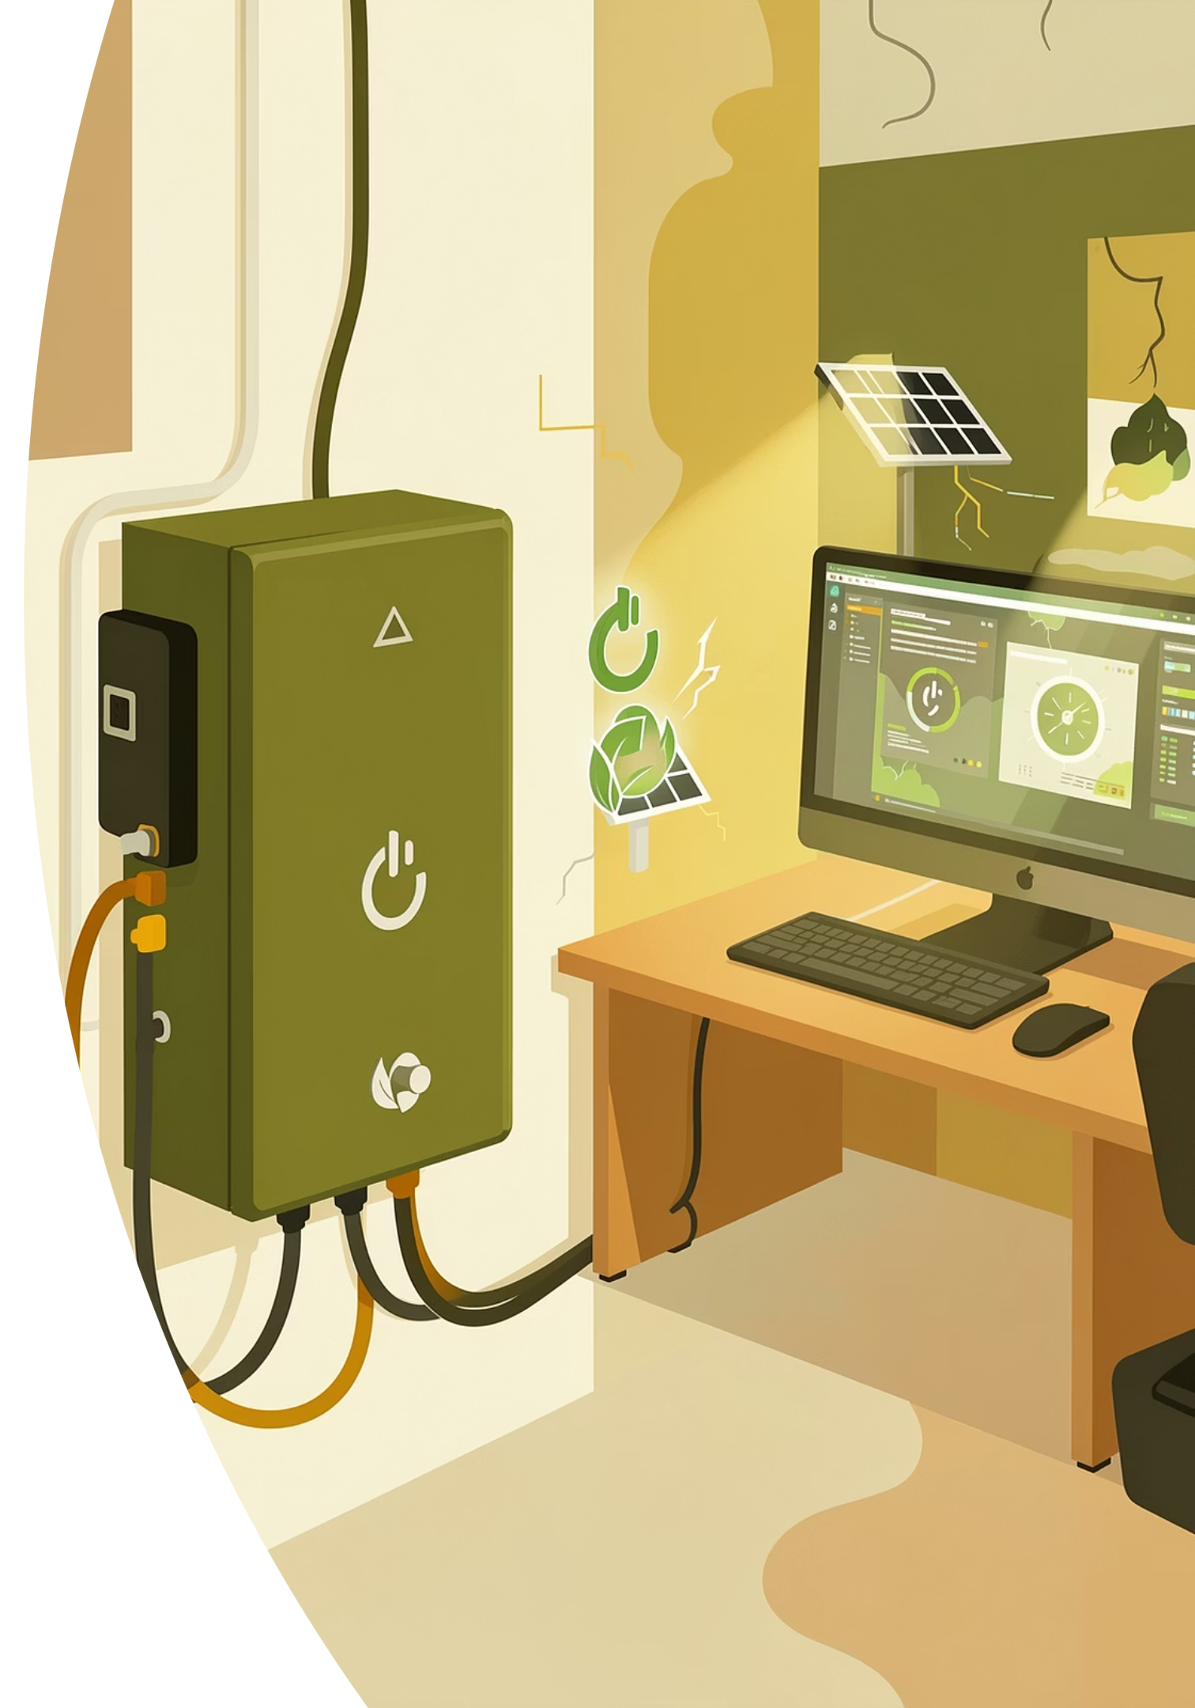

Conclusion & Recommendations
Recommended Design
Wiring Modifications
Case 3B — Without AC loads, integrating the existing 5.2 kVA inverter for Second Floor. New inverter: 15.9 kVA; Battery: 623 Ah / 25 kWh (2 hr backup).
Modifications to existing electrical wiring and distribution network are required for proper load segregation and safe integration. Must be included in the tendering scope.
Final Cost & Vendor Selection
Detailed financial analysis and final configuration to be determined based on vendor quotations, balancing performance and investment.
The proposed Li-Ion battery backup system delivers a scalable, efficient, and reliable solution ensuring uninterrupted operation of critical services at KSERC.
Page 10

