Slide 1
Instructions
Step 1: Print slide 2 of this presentation on A3 paper. Step 2: Use one puzzle per four students. Step 3: Ask each group to cut out all of the cards. Step 4: Tell students their first task is to match each picture card with its corresponding text card to form pairs. Once all pairs are complete, explain that their next task is to place the pairs in the correct order to represent the steps of synaptic transmission. Step 5: Let them dive in — and if you can, send me a photo of your students solving the puzzle! Step 6: Use the key on slide 3 for students to check their answers.

Slide 2
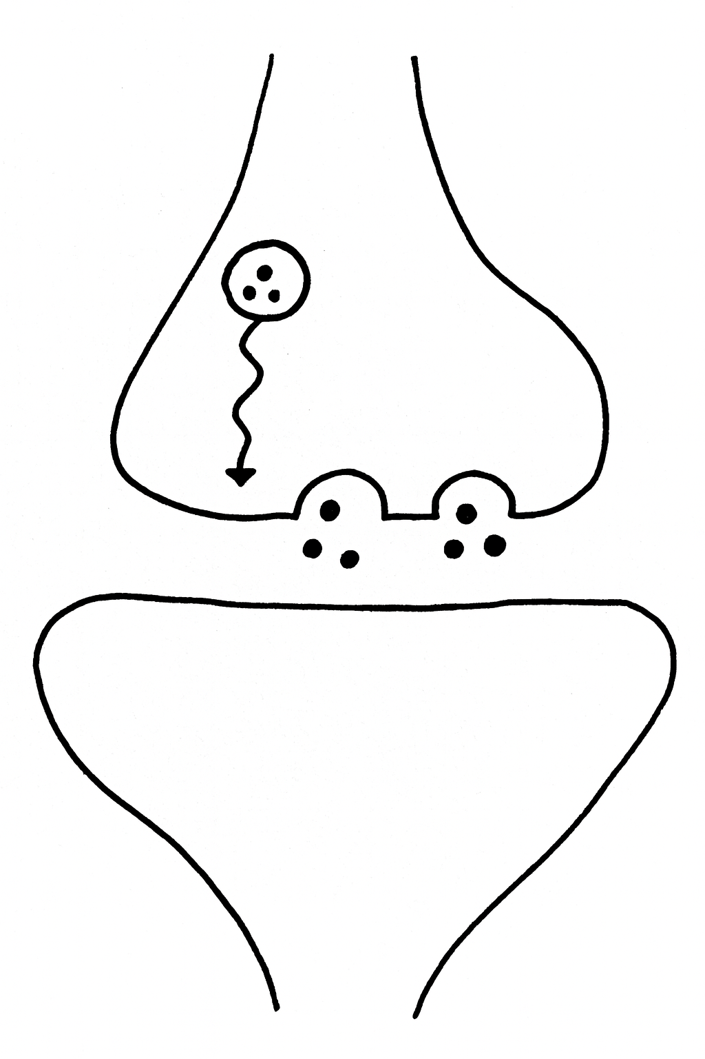
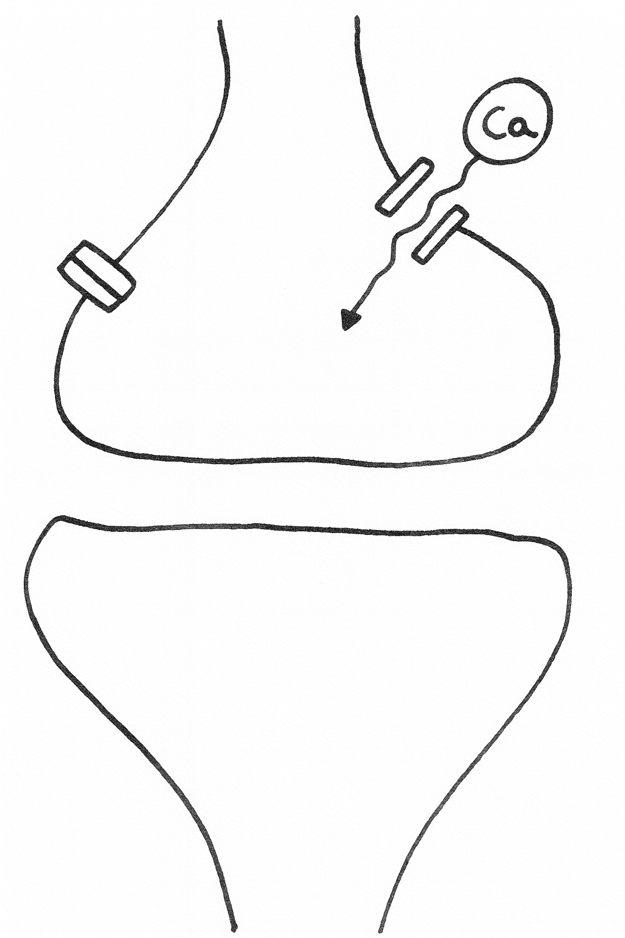
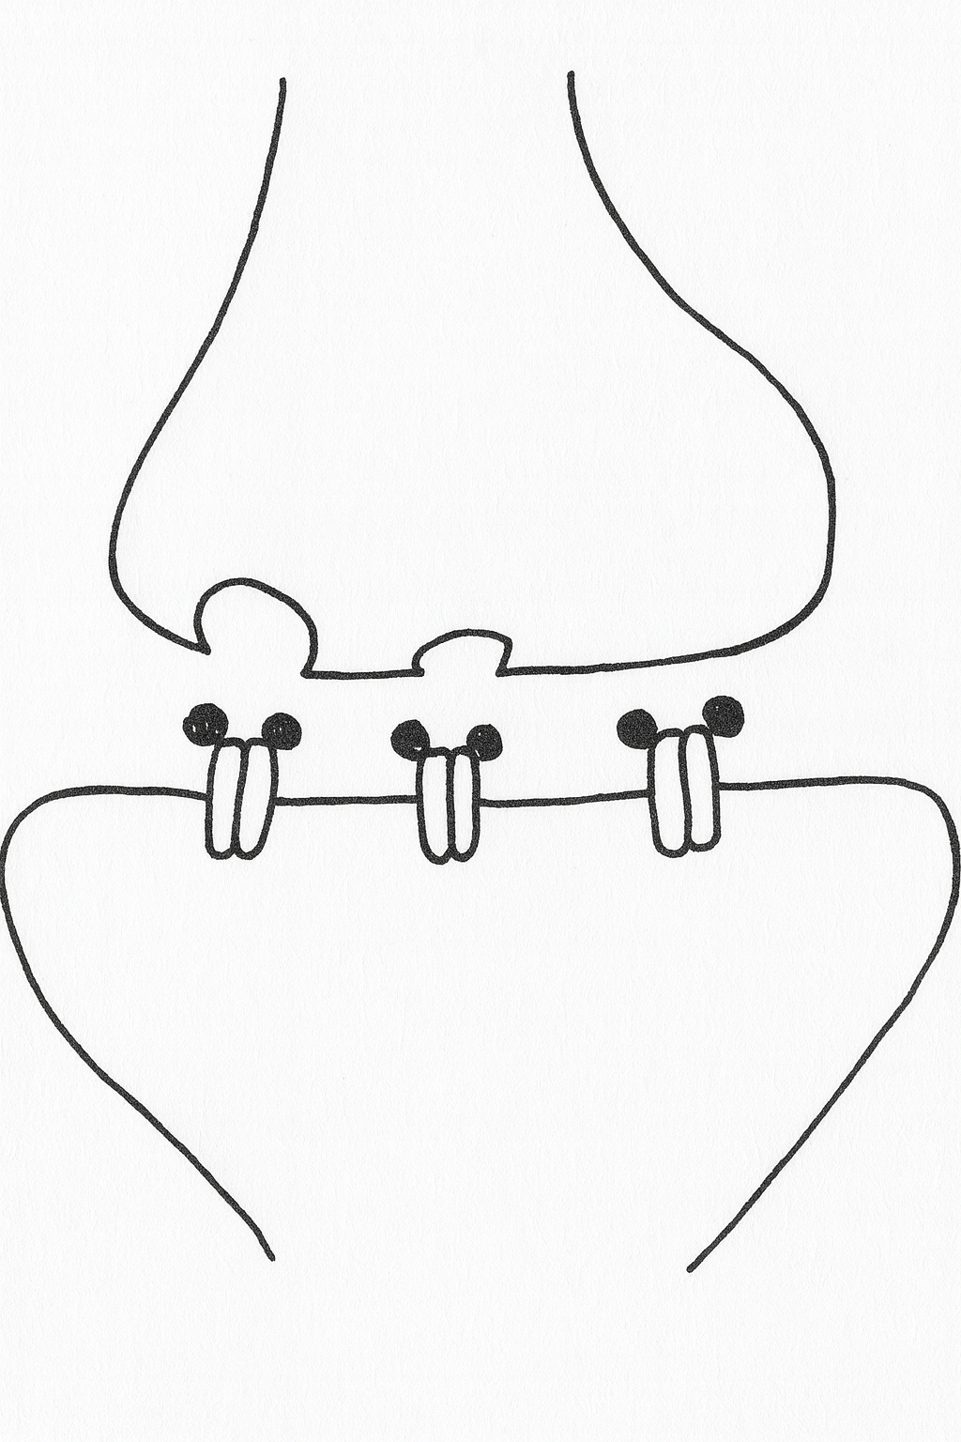
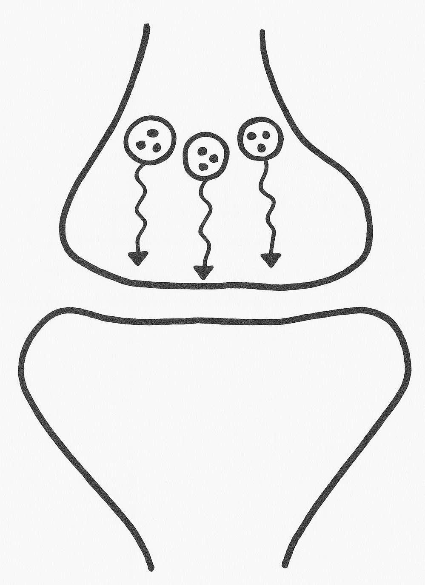
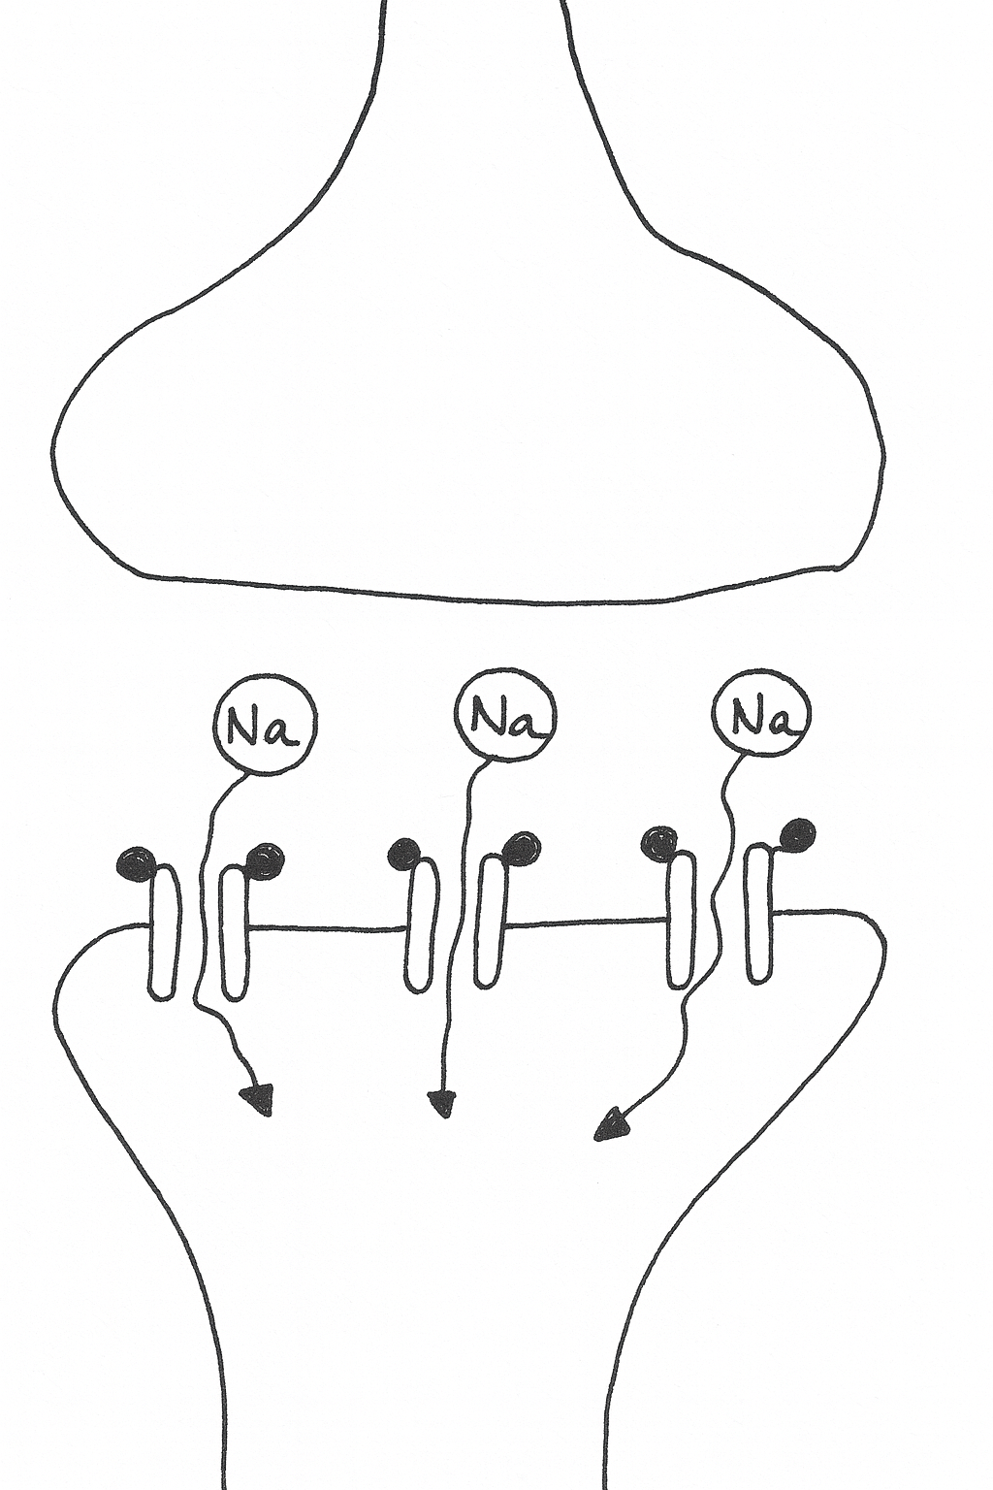

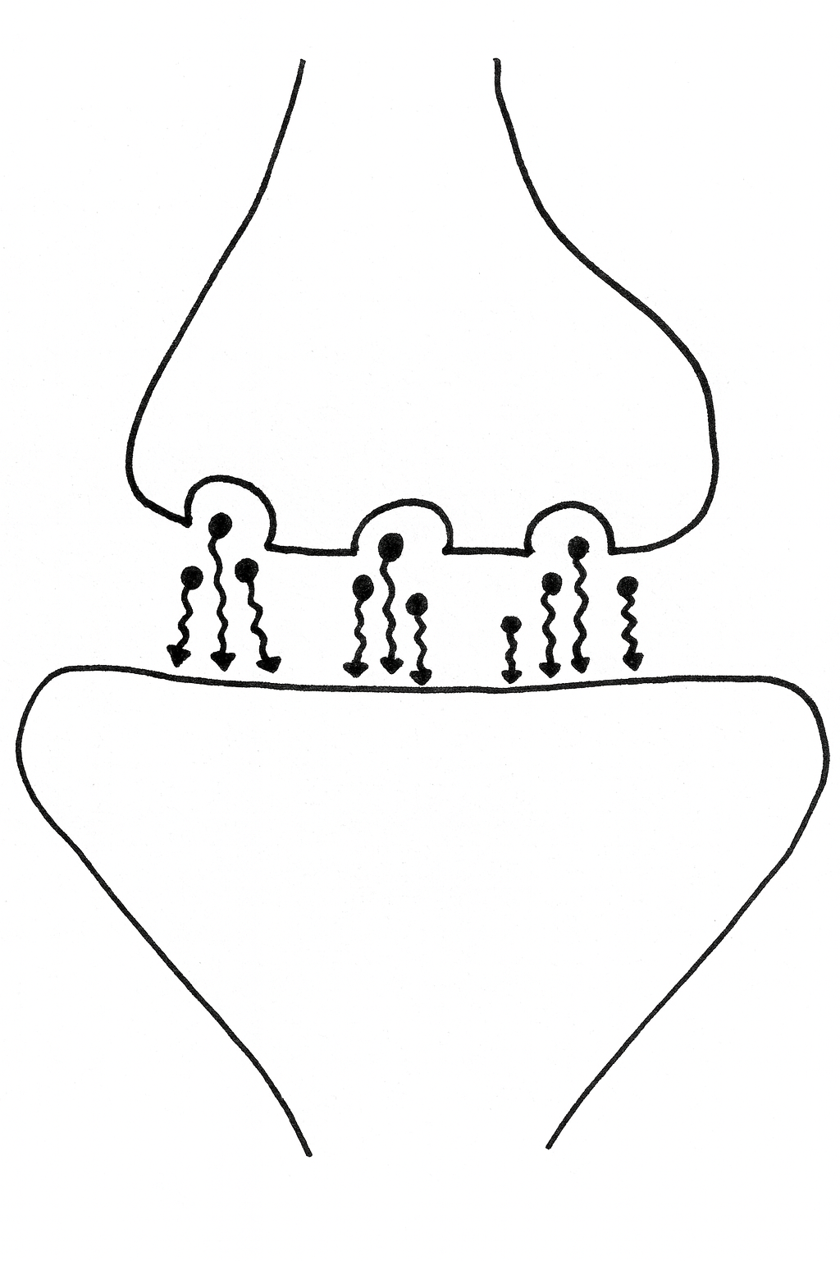
The action potential travels all the way down the axon until it gets to the very end.
The synaptic vesicles release neurotransmitter into the synaptic cleft.
The voltage gated Calcium channels open and Calcium enters the pre-synaptic neuron.
Neurotransmitter diffuses towards the dendrite of the post-synaptic neuron.
The Sodium channels in the post-synaptic neuron open allowing Sodium into the neuron.
The neurotransmitter binds to proteins (receptors) on the post-synaptic neuron..
Spare card
The synaptic vesicles move closer to the synaptic cleft.
Spare card

Slide 3
Key
Order | Picture Card | Text Card
1 |  | The action potential travels all the way down the axon until it gets to the very end.
2 |  | The voltage gated Calcium channels open and Calcium enters the pre-synaptic neuron.
3 |  | The synaptic vesicles move closer to the synaptic cleft.
4 |  | The synaptic vesicles release neurotransmitter into the synaptic cleft.
5 |  | Neurotransmitter diffuses towards the dendrite of the post-synaptic neuron.
6 |  | The neurotransmitter binds to proteins (receptors) on the post-synaptic neuron..
7 |  | The Sodium channels in the post-synaptic neuron open allowing Sodium into the neuron.

