Slide 1
Part 1: Place the red circles in their correct locations on the learning map.
The word ”joint” is used interchangeably with the word “articulation”.
There are three kinds of joints in the human body.
This learning map will focus on fibrous joints.
What does “joint”/ “articulation” mean?
What is in between the two bones in a fibrous joint?
Collagen. Collagen is a protein made up of three amino acid chains.
These terms refer to the spot where two bones meet.
Fibrocyte cells. These cells make collagen.
Ground substance. Ground substance is mostly water.
The first type is called fibrous joints.

Slide 2
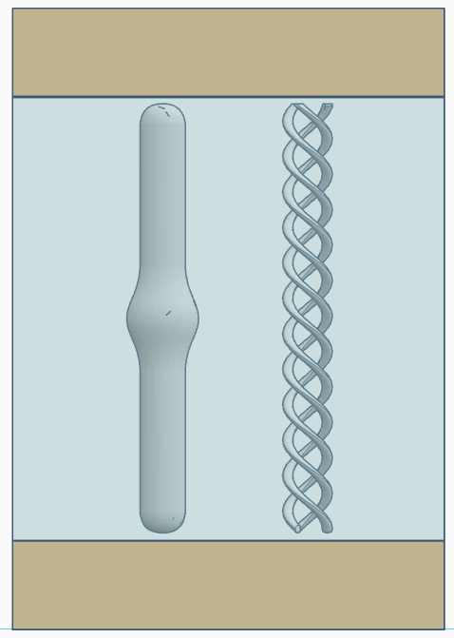
Part 2: Identify the components of a fibrous joint: fibrocyte, collagen and ground substance. Can you identify which parts of this image is bone tissue?

Slide 3
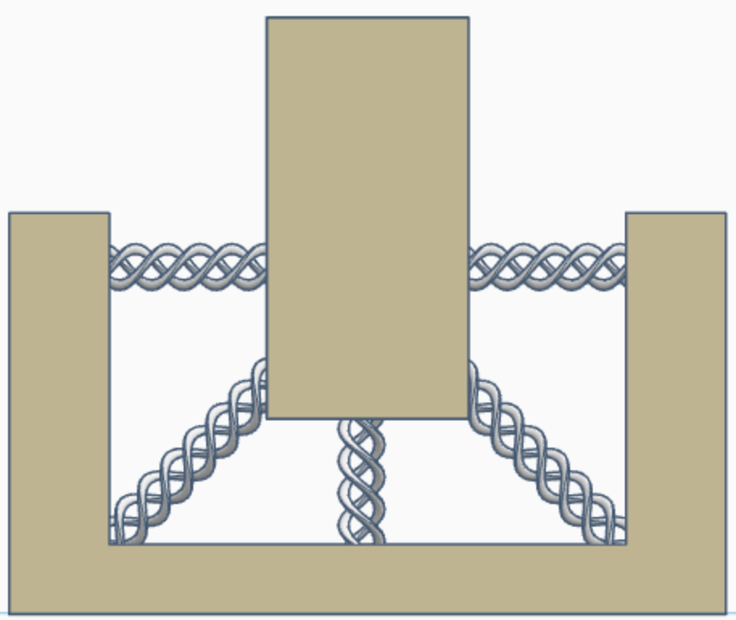
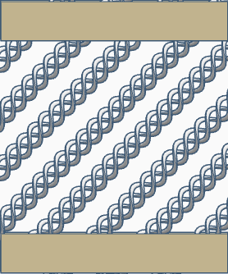
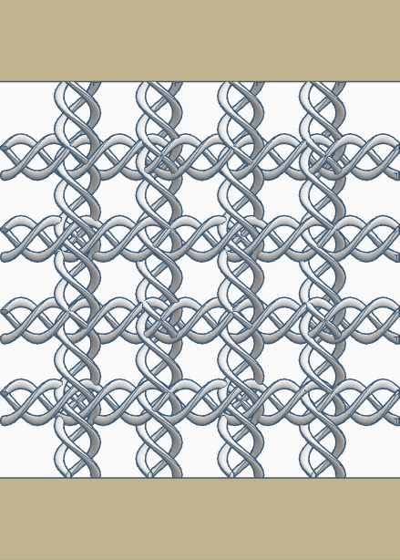
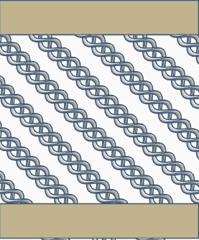
In the second layer, the collagen is arranged as a mirror image of the first layer.
This is is what the third type looks like.
In the second type of fibrous joint, the collagen is in two layers.
This is what an orthogonal lattice pattern looks like.
In the third type of fibrous joint, the collagen is arranged like ropes holding a boat at a dock.
This is what the second (mirror image) layer looks like.
Part 3: Place the red circles and the images in their correct locations on the learning map.
In the first type of fibrous joint, collagen is arranged in an orthogonal lattice pattern.
In the first layer, the collagen is arranged at an angle.
This is what the first layer looks like.
There are three main kinds of fibrous joints.

Slide 4
Part 4: Recap and self-test discussion questions
Which word is used interchangeably with the word articulation?
What does the word “joint” mean?
How many types of joints are there in the human body?
Which type of joint did you learn about today?
List and describe the 3 parts that make up all fibrous joints.
How many kinds of fibrous joint are there in the human body?
Describe how collagen is arranged in each of the fibrous joints?
Take home message: What is the major difference between the different types of fibrous joints?
How much would you expect a fibrous joint to move?

Slide 5
References
https://www.ncbi.nlm.nih.gov/books/NBK507893/
https://www.ncbi.nlm.nih.gov/books/NBK538534/
https://pubmed.ncbi.nlm.nih.gov/18216689/
https://pmc.ncbi.nlm.nih.gov/articles/PMC6767936/
https://pmc.ncbi.nlm.nih.gov/articles/PMC3938967/
https://samples.jblearning.com/9781284403077/9781284209273_CH02_023_048.pdf

