Slide 1

Fibrous Joints
Instructions for educators
Step 1: Give students the Fibrous Joints Student Version PowerPoint file to open on their own devices. Step 2: Show the students slide 2. Explain to the students that this activity is a drag and drop. What they have to do is, drag the red circles in the correct spots on the learning map. Once finished show them the correct placement of the circles as shown on slide 3.
Step 3: Show the students slide 4. Explain to them that they have to identify on the image the components listed. Once finished show them the correct answer as shown on slide 5.
Step 4: Show the students slide 6. Explain to the students that this activity is a drag and drop. What they have to do is, drag the red circles and the images in the correct spots on the learning map. Once finished show them the correct placement of the circles as shown on slide 7.
Step 5: To finish, have students discuss the answers to the questions on slide 8 and then clear up any misunderstandings by showing them the correct answers to the questions as shown on slide 9.
If you have used this activity, please let me know via nbilton@csu.edu.au. I would love to hear from you.
Nat

Slide 2
Part 1: Place the red circles in their correct locations on the learning map.
The word ”joint” is used interchangeably with the word “articulation”.
There are three kinds of joints in the human body.
This learning map will focus on fibrous joints.
What does “joint”/ “articulation” mean?
What is in between the two bones in a fibrous joint?
Collagen. Collagen is a protein made up of three amino acid chains.
These terms refer to the spot where two bones meet.
Fibrocyte cells. These cells make collagen.
Ground substance. Ground substance is mostly water.
The first type is called fibrous joints.

Slide 3
Part 1: Place the red circles in their correct locations on the learning map. KEY
The word ”joint” is used interchangeably with the word “articulation”.
These terms refer to the spot where two bones meet.
There are three kinds of joints in the human body.
This learning map will focus on fibrous joints.
What does “joint”/ “articulation” mean?
What is in between the two bones in a fibrous joint?
The first type is called fibrous joints.
Collagen. Collagen is a protein made up of three amino acid chains.
Fibrocyte cells. These cells make collagen.
Ground substance. Ground substance is mostly water.

Slide 4
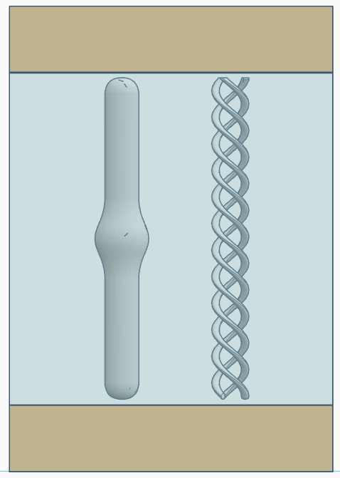
Part 2: Identify the components of a fibrous joint: fibrocyte, collagen and ground substance. Can you identify which parts of this image is bone tissue?

Slide 5
Part 2: Identify the components of a fibrous joint: fibrocyte, collagen and ground substance. Can you identify which parts of this image is bone tissue? KEY
bone tissue
collagen
fibrocyte
ground
substance
bone tissue

Slide 6
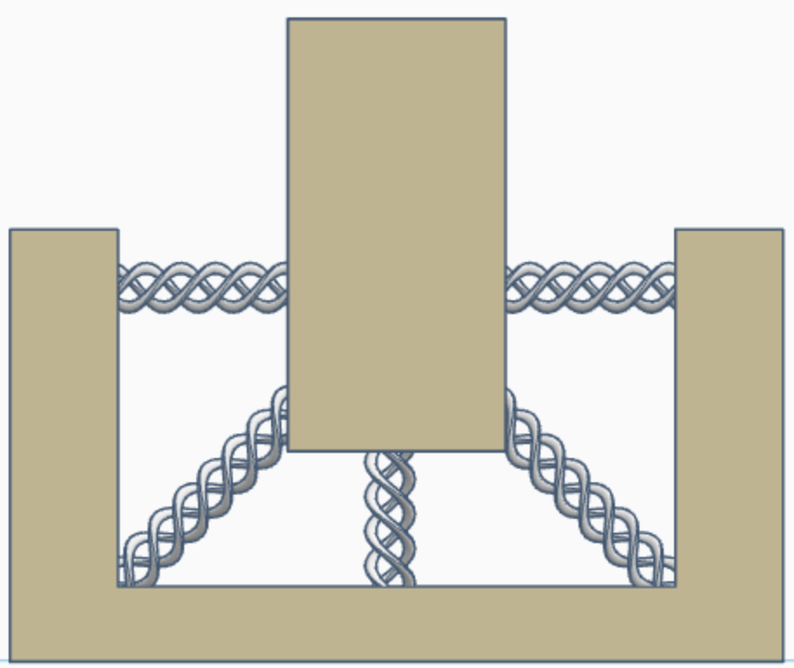
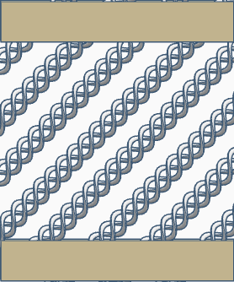
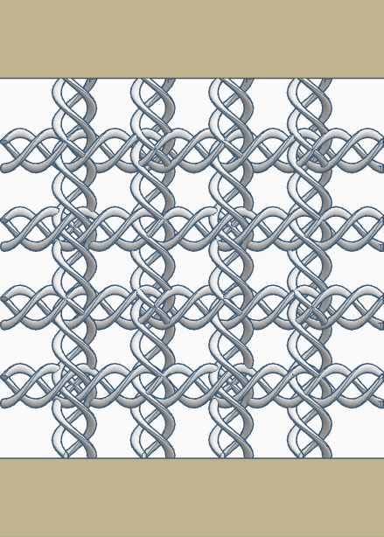
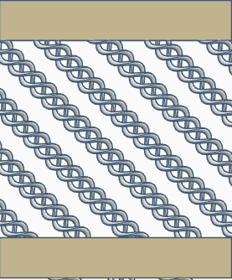
In the second layer, the collagen is arranged as a mirror image of the first layer.
This is is what the third type looks like.
In the second type of fibrous joint, the collagen is in two layers.
This is what an orthogonal lattice pattern looks like.
In the third type of fibrous joint, the collagen is arranged like ropes holding a boat at a dock.
This is what the second (mirror image) layer looks like.
Part 3: Place the red circles and the images in their correct locations on the learning map.
In the first type of fibrous joint, collagen is arranged in an orthogonal lattice pattern.
In the first layer, the collagen is arranged at an angle.
This is what the first layer looks like.
There are three main kinds of fibrous joints.

Slide 7
Part 3: Place the red circles and the images in their correct locations on the learning map. KEY
In the first type of fibrous joint, collagen is arranged in an orthogonal lattice pattern.
This is what an orthogonal lattice pattern looks like.
In the first layer, the collagen is arranged at an angle.
This is what the first layer looks like.
There are three main kinds of fibrous joints.
In the second type of fibrous joint, the collagen is in two layers.
In the second layer, the collagen is arranged as a mirror image of the first layer.
This is what the second (mirror image) layer looks like.
In the third type of fibrous joint, the collagen is arranged like ropes holding a boat at a dock.
This is is what the third type looks like.

Slide 8
Part 4: Recap and self-test discussion questions
Which word is used interchangeably with the word articulation?
What does the word “joint” mean?
How many types of joints are there in the human body?
Which type of joint did you learn about today?
List and describe the 3 parts that make up all fibrous joints.
How many kinds of fibrous joint are there in the human body?
Describe how collagen is arranged in each of the fibrous joints?
Take home message: What is the major difference between the different types of fibrous joints?
How much would you expect a fibrous joint to move?

Slide 9
Part 4: Recap and self-test discussion questions KEY
Which word is used interchangeably with the word articulation? joint
What does the word “joint” mean? the place where two bones meet
How many types of joints are there in the human body? 3
Which type of joint did you learn about today? fibrous
List and describe the 3 parts that make up all fibrous joints. fibrocytes (cells), collagen (protein), ground substance (water)
How many kinds of fibrous joint are there in the human body? 3
Describe how collagen is arranged in each of the fibrous joints? orthogonal lattice, angled 45 degrees mirrored and like bunches of ropes holding down something
Take home message: What is the major difference between the different types of fibrous joints? the way the collagen is arranged
How much would you expect a fibrous joint to move? Not very much at all

Slide 10
References
https://www.ncbi.nlm.nih.gov/books/NBK507893/
https://www.ncbi.nlm.nih.gov/books/NBK538534/
https://pubmed.ncbi.nlm.nih.gov/18216689/
https://pmc.ncbi.nlm.nih.gov/articles/PMC6767936/
https://pmc.ncbi.nlm.nih.gov/articles/PMC3938967/
https://samples.jblearning.com/9781284403077/9781284209273_CH02_023_048.pdf

