Slide 1


cell
Cell mediated immunity.
infectious agent
Instructions for educators
Print out slide 2 on A3 paper. One sheet per 4 students.
Step 1: The educator instructs the students to cut out all of the cards. Once the student has done this, they cut off the step portion (upper third) off each card. The students jumble them up and the reorder the steps with the images and text. Then educator shows the students the correct placement and allows the students to check their work.
Step 2: The educator instructs the students to now cut off all the image squares off each card (second third). The students jumble the step portion and the image portion of each card and reorder them. Leave the text portions aside for now. Then educator shows the students the correct placement and allow students to check their work.
Step 3: Now the students jumble up the step portions, the image portions and the text portions all together and reorder all of that. Then educator shows the students the correct placement and allow students to check their work.
Say thanks by sending me a photo of your students doing this activity at nbilton@csu.edu.au. I would love to hear from you. Please, I want to hear from you……… honestly.
Nat

Slide 2
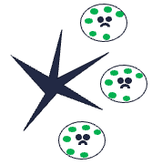


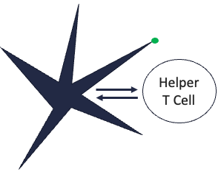
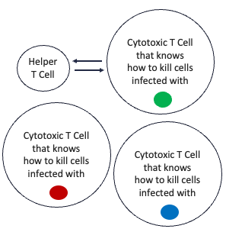
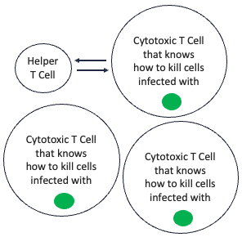
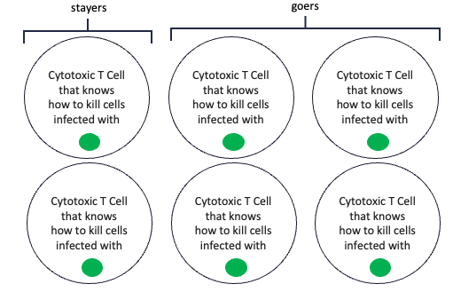
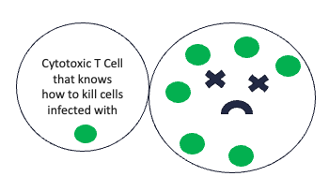
Step 1 | Step 2 | Step 3 | Step 4
It all starts with a dendritic cell coming across an infected cell somewhere in our tissues. | The dendritic cell phagocytizes one of the infected cells and presents the antigen on its cell membrane. | The dendritic cell makes its way from the tissue all the way to the nearest lymph node. | In the lymph node, the dendritic cell “talks to” a cell called a Helper T Cell. The dendritic cell “tells” the Helper T cell that the infectious agent (green circle) has been infecting our cells.
Step 5 | Step 6 | Step 7 | Step 8
In the lymph node, the Helper T cell eventually finds the correct Cytotoxic T cell for the job. | Then the Helper T cell tells the correct Cytotoxic T cell to make copies of itself. | Some of the Cytotoxic T cells now travel to the infected tissue but some stay behind in the lymph node. | The “goer” Cytotoxic T cells arrive at the infected tissue. Whilst there, they get very close to the infected cell and then release molecules to kill it.

