Slide 1
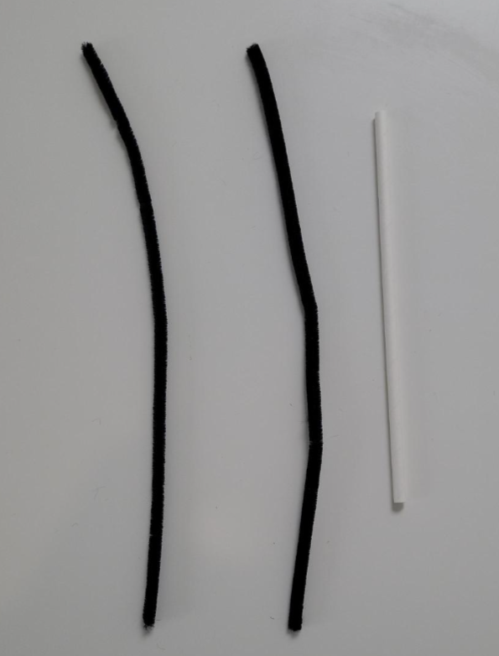
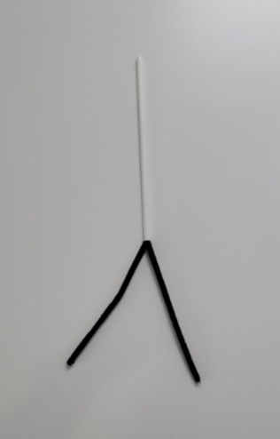
Model Construction
Step 1: Purchase the following items.
39 white straws
25 pipe cleaners
Step 2: grab 2 pipe cleaners and one straw
Step 3: insert both pipe cleaners into the straw about halfway up

Slide 2
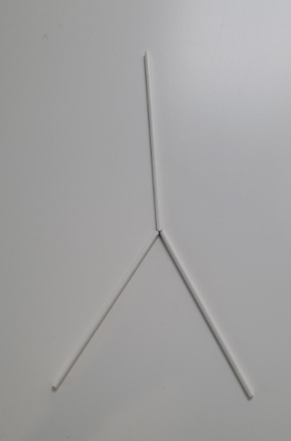
Model Construction
Step 4: Slide two straws over the exposed pipe cleaners
trachea
Instruct the students to label the model. They are going to be doing the labelling it as they build it.
They can use different colours for the different labels, and they can write the labels directly onto the straws.

Slide 3
Model Construction
Step 4: Slide two straws over the exposed pipe cleaners
right primary bronchi
left primary bronchi

Slide 4
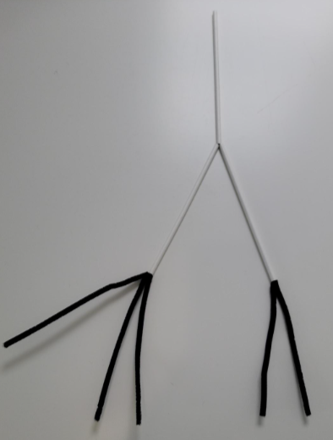
Model Construction
Step 5: Insert more pipe cleaners into the straws as shown in the image

Slide 5
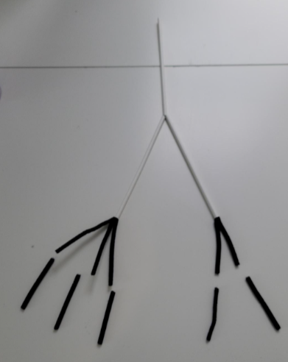
Model Construction
Step 6: Trim off the ends of the pipe cleaners a little (I cut off about 3 cm from the ends)

Slide 6
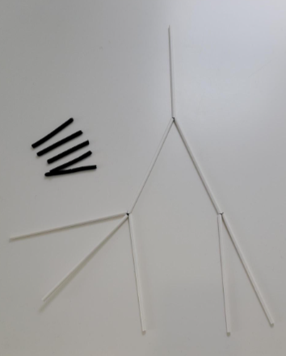
Model Construction
Step 7: Slide five straws over the exposed pipe cleaners
right secondary bronchi
left secondary bronchi

Slide 7
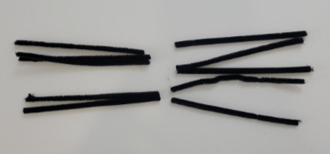
Model Construction
Step 8: Cut 5 pipe cleaners in half to create a total of 10 pieces

Slide 8
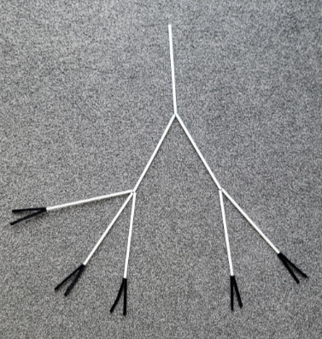
Model Construction
Step 9: Add the 10 pieces of pipe cleaner to the five straws as shown

Slide 9
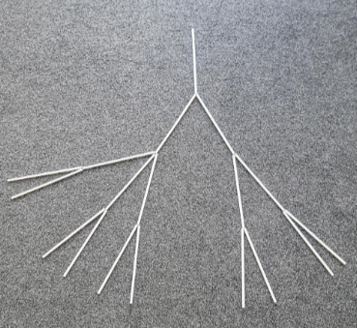
Model Construction
Step 10: Slide 10 straws over the exposed pipe cleaners as shown
right tertiary bronchi
left tertiary bronchi

Slide 10
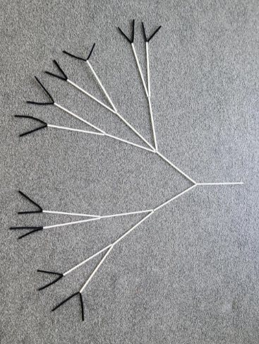
Model Construction
Step 11: cut 10 pipe cleaners in half and insert two per straw as shown.

Slide 11
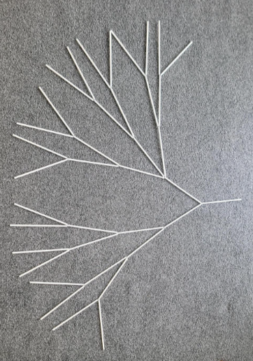
Model Construction
Step 12: slide the final 20 straws over the exposed pipe cleaners
right terminal bronchioles (very last level represented by 12 straws)
left terminal bronchioles (very last level represented by 8 straws)

Slide 12
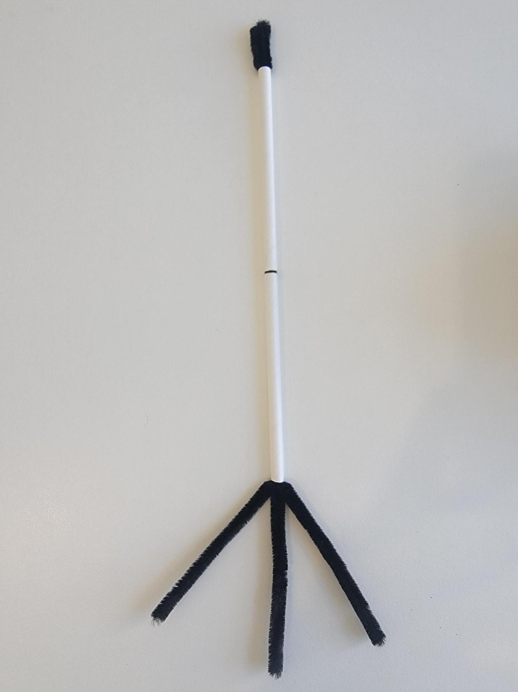
Model Construction
Step 13: cut one straw in half and slide the two pieces over three pipe cleaners
respiratory bronchiole
Instruct the students to label the parts as shown.
alveolar duct

Slide 13
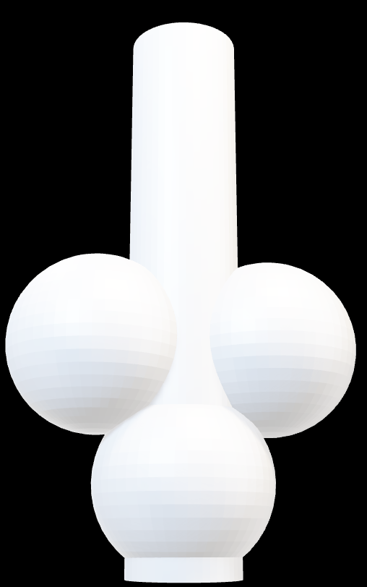
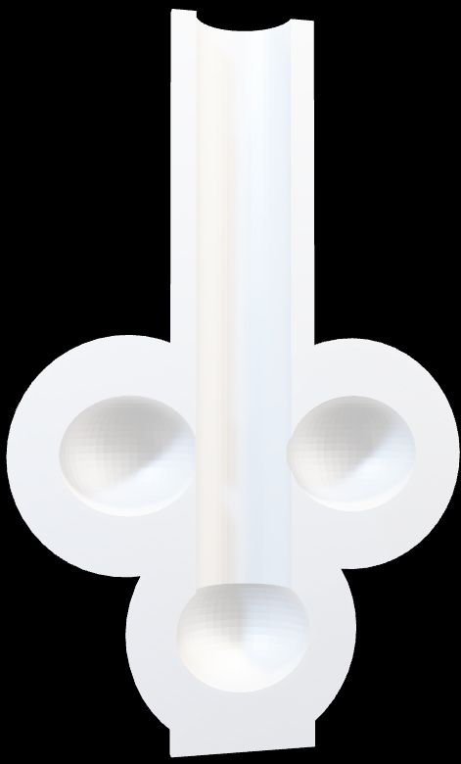
Model Construction
Important! I have yet to test print this model. I will do this during January 2026. If you print it before me, please let me know how it goes and if it needs tweaking. Let's work together ☺
Step 15:
If you have a 3D printer, print out the two models provided.
You should have two halves (A and B) which you can align together to represent a simple alveolar sac.
If you do not have access to a 3D printer, let me know and I will print these for you and send them to you free of charge. Click to rotate each model.
Full model not split in half
One half of the split model
alveolar duct
alveolus

Slide 14
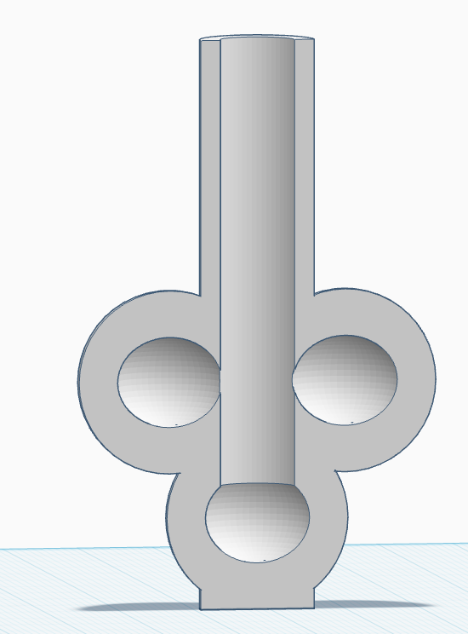
Model Construction
Step 15: make sure that the three pipe cleaners are sticking out about 7 cm from the bottom of the two straws.
Slide the three straws inside the top of the 3D printed model.
The pipe cleaners represent air.
Make sure that the “air” goes into each alveolus.
The model is now complete hooray!

Slide 15

More Ideas
After the model is fully completed, you could go into which parts are involved in the delivery of air versus which parts are involved in gas exchange. The parts that are responsible for conduction are from the trachea to the terminal bronchioles. The parts that are involved in gas exchange are from the respiratory bronchioles to the alveolus.
Say thanks Nat! by sending me a photo of your students doing this activity at nbilton@csu.edu.au

