Slide 1
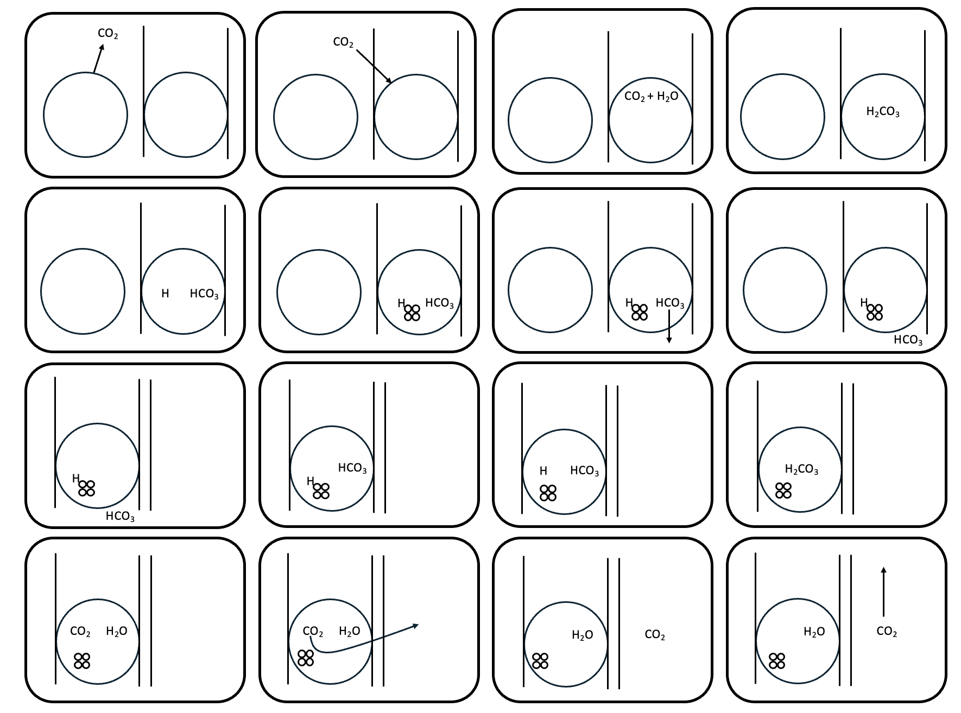
Instructions
Step 1: Print slide 2 of this presentation on A3 paper. Step 2: Use one puzzle per four students. Step 3: Ask each group to cut out all of the cards and mix them all up Step 4: What you can do is call each sentence out in turn and the student finds the relevant card for it. You continue to call cards out as they place them in order.
Sentences to call out.
carbon dioxide is released from inside the cell and enters the interstitial fluid
carbon dioxide diffuses from the interstitial fluid and into the erythrocyte
inside the erythrocyte carbon dioxide combines with water
when carbon dioxide combines with water it creates carbonic acid (show slide 3)
then the carbonic acid splits into a hydrogen ion and a bicarbonate molecule
the hydrogen ion binds to haemoglobin and stays in the erythrocyte
the bicarbonate molecule diffuses out of the erythrocyte and into the plasma
which card represents how we travel to the lungs (show slide 4)
which card shows how we arrive at the alveolus? what does the extra line represent (simple squamous epithelial cells which make up the alveolus) and what’s in the space between the lines (extracellular matrix)?
the bicarbonate molecule diffuses out of the plasma and back into the erythrocyte
the hydrogen ion detaches from haemoglobin and continues to stay in the erythrocyte
hydrogen ion and the bicarbonate molecule combine to make carbonic acid (show slide 5)
the carbonic acid splits into carbon dioxide and water
the carbon dioxide diffuses into the alveolus
the water molecule stays in the erythrocyte
the carbon dioxide is blown out of the body by respiration (show slide 6)
Step 5: Please please please send me a photo of your students solving the puzzle at nbilton@csu.edu.au. Step 6: Use the key on slide 2 for students to check their final answers for all of the rows at once.
Step 7: Add the chloride shift, the other two ways that carbon dioxide is transported in the blood and the role of the enzyme (carbonic anhydrase) in the process.
Further reading: https://www.ncbi.nlm.nih.gov/books/NBK532988/
start
end

Slide 2
.
CO₂
CO₂
CO₂ + H₂O
H₂CO₃
H
HCO₃
H
HCO₃
H
HCO₃
H
HCO₃
H
H
HCO₃
H
HCO₃
H₂CO₃
HCO₃
CO₂ H₂O
CO₂ H₂O
H₂O
CO₂
H₂O
CO₂

Slide 3
.
CO₂
CO₂
CO₂ + H₂O
H₂CO₃

Slide 4
H
HCO₃
H
HCO₃
H
HCO₃
H
HCO₃

Slide 5
H
H
HCO₃
H
HCO₃
H₂CO₃
HCO₃

Slide 6
CO₂ H₂O
CO₂ H₂O
H₂O
CO₂
H₂O
CO₂

