Slide 1
Instructions
Step 1: Print slides 2, 3, and 4 in colour and provide one full set per group of four (or fewer) students.
Step 2: Ask students to cut out all the wedges from all three pages, then sort the pieces by colour.
Step 3: Explain to students what each colour represents. Walk them through the sequence—stimulus, sensory receptor, control centre, effector, and response—and let them know that they’ll be using these pieces to explore several feedback loops.
The stimulus is the thing that gets the loop started. The sensory receptor detects what’s changed, and the control centre decides what to do about this change. When the control centre makes up its mind , it tells the effector what to do. The response in the effect of the loop being completed.
Step 4: Instruct the students to put the loop on slide two back together again reiterating what each term means.
Step 5: Explain to the students that now we are going to be learning about two feedback loops about blood pressure. Mix up the wedges on slides 3 and 4 and give the students time to put the two loops in order. Show them the correct order of both when they are done.
Step 6: Explain to the students that both are negative feedback loops which means (in this instance) that if something is too low, the loop brings it back up again. You can also add in here that the time to complete one whole loop is faster in slide 3 than it is in slide 4.
Step 7: Print slide 5 in black and white (or just draw it on the board and discuss with the students whether they think the symbols are appropriate to represent the wedges in slide 2. If they don’t like the symbols provided encourage them to create their own. Instruct the students to complete the table with their own symbols to help them remember each component of the feedback loop and what it does.
Step 8. Please send me a photo of your students doing this activity at nbilton@csu.edu.au or fill out the feedback form on my website. Even if you are just planning to use it at this stage, let me know ☺
Extension possibilities:
Baroreceptor reflex: add in the second location where baroreceptors are found (left and right common carotid arteries) and what that means with regards to monitoring of the blood pressure. Basically, the blood pressure coming out of the heart is monitored in two places, in the blood going to the body (aorta), and in the blood going to the head (carotids).
RAAS: Angiotensin 2 also works indirectly to increase blood pressure. It does this by increasing blood volume. One way it does this is by telling the adrenal gland to release aldosterone. Aldosterone moves salt from the urine (where it was destined to leave the body) back into the blood stream and wherever salt (Na⁺) goes, water follows.
Further reading
Baroreceptors: https://www.ncbi.nlm.nih.gov/books/NBK538172/
Renin-angiotensin-aldosterone system (RAAS): https://www.ncbi.nlm.nih.gov/books/NBK470410/

Slide 2
stimulus
response
sensory receptor
effector
control center

Slide 3
decreased blood pressure in the aorta
blood pressure in the aorta rises
sensory receptors in the aorta fire action potentials
the action potentials from the medulla reach the heart and heart rate increases
medulla receives the action potentials from the baroreceptors and sends its own action potentials out

Slide 4
There are eight po ssible blood types in humans.
decreased blood pressure going into the kidney
vasoconstriction causes an increase in blood pressure
renin converts angiotensinogen to angiotensin 1, the angiotensin-converting enzyme then converts angiotensin 1 to angiotensin 2
juxta-glomerular cells (JG) in the kidney detect the low blood pressure
JG cells release renin into the bloodstream

Slide 5
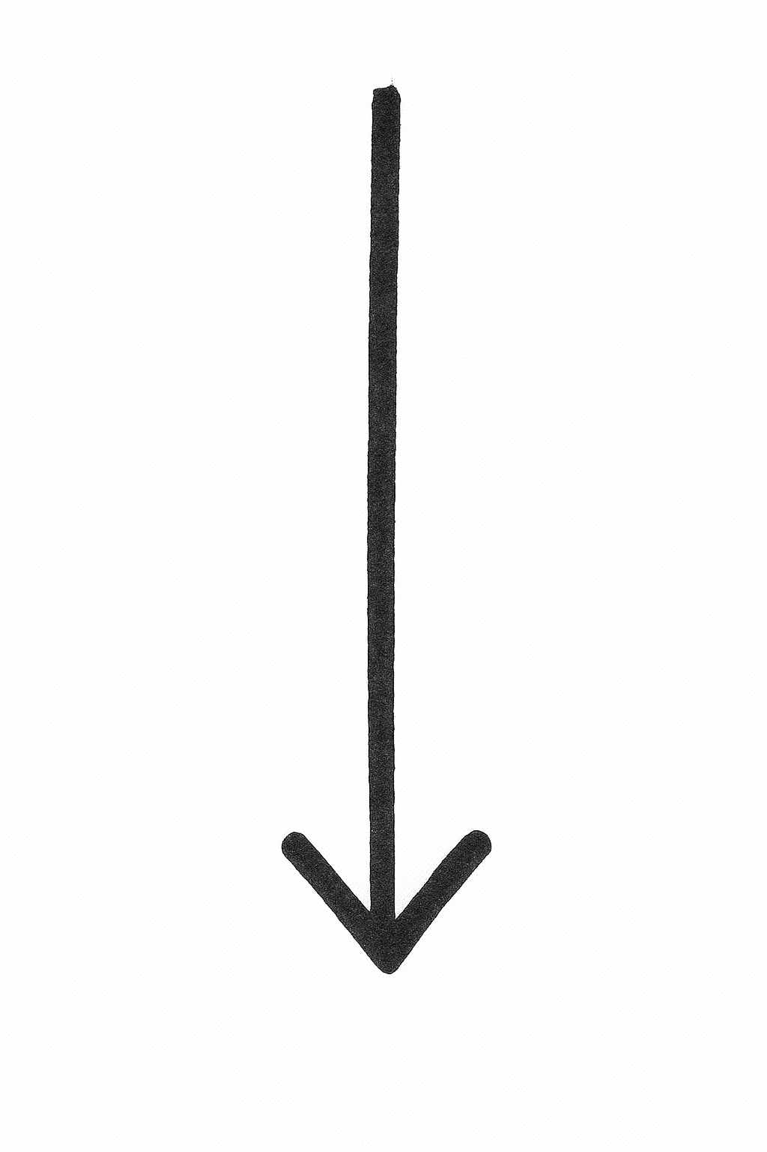
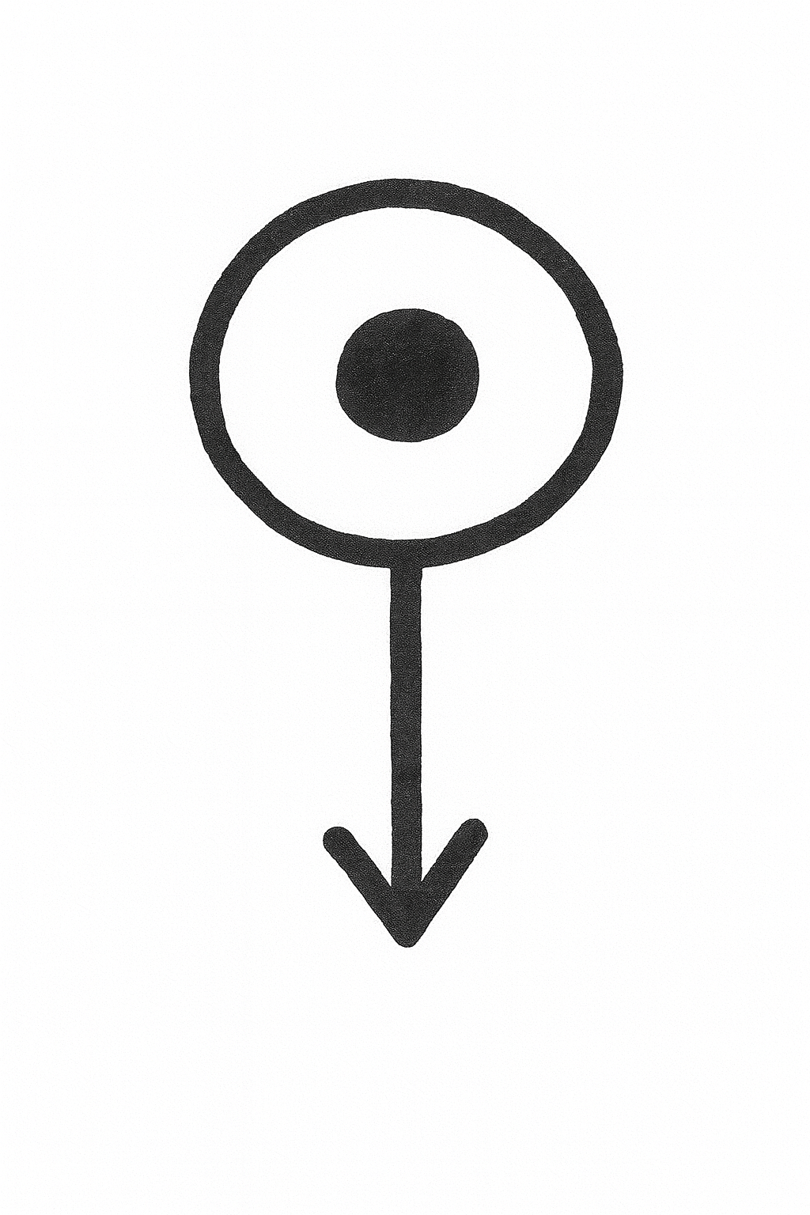
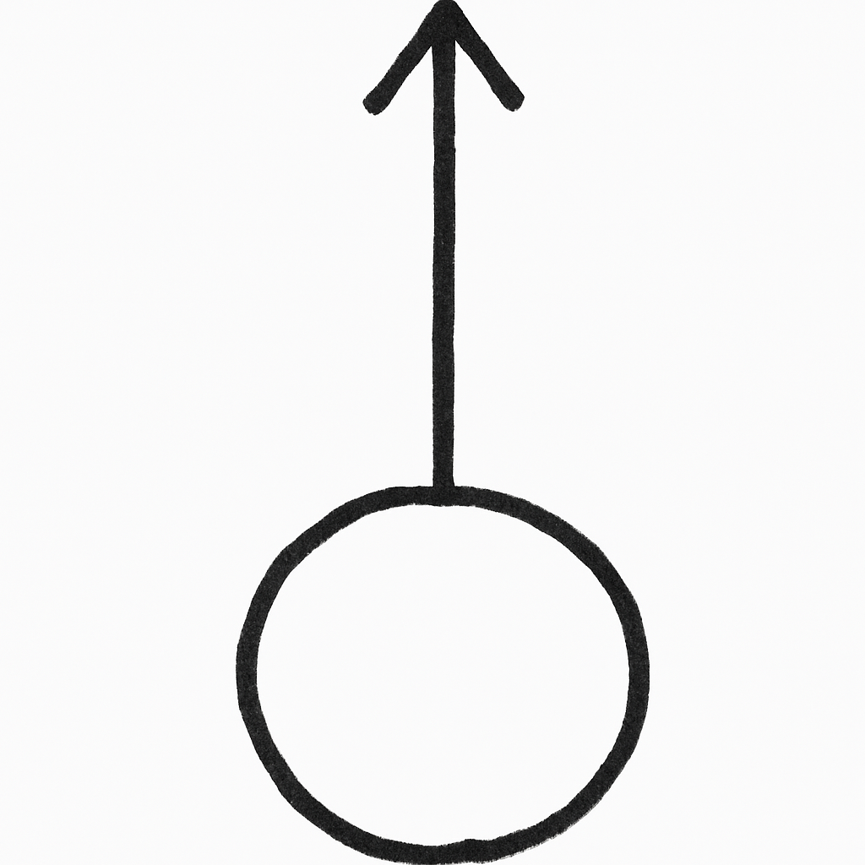
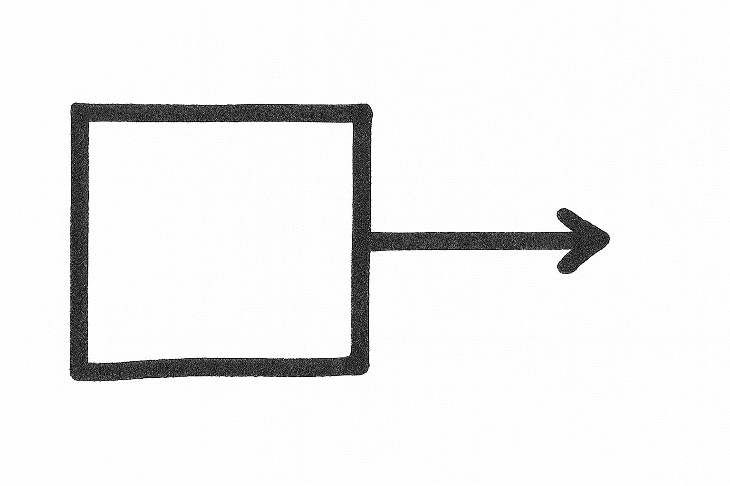
 | stimulus | sensory receptor | control centre | effector | response
My symbol

Slide 6
There are eight po ssible blood types in humans.

Slide 7
There are eight po ssible blood types in humans.

