Slide 1



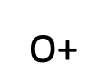





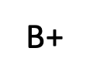

There are eight possible blood types in humans.
antigens
antibodies
blood types
A
A
A
A
A
A
A
A
A
A
B
B
B
B
B
B
B
B
B
B
D
D
D
D
D
D
D
D
D
D

