Slide 1
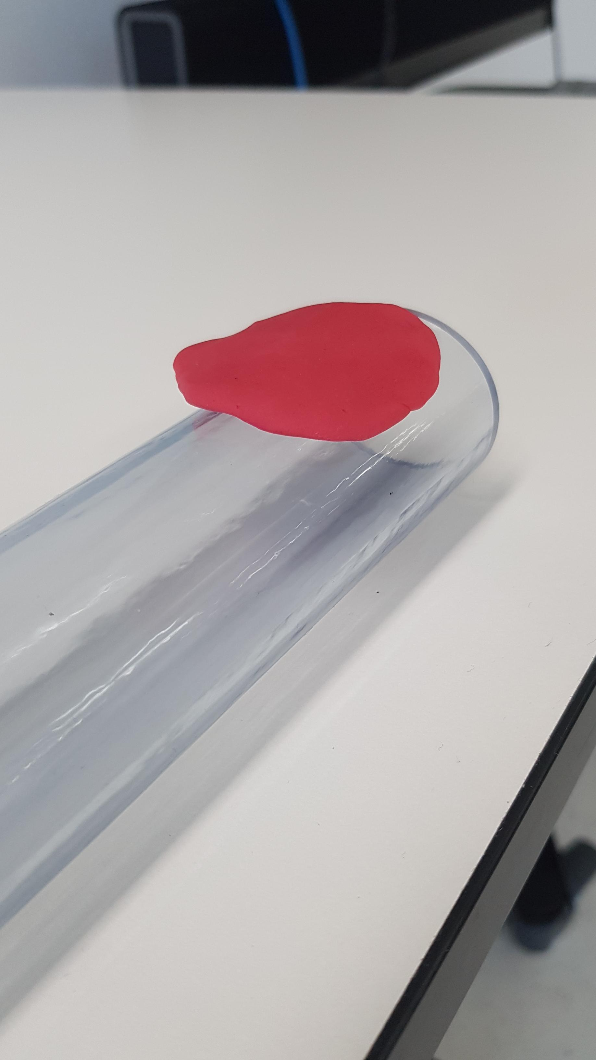
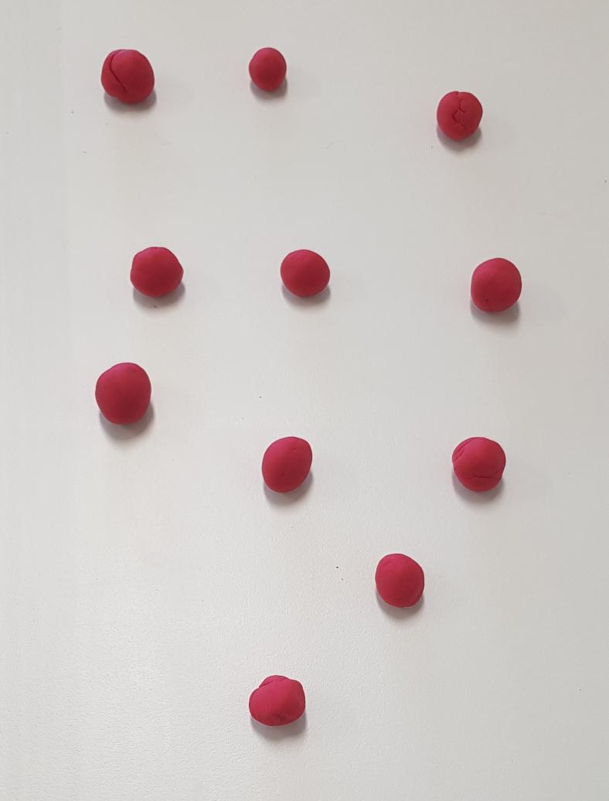
Instructions
Step 1: Purchase a length of clear plastic tubing (available in the irrigation section of any hardware store) and five different colours of Play-Doh. Below is what I used.
https://www.bunnings.com.au/pope-38mm-x-90cm-clear-vinyl-tubing_p3130578
https://theplaydoh.com/
Step 2: Explain to students that they will each receive a small amount of Play-Doh to make a flat small “pancake” shape. These pancakes will represent endothelial that will be used to make a blood vessel.
Step 3: Once students have finished shaping their pancake, they should bring it to you at the front of the room, where you will have the clear plastic tubing ready for the next step.
Play-Doh Structures
Endothelial cells
Astrocyte
Neuron
Basement membrane
Pericyte

Slide 2
Step 4: After students bring their Play-Doh “endothelial cells” to the front, use the clear plastic tubing to demonstrate how the body constructs a vessel from individual cells. Strategically place each Play-Doh pancake along the outside of the tubing so students can visually connect the idea of cells arranging themselves to form a continuous tube.
Step 5: At this stage, you can also model three different types of capillaries.
Sinusoidal capillaries: Place the endothelial cells widely apart, leaving obvious gaps between them. Explain that these large openings allow the greatest movement of substances in and out of the vessel.
Fenestrated capillaries: Position the endothelial cells touching each other so there are no gaps between cells, then poke small holes through the Play-Doh to represent fenestrations. These “windows” allow selective movement of fluids and small molecules.
Continuous capillaries: Arrange the endothelial cells tightly packed together, with no gaps and no holes. Emphasize that this type forms the most complete barrier.
Step 6 : You may also choose to introduce the basement membrane at this stage. This step is optional, so include it only if it adds value for your students.
If you do include it, simply grab another colour of Play-Doh and either explain the concept or add it directly to the model:
For continuous and fenestrated capillaries, create a continuous layer around the endothelial cells.
For sinusoidal capillaries, apply the Play-Doh in a patchy, discontinuous pattern to show the incomplete basement membrane.
You can also mention to students that the “basement membrane” is not truly a membrane, but rather a supportive layer of extracellular matrix—which is why this step is optional in the hands-on model.

Slide 3
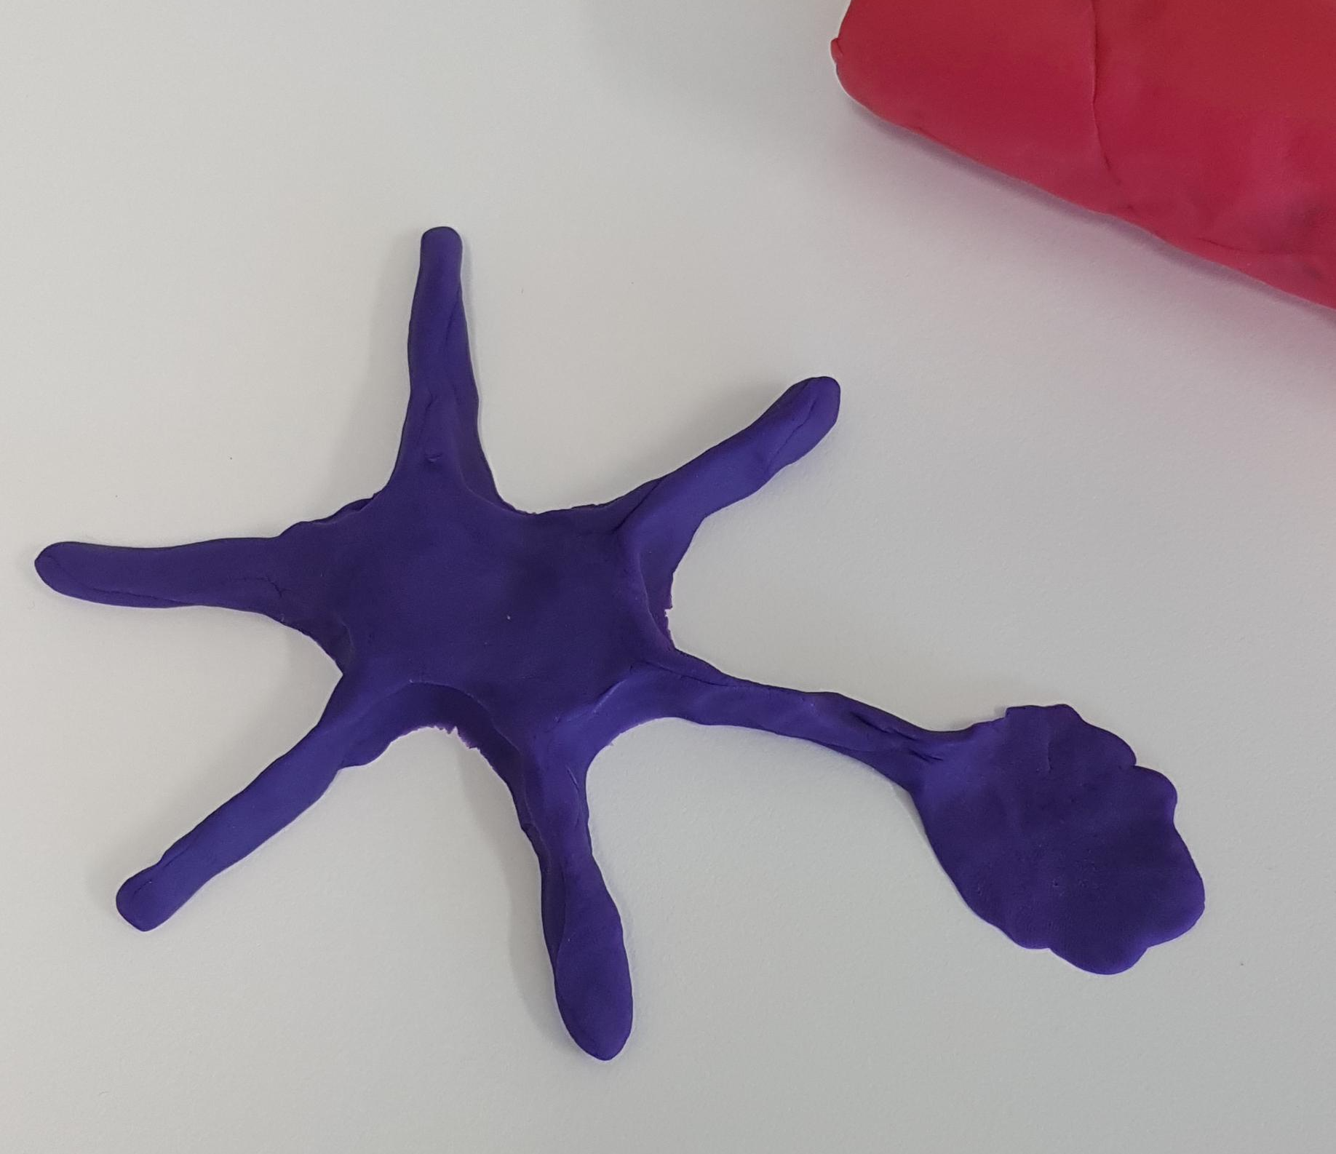
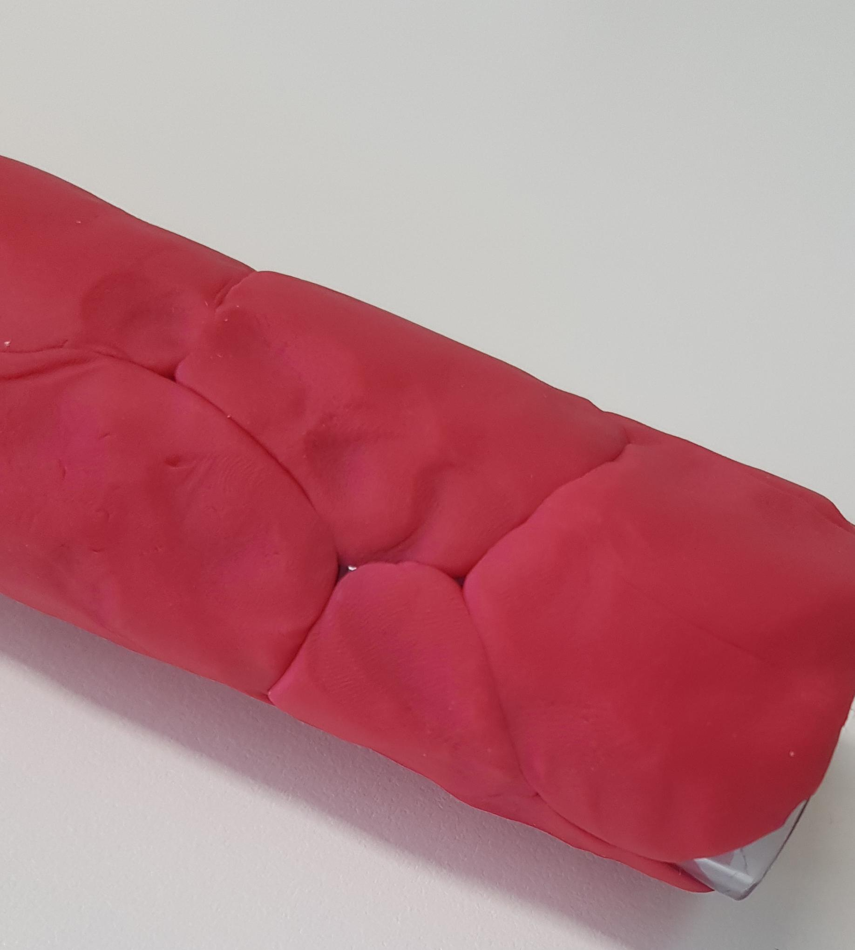
This sequencing is intentional: next, you will build on the continuous this and extend the continuous capillary model by adding additional elements to represent the blood–brain barrier.
Step 7: Now, introduce two additional colours of Play-Doh. Ask students to use these to build a simple astrocyte and a neuron (one of each from each student), each in a different colour so the structures are easy to distinguish. At this point you might want to explain to them that neurons need supporting cells to work, and this is one kind of supporting cell.
While students are shaping these, take a moment to refine your continuous capillary model at the front of the room (make it longer if you have to). Make sure the endothelial cells are packed tightly with no gaps, so the vessel is ready for the next step—where students will combine their astrocyte, neuron, and capillary to model the blood–brain barrier.
Step 8: Students have likely built a Play-Doh neuron before, so they will already have a sense of what that structure should look like. The astrocyte, however, may need more guidance. Explain that an astrocyte has a star-like shape, with several branching “arms.”
Importantly, ask students to make one of the astrocyte’s arms flat—almost like a little “foot (purple structure).

Slide 4
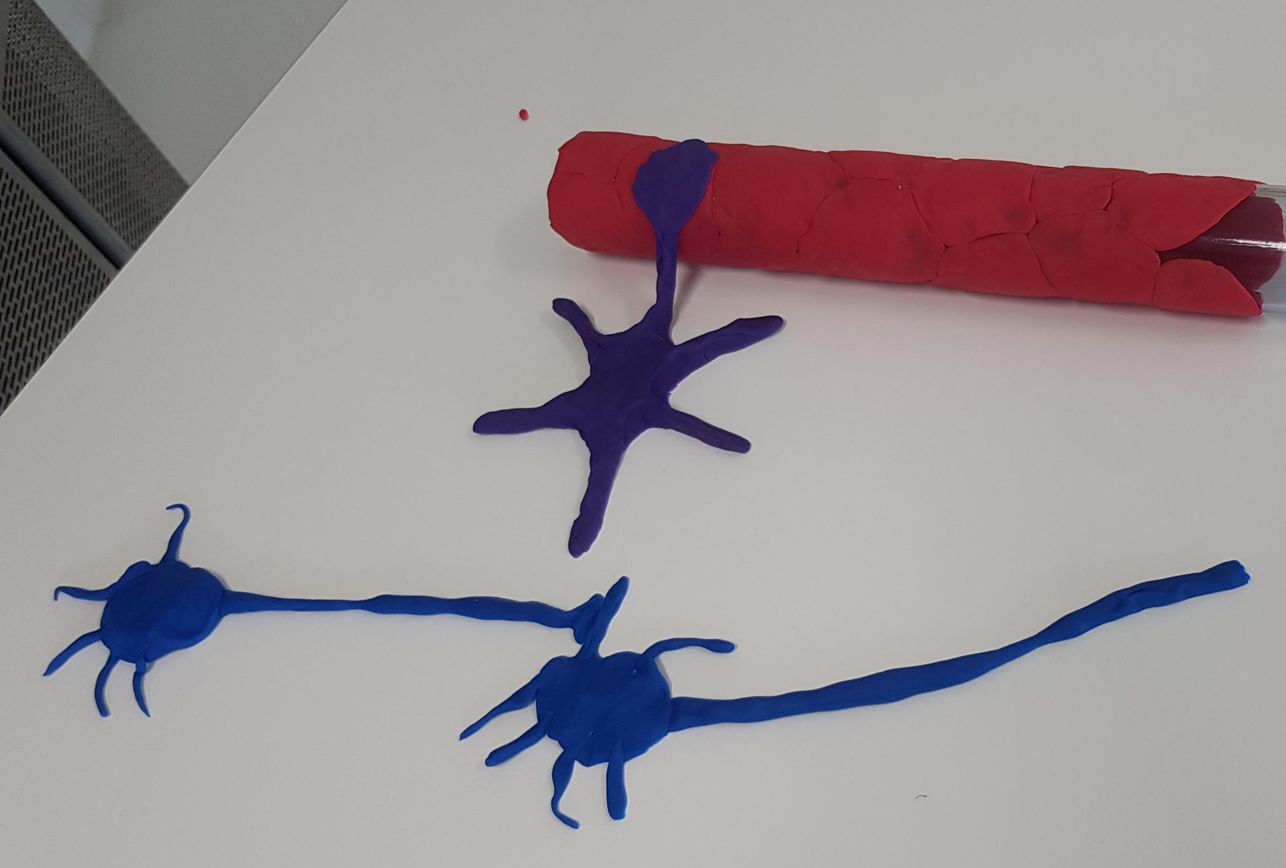
Step 9:
Lay the capillary flat.
Make sure your continuous capillary model is resting horizontally on the table so students can easily work around it.
Add the astrocyte end-feet.
Have students place the flattened “feet” of their astrocytes directly onto the surface of the capillary.
Repeat this along the entire length of the vessel so it looks like multiple astrocytes are wrapping around it.
Position the neurons.
Place each neuron next to its corresponding astrocyte—close enough to show the relationship, but not touching the capillary itself.
If you wish, check that the neurons are arranged so their axon terminals and dendrites are oriented in a way that shows proper synapsing.
Repeat the pattern shown below.
Continue adding astrocytes and neurons in this sequence until all student-made structures have been incorporated into the model.

Slide 5
Step 10: To finish the activity, recap the model and offer a possible extensions based on the readings below.
Explain to students that the blood–brain barrier (BBB) exists only in the central nervous system—nowhere else in the body. Emphasize that, in this simplified model, the BBB is formed by two main components: the continuous capillaries and the astrocytes wrapped around them.
Highlight the functional takeaway: anything moving from the blood into where the neurons are sitting must pass through the astrocyte first.
Step 11: Take a photo of your students doing this activity and send it to me at nbilton@csu.edu.au. It will really make my day ☺
You have probably noticed that I did not include pericytes into my model. I wanted to keep this model as simple as I could. If teaching about the control of blood flow or the roles of different types of pericytes is important to your students, these cells can be added easily to this simple model by using another color of Play-Doh.
Extension resources
Blood Vessels and Endothelial Cells
https://www.ncbi.nlm.nih.gov/books/NBK26848/
Histology, Blood Vascular System
https://www.ncbi.nlm.nih.gov/books/NBK553217/
Histology, Capillary
https://www.ncbi.nlm.nih.gov/books/NBK546578/
What is a pericyte?
https://pmc.ncbi.nlm.nih.gov/articles/PMC4759679/#:~:text=Keywords:%20Pericyte%2C%20capillary%2C%20cerebral,control%20of%20brain%20blood%20flow.

